Slide 1
Interpretation of Nematode Count Data in Long-term Plantings Howard Ferris Department of Nematology University of California Davis December 2009

Slide 2
Example: management costing $300
Tolerance Level
Economic Threshold
(for this management option)

Slide 3
But what about perennial crops
of different age, susceptibility,
supporting different
nematode communities?
Area = average nematodes * Degree-Days
Dosage = average nematodes
Determining trajectories of change……

Slide 4
500 DD
500 DD
Threshold
temperature

Slide 5
Determining trajectories
of change……
Moving
average
calculations

Slide 6
Some Real Data…..

Slide 8
Cumulative Nematode Dosage = Σ Areas
Area = average nematodes * Degree-Days

Slide 10
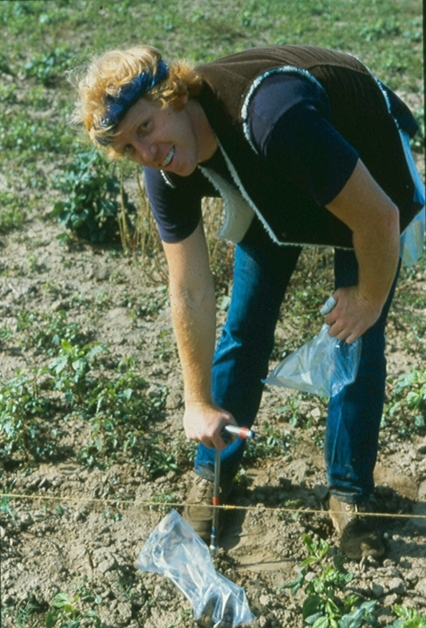
Happy
Nematode
Hunting!

