Slide 1
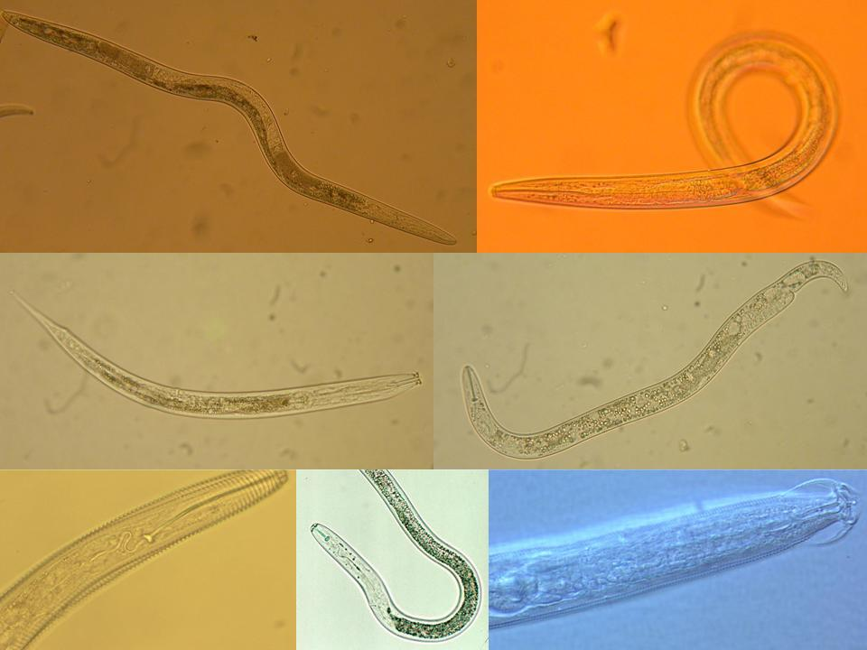
Approaches in Faunal Analysis
Howard Ferris
Department of Entomology and Nematology
University of California, Davis
hferris@ucdavis.edu
April, 2012
Notes:
1

Slide 2
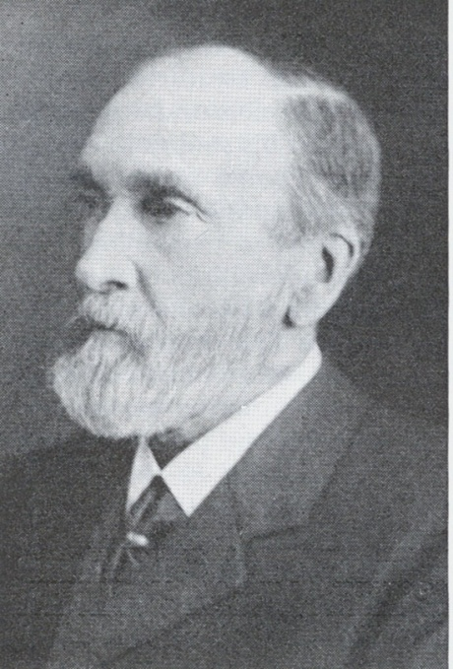
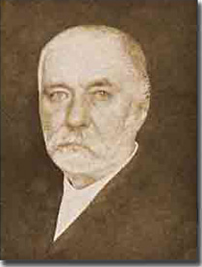
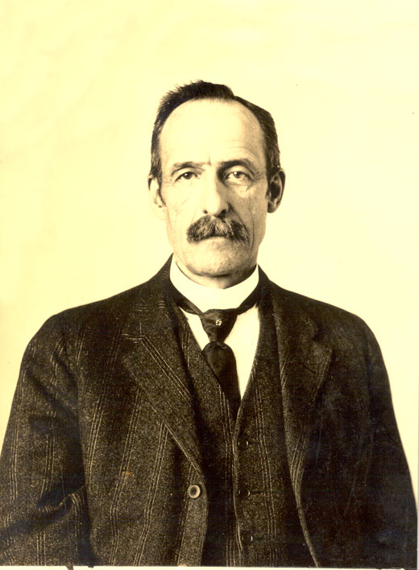
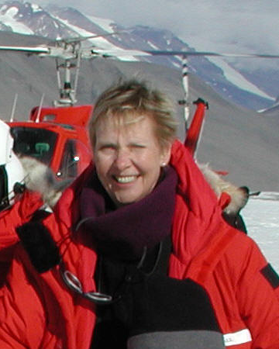



19th Century to mid 20th Century
recognition of abundance and habitat diversity
Bastian
Maupas
Cobb
20th Century to present
functional diversity and bioindicator potential
Wall
Ingham
Yeates
Bongers

Slide 3
Colonizer-persister Series
A milestone - calibration of ecosystem condition:
Maturity Index =
opportunism
structure
enrichment
stability
1
2
3
4
5
Bongers, T. 1990 The maturity index: an ecological measure
of environmental disturbance based on nematode species
composition. Oecologia 83: 14-19.
Bongers

Slide 4
Colonizer-persister series as indicator of ecosystem function
opportunism
structure
enrichment
stability
1
2
3
4
5
Structure Indicators
Numerator/Denominator issues:
% w₁.cp₁ = 100 w₁.cp₁ / Σ w_{i}.cp_{i} for i = 1-5
It should be possible to increase structure without decreasing enrichment, and vice versa. The axes should be independent
Basal Fauna
Enrichment Indicators

Slide 5
Colonizer-persister series as indicator of ecosystem function
opportunism
structure
enrichment
stability
1
2
3
4
5
A question:
should the separations between the classes be equal?

Slide 6
Structure Indicator Weighting
Connectance
The relationship between trophic links and species richness
5.0
3.2
Potential Links
1.8
L=αS²
0.8

Slide 7
Enrichment Indicator Weighting
Resource availability
Food consumption necessary to achieve body weight
Mean Wt, cp1 = 2.68 µg
Mean Wt, cp2 = 0.64 µg
Differential ≈ 4x
cp2 weighting = 0.8
cp1 weighting = 3.2

Slide 8
Nematode
Faunal Profiles
bacterivores
fungivores
Enriched
Enrichment index
100 (w1.cp1 + w2.Fu2)
/ (w1.cp1 + w2.cp2 )
Ba₁
Enrichment trajectory
Structured
Fu₂
fungivores
bacterivores
Fu₂
Basal
Ba₂
Om₄
Om₅
Basal
condition
omnivores
Ca₃
Ca₄
Ca₅
carnivores
Fu₃
Fu₄
Fu₅
fungivores
Ba₃
Ba₄
Ba₅
bacterivores
Structure trajectory
Ferris et al., 2001
Structure Index = 100 wi.cpi / (wi.cpi + w2.cp2 ) for i = 3-5

Slide 9
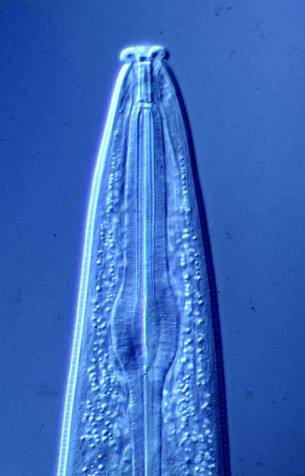
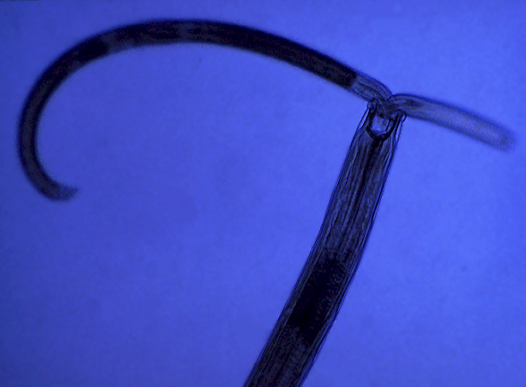
Testable Hypotheses of Food Web Structure and Function
Disturbed
N-enriched
Low C:N
Bacterial
Conducive
Enriched
Maturing
N-enriched
Low C:N
Bacterial
Regulated
Ba₁
Enrichment index
Structured
Fu₂
Degraded
Depleted
High C:N
Fungal
Conducive
Matured
Fertile
Mod. C:N
Bact./Fungal
Suppressive
Fu₂
Basal
Ba₂
Om₄
Om₅
Basal
condition
Ca₃
Ca₄
Ca₅
Fu₃
Fu₄
Fu₅
Ba₃
Ba₄
Ba₅
Structure index
Ferris et al., 2001

Slide 10
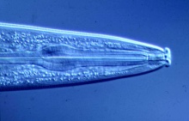

Trajectory Analysis of Some California Soil Systems
100
Tomato
Systems
Yolo Co.
Prune
Orchards
Yuba Co.
Enrichment Index
50
Redwood
Forest and
Grass
Mendocino Co.
Mojave
Desert
0
0
50
100
Structure Index

Slide 11
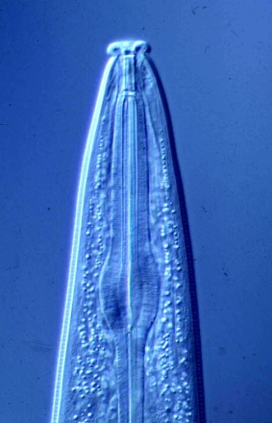

How Fragile is the System?
Sampled 2000
Organically-managed for 12 years
Sampled 2001
After Deep Tillage
100
100
50
50
Enrichment index
0
0
0
50
100
0
50
100
Structure index
Structure index
Berkelmans et al. (2003)

Slide 12
Assessment of Ecosystem Services
There are many useful indices……..
they are based on relative abundance of taxa:
Diversity indices
- Hill, Shannon-Weaver, Simpson, etc.
The Maturity Index family
Colonizer-persister series > MI Bongers, 1990
Functional indices
Enrichment Index, Structure Index, etc.
Ferris et al., 2001
Notes:
12

Slide 13
There are several diversity indices already in use
Functional Diversity
 | A | B
Hoplolaimidae | 5 | 30
Pratylenchidae | 1 | 25
Aphelenchidae | 10 | 30
Cephalobidae | 30 | 5
Plectidae | 25 | 10
Rhabditidae | 30 | 5
Dorylaimidae | 2 | 1
Discolaimidae | 5 | 2
Totals | 108 | 108
Hill N₀ | 8.00 | 8.00
Simpson | 0.22 | 0.22
Shannon | 1.67 | 1.67
Hill N₁ | 5.32 | 5.32
Hill N₂ | 4.52 | 4.52
Pielou J' | 0.80 | 0.80
The indices are more usefully applied to functional guilds as indicators of functional redundancy and functional complementarity.
Horizontal vs. Vertical application

Slide 14
Functional Redundancy and Complementarity
Predators of Nematodes
Nematodes alone
Full functional guild

Slide 15
consider biomass
magnitude of each function/service?

Slide 16
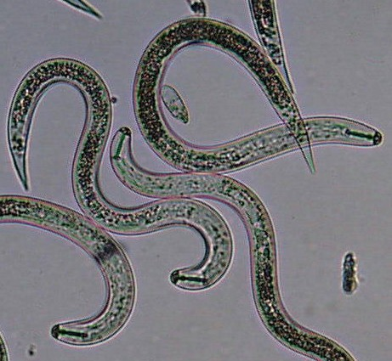
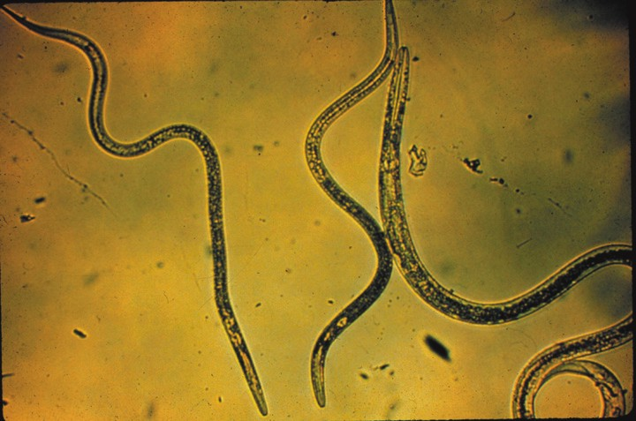
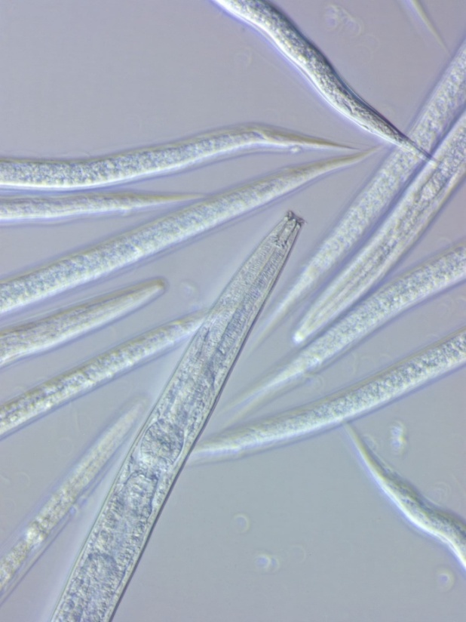
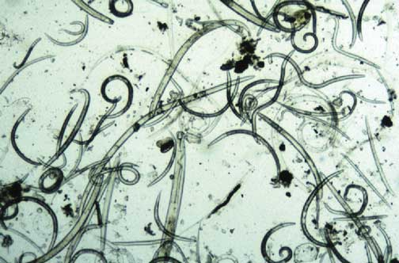
What is the magnitude of the function or service?
How much carbon is being processed?
How much energy is being used?
The indices are useful, but…..…
They do not indicate biomass, metabolic activity or magnitude
of functions/services – so, we develop the Metabolic Footprint

Slide 17
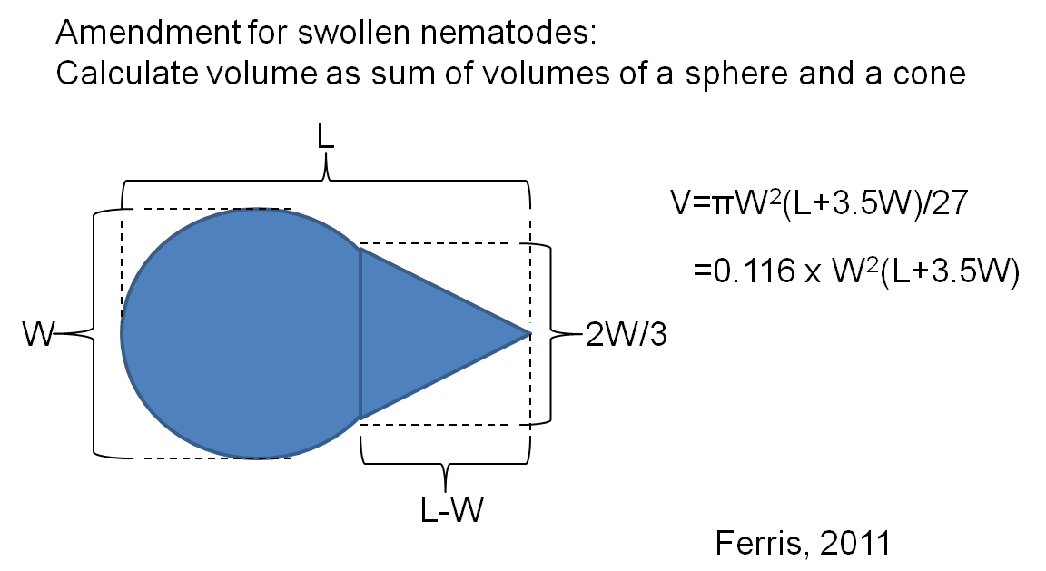
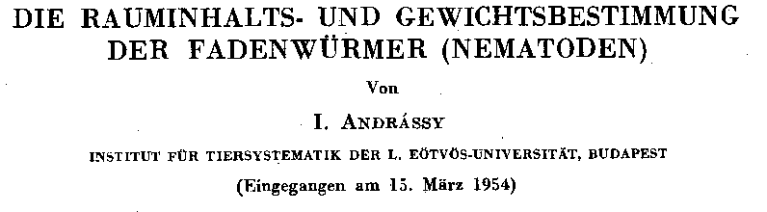

per Andrássy, 1956
a) Calculated the volume of a nematode –
L₁
L₂
L₃
L₄
r₁
r₂
r₃
r₄
v₁=π(L₁/3)(r₁²+r₁r₂+r₂²)
v₂=π(L₂/3)(r₂²+r₂r₃+r₃²)
v₃=π(L₃/3)(r₃²+r₃r₄+r₄²)
v₄=π(L₄/3)(r₄²⁾)
A convenient proxy…
let W=2r₃ and L=L₁+L₂+L₃+L₄ , then V = v₁+v₂+v₃+v₄ = W²L/1.7
Andrássy: “I am indebted to Dr. I. Juvancz of the Institute of Applied Mathematics,
who examined my calculations.”
b) Determined the density of nematodes (g/mL) as that of liquids
in which they float at a constant level =1.084
Then, Mass = Volume x Density:
Mass = W²L x 1.084/(1.7 x 10⁶) μg
or
Mass = 0.116 x W²(L+3.5W) x 1.084/10⁶ μg

Slide 18
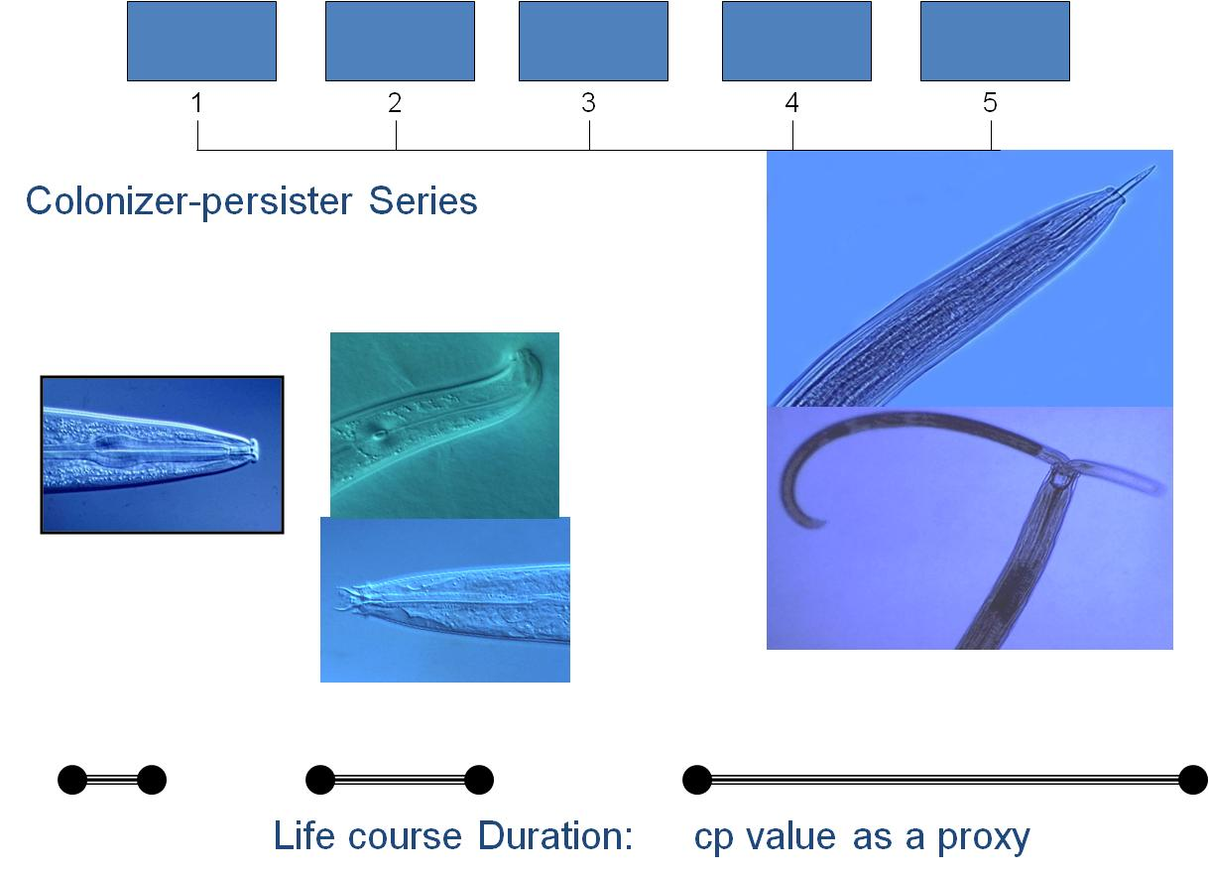
Production
Nematodes differ in rates of growth
Need to adjust production estimates
in relation to life course duration
Another proxy: cp value related to
life course duration – per Bongers, 1990
Taxon Production normalized:
P_{t} = N_{t} M_{t}/(cp_{t})
Metabolic activity - Respiration
Use the power relationship of
basal metabolism and body mass: R = c M^{0.75}
If taxon biomass = N_{t} M_{t}, then:
Metabolic Footprint = Σ (R_{t} + P_{t})
for all taxa present or for taxa representing a specific function or ecosystem service
Taxon Respiration:
R_{t} = N_{t} M_{t}^{0.75}

Slide 19
Nematode Faunal Profiles
and the Metabolic Footprint
Enriched
bacterivores
fungivores
Enrichment index
100 (w1.cp1 + w2.Fu2)
/ (w1.cp1 + w2.cp2 )
Ba₁
Enrichment trajectory
Structured
Fu₂
fungivores
bacterivores
Fu₂
Basal
Ba₂
Om₄
Om₅
Basal
condition
omnivores
Ca₃
Ca₄
Ca₅
carnivores
Fu₃
Fu₄
Fu₅
fungivores
Ba₃
Ba₄
Ba₅
bacterivores
Structure trajectory
Ferris, 2010
Structure Index = 100 w_{i}.cp_{i} / (w_{i}.cp_{i} + w₂.cp₂ ) for i = 3-5
Ferris et al, 2001

Slide 20
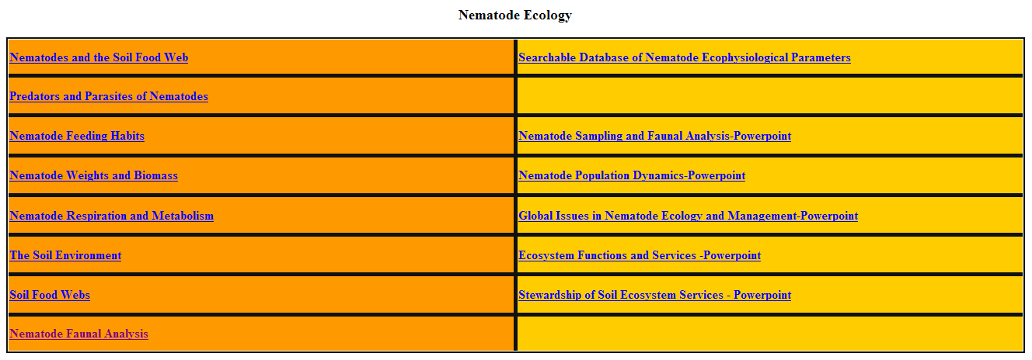
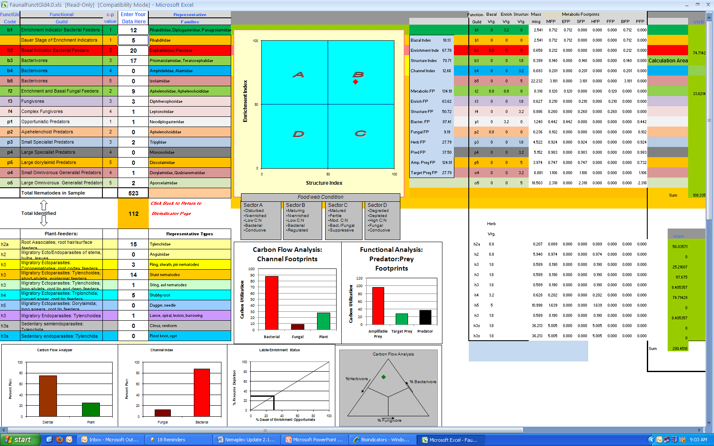
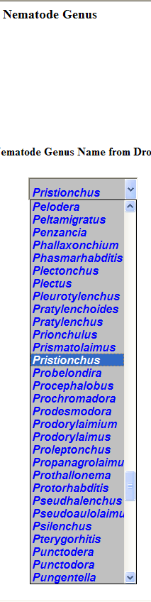
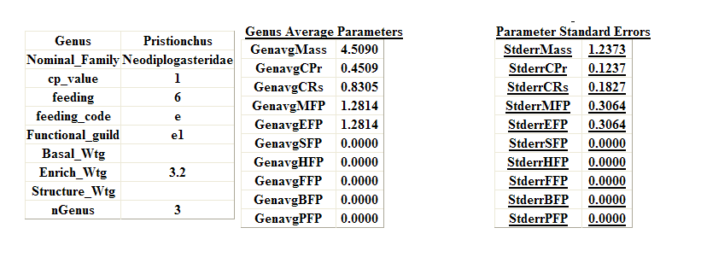
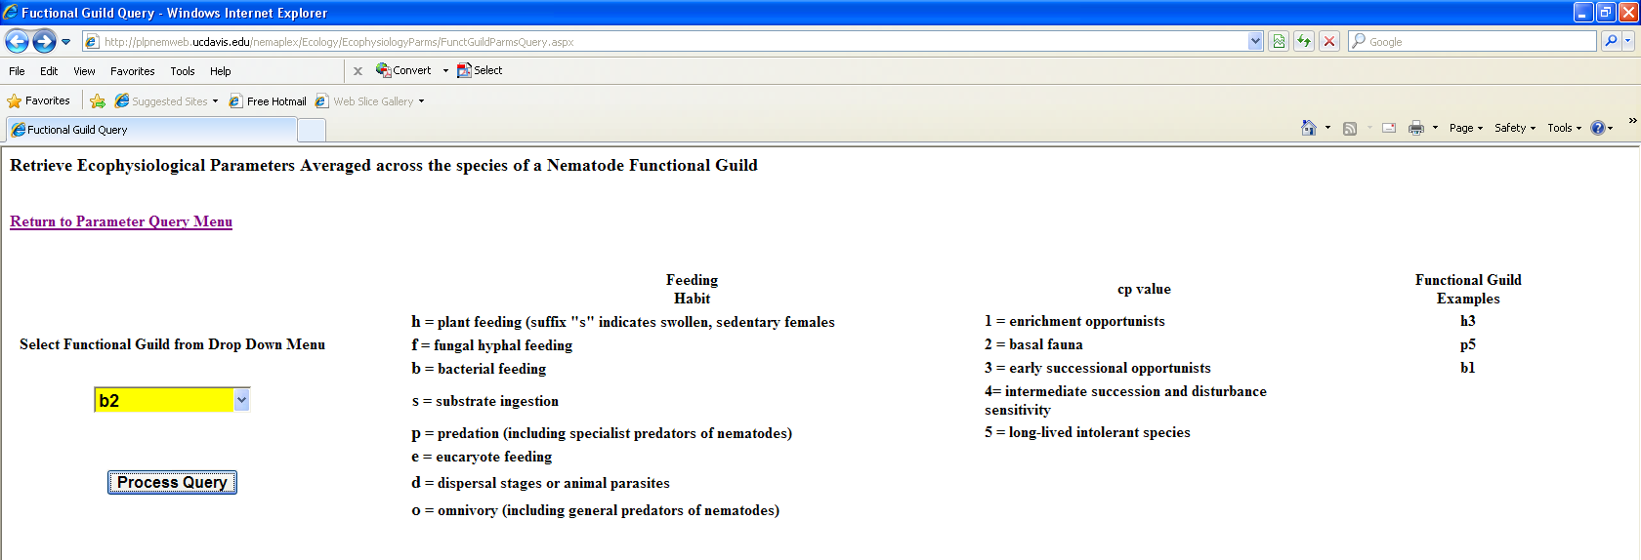
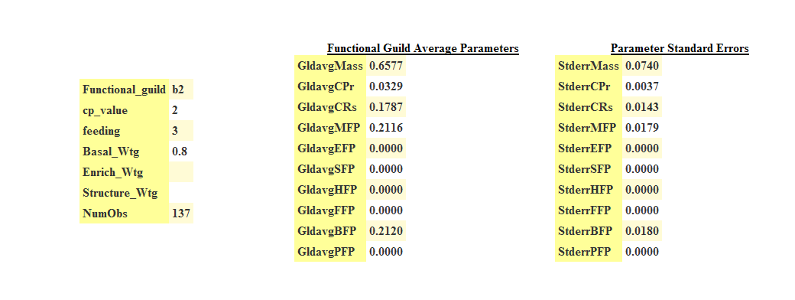
Faunal Analysis
Nematode Ecology
Nematode Faunal Analysis
A Database of Ecophysiological Parameters
in Nemaplex

Slide 21
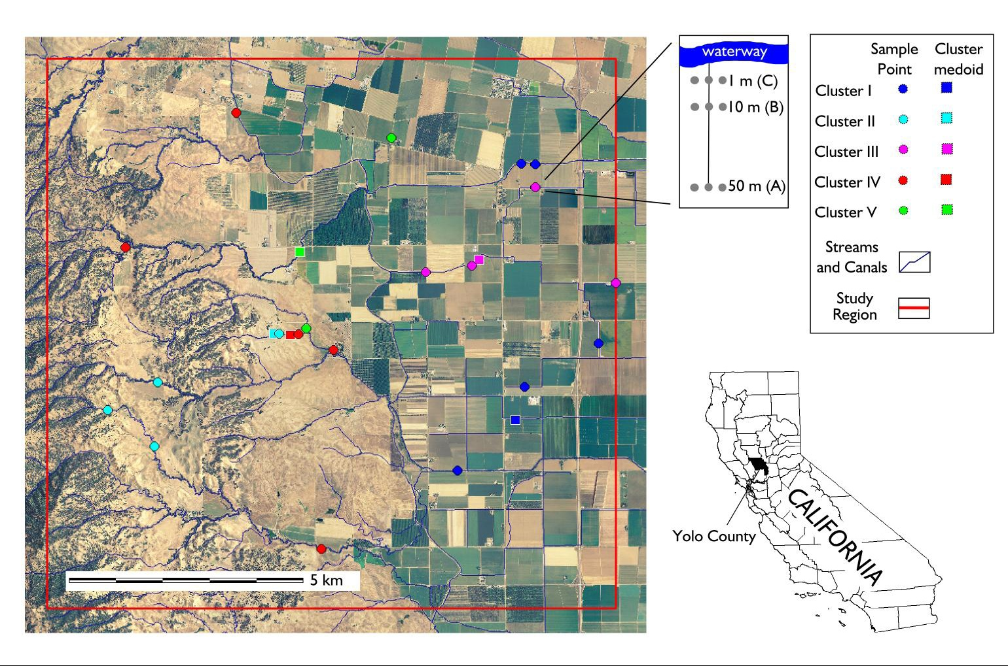
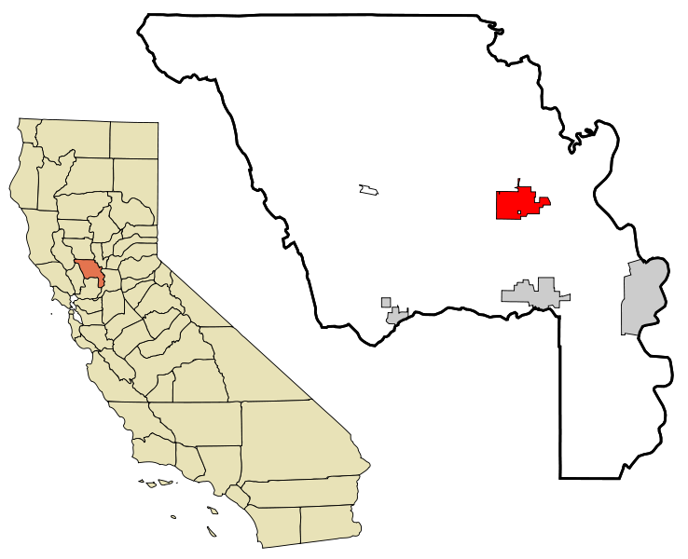
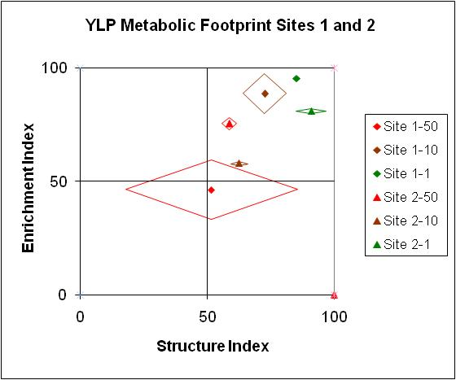
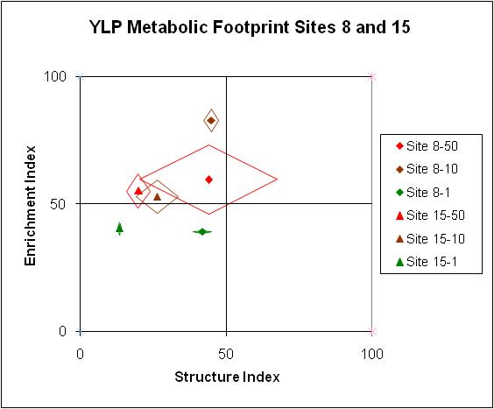
The Yolo Landscape Project
Sites 1 and 2
Sites 8 and 15
Yolo County, California

Slide 22
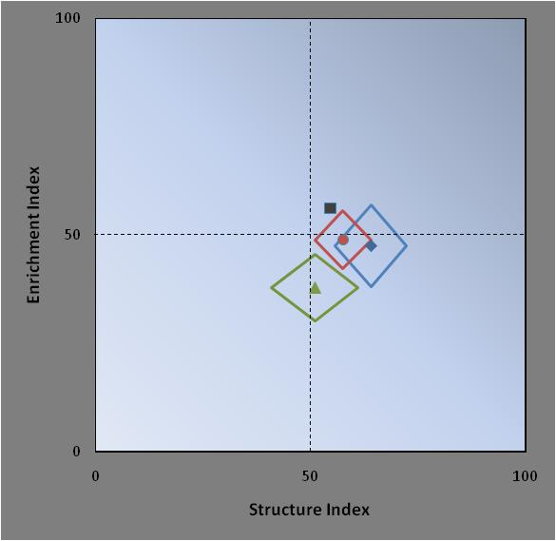
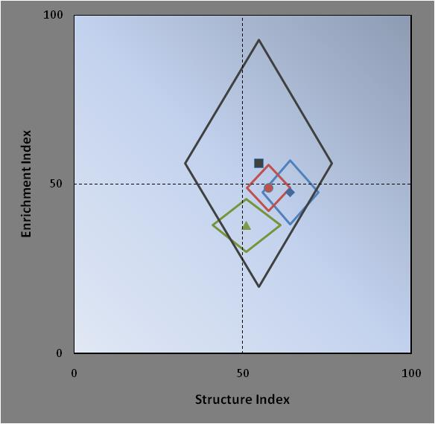
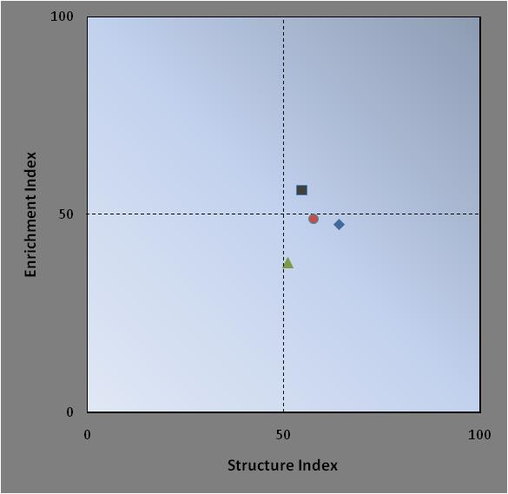
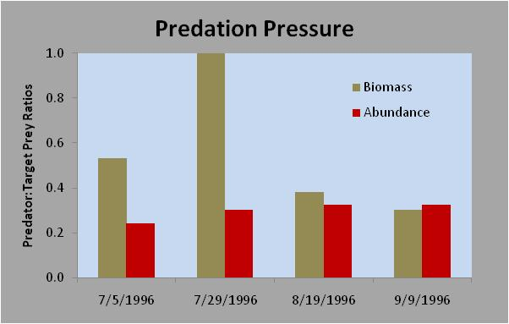
Nematode Fauna of a Hungarian Steppe Grassland – Péter Nagy, 1998
Four sampling dates
Faunal Analysis: Functional Indices
Faunal Analysis: Functional Indices and Metabolic Footprints
end of summer

Slide 23
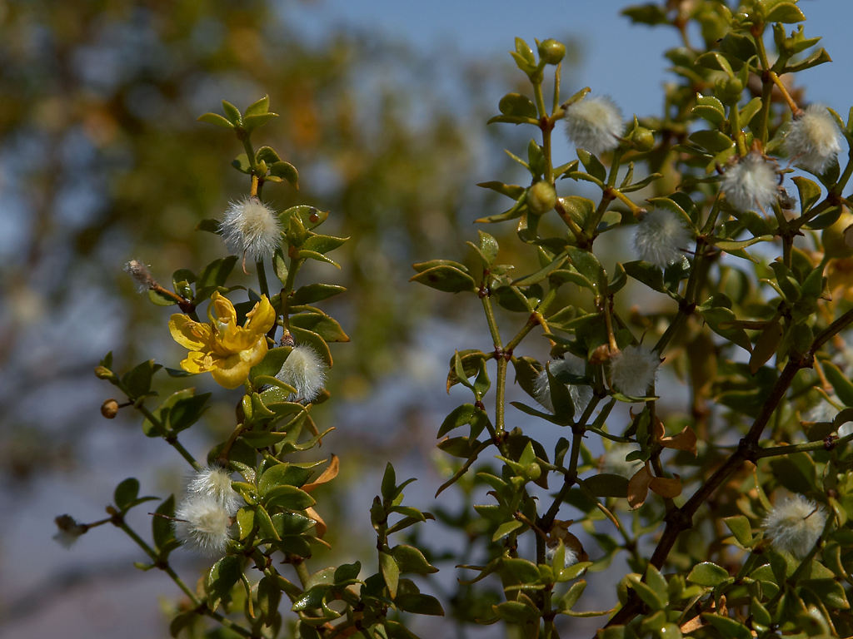
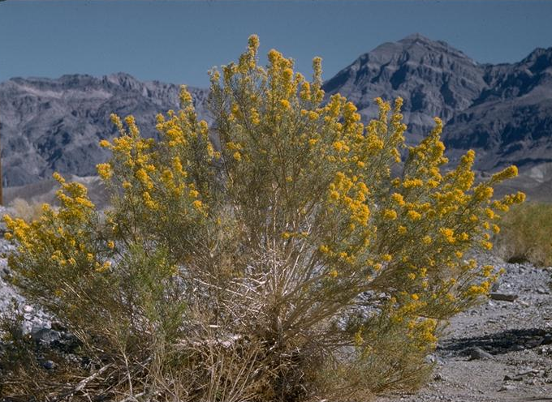
45.9
66.3
5.9

Slide 24
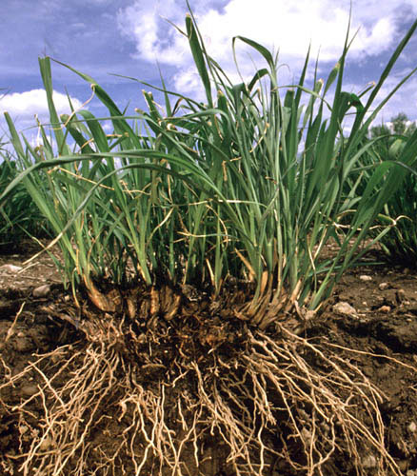
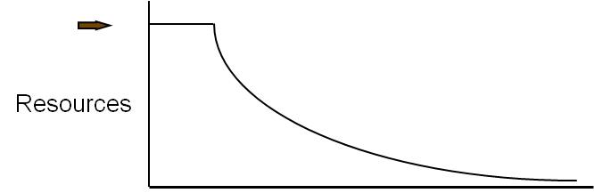
Economies of Ecosystems: Carbon and Energy are the Currencies
CO₂
CO₂
CO₂
CO₂
Stewardship
bacteria
protozoa
nematodes
carbohydrates
and
proteins
C
N
nematodes
arthropods
fungi
carbohydrates
and
amino acids
other
organisms
nematodes
fungi
arthropods
nematodes
NO₃
Carbon and energy transfer
Carbon is respired by all organisms in the food web
The amounts of Carbon and Energy available limit the size and activity of the web
NH₃
NH₃
NH₃

Slide 26
Some References to the progression of these ideas
Bongers, T. 1990. The maturity index, an ecological measure of environmental disturbance based on nematode species composition. Oecologia 83:14-19.
Bongers, T., M. Bongers. 1998. Functional diversity of nematodes. Appl. Soil Ecol. 10:239-251.
Bongers, T., H. Ferris. 1999. Nematode community structure as a bioindicator in environmental monitoring. Trends Ecol. Evol. 14:224-228.
Ferris, H., T. Bongers, R.G.M. de Goede. 2001. A framework for soil food web diagnostics: extension of the nematode faunal analysis concept. Appl. Soil Ecol. 18:13-29.
Ruess, L., H. Ferris. 2004. Decomposition pathways and successional changes. In R.C. Cook and D.J. Hunt (eds) Proceedings of the Fourth International Congress of Nematology. Nem. Monogr. Persp. 2. Brill, Netherlands. 866p.
Ferris, H., T. Bongers. 2006. Nematode indicators of organic enrichment. J. Nematology 38:3-12.
Sánchez-Moreno, S., H. Ferris. 2007. Suppressive service of the soil food web: Effects of environmental management. Agric. Ecosyst. and Environ. 119:75-87.
Ferris H. 2010. Form and function: metabolic footprints of nematodes in the soil food web. European J. Soil Biology 46:97-104.
More information: http://plpnemweb.ucdavis.edu/nemaplex
Notes:
26
26

Slide 27
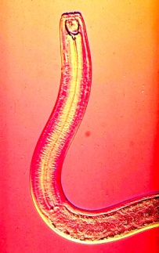
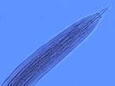
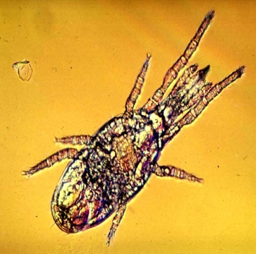
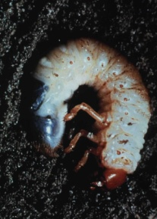
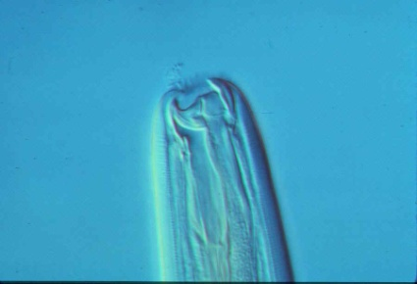

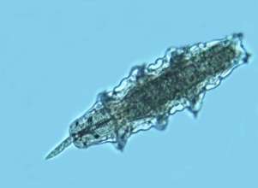

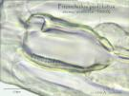
Ecosystem Function - Level of Resolution: Individual Taxa or Functional Guilds?
Organisms of similar ecological amplitude and sensitivities which perform the same function
A
B
Is A an indicator of B?

Slide 28
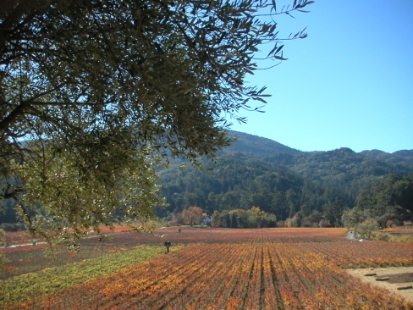
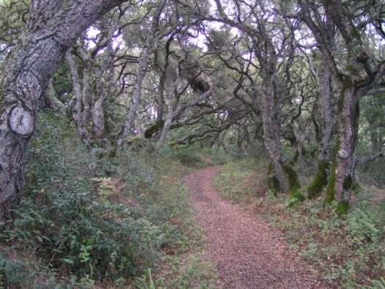
An Ecosystem Service:
Predation on Pest Species
Predator: Prey Ratio
Sanchez-Moreno et al., 2008
Notes:
We expected to have greater suppressiveness in samples with higher abundances of P and O. But predation depended not on the abundance of the high trophic levels but on the ratio of predator/prey, following a density-dependent function. Suppressiveness is optimized when predator/prey ratio is high; so few preys are available for each predator. When the biomass of prey is very high, suppressiveness in reduced. In agricultural fields, where fertilizers and organic matter are incorporated to the soil, the consequent increase of microbial populations are used by microbial-feeders to increase their population size, and this relationship is altered. When many other prey are available, the predation pressure on the target nematode reduces.

Slide 29

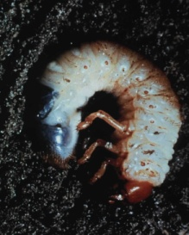

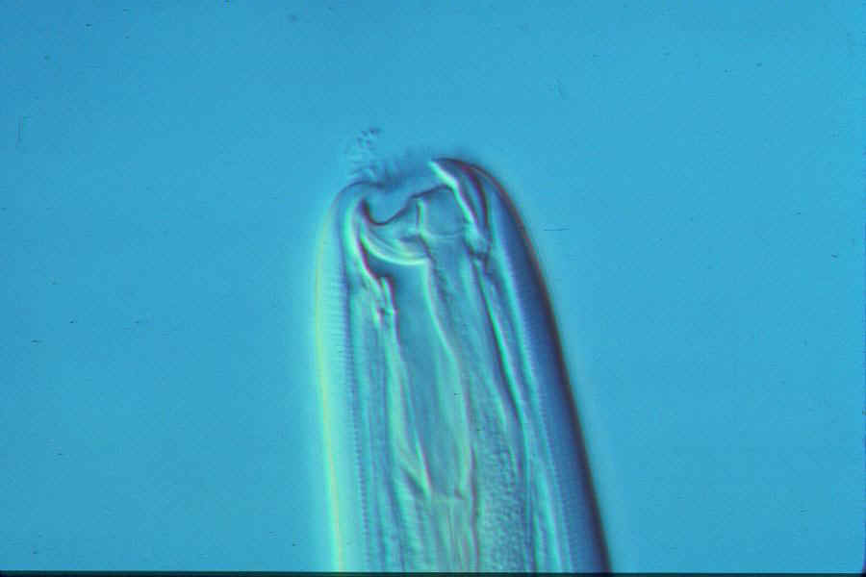


Which organisms perform the suppressive service?
80
70
60
50
r = 0.41
Structure index
40
30
20
10
0
78
83
88
93
Soil suppressiveness
Sánchez-Moreno and Ferris, 2007.
Notes:
Who plays that role? Who suppress the target nematode. M. incognita, more efficiently in the woods that in the vineyard? The relative abundances of predators, omnivores and the sum of both were significantly correlated with the strength of the suppression. When more nematodes appear in the higher trophic levels, more suppressive becomes the SFW. Probably, not only nematodes suppress root-knot juveniles. The SI was described as an indicator of SFW structure and connectance, and postulate that P and O nematodes are indicators of other organisms with similar functional roles, from nematode trapping fungi to predatory microarthropods.

Slide 30
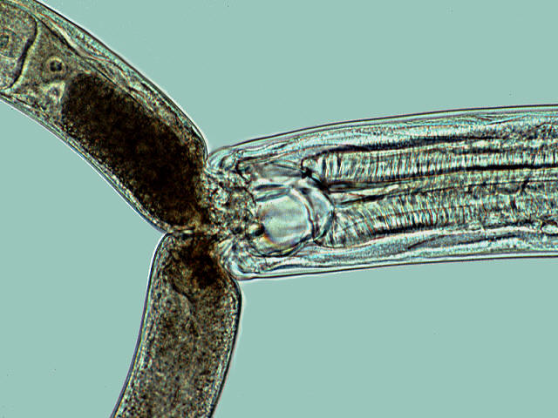
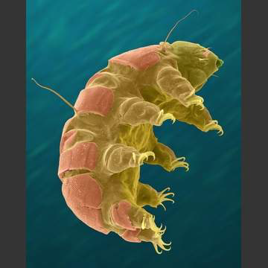
Same role, different actors – successional effects
June
4.0
3.5
Tardigrades / suppressiveness
R = 0.59, p < 0.05
3.0
2.5
2.0
Dead / Alive Nematodes
1.5
r = 0.73 P <0.05
1.0
0.5
0.0
October
-0.5
soil suppressiveness / tardigrades
r = 0.59, P < 0.05
-2
0
2
4
6
8
10
12
14
16
18
20
Number of Tardigrades
Sanchez-Moreno et al., 2008
Notes:
The same soil function can be performed by different organisms. In the experimental soil, number of dead and alive nematodes were counted 24 h after the nematodes were extracted from the soil. The ratio dead/ alive nematodes was strongly correlated with the number of tardigrades present in each sample; the higher the number of tardigrades, more dead nematodes were counted. Number of nematodes eaten by the tardigrades was higher when a high number of prey were available.

Slide 31
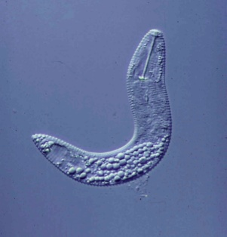
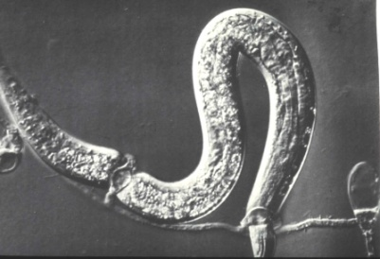
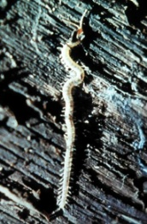













Soil Food Web Structure - the need for indicators
Notes:
Structural and Functional Resilience of the soil food web is determined by connectance redundant and resilience of the web. Guilds vary in their sensitivity to environmental disturbance.. Often guilds at higher trophic levels in the web are more sensitive than those at lower trophic levels. Disturbance of the web may result in reduction of abundance of predators of opportunistic species. Consequently, upon enrichment with organic matter or plant growth, opportunistic herbivore and decomposer species may increase unregulated resulting in damage to the primary producer (plant) or immobilization of nutrients or other examples of functional instability.

Slide 32




The Nematode Fauna as a Soil Food Web Indicator
Herbivores
Bacterivores
Fungivores
Omnivores
Predators

Slide 33




Enrichment Indicators
Structure Indicators
Rhabditidae
Panagrolaimidae
etc.
Short lifecycle
Small/ Mod. body size
High fecundity
Small eggs
Dauer stages
Wide amplitude
Opportunists
Disturbed conditions
Aporcelaimidae
Nygolaimidae
etc.
Long lifecycle
Large body size
Low fecundity
Large eggs
Stress intolerant
Narrow amplitude
Undisturbed conditions
Basal Fauna
Cephalobidae
Aphelenchidae, etc.
Moderate lifecycle
Small body size
Stress tolerant
Feeding adaptations
Present in all soils

