Slide 1
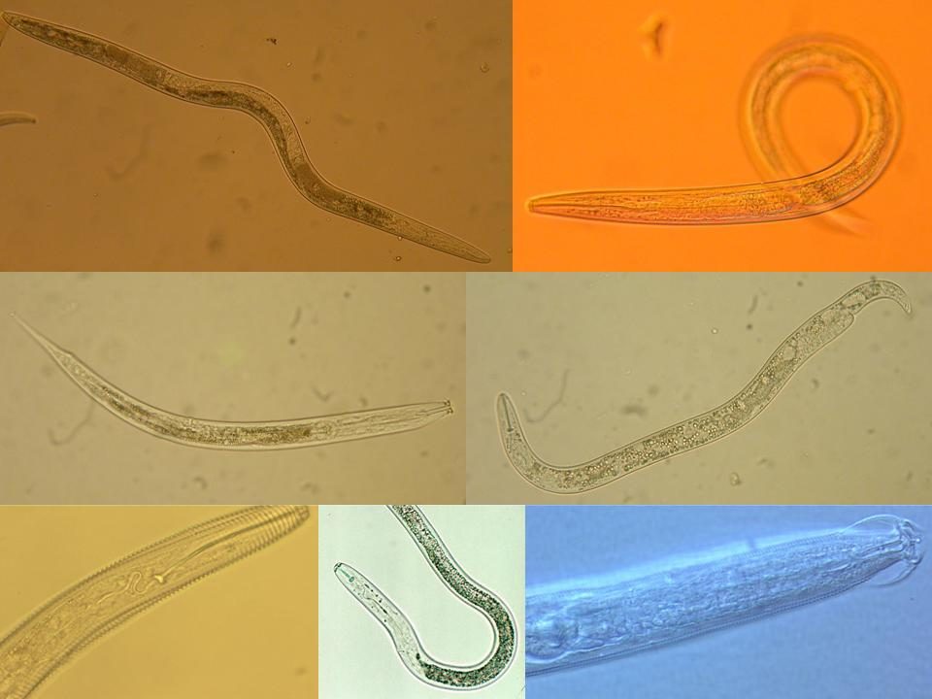
Ecología de Nematodos
y
Salud de Suelo
Algunos Detalles de Biología y Ecología
de Géneros de Nematodos Fitoparásitos
Howard Ferris
Universidad de California, Davis
Notes:
30 min talk
Interactions:
Nematodes affect other organisms, other organisms affect nematodes
Nematodes feed on plants – plants provide food for nematodes.
Nematodes feed on bacteria, nematodes farm bacteria – in soil, insects,
bacteria feed nematodes, bacteria kill nematodes
Nematodes feed on fungi and are fed upon by fungi.
Nematodes feed on protozoa and microarthropods, tardigrades, mites,
collembola and are fed upon
What are the ecosystem effects (effects on functions)?
Enrichment
Movement of and to resources
Nutrient and carbon cycling
Nutrient and carbon movement and sequestration
Effects on services?
Antagonists of nematodes occur in many groups of organisms that are components of the soil food web.
The interactions of many soil organisms results in biological buffering or regulation of the nematode population through the mechanisms of Exploitation, Competition, and Antibiosis
1

Slide 2
Los Nematodos
de vida libre
parásitos de animales
parásitos de plantas
marinos

Slide 3
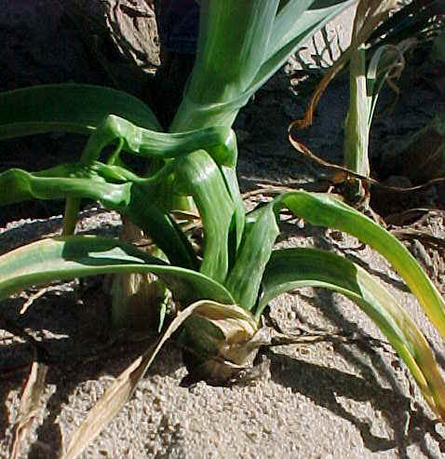
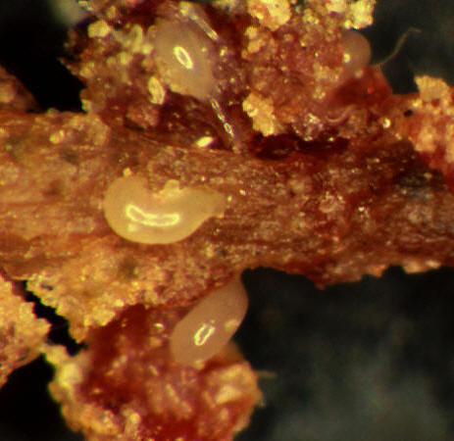
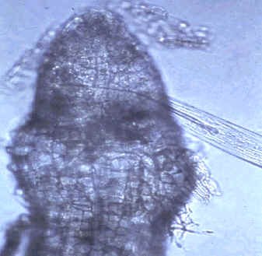
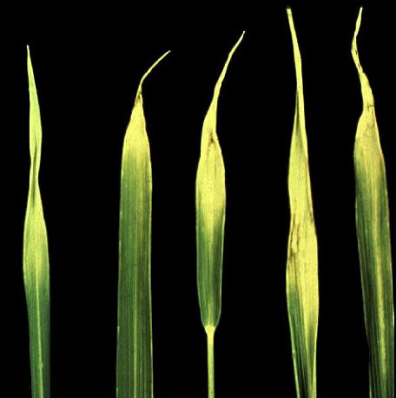
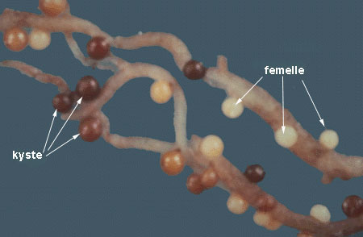
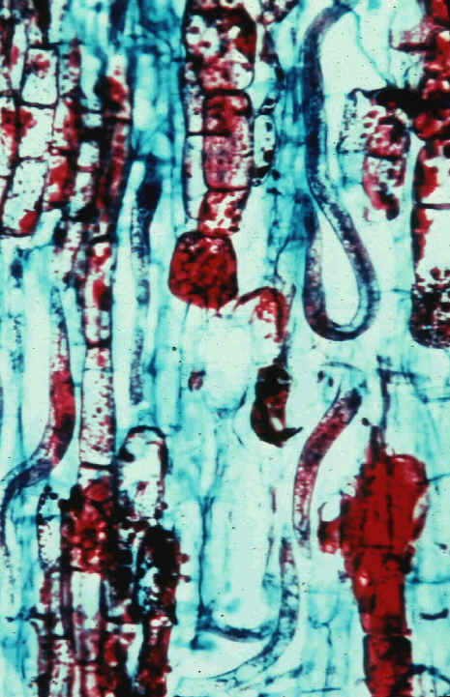
Top 10 plant-parasitic nematodes in molecular plant pathology
Jones et al., 2013. Molecular Plant Pathology 14:946-961.
el “top 10” generos en base a la importancia económica y científica
Meloidogyne spp. – nematodos agalladores
Heterodera y Globodera spp. – nematodos quistes
Pratylenchus spp. - nematodos de las lesiones de la raíz
Radopholus spp. (similis) – nematodos madrigueras
Ditylenchus spp. (dipsaci) – nematodos de tallo y bulbo
Bursaphelenchus spp. (xylophilus) – nematodos de marchitamiento del pino
Rotylenchulus spp. (reniformis) – nematodos reniforme
Xiphinema spp. (index) – nematodos puñales
Nacobbus spp. (aberrans ) – nematodos agalladores falsos
Aphelenchoides spp. (besseyi) – nematodos punta blanca de arroz
hembras
quistes

Slide 4
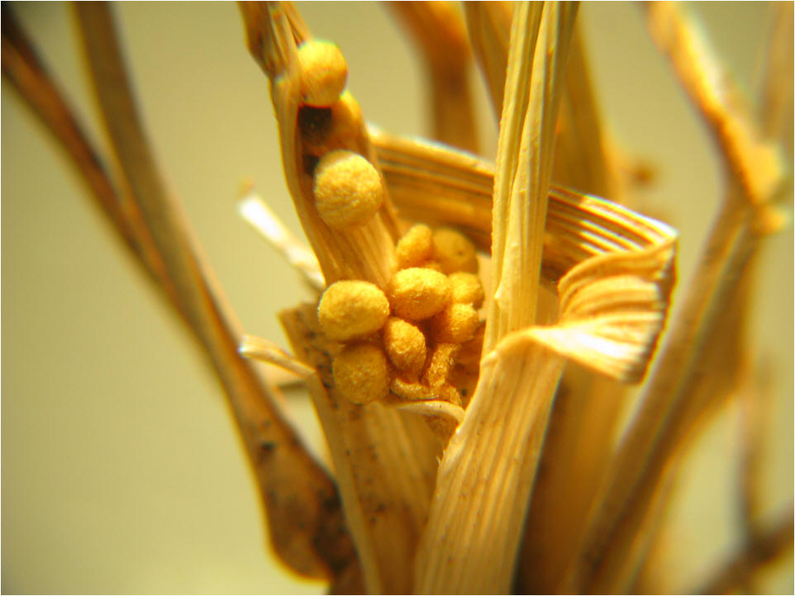
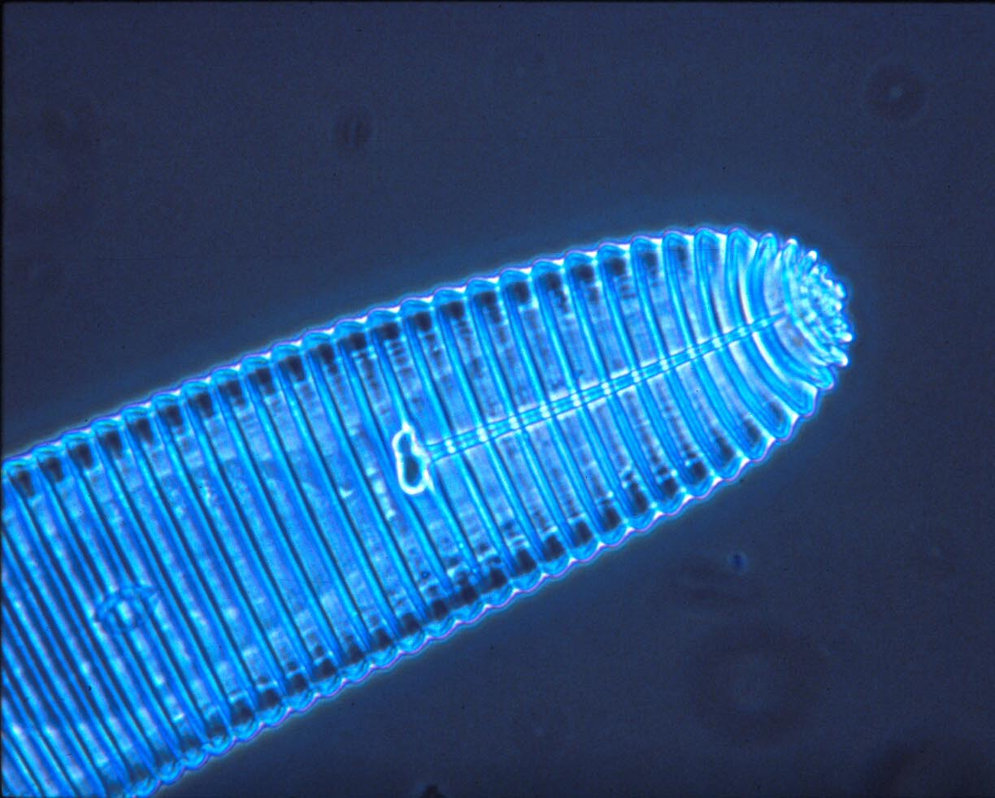
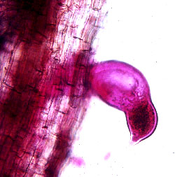
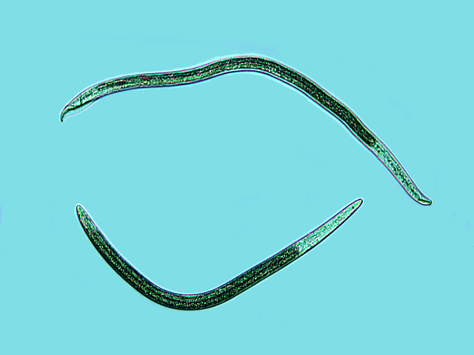
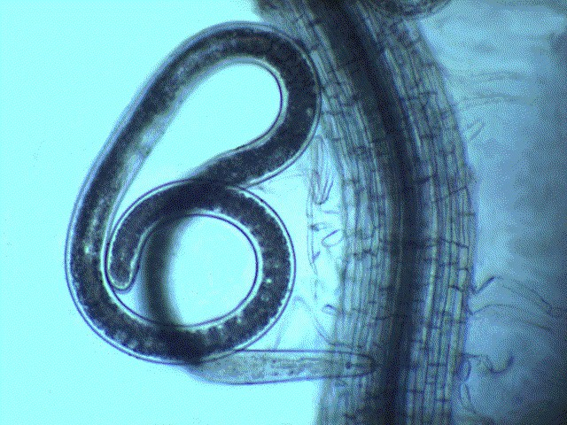
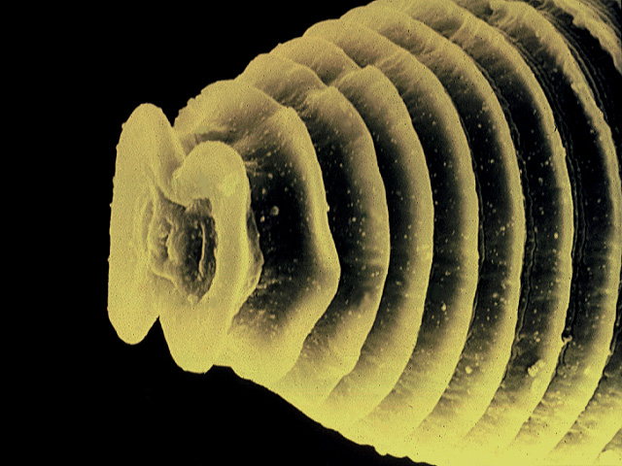
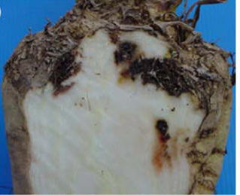
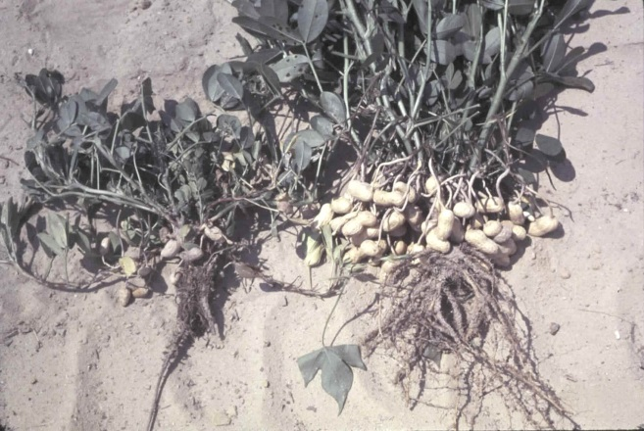
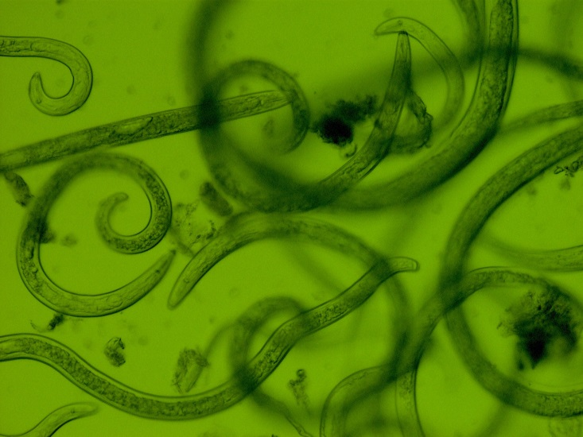
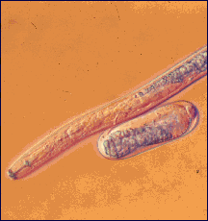
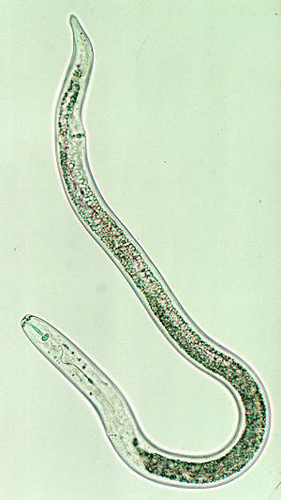
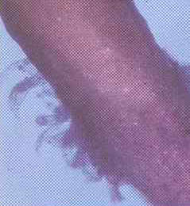
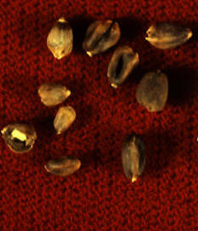
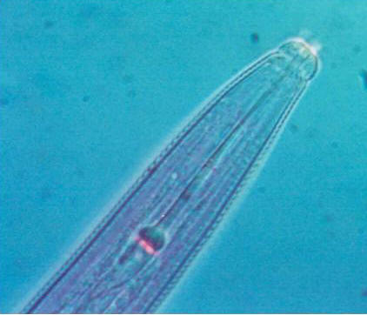
y un monton de otros!

Slide 5
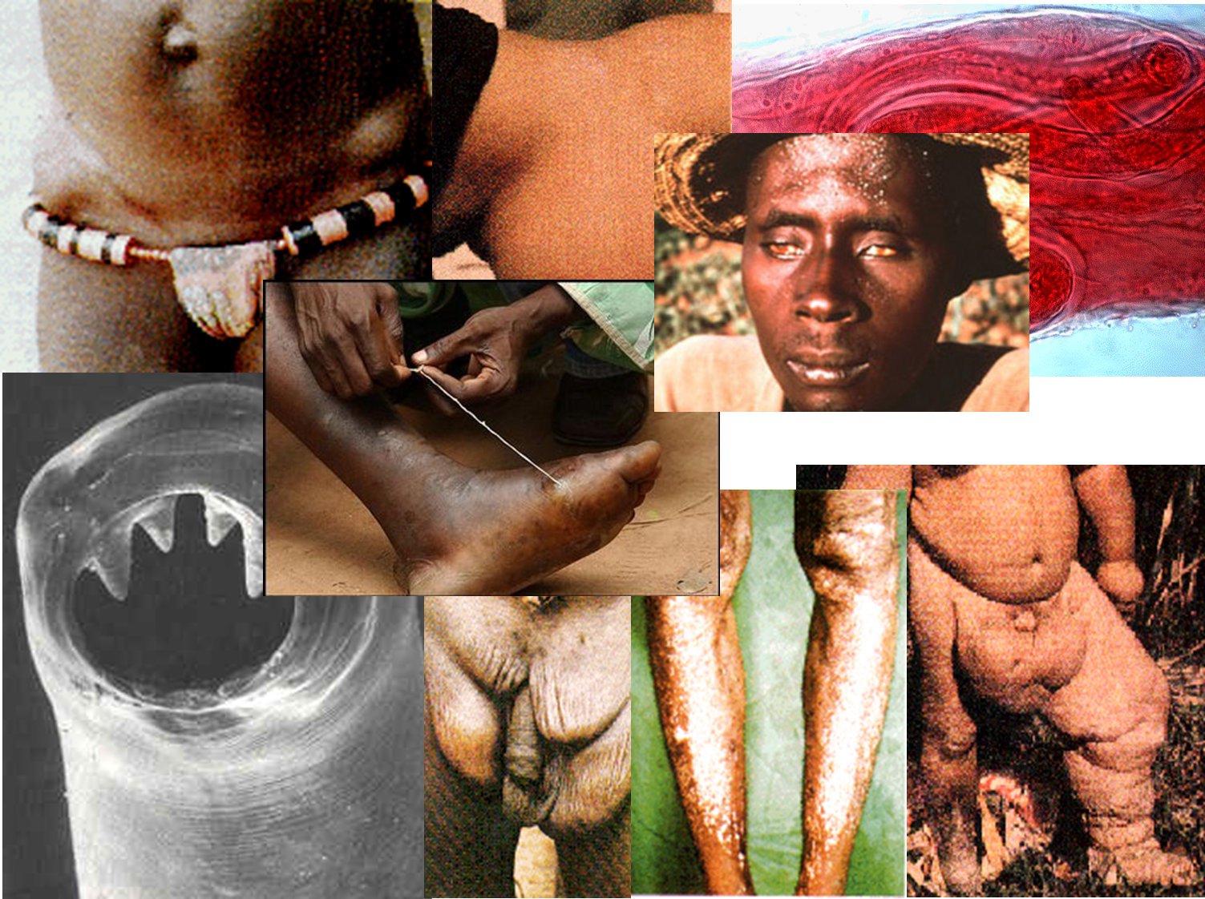
y no se olvide de los parásitos de los animales y humanos

Slide 6
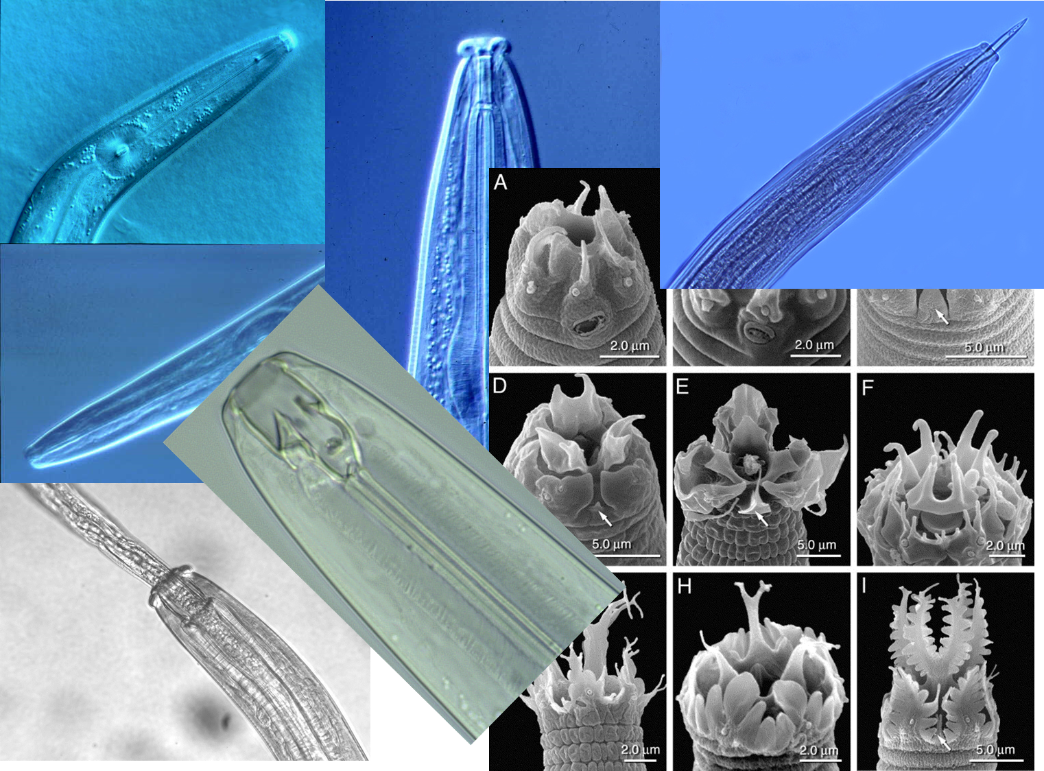
pero creo que, en una escala global, los servicios beneficiosos de bacterivoros, fungivoros y depredadores son mayores que los efectos negativos de los parásitos
- si no limitada por las actividades humanas

Slide 7
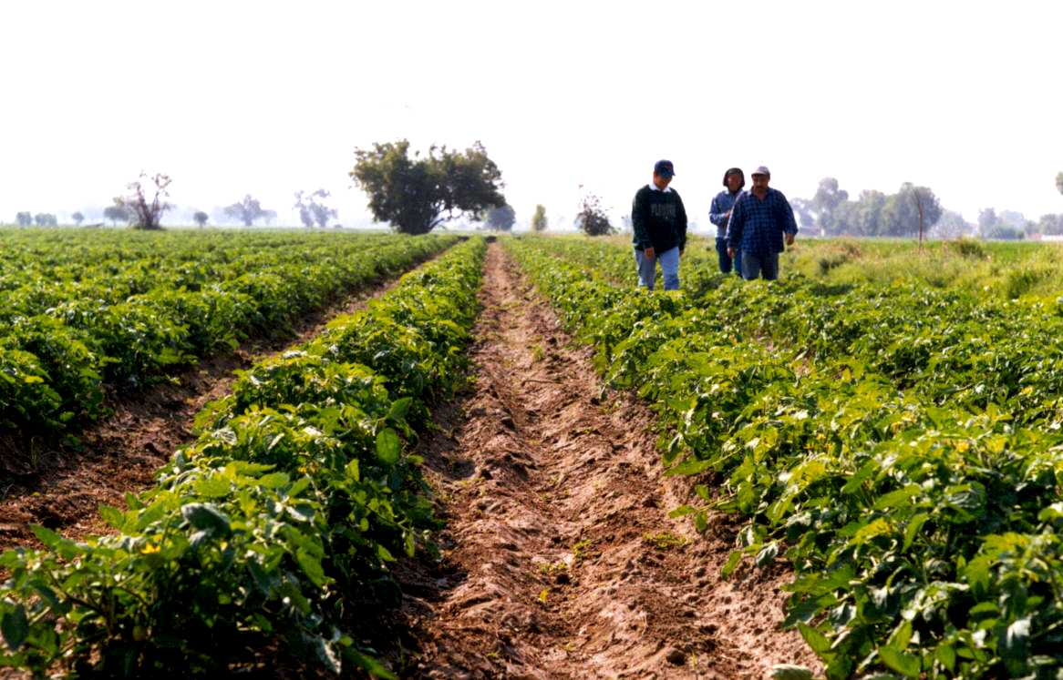
Dis-servicios = Servicios Negativos
Nematodos parásitos de las plantas
Características

Slide 8
Clasificación Actual de los Nematodos
(basados ​​en la ssu rDNA)
Nematoda
Enoplea |  |  |  |  | Chromadorea
Enoplia |  |  | Dorylaimia |  | Chromadoria
 | Enoplida |  | Dorylaimida |  | Rhabditida
 | Triplonchida |  | Mermithida |  | Plectida
 |  |  | Mononchida |  | Araeolaimida
 |  |  | Dioctophymatida |  | Monhysterida
 |  |  | Trichinellida |  | Desmodorida
 |  |  | Isolaimida |  | Desmoscolecida
 |  |  | Muspiceida |  | Chromadorida
 |  |  | Marimerthida
Dorylaimida
Freshwater and terrestrial habitats, some marine.
Feed as predators or on fungi, algae and higher plants.
Rhabditida
Parasites of plants and animals and bacterial- and fungal-feeders.
Soil and freshwater nematodes.
Triplonchida
Freshwater and terrestrial habitats, some marine.
Feed as predators or on bacteria, fungi, algae and higher plants.
clase (ea)
subclase (ia)
orden (ida)
suborden (ina)
superfamilia (oidea)
familia (idae)
subfamilia (inae)
per De Ley & Blaxter, 2002

Slide 9
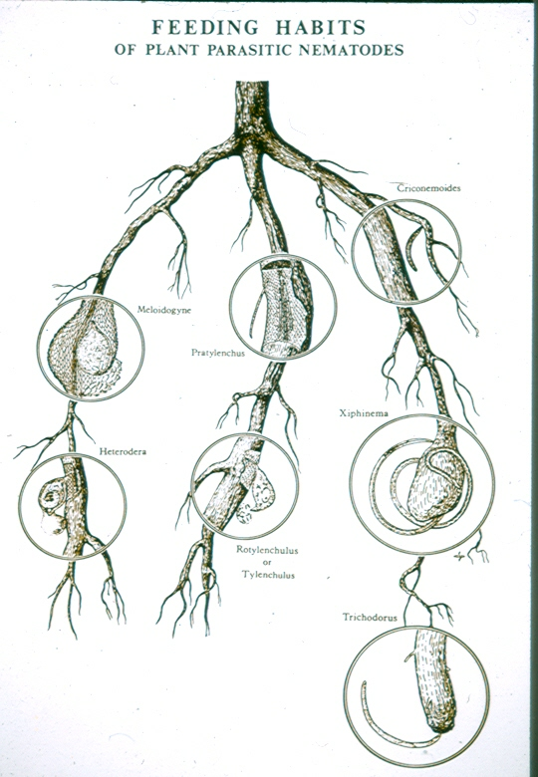
hábitos de alimentación de los nematodos parásitos de plantas

Slide 10
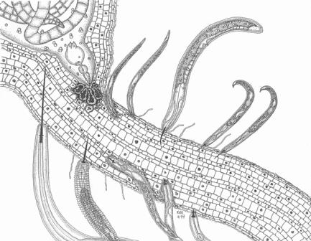

Slide 11
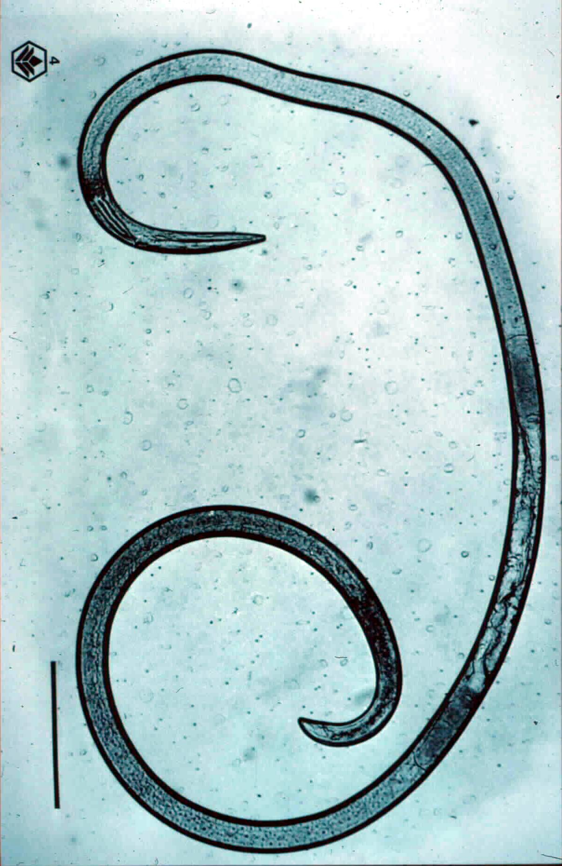
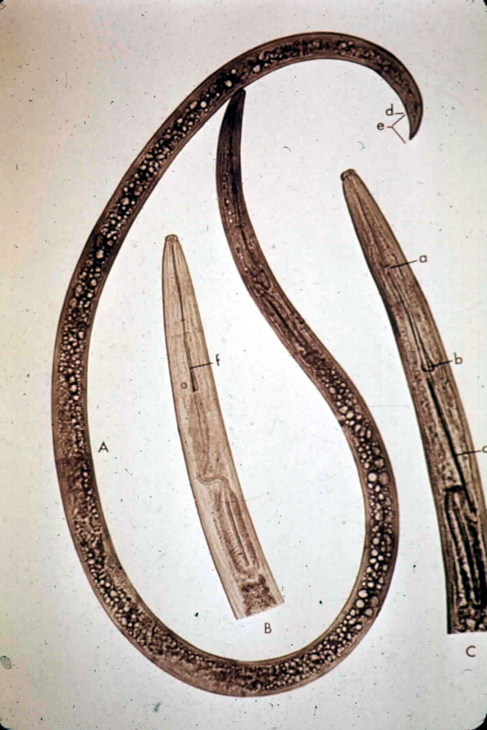
Xiphinema y Longidorus

Slide 12
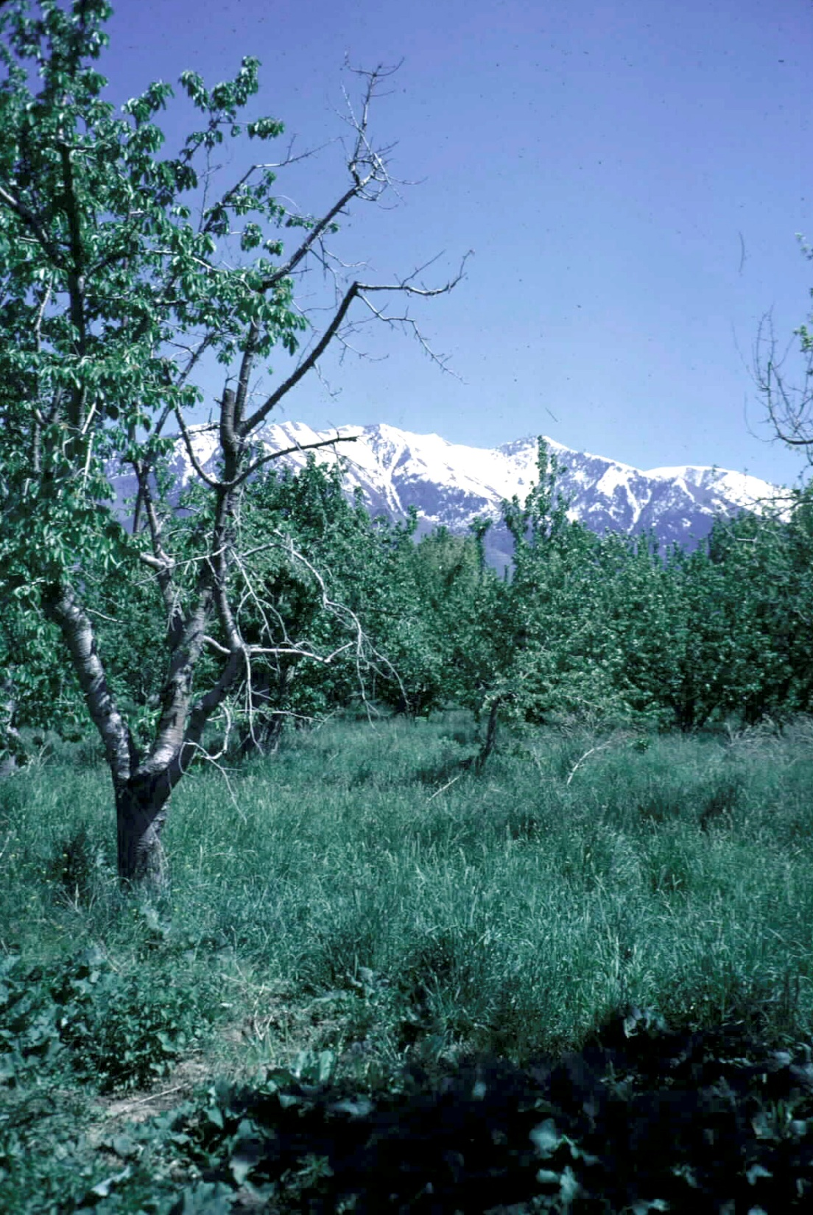
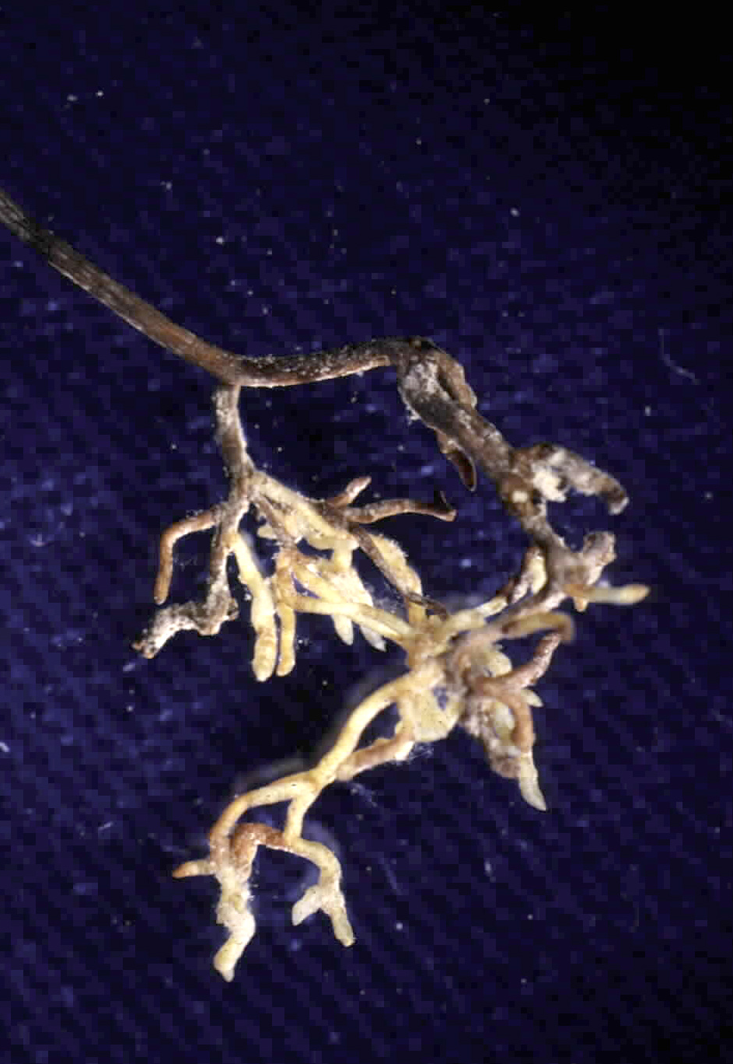

Slide 13
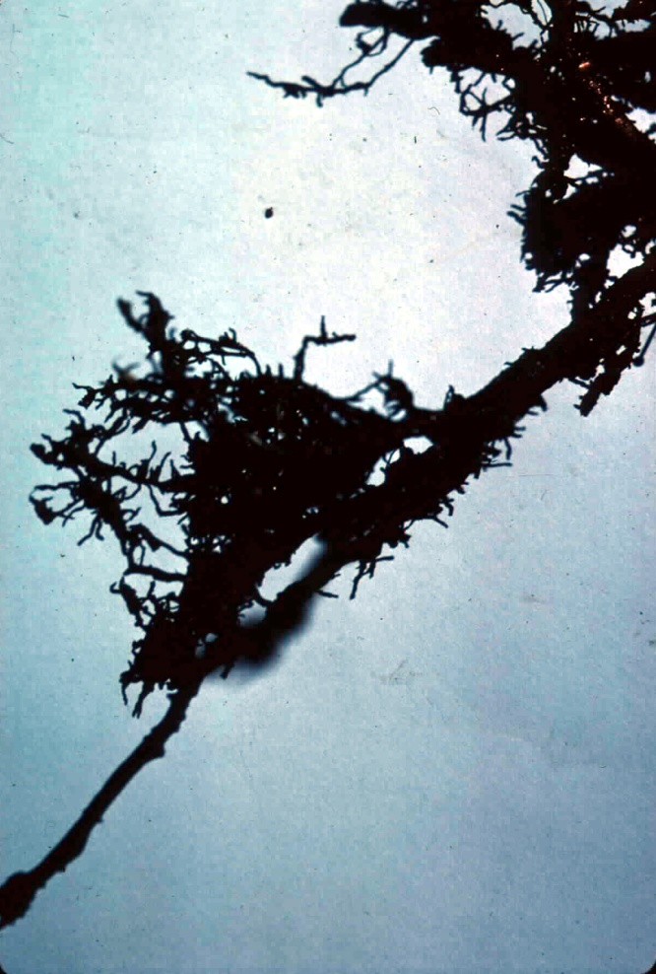
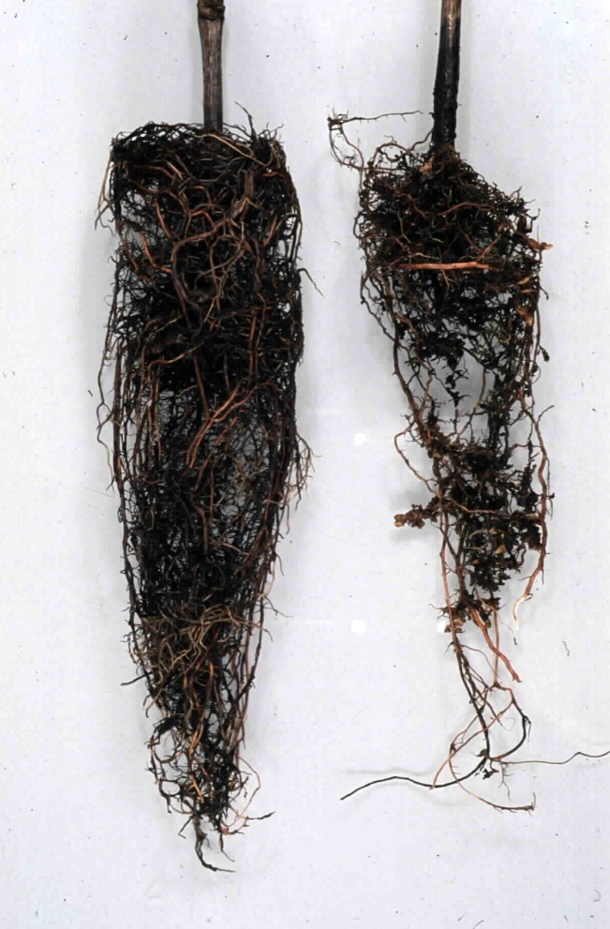
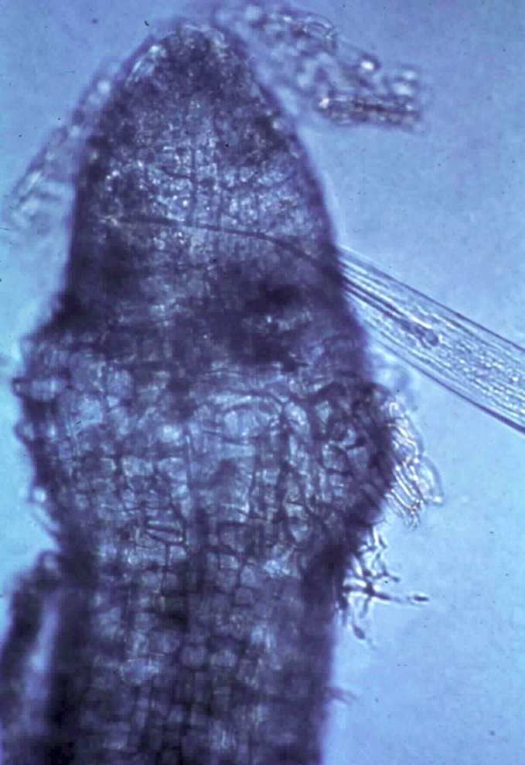
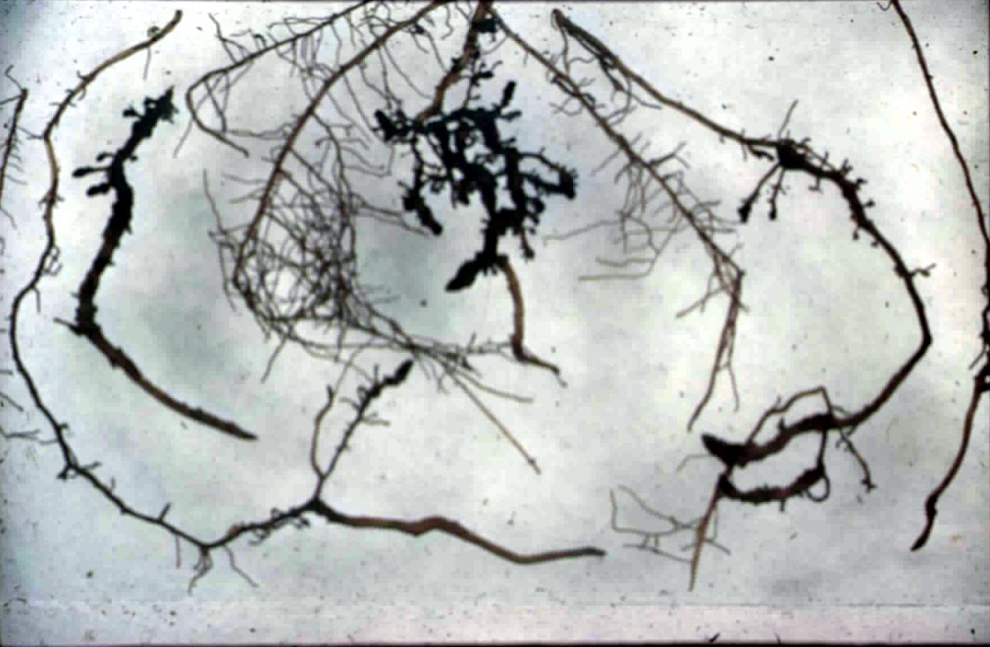
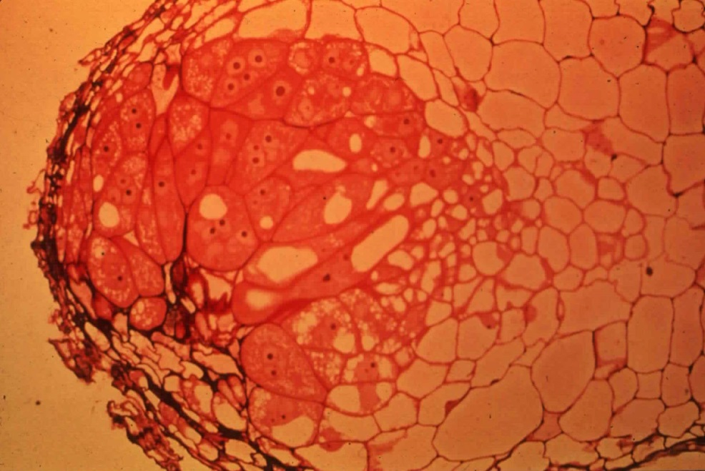

Slide 14
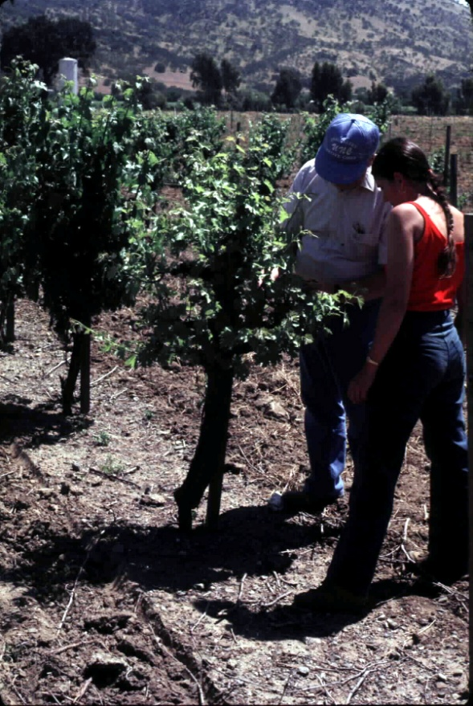
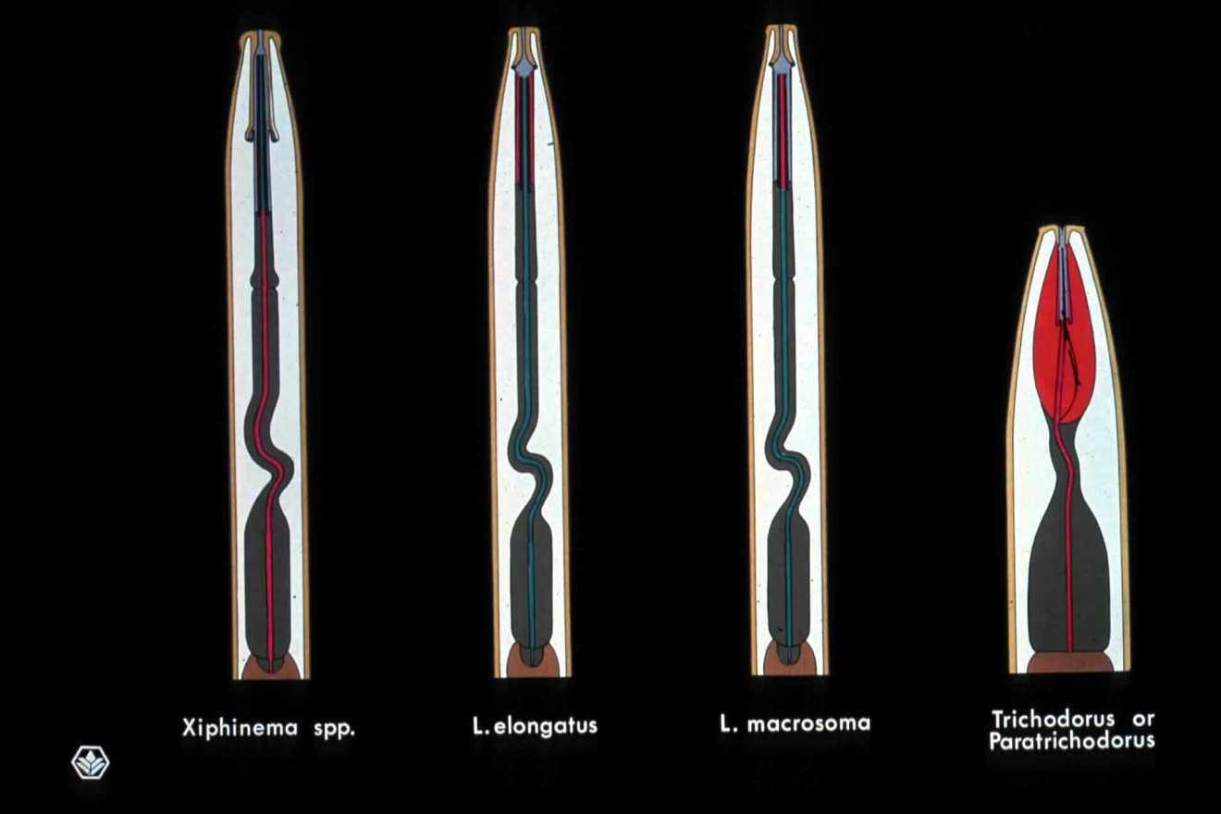
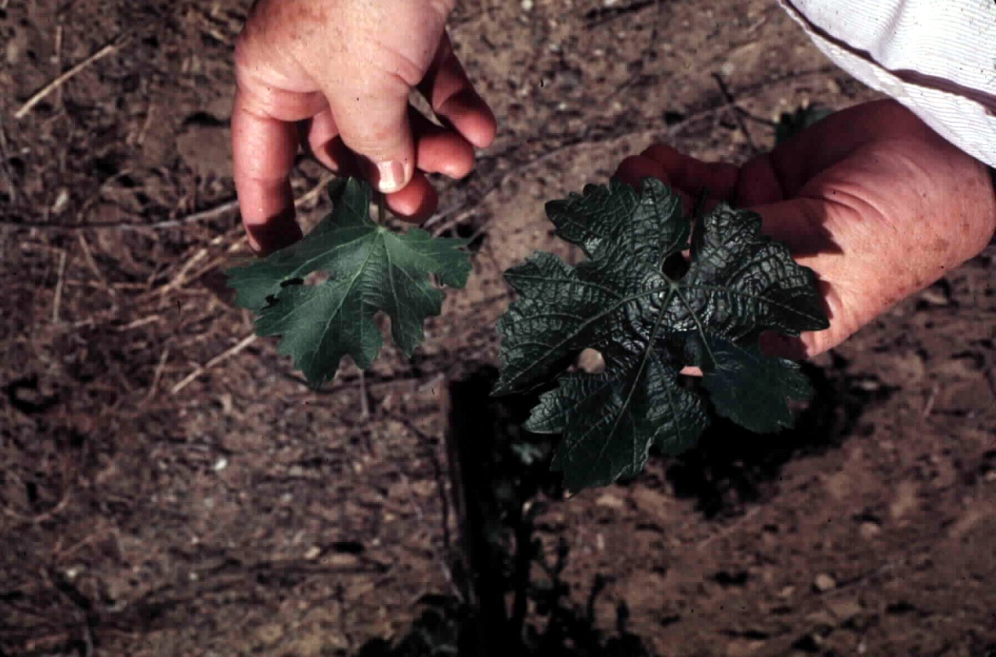
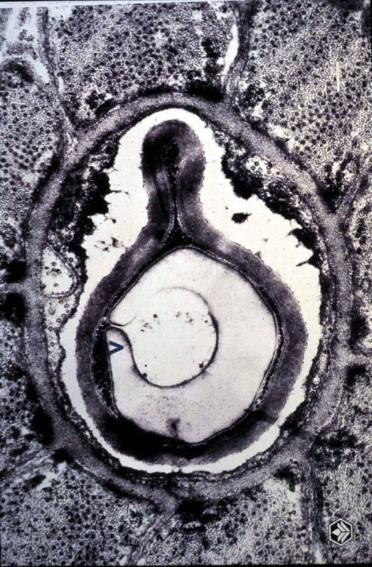
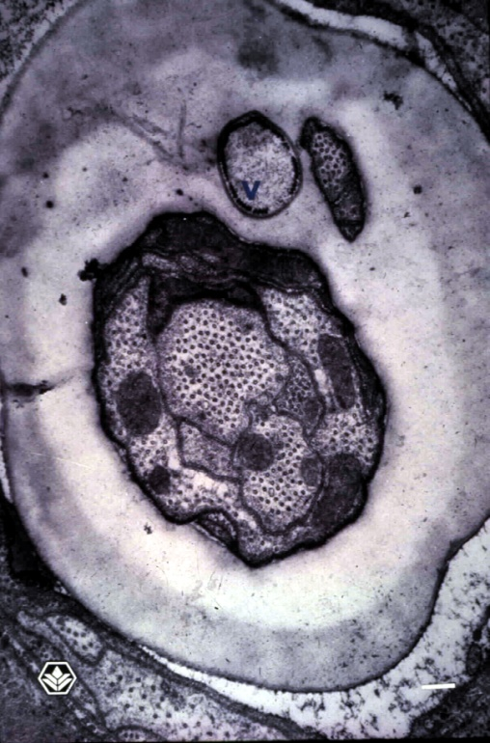

Slide 15
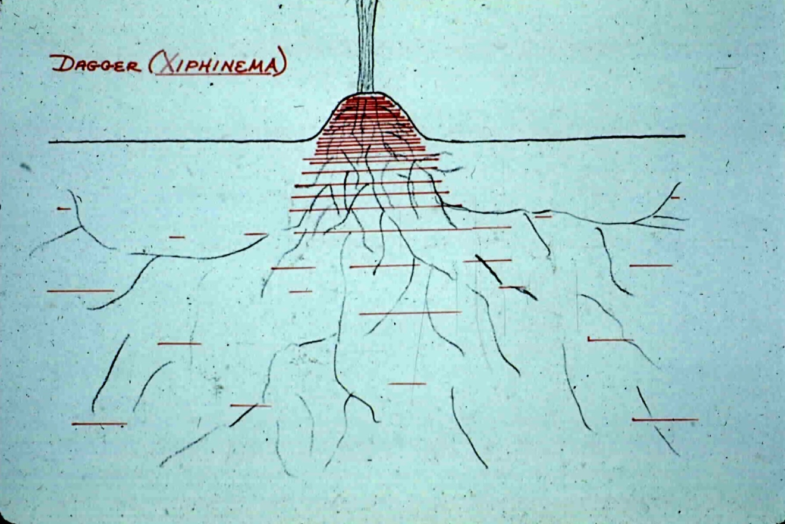
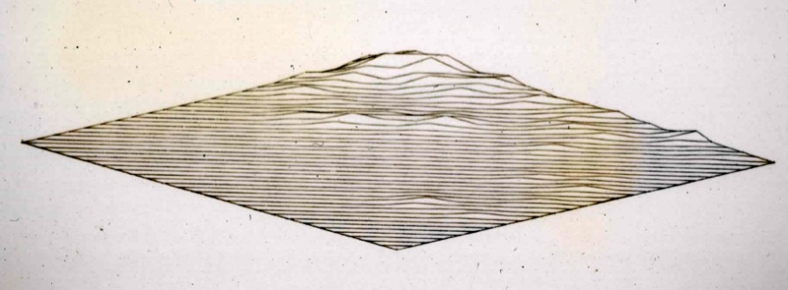
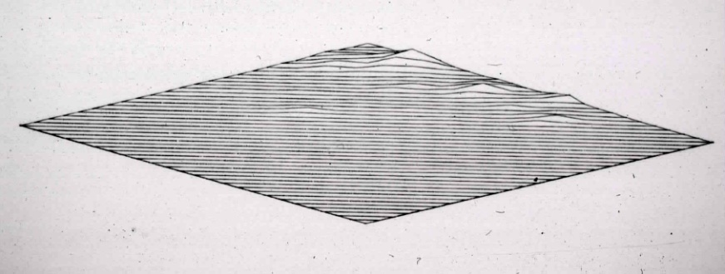
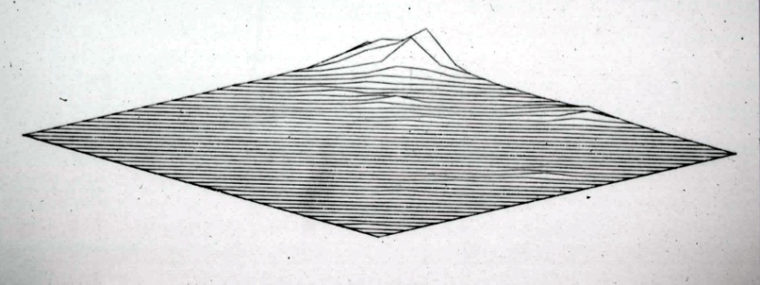
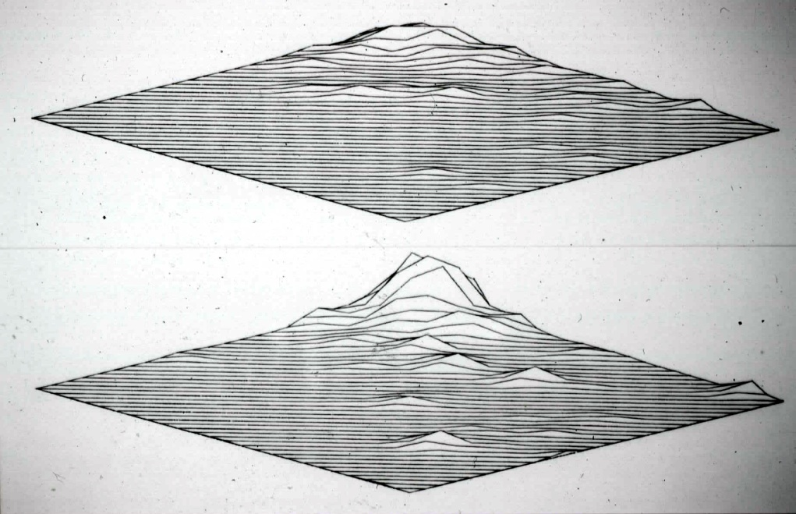
October Year 1
January Year 2
June Year 2
October Year 1 and September Year 2

Slide 16
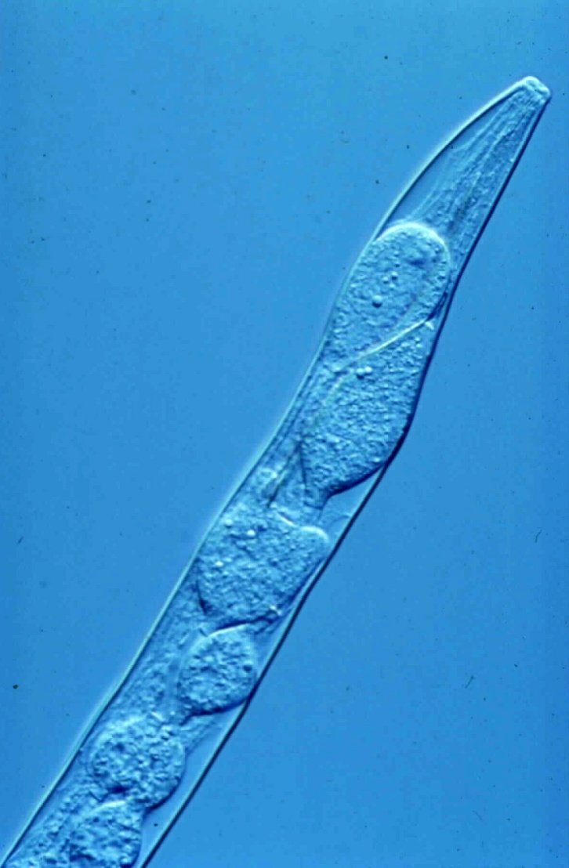
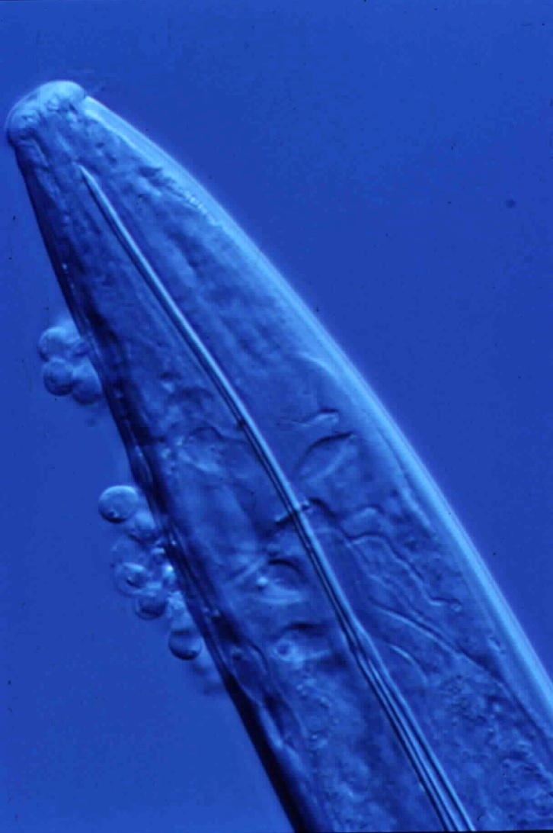
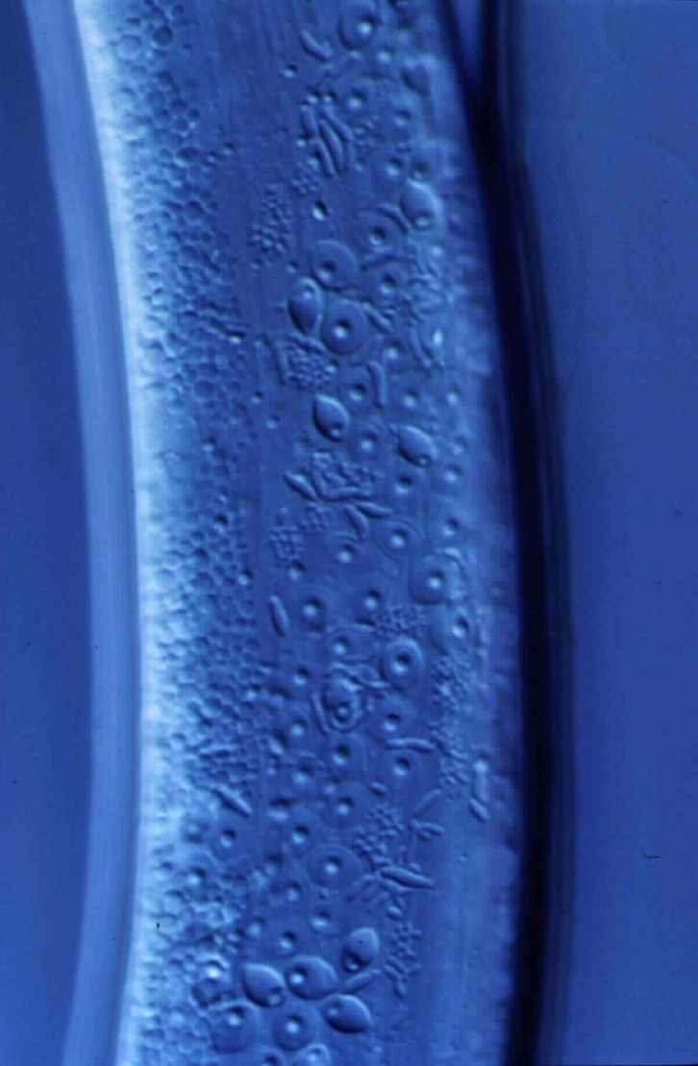
Catenaria anguillulae
zoosporangia
Catenaria anguillulae
encysted zoospores
Pasteuria penetrans
Several life stages

Slide 17
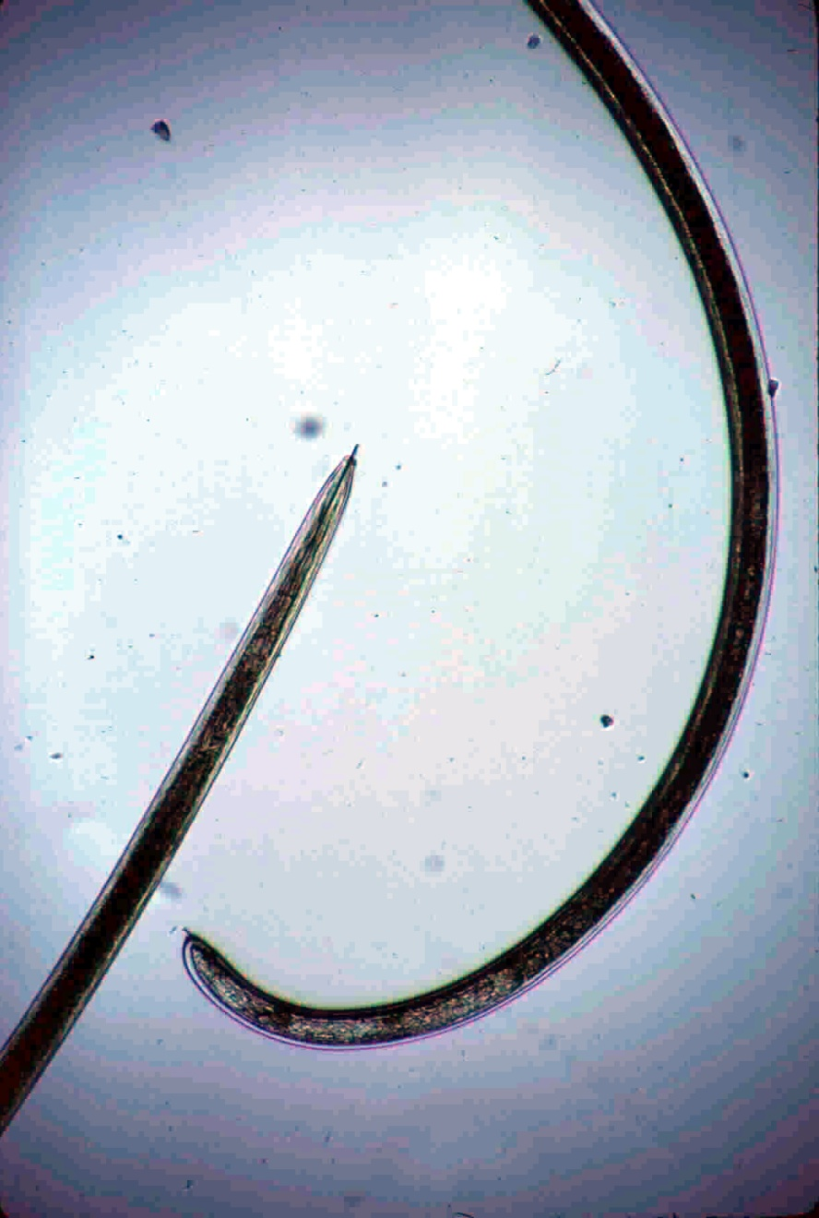
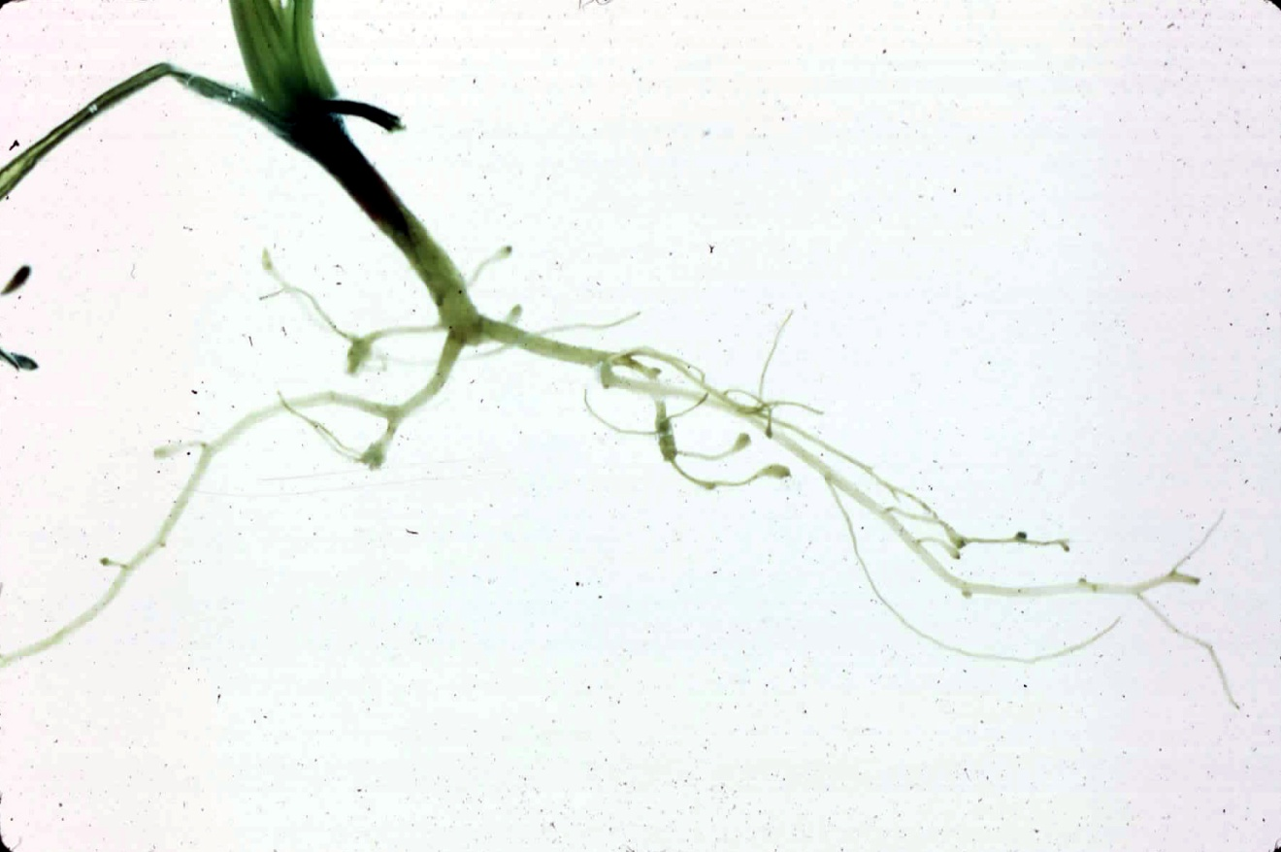
Longidorus africanus

Slide 19
Trichodoridae
Onchiostyle
(Order
Triplonchida)
spear or onchium
(a solid tooth with
dorsal groove)
curved onchiophore
esophageal
lumen

Slide 21
Trichodorus - onions
Trichodorus – alfalfa stand decline
Trichodorus – spatial pattern
Trichodorus - sugarbeet

Slide 22
Easter lily bulb field, Del Norte County
Pratylenchus penetrans reduces rate
of bulb enlargement
Pratylenchus
Nematicide trial for P. penetrans control
Nematicide application through
irrigation system

Slide 23
Pratylenchus
and necrosis
in root cortex

Slide 24
Pratylenchus damage
Peanut pod distortion and lesions
Patchy growth in relation to
P. penetrans densities
Onion yields in relation to P. penetrans densities

Slide 25
Apple replant problem; P. penetrans, Netherlands
Plum rootstock trial for P. vulnus,
California
Apple replant problem (left); P. penetrans, New York

Slide 26
Pratylenchus

Slide 27
Rotylenchulus y Nacobbus (y otros)
Nacobbus aberrans

Slide 28
Rotylenchulus reniformis

Slide 29
Rotylenchulus reniformis
- cotton
R. reniformis
- cowpea
R. reniformis
- soybean

Slide 30
Rotylenchulus reniformis
- nematicide trial, pineapple, Hawaii

Slide 32
Nacobbus aberrans, México

Slide 33
Nacobbus aberrans
- Wide host range.
- High population density in the field.
- Resistant to adverse condition.
- Host roots severely galled.
IN MÉXICO:
- First report by Bruner in pepper crops (1967).
- Impact:
+ Hidalgo State.- Abandon production.
+ Tecamachalco, Puebla.- Losses of 83%.
(Cid del Prado et al., 1997, Cristóbal, 2001).

Slide 35
N. aberrans distribution in Mexico
Cid del Prado et al. (1991).

Slide 36
iMPORTANT ECONOMIC CROPS IN MÉXICO
TOMATO
(Solanum lycopersicum)

Slide 37
CHILI PEPPER
(Capsicum annuum L.)

Slide 38
BEANS
(Phaseolus vulgaris L.)

Slide 39
POPULATION DYNAMICS
- Complete life cycle (40-45 days) and maximum abundances of each stage in the roots.
(Cid del Prado et al., 1995b; Cid del Prado et al., 1997a).
- Maximum abundances in tomato crops:
1) J2 at 6, 11, 15 and 22 weeks after transplanting.
2) J3 at 4, 8 and 16 weeks after transplanting.
- Adult females are evident in the second and third week after transplanting. Abundances may reach 20 females/g root (16th week).
(Cid del Prado et al., 1997).

Slide 40
- N. aberrans J3 and J4 survive under field conditions without a host for one year.
- J3 and J4, possibly in anhydrobiotic state, are the primary inoculum infecting susceptible hosts the next year.
- Survival of J3 and J4 increases if they are in root fragments.
- Eggs and J2 do not survive without a host or under adverse conditions.
(Cristóbal, 2001).
SURVIVAL

Slide 41
EFFECTS ON PLANT NUTRITION
(Nitrogen)
Without nematodes
With nematodes
Roots
Foliage

Slide 42
EFFECTS ON PLANT NUTRITION
(Phosphorus)
Without nematodes
With nematodes
Roots
Foliage

Slide 43
BIOLOGICAL CONTROL
*Organic amenments
*Animal Manures
*Nematophagous fungi
Ignacio Cid del Prado and colleagues - México

Slide 44
Organic Material
+
Pochonia chlamydosporia
Control

Slide 45
GENETIC RESISTANCE IN BEANS
Improved varieties:
Bayo Mecentral, Flor de Mayo M-38, Bayo INIFAP, Negro Puebla and Río Grande.
Criollas varieties:
Amarillo Calpan, Black Querétaro, Negro San Luís, Flor de Junio Criollo and Flor de Mayo Criollo.

Slide 46
INTEGRATED PEST MANAGEMENT FOR N. aberrans
Total tomato production under different N. aberrans control strategies

Slide 47
Tylenchulus semipenetrans
citrus nematode
citrus replants
- control vs. preplant fumigation

Slide 48
1,3 dichloropropene-1,2 dichloropropane, preplant
DBCP application, Coachella
Tylenchulus semipenetrans
citrus
chemical control trials, California
untreated control

Slide 49
Gracias!
http://plpnemweb.ucdavis.edu/nemaplex

