Slide 1
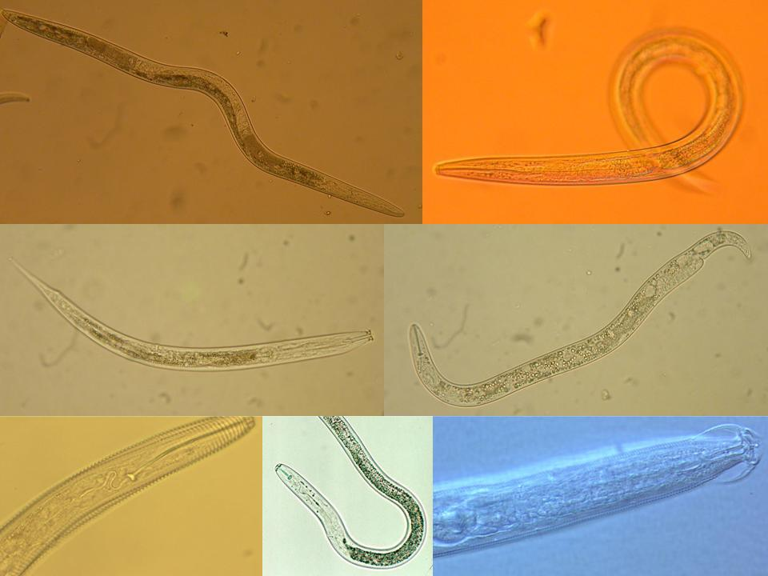
Ecología de Nematodos
y
Salud de Suelo
Resistencia de las Plantas
Howard Ferris
Universidad de California, Davis
Notes:
30 min talk
Interactions:
Nematodes affect other organisms, other organisms affect nematodes
Nematodes feed on plants – plants provide food for nematodes.
Nematodes feed on bacteria, nematodes farm bacteria – in soil, insects,
bacteria feed nematodes, bacteria kill nematodes
Nematodes feed on fungi and are fed upon by fungi.
Nematodes feed on protozoa and microarthropods, tardigrades, mites,
collembola and are fed upon
What are the ecosystem effects (effects on functions)?
Enrichment
Movement of and to resources
Nutrient and carbon cycling
Nutrient and carbon movement and sequestration
Effects on services?
Antagonists of nematodes occur in many groups of organisms that are components of the soil food web.
The interactions of many soil organisms results in biological buffering or regulation of the nematode population through the mechanisms of Exploitation, Competition, and Antibiosis
1

Slide 2
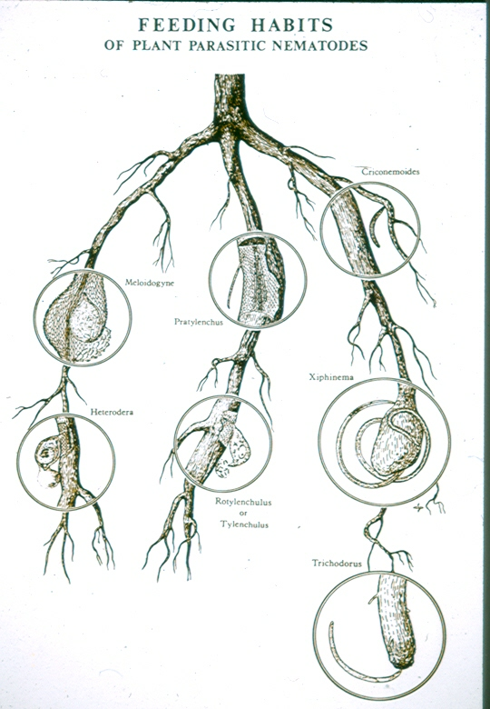
hábitos de alimentación de los nematodos parásitos de plantas

Slide 3
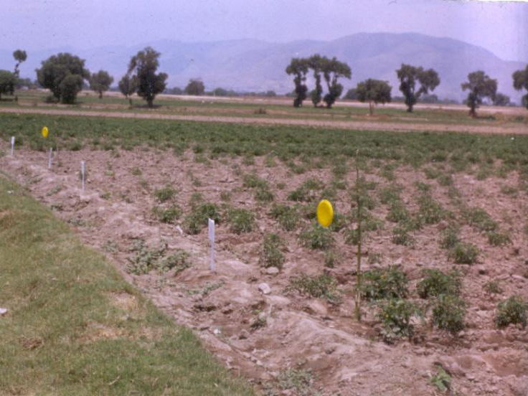
El parasitismo exitoso por nematodos parásitos de plantas
Supresión de las defensas de plantas por nematodos

Slide 4
Patógenos Biotróficos
Los patógenos que sólo pueden alimentarse de plantas vivas y deben mantener el huésped y sus células vivas se denominan patógenos biotróficos.
Nematodos sedentarios ecto y endoparásitos, pertenecen a esta categoría, por ejemplo, las especies de los géneros Meloidogyne, Heterodera, Xiphinema, Tylenchulus, Rotylenchulus.
Los nematodos que retiran contenidos celulares y formen células individuales y luego pasan a los otras células, son considerados “cell grazers” (herbívoros celulares), no patógenos biotróficos.

Slide 5
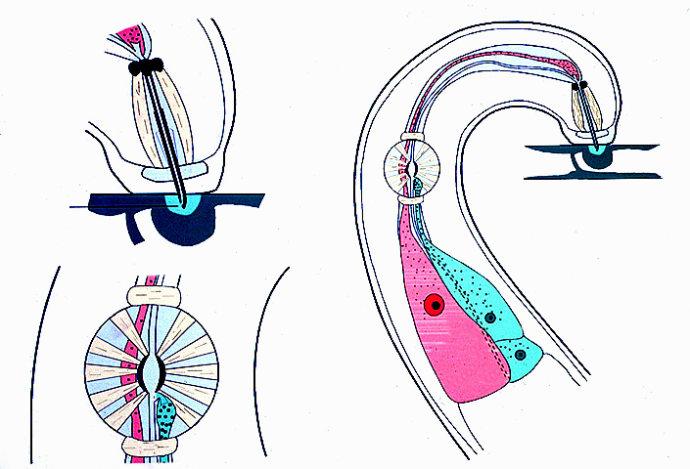
Defensas de las Plantas
1. Defensas pre-existentes - la resistencia basal
a. Estructural - cera de la cutícula, grosor de la pared, las espinas que inhiben la penetración de las células.
b. Productos químicos y otros compuestos fenólicos que inhiben o matan a los organismos invasores.

Slide 6
2. Resistencia sistémica inducida
a. DAMP Señales
Los daños asociados-patrones moleculares (DAMP) resultar en
la activación de la vía de ácido jasmónico
la producción de compuestos fenólicos
otros mecanismos

Slide 7
2. Resistencia sistémica inducida
b. PAMP Señales
Los patrones moleculares asociados a patógenos (PAMP) son reconocidos por los receptores en la superficie celular.
activar la ruta del ácido salicílico
iniciar localizada muerte celular programada - la respuesta hipersensible
Notes:
Invading bacteria and fungi, and probably nematodes, release effector molecules into plant cells to suppress PTI and render the plant susceptible to infection or invasion.
PAMP-triggered PTI, the first line of defense, may involve production of salicylic acid (SA) as a signal to invoke defense mechanisms. In that case, successful nematode infections would involve suppression of SA production, reduction of callose thickening of cell walls and suppression of active oxygen defense responses (H₂O₂, superoxide) which may initiate localized programmed cell death – hypersensitive response.
SA signaling is possibly disrupted by chorismate mutase produced in the esophageal glands. In the PTI signaling pathway, chorismate is converted to salicylic acid. Chorismate mutase from the nematode reduces chorismate and thus SA, so defense mechanisms are not triggered. Incidentally, like cellulases, chorismate mutase is an example of horizontal gene transfer from bacteria. Nematodes are the only metazoan with the enzyme.
An alternative mechanism of PTI suppression by nematodes is the production of effectors which cause ubiquitin to attach to plant signal proteins and thus reduce their levels and effectiveness in triggering PTI responses.
The evolution of effector suppression of PTI has resulted in evolution of immune receptors, with a nucleotide-binding domain and a leucine-rich domain (NB-LRR), in plants that recognize the effector molecules and activate effector-triggered immunity (ETI). However, successful pathogens have evolved next-generation effectors that suppress ETI.
One possible candidate is the Hg30C02 effector protein of Heterodera glycines which may be involved in active suppression of host defenses (Hamamouch et al., 2012).
Another is the 8D05 parasitism gene of Meloidogyne incognita which is required for successful infection of host roots. The gene codes for a protein that is secreted from the subventral glands duriing initiation of the feeding site (Xue et al., 2013).
Plants have responded with more specific ETIs and the evolutionary treadmill continues.
PTI responses to PAMPs and DAMPs are relatively general in their effect but higher level ETIs are progressively more specific to individual pathogens.
The cyclical evolutionary process of plant-nematode interactions with regard to plant immunity and susceptibility is depicted by the zig-zag-zig model (Jones and Dangl, 2006). Initially PAMPs trigger PTI which reduces susceptibility. Then nematodes develop effectors that suppress PTI and plants evolve immunity responses to the effectors.

Slide 8
2. Resistencia sistémica inducida
c. La Supresión de Patógeno-desencadenó inmunidad (PTI) desde Efectors
(ETI = efector-desencadenada inmunidad
ETS = efector-desencadenada susceptibilidad)
La invasión de nematodos, probablemente, liberan moléculas efectoras para suprimir patógeno-desencadenó inmunidad - PTI y hacer que la planta sea susceptible a la invasión.
Ácido salicílico señalización es interrumpida por corismato mutasa, producida en las glándulas esofágicas.
Corismato mutasa del nematodo reduce corismato, y por lo tanto el AS, por lo que los mecanismos de defensa no se activan.
El gen parasitismo Mi8D05 de Meloidogyne incognita produce una proteína efectora de 382 aminoácidos en las glándulas subventral de M. incognita J2.
La interferencia de Mi8D05 para ARNi reducido por 90% la infección por M. incognita de Arabidopsis.
Un otra efector es la Hg30C02 proteina de Heterodera glycines.

Slide 9
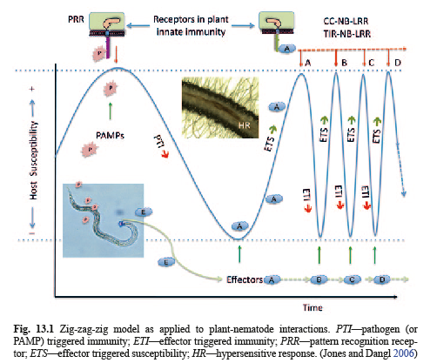
Las fuentes de sistemas específicos ETI son genes de resistencia.
Se han identificado algunas moléculas efectoras ETS nematodo.
Un candidato recientemente descubierto es la proteína efectora Hg30C02 de Heterodera glycines..

Slide 10
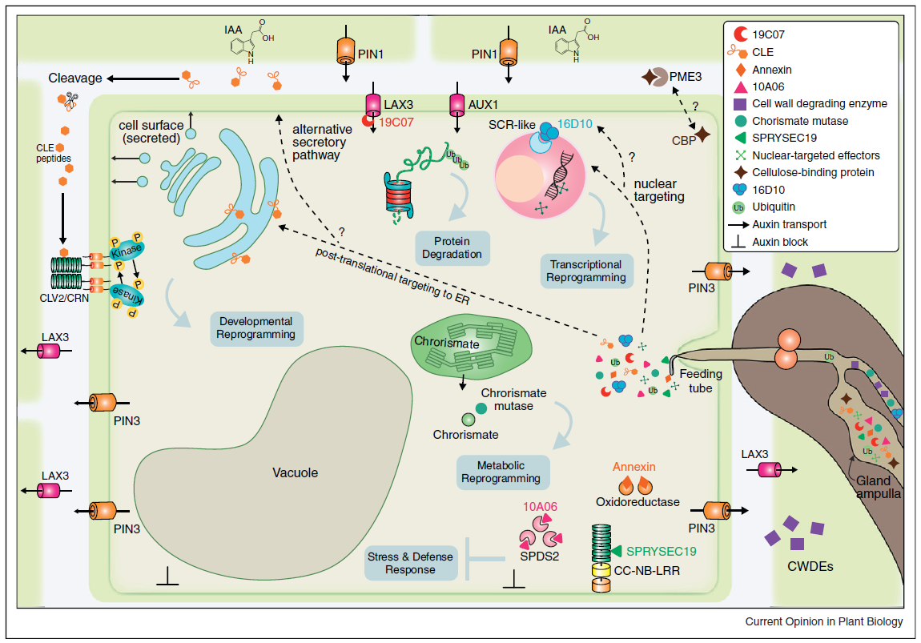
Resumen:
Proteínas efectoras procedentes de las glándulas esofágicas son secretadas
a través del estilete.
Enzimas degradantes la paredes celulares de facilitar la migración de
nematodos a través de la raíz.
Proteínas del huésped son los blancos de los efectores de nematodos.
La proteínas ubiquitina secretada para nematodos alteran la degradación
vías de proteínas plantas.
Mutasa corismato de nematodos altera la señalización del ácido salicílico.
Upregulation de proteínas de transporte de afluencia auxina y regulación
De PIN1 transportador auxina conduce a la acumulación local de auxina.
Desplazamiento de portadora eflujo auxina PIN3 a las membranas
plasmáticas entrega auxina a las células adyacentes.
Otros efectores putativos de nematodos incluyen proteasas,
proteínas del veneno de alérgenos, calreticulin, MAP-1, RBP-1 y NodL.
Gheysen, G. and Mitchum, M.G. 2011. How nematodes manipulate plant development pathways for Infection. Current Opinion in Plant Biology 14:415-421.
Notes:
Effector proteins originating from the subventral and dorsal esophageal gland cells are secreted through the stylet into plant cells.
Cell-wall degrading enzymes facilitate nematode migration through root tissues.
Host proteins are targeted by nematode effectors
Effector proteins containing a nuclear localization signals move to the plant nucleus
Nematode secreted ubiquitin extension proteins alter cell protein degradation pathways.
Chorismate mutase disrupts salicylic acid signaling.
Upregulation of auxin influx transport proteins and downregulation of PIN1 auxin transporter leads to local accumulation of auxin.
Shifting of PIN3 auxin efflux carrier to the plasma membranes delivers auxin to adjacent cells.
Other putative nematode effectors are not pictured, including include proteases, venom-allergen proteins, calreticulin, MAP-1, RBP-1, and NodL.

Slide 11
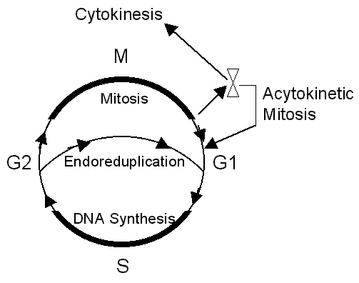
subvertir el ciclo celular
The eukaryotic cell cycle has four stages.:
1. Nuclear DNA is replicated during synthesis phase (S-phase).
2. DNA synthesis is followed by an interval called the G2 phase (G=gap).
3. Mitosis occurs, the nucleus divides (M-phase).
4. The interval between the completion of mitosis and the beginning of DNA synthesis is the G1-phase
Cytokinesis occurs after the mitosis phase.
In the Meloidogyne feeding site there are repetitions of the S and M phases but not cytokinesis. This is called acytokinetic mitosis or karyokinesis without cytokinesis.
In Heterodera and Globodera feeding site, the S phase of the cell cycle is activated but not the M phase. The S-phase is repeated many times (endoreduplication) but there is no mitosis (karyokinesis).

Slide 12
Ácido salicílico señalización es interrumpida por corismato mutasa, producida en las glándulas esofágicas.
Corismato mutasa del nematodo reduce corismato, y por lo tanto el AS, por lo que los mecanismos de defensa no se activan.
Mutasa corismato sólo se encuentra en bacterias, hongos, plantas superiores ...... ..y nematodos.
Corismato mutasa es un ejemplo de transferencia horizontal de genes de las bacterias.
Los nematodos son metazoanos
sólo con la enzima.
Las celulasas en nematodos también
se consideran ejemplos de
transferencia horizontal de genes.

Slide 13
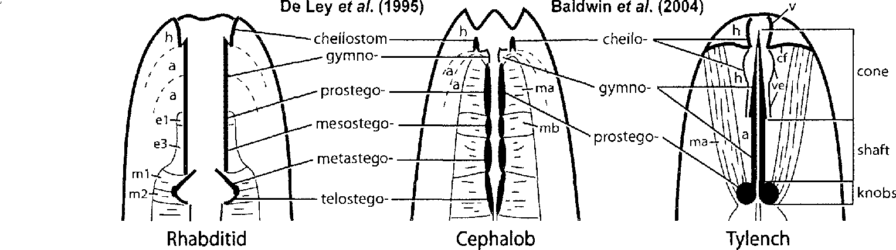
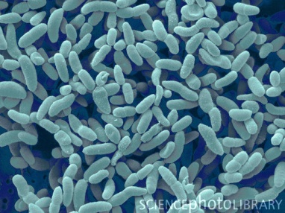
la evolución del parasitismo de las plantas
Rhabditoidea
Cephaloboidea
Tylenchoidea
transferencia horizontal de genes - HGT
celulasa – GHF5 - la familia glicósido hidrolasa
corismato mutasa
bacterias

Slide 14
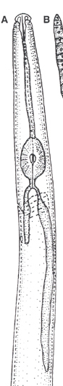
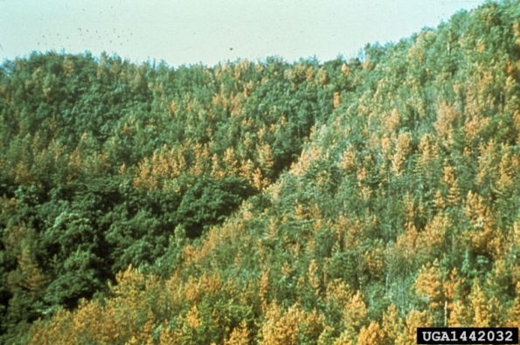
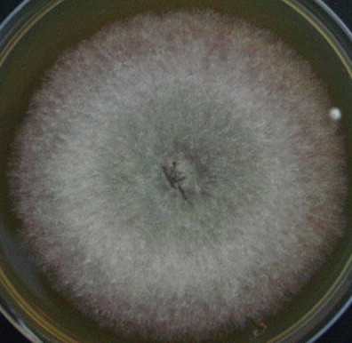
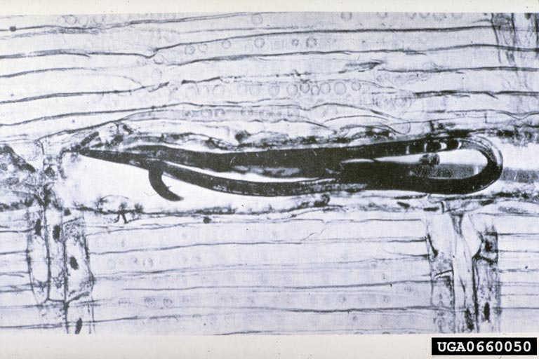
la evolución del parasitismo de las plantas
Aphelenchoidea
hongos
Bursaphelenchus xylophilus
transferencia horizontal de genes - HGT
celulasa – GHF45 - la familia glicósido hidrolasa
GHF5 se produce en A. fragariae cuando se alimentan de tejido de la planta;
su expresión disminuye x1800 cuando se transfiere a los hongos

Slide 15
Nematodos herbivoros……..
Reprimir o evitar las defensas del huésped
Subvertir el ciclo celular
Alterar partición fotosintato
Causa daño mecánico a las células y tejidos
Causa la muerte celular
Modificar el desarrollo de células
Modificar la función celular
Interrumpir la absorción de agua y nutrientes
Crear vías de entrada por otros organismos
Predisponer a las plantas a enfermedades y otros factores de estrés
Vector virus de plantas y talvez otro organismos

Slide 16
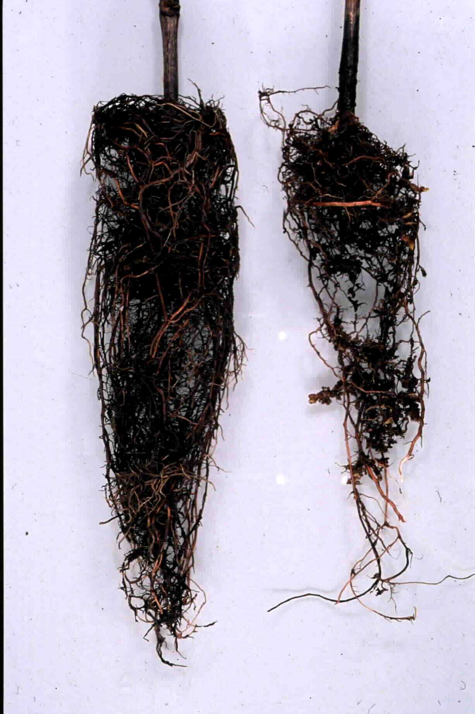
Resistencia de Vid
Patrones
-tienen resistencia a diferentes
especies de nematodos
-y diferentes características horticultural
Xiphinema

Slide 17
Fuentes de Resistencia
Snyder (1930s), Lider (1950s), Weinberger (1960s), Olmo (1980s), Walker (1990s+)

Slide 18
Cría y Selección de Resistencia Ancho y Durable
Un proceso de 15 años

Slide 19
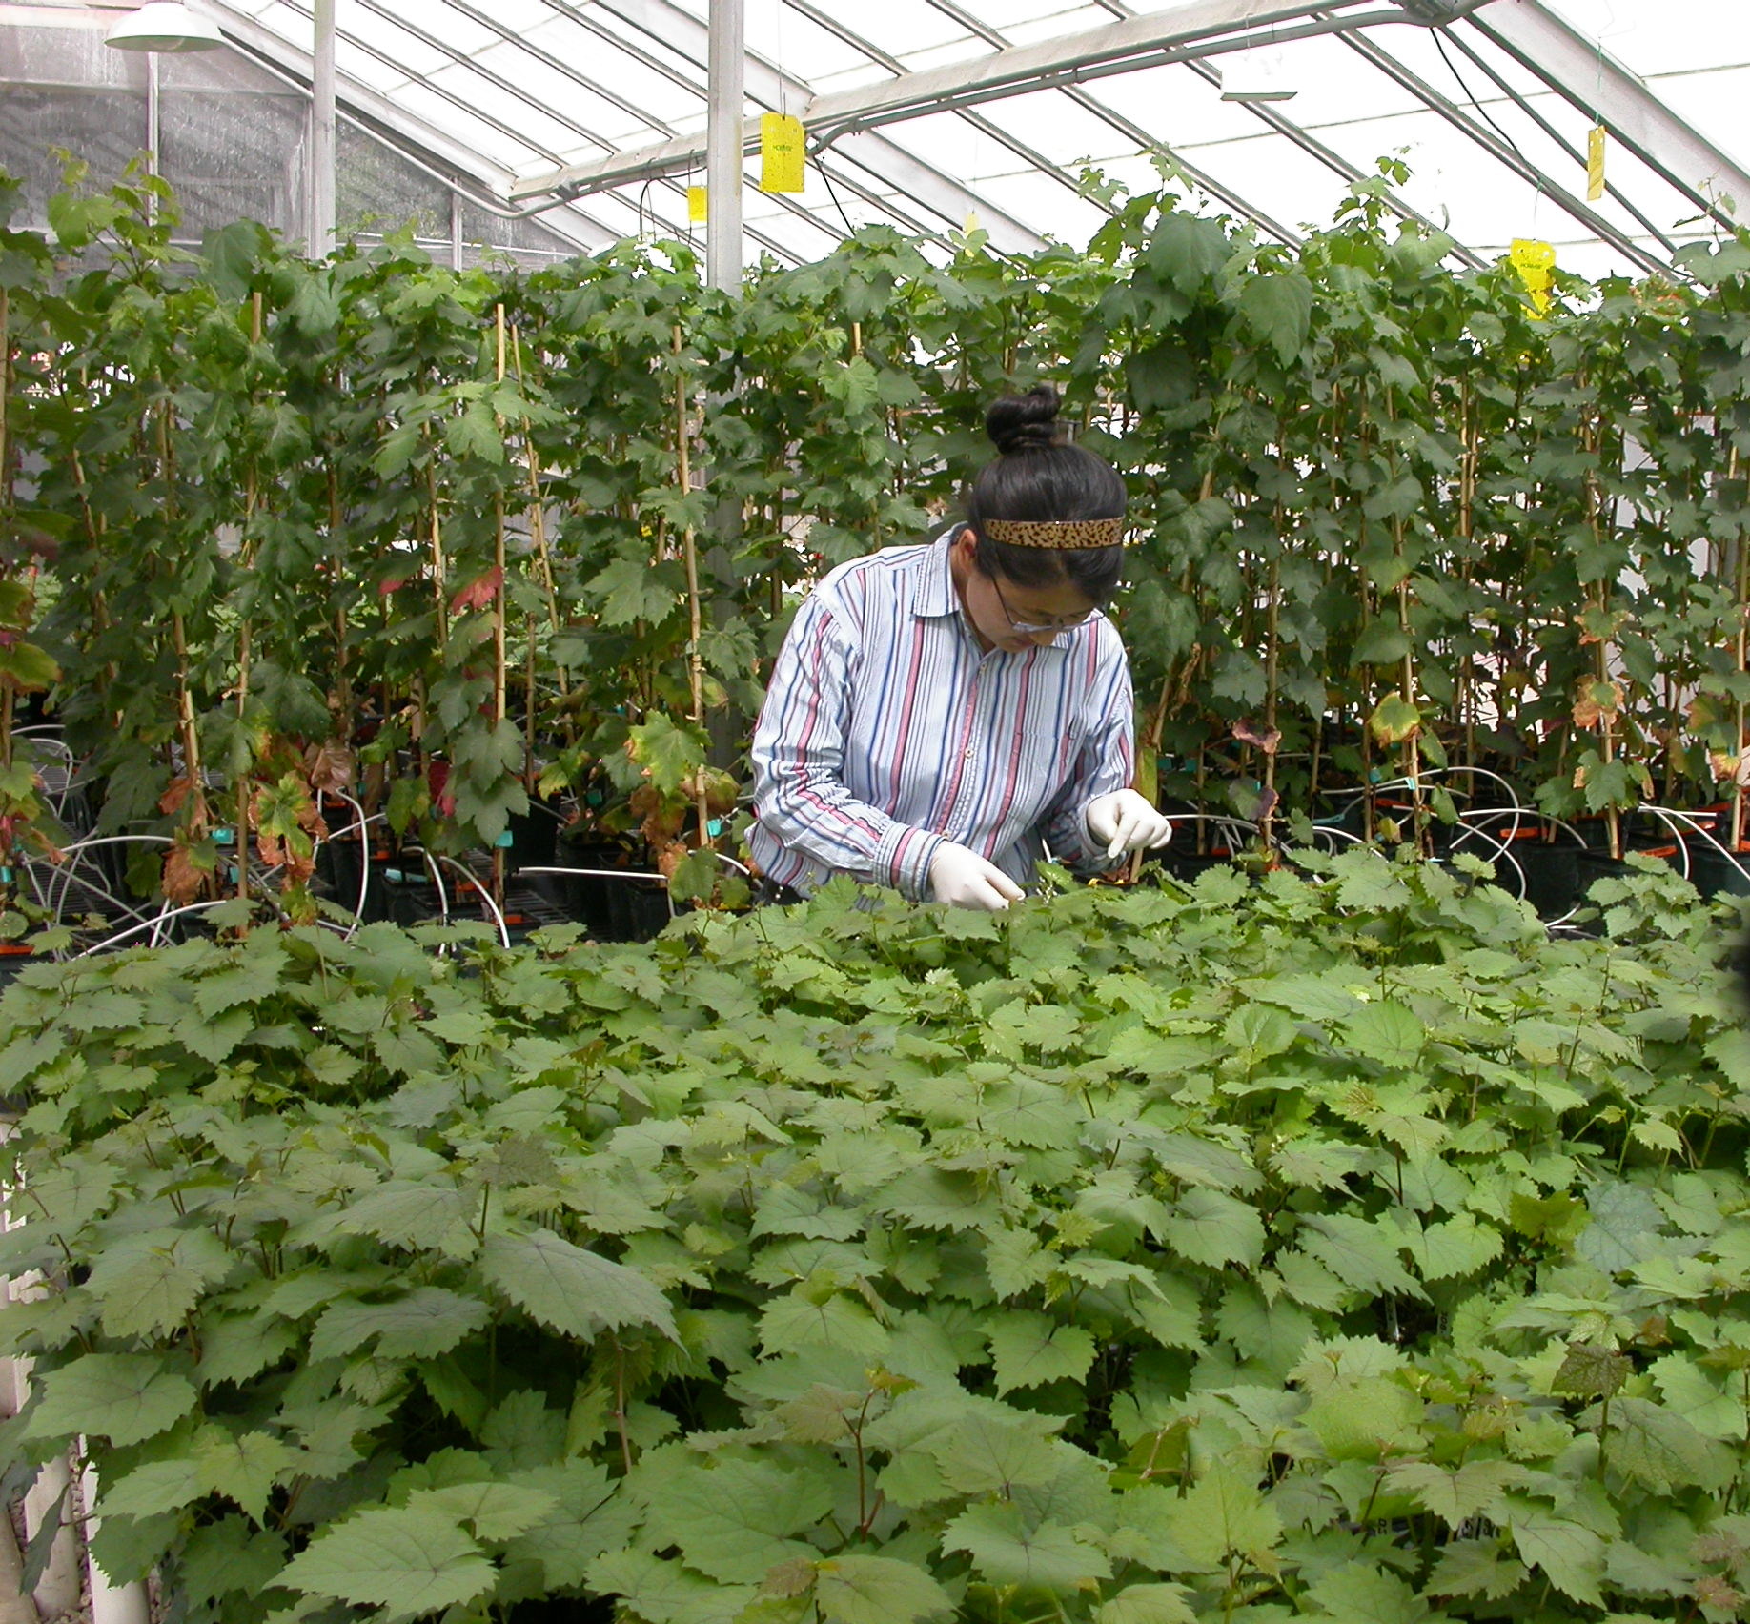
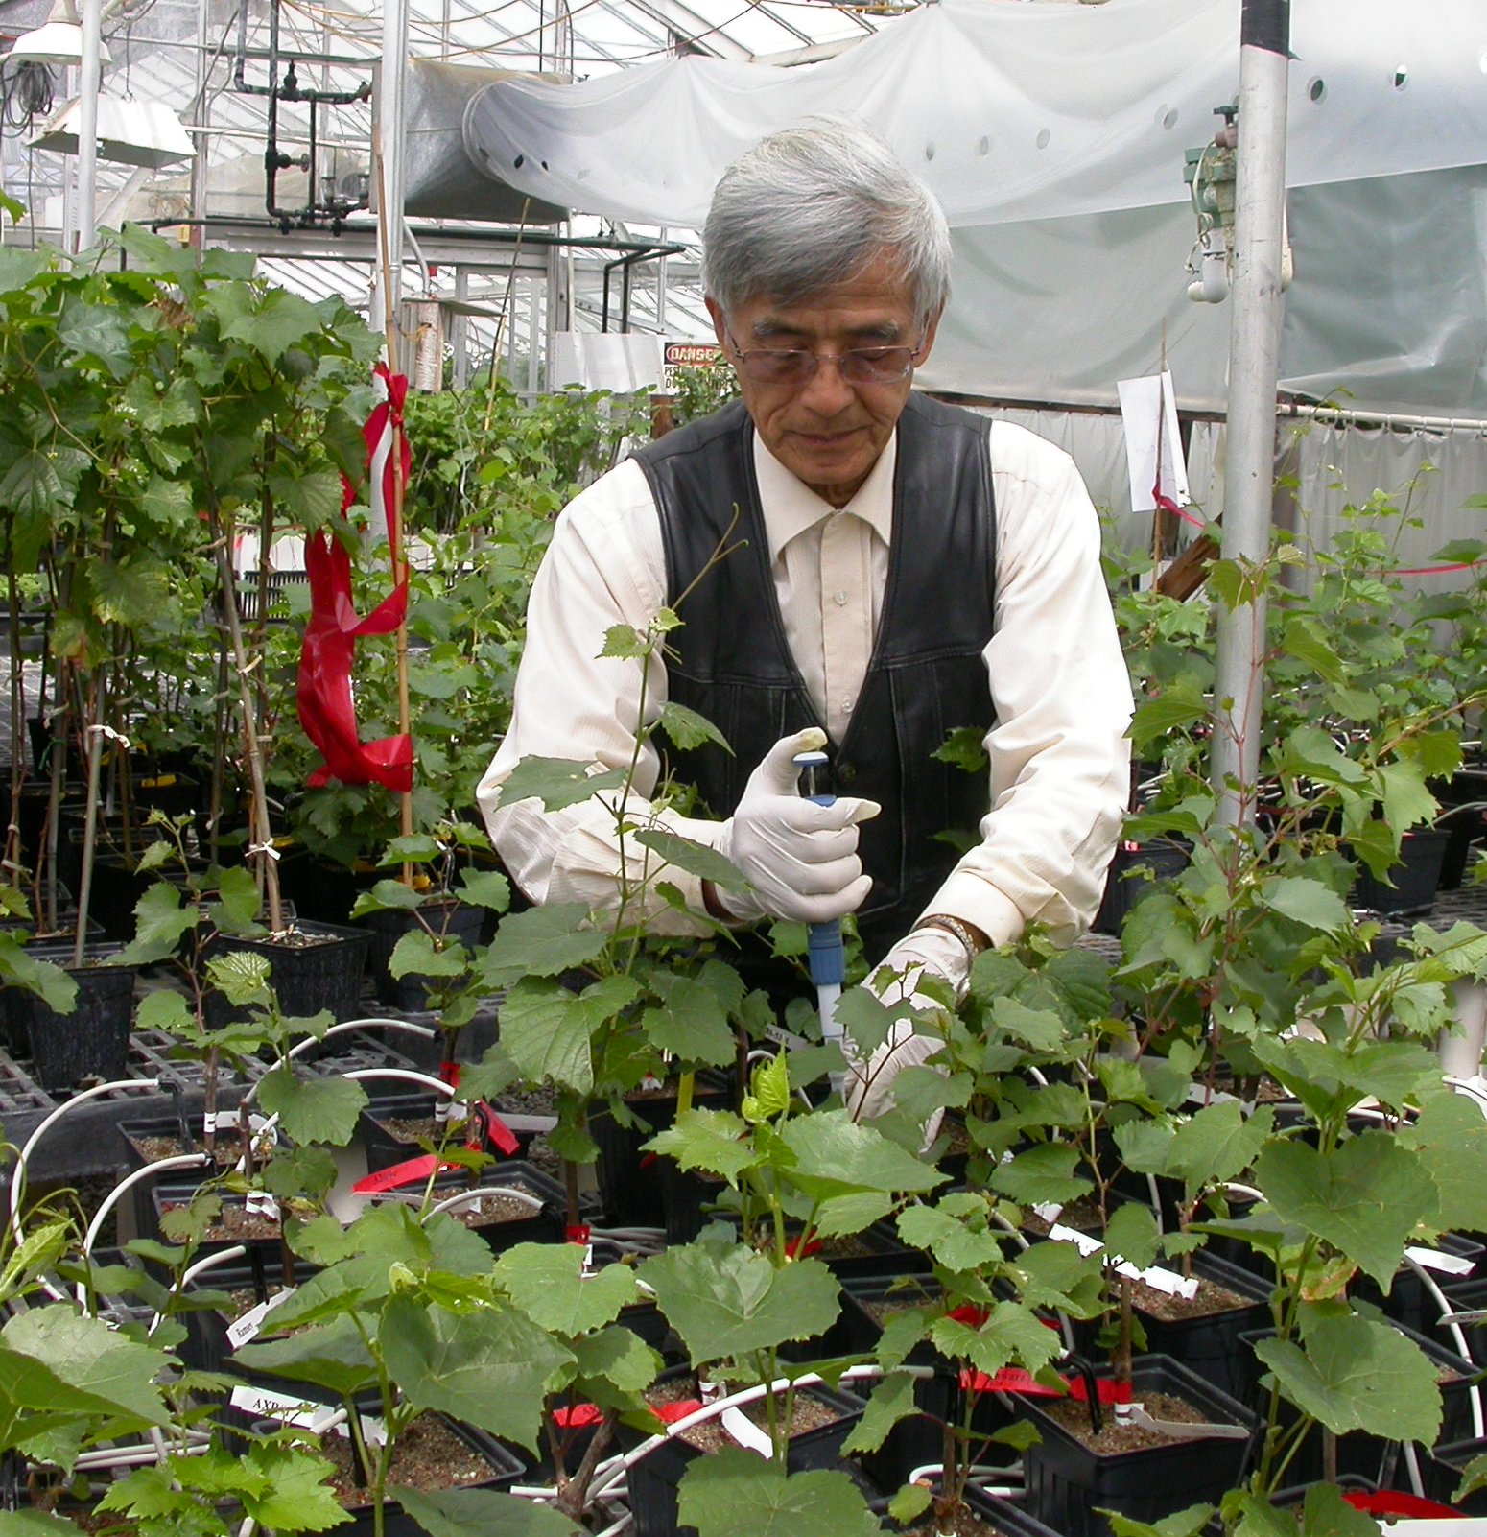

Slide 20
Caracteristicas de Patrones Nuevas
UCDGRN-1 | nematode resistance from Vitis rupestris and Muscadinia rotundifolia. 80% rooting and grafting success from dormant cuttings.
UCDGRN-2 | nematode resistance from V. rufotomentosa and V. champini (cv Dog Ridge). roots and grafts easily.
UCDGRN-3 | nematode resistance from V. rufotomentosa, V. champinii (cvs Dog Ridge and c9038). good rooting and grafting abilities.
UCDGRN-4 | nematode resistance from V. rufotomentosa, V. champinii (cvs Dog Ridge and c9038). good rooting and grafting abilities.
UCDGRN-5 | nematode resistance from V. champinii (cvs Ramsey and c9021). good rooting and grafting abilities.

Slide 21
Ancho de Resistencia
R
MR
MR
MR
MS

Slide 22
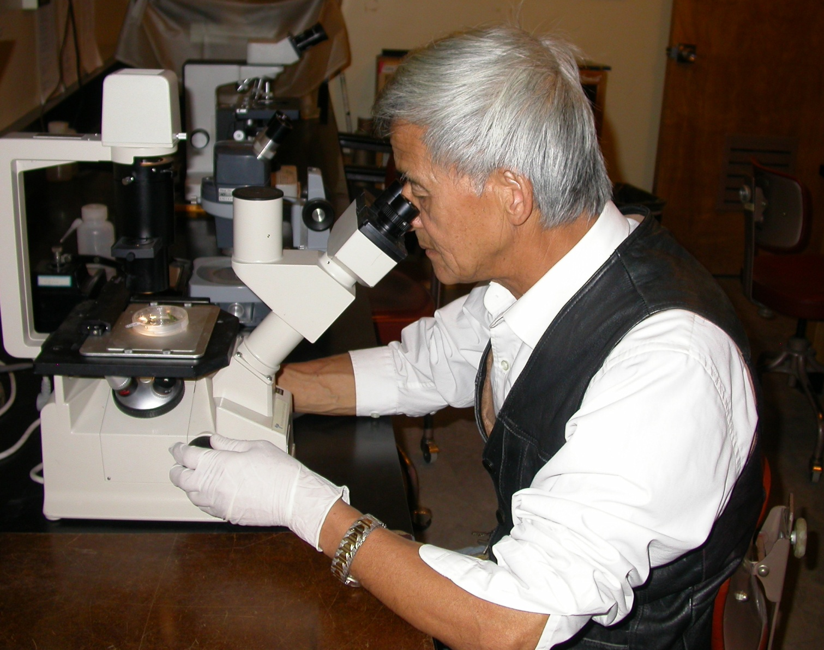
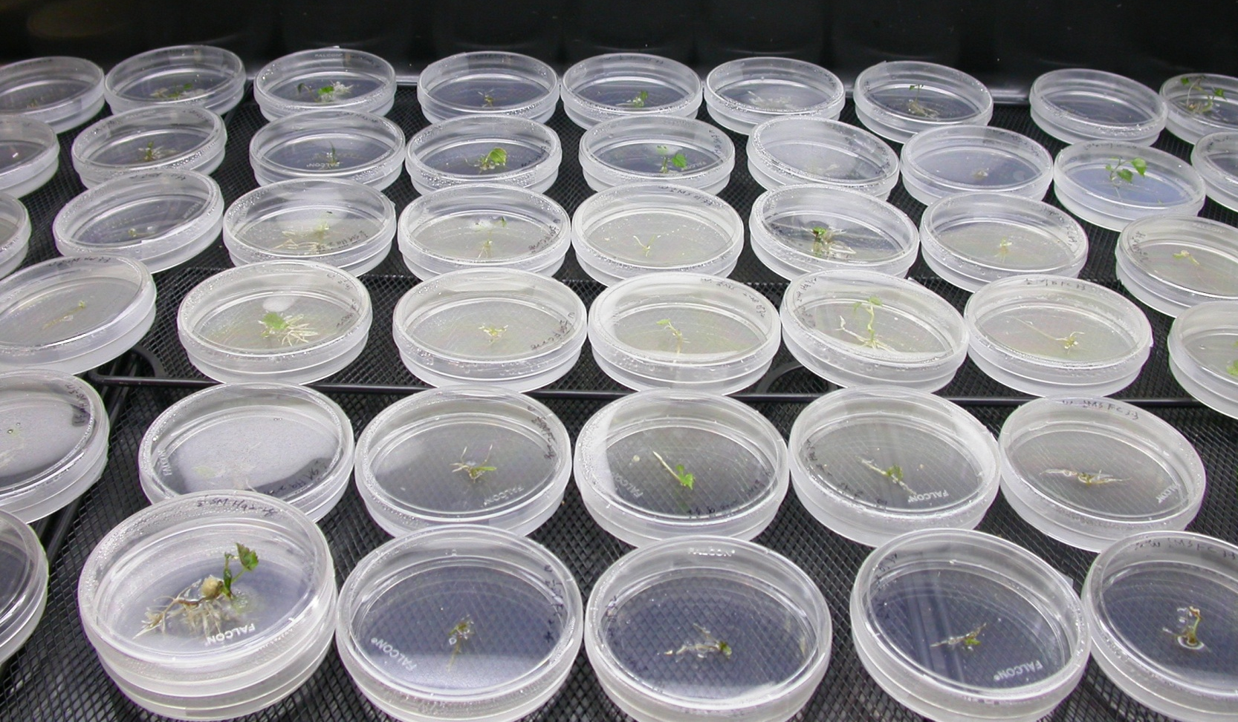
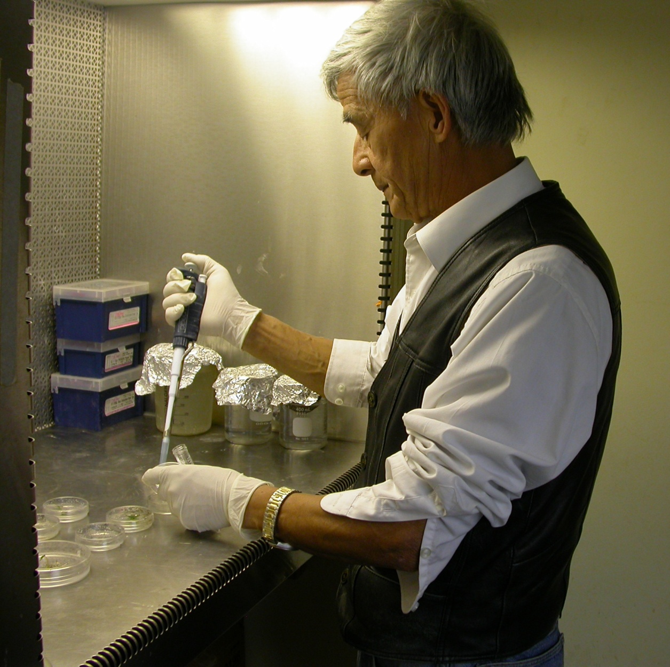
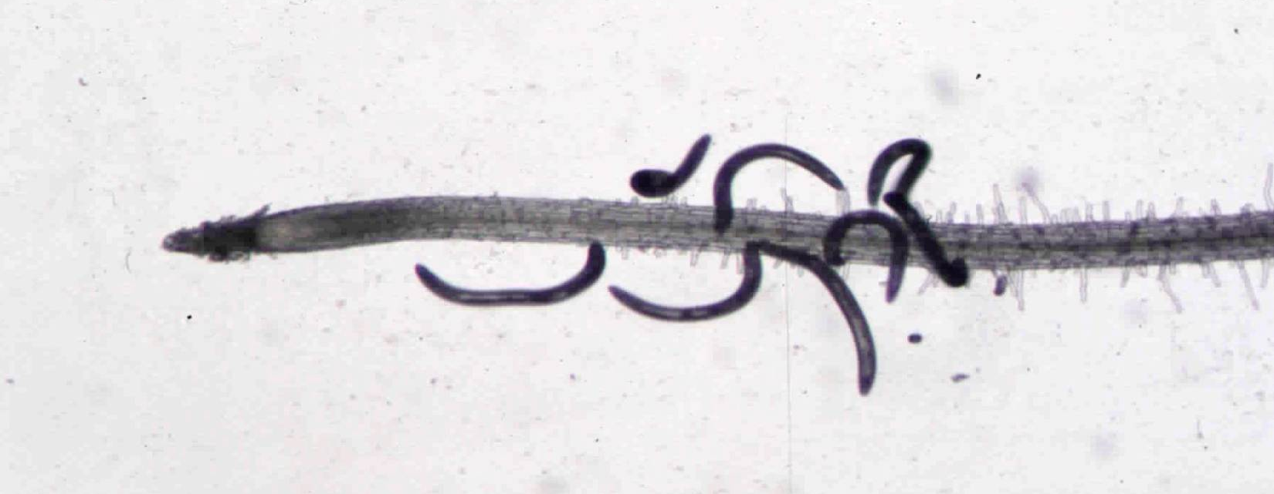
¿Cuál es la forma de resistencia de los portainjertos nuevos?

Slide 23
Genotype | Parentage | M. incognita Race 3 | M. javanica | Meloidogyne pathotypes Harmony A&C | M. chitwoodi | X. index | C. xenoplax | P. vulnu | T. semipenetrans | X. ameriacanum | Para. hamatus
101-14Mgt | V. riparia, V. rupestris |  |  | R |  | S | S | MR |  |  | S
1103Paulsen | V. solonis x V. riparia |  |  | S |  | S | S | MS |  |  | S
110Richter | V. berlandieri, V. rupestris |  |  | MR |  | S | S | S |  |  | S
140Ruggeri | V. berlandieri, V. rupestris |  |  | MR |  | S | S | S |  |  | MS
1613Couderc | V. solonis, V. othello | R | R | S | S | MR | S | MS | S | S
1616Couderc | V. solonis, V. riparia |  |  | MR |  | S | S | MS |  |  | S
3309Couderc | V. riparia, V. rupestris | S | S | S |  | MS | S | S | S | S | S
420A | V. berlandieri, V. riparia |  |  | R |  | S | S | MS |  |  | S
44-53Malegue | V. riparia, V. cordifolia, V. rupestris |  |  | S |  | S | MR | MS |  |  | S
AxR1 | V. vinifera, V. rupestris |  |  | S |  | S | S | S |  |  | S
Borner | V. riparia, V. cinerea |  |  | R |  | R | S | MS
Dog Ridge | V. champinii | R | R | S |  | S | S |  | MR | MR | MS
Freedom | V. champinii, V. longii, V. vinífera, V. riparia, V. labrusca | R | R | S | S? | R | MS | MS | S | MS | MR
Harmony | V. champinii, V. longii, V. vinífera, V. riparia, V. labrusca | R | R | S | S | MS | S | S | S | S | S
K51-32 | V. champinii, V. rupestris | MR |  |  |  | MS | S | R | S |  | S
Kober 5BB | V. berlandieri, V. riparia |  |  | R |  | S | S | MS |  |  | MR
Ramsey | V. champinii | R | R | S | S? | MR | S | MS | MS | S | S
Riparia Gloire | V. riparia |  |  | R |  | R | S | MR |  |  | S
RS-3 | V. candicans, V. riparia, V. rupestris | R | R | MR | MR | S | S | MR |  |  | S
hferris@ucdavis.edu http://plpnemweb.ucdavis.edu/Nemaplex

Slide 24
Genotype | Parentage | M. incognita Race 3 | M. javanica | Meloidogyne pathotypes Harmony A&C | M. chitwoodi | X. index | C. xenoplax | P. vulnu | T. semipenetrans | X. ameriacanum | Para. hamatus
RS-9 | V. candicans, V. riparia, V. rupestris | R | R | R | R | S | S | MS |  |  | S
Schwarzmann | V. riparia, V. rupestris | S | MR | S |  | MR | MS | S | S | MS | S
St. George | V. rupestris | S |  | S |  | S | S | MS |  |  | MS
Teleki 5C | V. berlandieri, V. riparia | MS | MR | S |  | MR | MS | S | S | S | MS
USDA 10-17A | V. simpsoni, M. rotundifolia | R | R | R | R | R | MS | R | R
USDA 10-23B | V. doanianna | R | R | R | R | R | MR | R | R
USDA 6-19B | V. champinii | R | R | MS | R | MR | MR | R | R | R
VR O39-16 | V. vinifera, M. rotundifolia | S | S | S |  | R | R | MR | S | MR | MR
UCD GRN1 | V. rupestris cv A. de Serres, M. rotundifolia cv Cowart | R |  | R |  | R | R | MR | R |  | MR
UCD GRN2 | V. rufotomentosa, V. champinii cv Dog Ridge, V. riparia cv Riparia Gloire | R |  | R |  | R | MS | MR | MS |  | MR
UCD GRN 3 | V. rufotomentosa, V. champinii cv Dog Ridge), V. champinii cv c9038, V. riparia cv Riparia Gloire | R |  | R |  | R | MR | MR | MR |  | MR
UCD GRN4 | V. rufotomentosa, V. champinii cv Dog Ridge), V. champinii cv c9038, V. riparia cv Riparia Gloire | R |  | R |  | R | MR | MR | MR |  | MS
UCD GRN5 | V. champinii cv Ramsey, V. champinii cv c9021), V. riparia cv Riparia Gloire | R |  | R |  | R | R | MR | MR |  | MR
hferris@ucdavis.edu http://plpnemweb.ucdavis.edu/Nemaplex

Slide 25
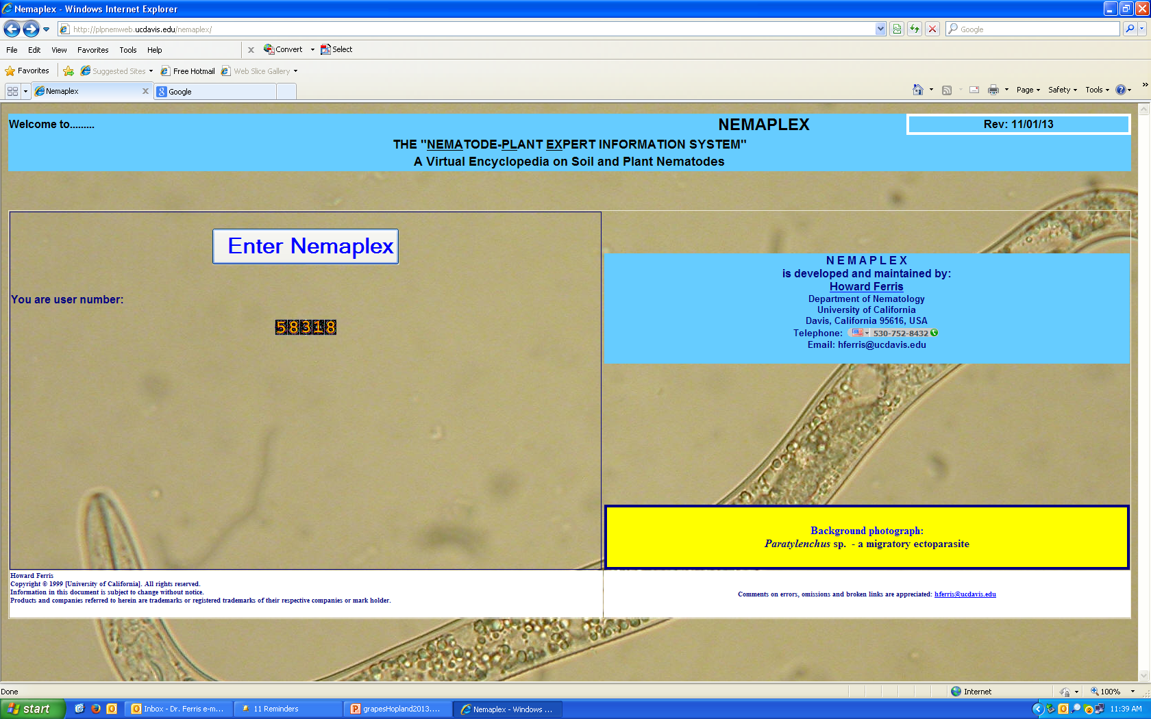
búsqueda de la información…….
Nemaplex: http://plpnemweb.ucdavis.edu/nemaplex

Slide 26
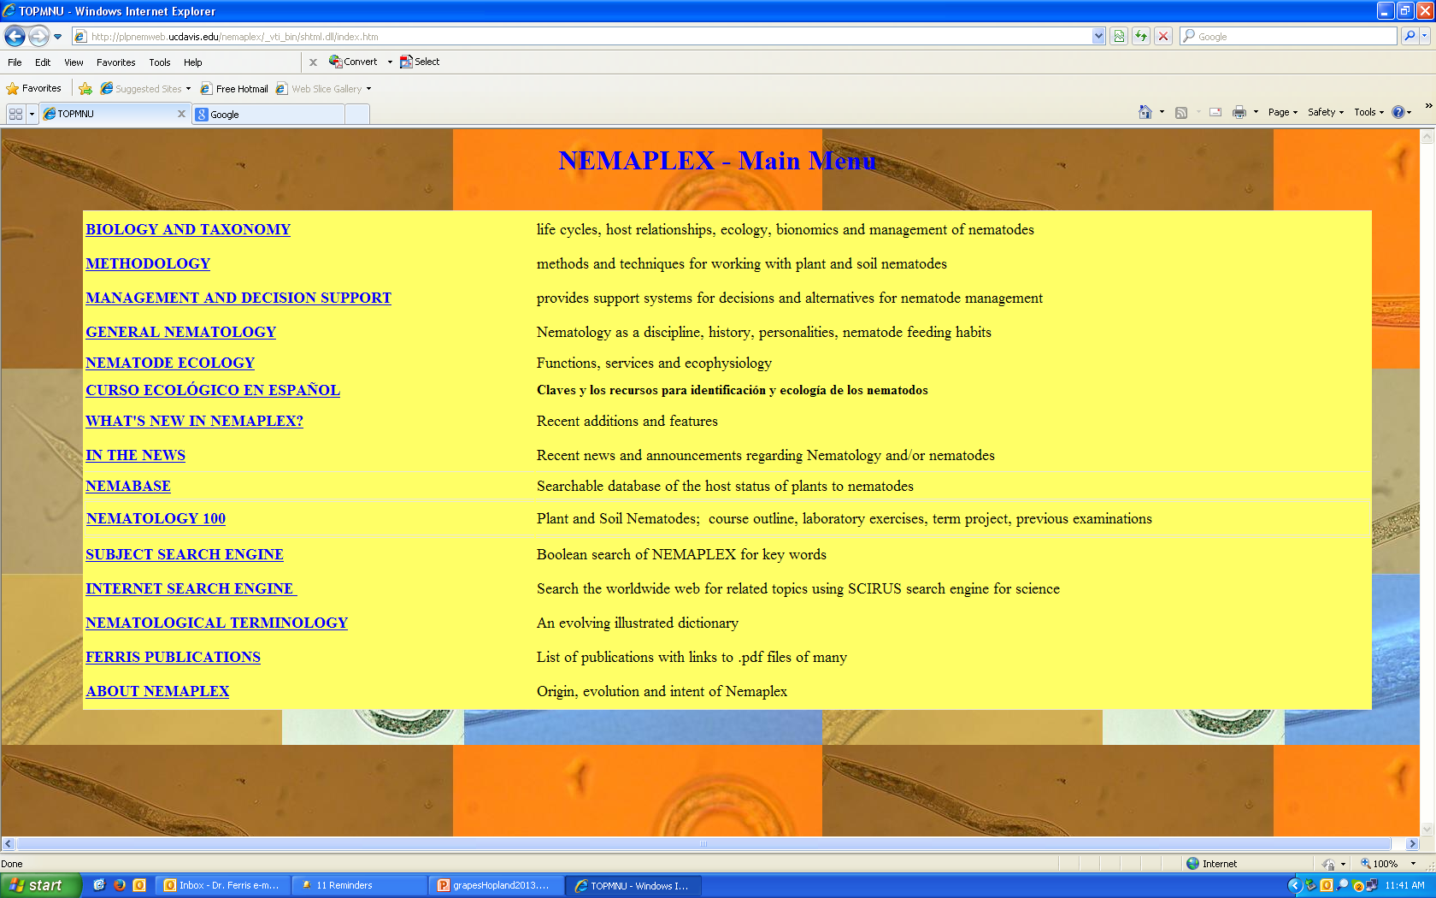
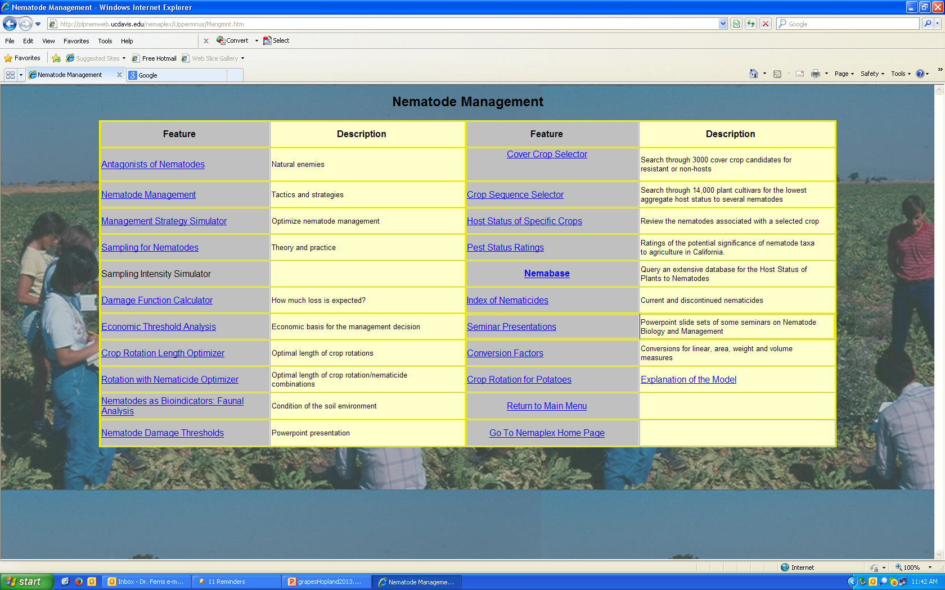
>53,700 entries

Slide 27
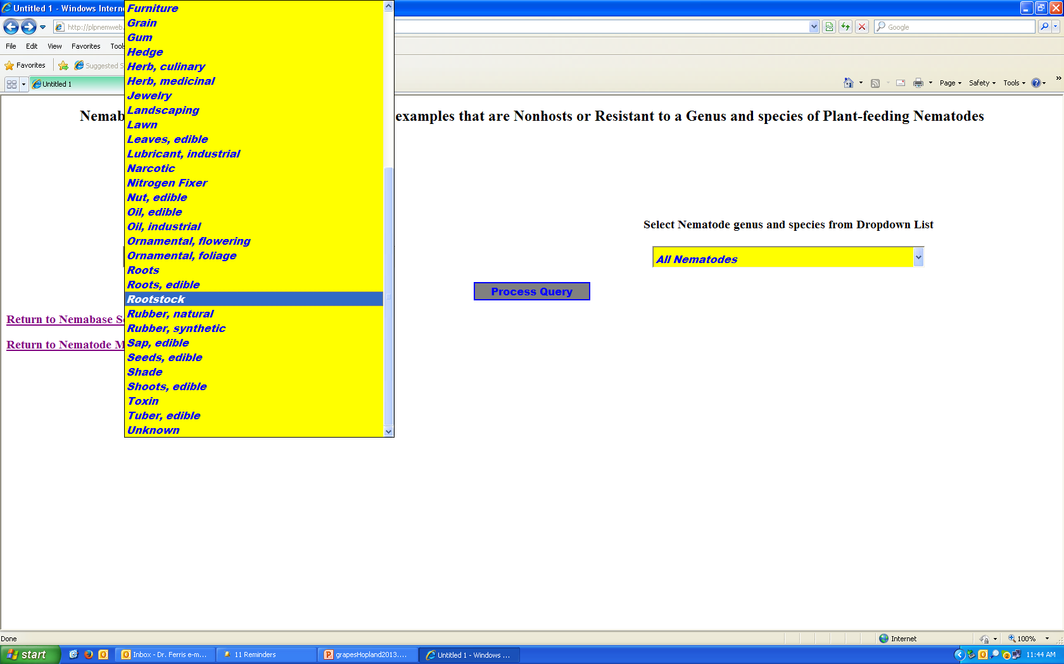
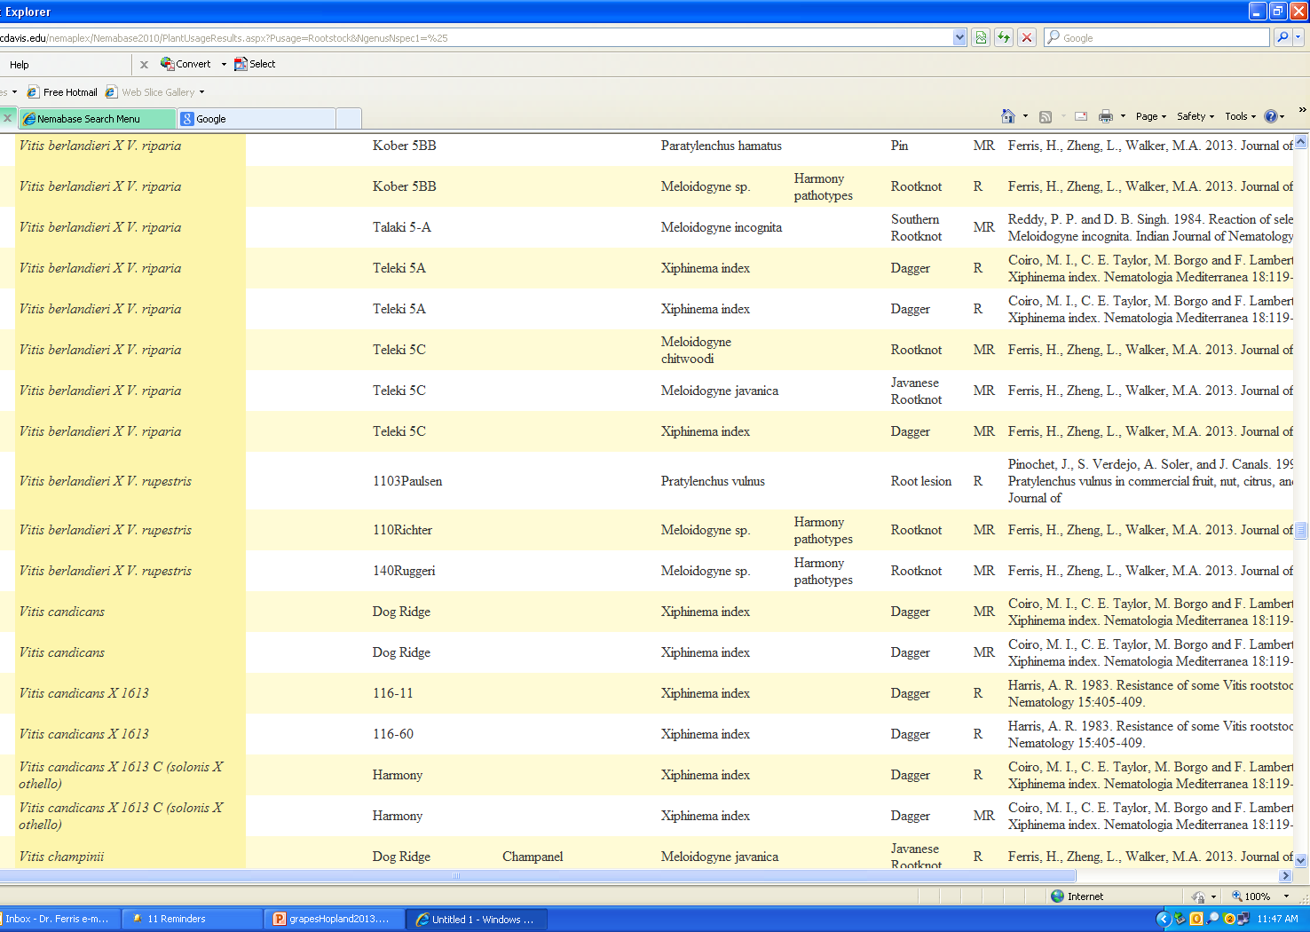
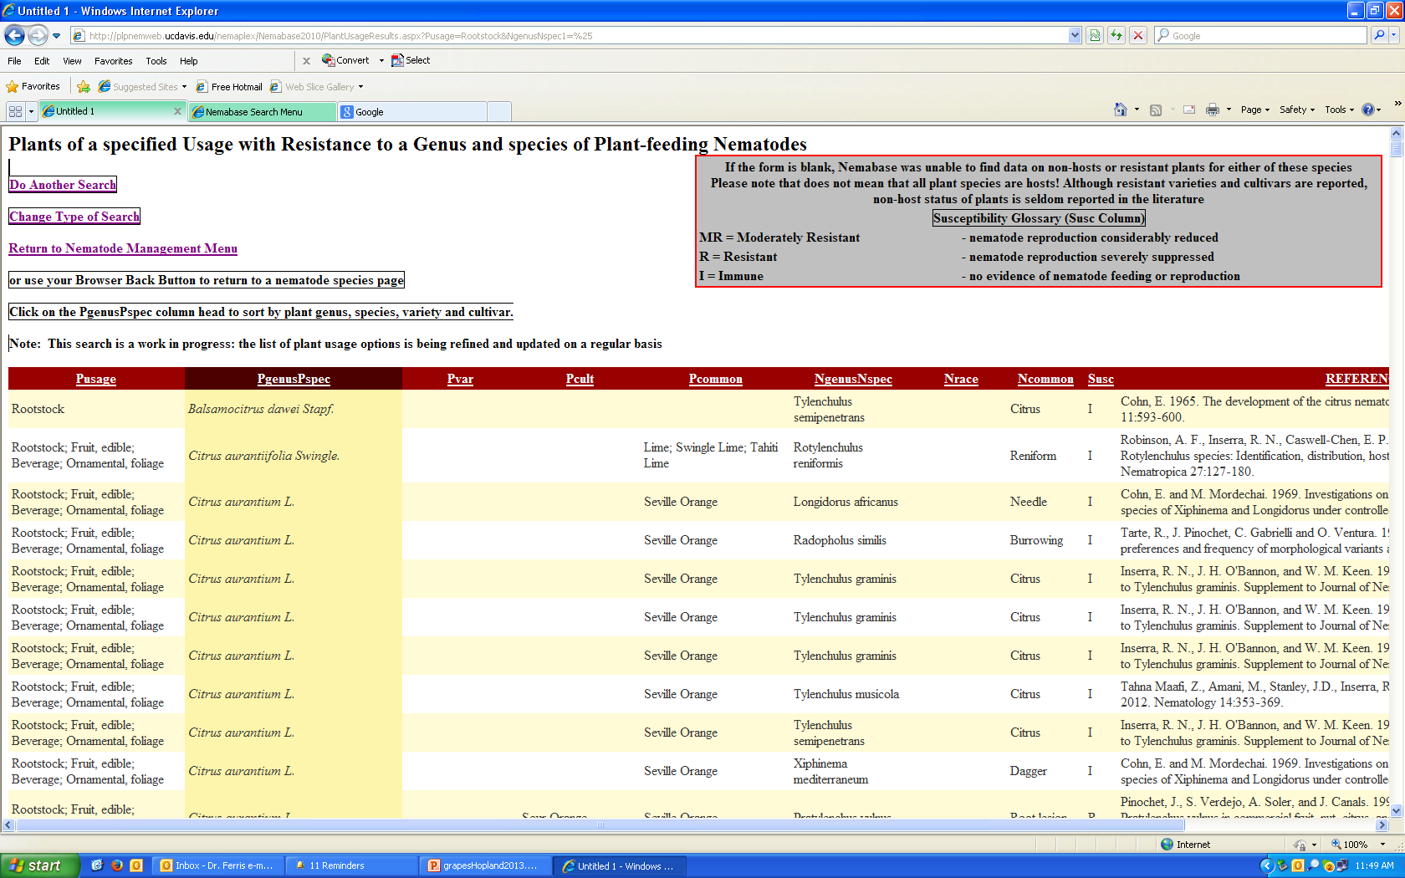

Slide 28
References
Fu, Z., Agudelo, P., Wells, C.E. 2012. Differential expression of a β-1,4-endoglucanase induced by diet change in the foliar nematode Aphelenchoides fragaria. Phytopathology 102:804-811.
Hamamouch, N., Li, C., Hewezi, T., Baum, T.J., Mitchum, M.G., Hussey, R.S., Vodkin, L.O., Davis, E.L. 2012. The interaction of the novel 30C02 cyst nematode effector protein with a plant b-1,3-endoglucanase may suppress host defence to promote parasitism. Journal of Experimental Botany.
Smant, G., Jones, J. 2011. Suppression of plant defences by nematodes. Chapter 13, pp 273-286. In Jones, J., Gheysen, G., Fenoll, C. (eds). Genomics and Molecular Genetics of Plant-Nematode Interactions. Springer, NY.
Jones, J.D.G, Dangl, J.L. 2006. The plant immune system. Nature 444:323-329.
Jones, J.T., Gheysen, G. and Fenoll, C. (eds) 2011. Genomics and molecular genetics of plant-nematode interactions. Springer Academic Publishers.
Jones, J. 2012. Lectures in the EUMAINE program, University of Ghent.
Xue, B., Hamamouch, N., Li, C., Huang, G., Hussey, R.S., Baum, T.J., Davis, E.L. 2013. The 8D05 parasitism gene of Meloidogyne incognita is required for successful infection of host roots. Phytopathology 103:175-181.

Slide 29
References
Fu, Z., Agudelo, P., Wells, C.E. 2012. Differential expression of a β-1,4-endoglucanase induced by diet change in the foliar nematode Aphelenchoides fragaria. Phytopathology 102:804-811.
Hamamouch, N., Li, C., Hewezi, T., Baum, T.J., Mitchum, M.G., Hussey, R.S., Vodkin, L.O., Davis, E.L. 2012. The interaction of the novel 30C02 cyst nematode effector protein with a plant b-1,3-endoglucanase may suppress host defence to promote parasitism. Journal of Experimental Botany.
Smant, G., Jones, J. 2011. Suppression of plant defences by nematodes. Chapter 13, pp 273-286. In Jones, J., Gheysen, G., Fenoll, C. (eds). Genomics and Molecular Genetics of Plant-Nematode Interactions. Springer, NY.
Jones, J.D.G, Dangl, J.L. 2006. The plant immune system. Nature 444:323-329.
Jones, J.T., Gheysen, G. and Fenoll, C. (eds) 2011. Genomics and molecular genetics of plant-nematode interactions. Springer Academic Publishers.
Jones, J. 2012. Lectures in the EUMAINE program, University of Ghent.
Xue, B., Hamamouch, N., Li, C., Huang, G., Hussey, R.S., Baum, T.J., Davis, E.L. 2013. The 8D05 parasitism gene of Meloidogyne incognita is required for successful infection of host roots. Phytopathology 103:175-181.

Slide 30
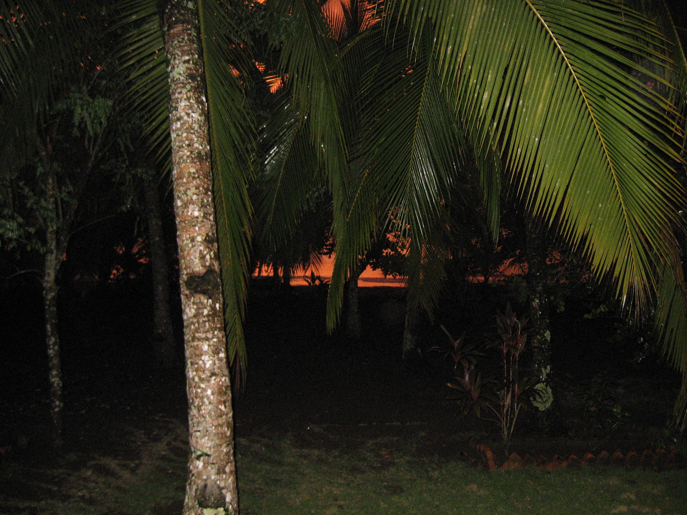
Gracias!
http://plpnemweb.ucdavis.edu/nemaplex

