Slide 1
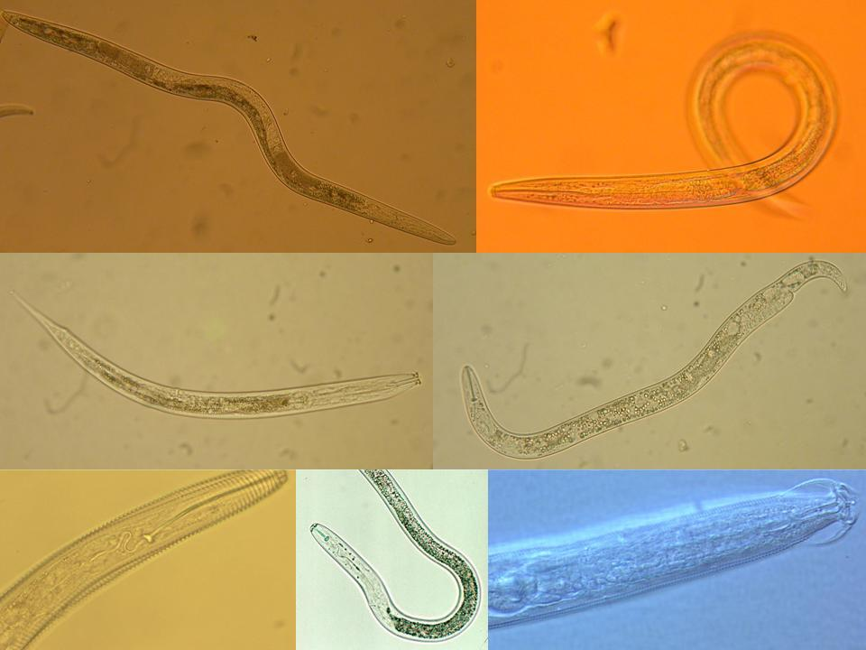
Current and Future Directions
in
Nematode Faunal Analysis
Four inter-related topics:
Regulation and Connectance
Assessment of Services
Stewardship
Technology
Howard Ferris
Department of Nematology
University of California, Davis
July, 2011
Notes:
30 min talk
Interactions:
Nematodes affect other organisms, other organisms affect nematodes
Nematodes feed on plants – plants provide food for nematodes.
Nematodes feed on bacteria, nematodes farm bacteria – in soil, insects,
bacteria feed nematodes, bacteria kill nematodes
Nematodes feed on fungi and are fed upon by fungi.
Nematodes feed on protozoa and microarthropods, tardigrades, mites,
collembola and are fed upon
What are the ecosystem effects (effects on functions)?
Enrichment
Movement of and to resources
Nutrient and carbon cycling
Nutrient and carbon movement and sequestration
Effects on services?
Antagonists of nematodes occur in many groups of organisms that are components of the soil food web.
The interactions of many soil organisms results in biological buffering or regulation of the nematode population through the mechanisms of Exploitation, Competition, and Antibiosis
1

Slide 2
Soil Food Web Functions - metabolic and behavioral activities
of organisms that impact the biotic or abiotic components of the ecosystem
Functions may be classified, subjectively, as Services, Disservices
(or Neutral)
Disservices:
Damage plants of agricultural or ornamental significance
Injure humans and vertebrate animals
Services:
Sequester and redistribute minerals
Mineralize organic molecules
Accelerate turnover
Regulate and suppress pests
Alter substrate to provide access to other organisms
Redistribute organisms in space
Biodegrade toxins
Reduce soil erosion
Increase agricultural production
Notes:
Interactions:
Nematodes affect other organisms, other organisms affect nematodes
Nematodes feed on plants – plants provide food for nematodes.
Nematodes feed on bacteria, nematodes farm bacteria – in soil, insects,
bacteria feed nematodes, bacteria kill nematodes
Nematodes feed on fungi and are fed upon by fungi.
Nematodes feed on protozoa and microarthropods, tardigrades, mites,
collembola and are fed upon
What are the ecosystem effects (effects on functions)?
Enrichment
Movement of and to resources
Nutrient and carbon cycling
Nutrient and carbon movement and sequestration
Effects on services?
Antagonists of nematodes occur in many groups of organisms that are components of the soil food web.
The interactions of many soil organisms results in biological buffering or regulation of the nematode population through the mechanisms of Exploitation, Competition, and Antibiosis
2

Slide 3
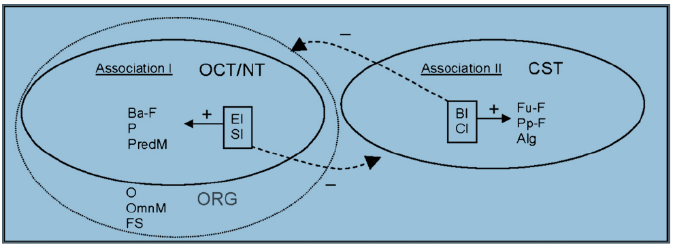
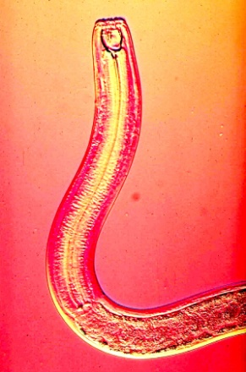
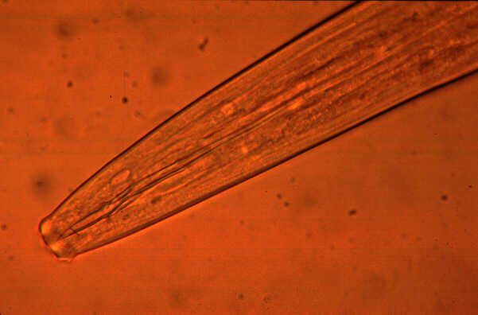
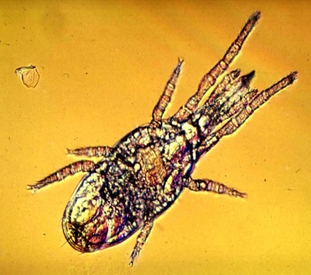
Soil Food Web Structure in Conventional and Organic Systems:
Nematodes as indicators of predaceous, omnivorous and fungivorous mites
Organic
Reduced
tillage
Standard
tillage
Nem Bacterivores
Nem Predators
Mite Predators
Nem Fungiv
Nem Herbiv
Mite Algiv
Nem Omniv
Mite Omniv
Mite Saprob
Conventional
Standard
tillage
Sánchez-Moreno et al., 2009

Slide 4
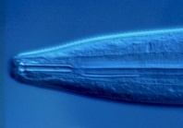
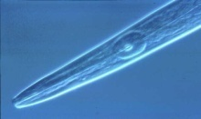
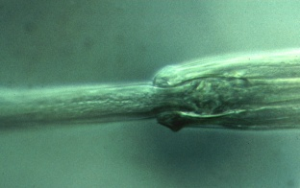
Agricultural Management Effects
Nematode Sensitivity to Mineral Fertilizer
Ammonium sulfate
200
Nematode guild
150
c-p 1
Standardized Counts
c-p 2
100
X
c-p 3
50
c-p 4
X
c-p 5
X
X
0
X
X
0
0.02
0.05
0.1
0.5
1
Concentration (mM-N)
Tenuta and Ferris, 2004

Slide 5
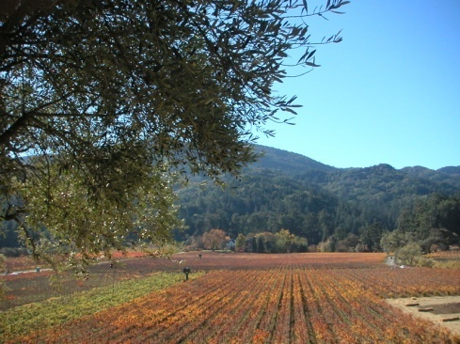
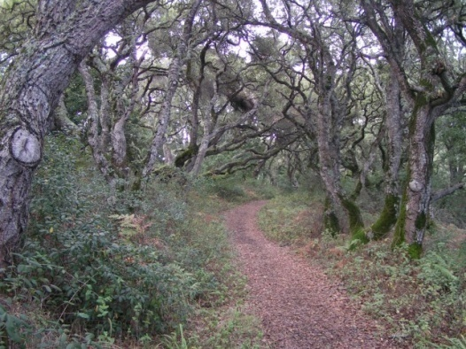
An Ecosystem Function: Regulation of Opportunistic Species
Density-dependent predation
Predator: Prey Ratio
Sánchez-Moreno and Ferris, 2007
Notes:
5
We expected to have greater suppressiveness in samples with higher abundances of P and O. But predation depended not on the abundance of the high trophic levels but on the ratio of predator/prey, following a density-dependent function. Suppressiveness is optimized when predator/prey ratio is high; so few preys are available for each predator. When the biomass of prey is very high, suppressiveness in reduced. In agricultural fields, where fertilizers and organic matter are incorporated to the soil, the consequent increase of microbial populations are used by microbial-feeders to increase their population size, and this relationship is altered. When many other prey are available, the predation pressure on the target nematode reduces.

Slide 6
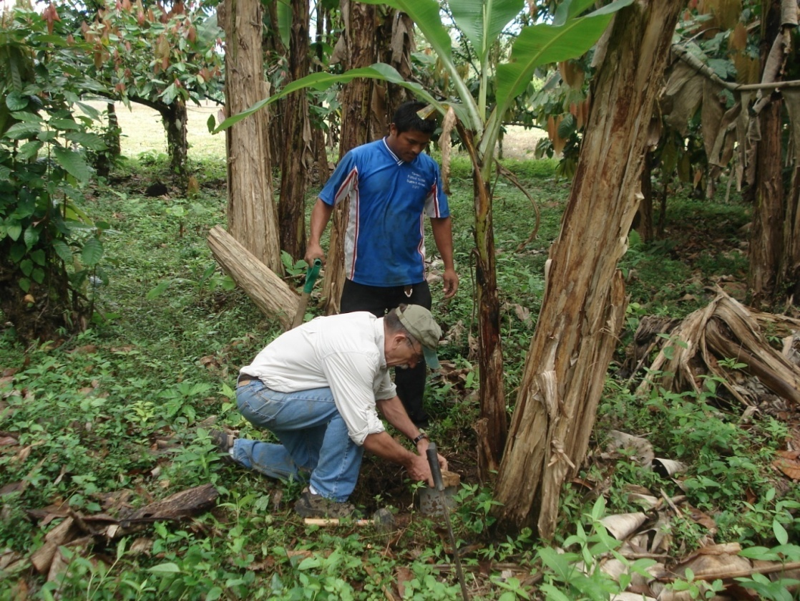
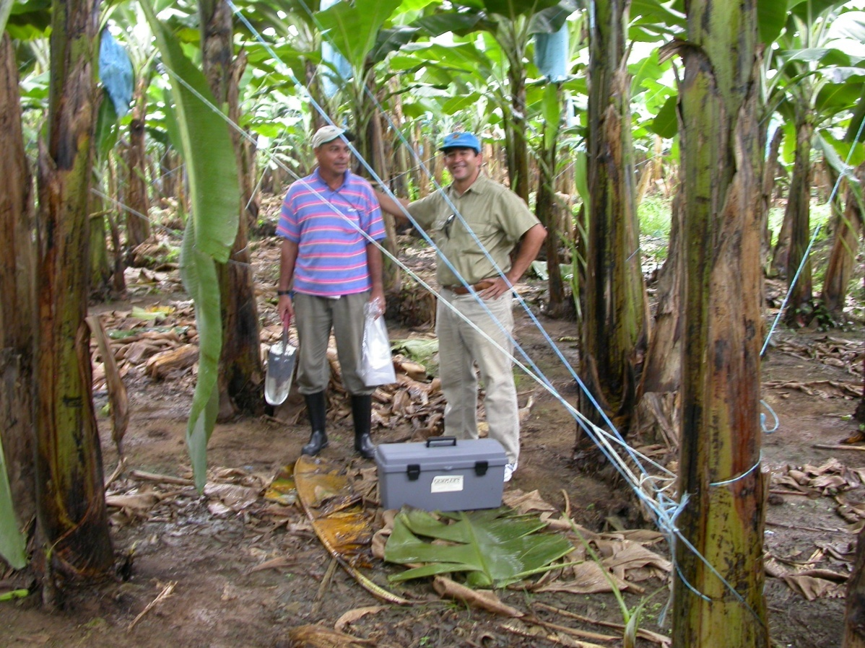
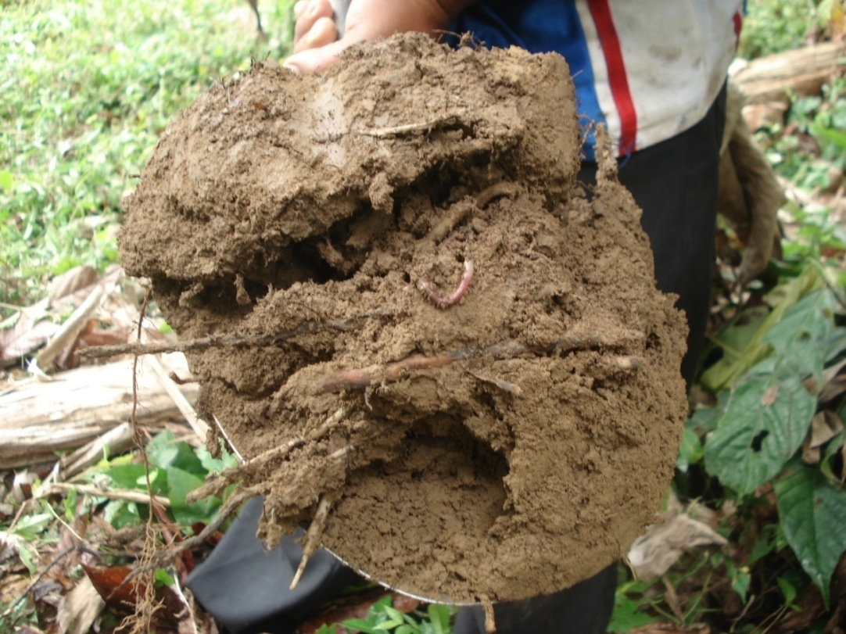
Food Web Complexity and the
Regulation Function
Management practices in industrialized agriculture result in:
Soil food web simplification
Reduction in higher trophic levels
We tested nematode predator:prey hypotheses with data from banana plantations in four Central American countries……….
Costa Rica, 2008

Slide 7
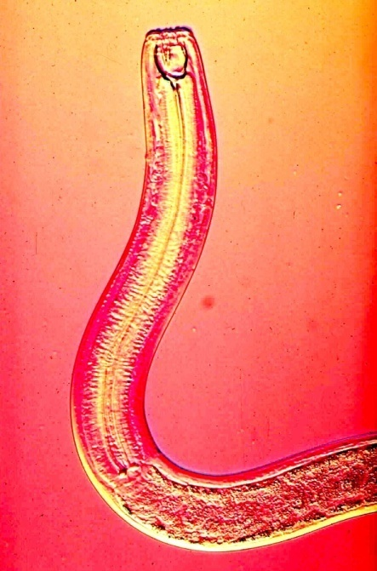
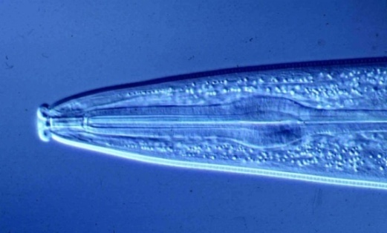
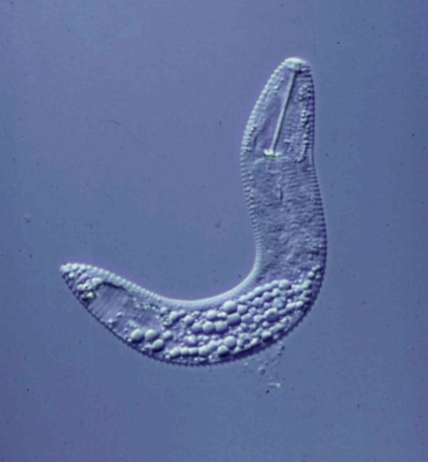
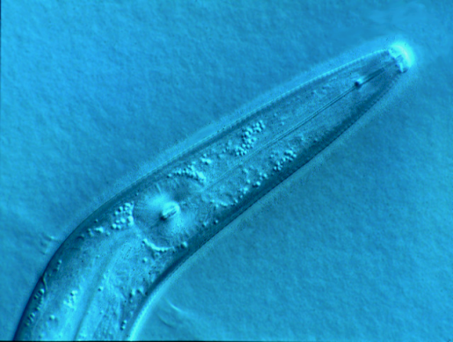
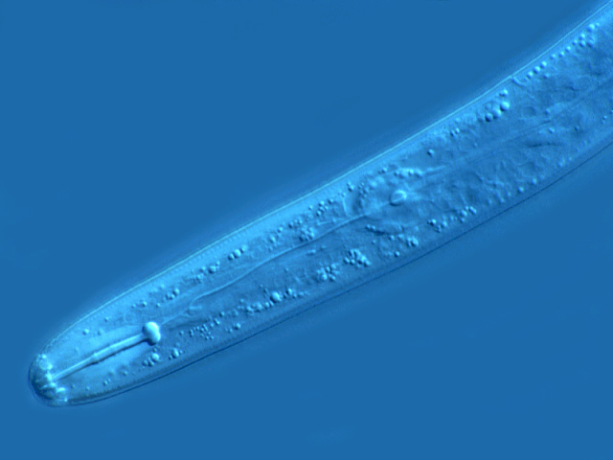
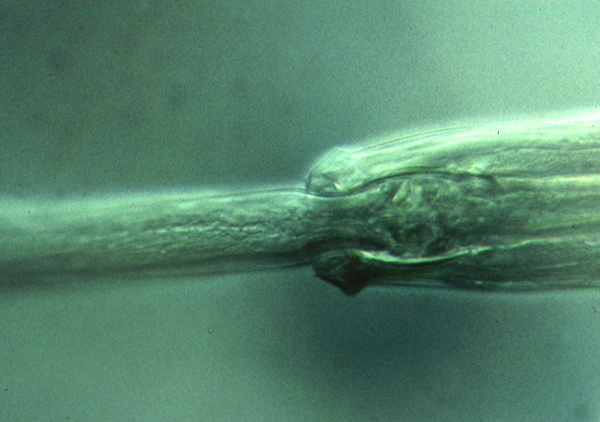
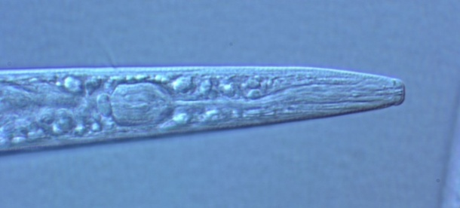
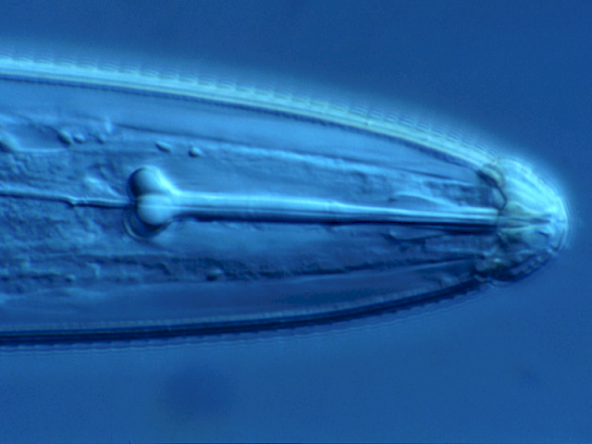
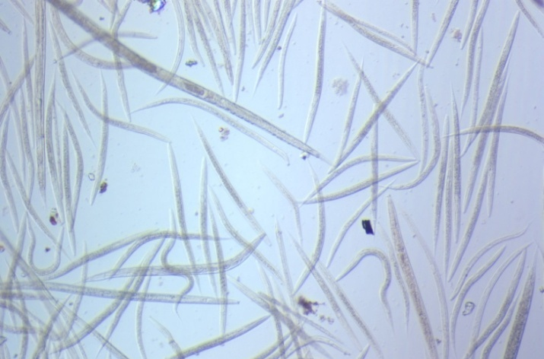
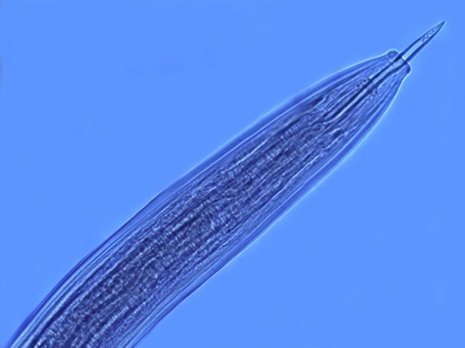
Predators and prey – the Apparent Competition Hypothesis
Generalist and
Specialist Predators
Amplifiable Prey
Target Prey
Fungal-, bacterial-feeding
Nematodes
Plant-feeding Nematodes

Slide 8
Trophic cascades: amplifiable and target prey The Apparent Competition Hypothesis
Predator Nematodes
-
+
x
Amplifiable Prey
Target Prey
+
Microbial Biomass
Goal: x.Pred > y.TgtPrey
+
y
Organic Matter
+
+
+
Plant Roots
Litter
+
External Sources

Slide 9
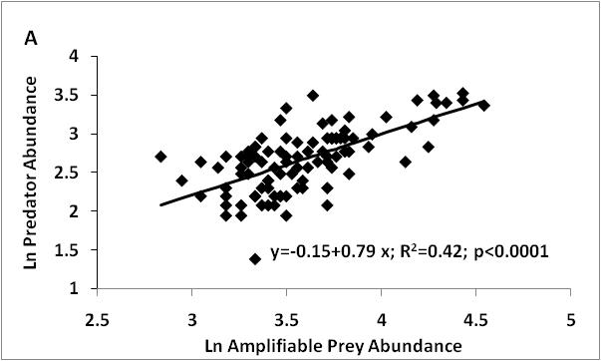
Banana Plantations - Panama
Subtle Apparent Competition
………but

Slide 10
Trophic cascades: amplifiable and target prey – the expanded model
A=favorable conditions for predators
Functional complementarity
B=co-location of predators and prey
+
Other Prey
E4
A
Predator Nematodes
+
Other Predators
-
+
+
B
B
-
A
E1
Amplifiable Prey
+
Target Prey
+
+
-
+
B
Protozoa
+
B
-
E2
Microbial Biomass
Root Associate
Nematodes
-
E5
E6
Nematophagous Fungi
+
+
Rhizosphere Bacteria
+
+
Organic Matter
+
+
+
+
E3
+
Plant Roots
Litter
+
External Sources
Notes:
10
10

Slide 11
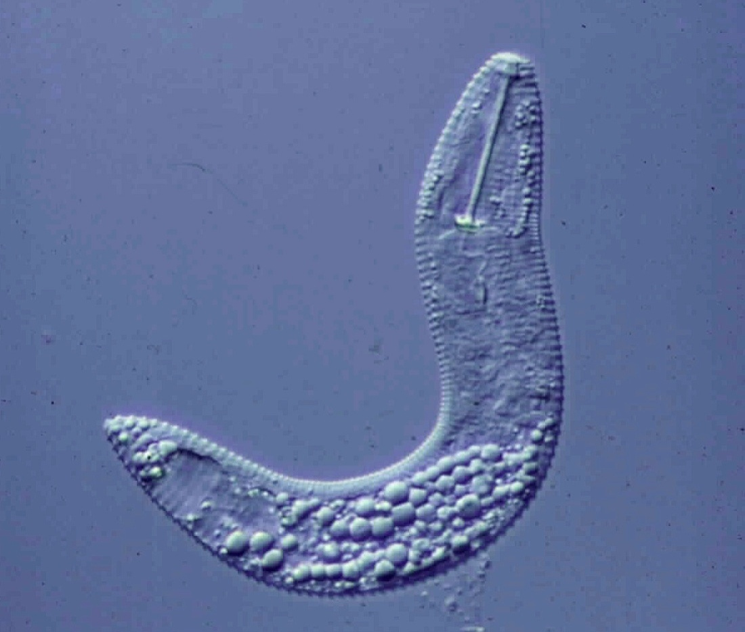
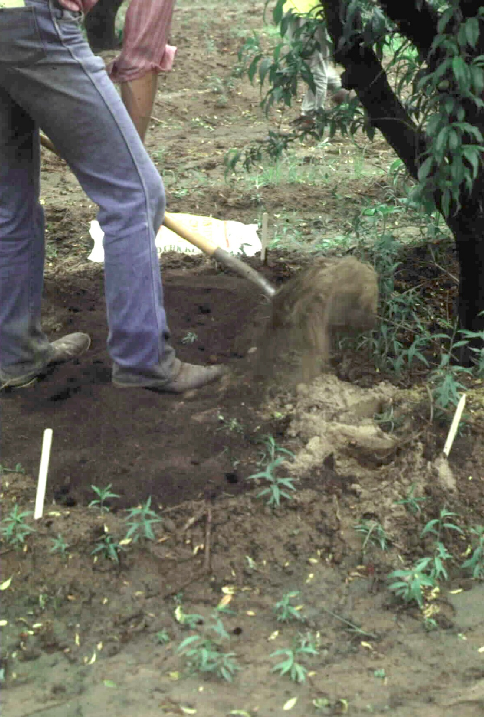
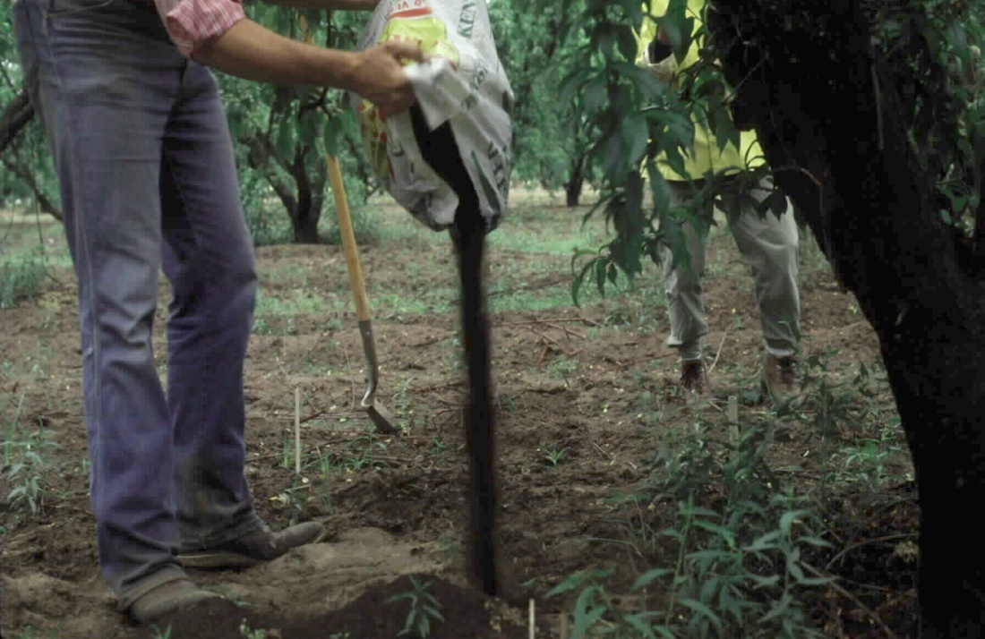
Target Prey:
the ring nematode
Connectance: the proportion of the potential links in a food web
that are (or can be) realized
Enhancing Amplifiable Prey
Jaffee et al., 1994

Slide 12


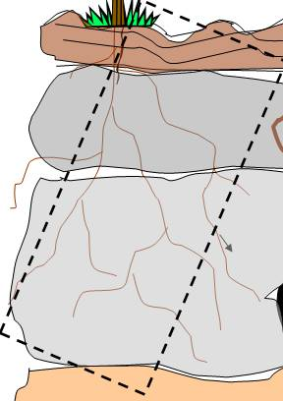
g
m
g
Nematode
assemblages
a=1,2,3,4
b=1,3,4
c=3
d=1,4
e=2
f=1,4
g=5,6,7,8
h=8
i=5
j=5,6
k=7,8
l=5,6,7
m=5,8
h
h
m
k
k
k
h
i
j
(4)
(2)
(2)
(2)
(1)
(1)
(1)
(1)
(1)
(1)
(2)
(1)
(2)
j
lk
i
j
i
e
d
d
a
a
a
a
d
c
c
d
a
a
b
b
c
f
c
f
Taxa detected:
1,2,3,4,5,6,7,8
The issues of co-location
and connectance

Slide 13
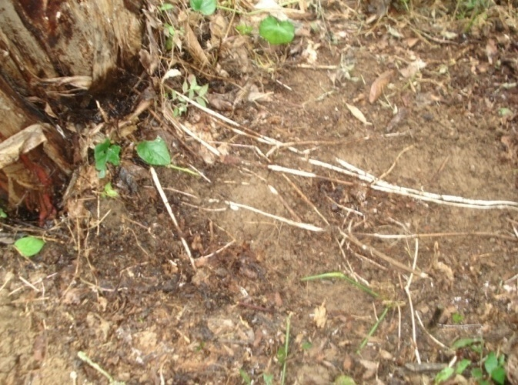
Connectance
Organic banana
production system
Costa Rica
Co-location of Amplifiable and Target Prey

Slide 14
Assessment of Ecosystem Services
There are many useful indices……..
they are based on relative abundance of taxa:
Diversity indices
- Hill, Shannon-Weaver, Simpson, etc.
The Maturity Index family
Colonizer-persister series > MI Bongers, 1990
Functional indices
Enrichment Index, Structure Index, etc.
Ferris et al., 2001
The indices indicate Structure and Potential Function…..
Notes:
Interactions:
Nematodes affect other organisms, other organisms affect nematodes
Nematodes feed on plants – plants provide food for nematodes.
Nematodes feed on bacteria, nematodes farm bacteria – in soil, insects,
bacteria feed nematodes, bacteria kill nematodes
Nematodes feed on fungi and are fed upon by fungi.
Nematodes feed on protozoa and microarthropods, tardigrades, mites,
collembola and are fed upon
What are the ecosystem effects (effects on functions)?
Enrichment
Movement of and to resources
Nutrient and carbon cycling
Nutrient and carbon movement and sequestration
Effects on services?
Antagonists of nematodes occur in many groups of organisms that are components of the soil food web.
The interactions of many soil organisms results in biological buffering or regulation of the nematode population through the mechanisms of Exploitation, Competition, and Antibiosis
14

Slide 15
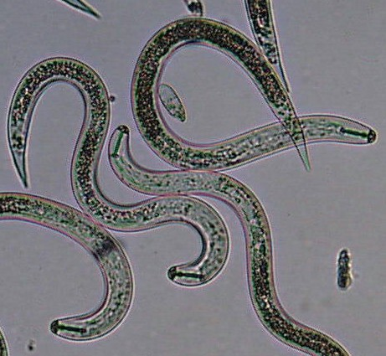
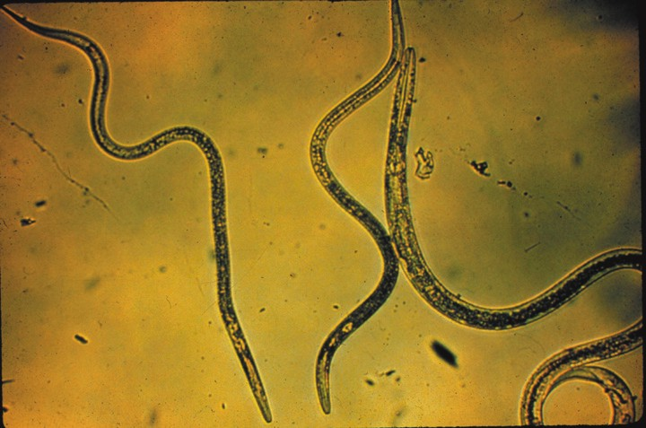
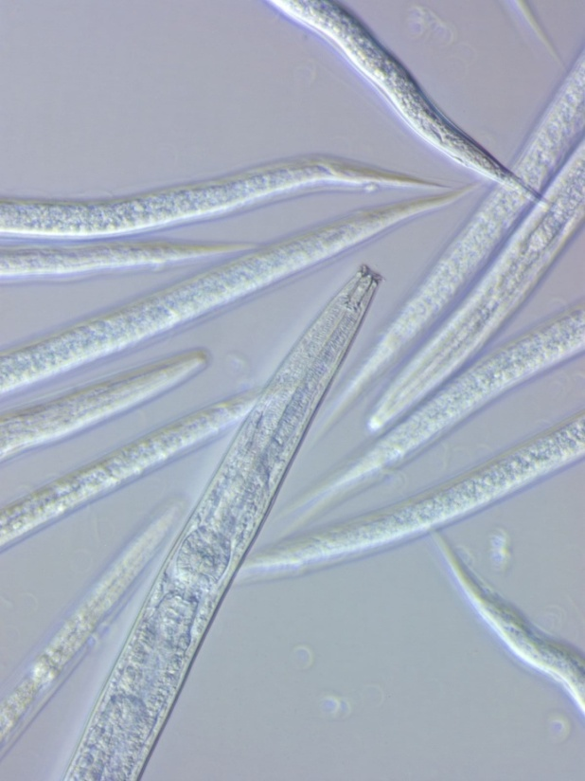
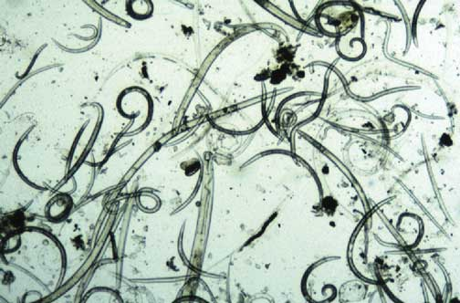
What is the magnitude of the function or service?
How much carbon is being processed?
How much energy is being used?
The indices are useful, but…..…
They do not indicate biomass, metabolic activity or magnitude
of functions/services – so, we develop the Metabolic Footprint

Slide 16
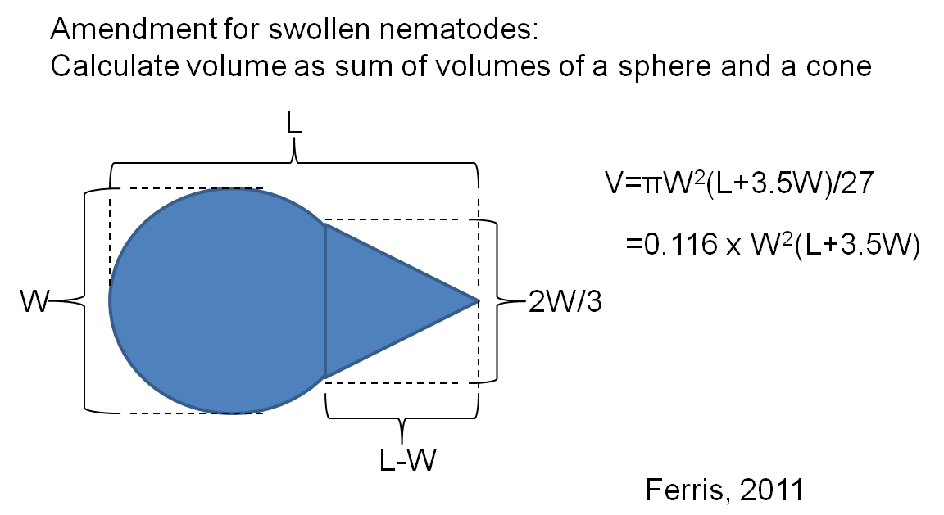
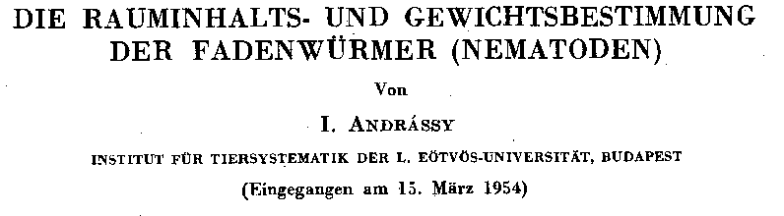

per Andrássy, 1956
a) Calculated the volume of a nematode –
L₁
L₂
L₃
L₄
r₁
r₂
r₃
r₄
v₁=π(L₁/3)(r₁²+r₁r₂+r₂²)
v₂=π(L₂/3)(r₂²+r₂r₃+r₃²)
v₃=π(L₃/3)(r₃²+r₃r₄+r₄²)
v₄=π(L₄/3)(r₄²⁾)
A convenient proxy…
let W=2r₃ and L=L₁+L₂+L₃+L₄ , then V = v₁+v₂+v₃+v₄ = W²L/1.7
b) Determined the density of nematodes (g/mL) as that of liquids
in which they float at a constant level =1.084
Then, Mass = Volume x Density:
Mass = W²L x 1.084/(1.7 x 10⁶) μg
or
Mass = 0.116 x W²(L+3.5W) x 1.084/10⁶ μg

Slide 17
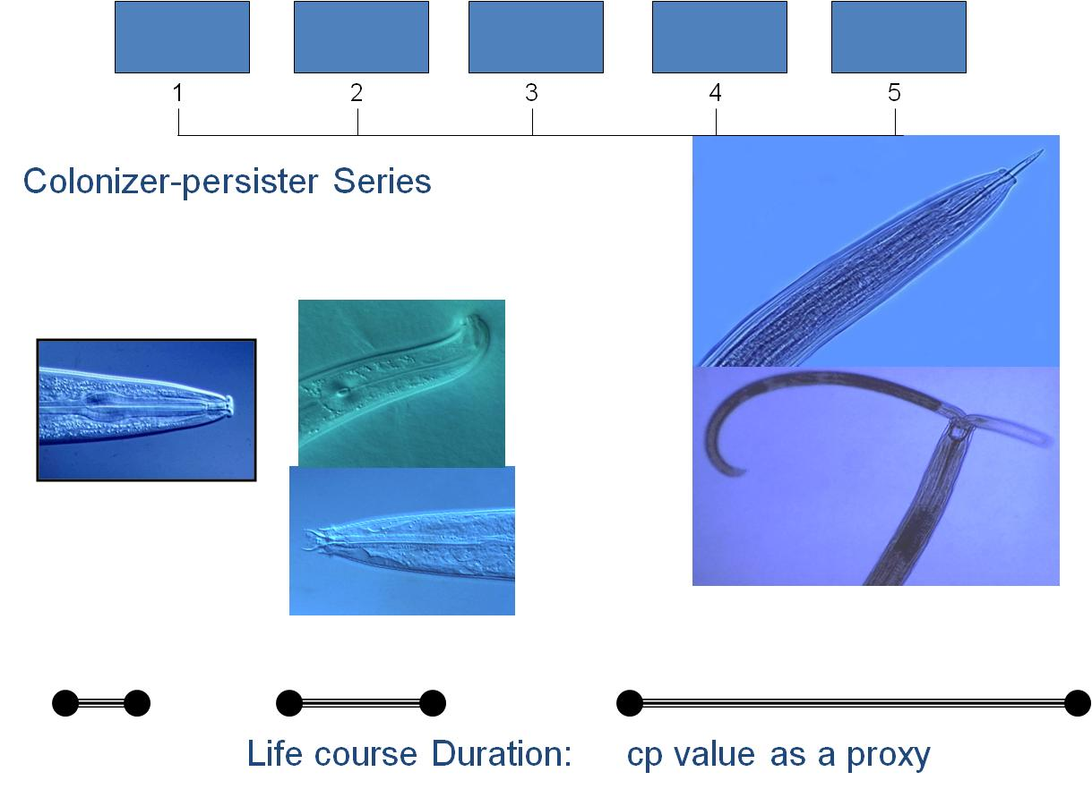
Production
Nematodes differ in rates of growth
Need to adjust production estimates
in relation to life course duration
Another proxy: cp value related to
life course duration – per Bongers, 1990
Taxon Production normalized:
P_{t} = N_{t} M_{t}/(cp_{t})
Metabolic activity - Respiration
Use the power relationship of
basal metabolism and body mass: R = c M^{0.75}
If taxon biomass = N_{t} M_{t}, then:
Metabolic Footprint = Σ (R_{t} + P_{t})
for all taxa present or for taxa representing a specific function or ecosystem service
Taxon Respiration:
R_{t} = N_{t} M_{t}^{0.75}

Slide 18
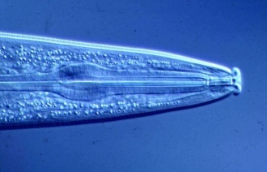

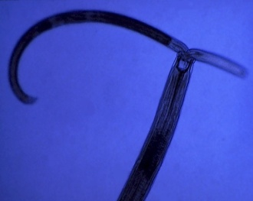
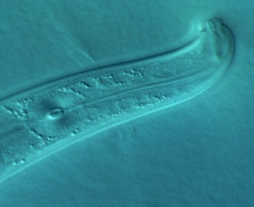
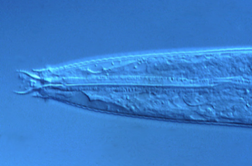
Enrichment Indicators
Structure Indicators
Rhabditidae
Panagrolaimidae
etc.
Short lifecycle
Small/ Mod. body size
High fecundity
Small eggs
Dauer stages
Wide amplitude
Opportunists
Disturbed conditions
Aporcelaimidae
Nygolaimidae
etc.
Long lifecycle
Large body size
Low fecundity
Large eggs
Stress intolerant
Narrow amplitude
Undisturbed conditions
Basal Fauna
Cephalobidae
Aphelenchidae, etc.
Moderate lifecycle
Small body size
Stress tolerant
Feeding adaptations
Present in all soils
Integrate Metabolic
Footprint and
Faunal Analysis
Indices

Slide 19
Nematode Faunal Profiles
and the Metabolic Footprint
Enriched
bacterivores
fungivores
Enrichment index
100 (w1.cp1 + w2.Fu2)
/ (w1.cp1 + w2.cp2 )
Ba₁
Enrichment trajectory
Structured
Fu₂
fungivores
bacterivores
Fu₂
Basal
Ba₂
Om₄
Om₅
Basal
condition
omnivores
Ca₃
Ca₄
Ca₅
carnivores
Fu₃
Fu₄
Fu₅
fungivores
Ba₃
Ba₄
Ba₅
bacterivores
Structure trajectory
Ferris, 2010
Structure Index = 100 w_{i}.cp_{i} / (w_{i}.cp_{i} + w₂.cp₂ ) for i = 3-5
Ferris et al, 2001

Slide 20
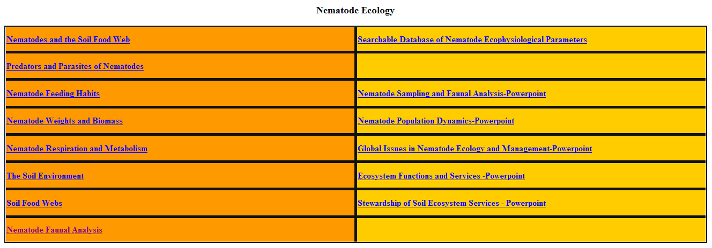
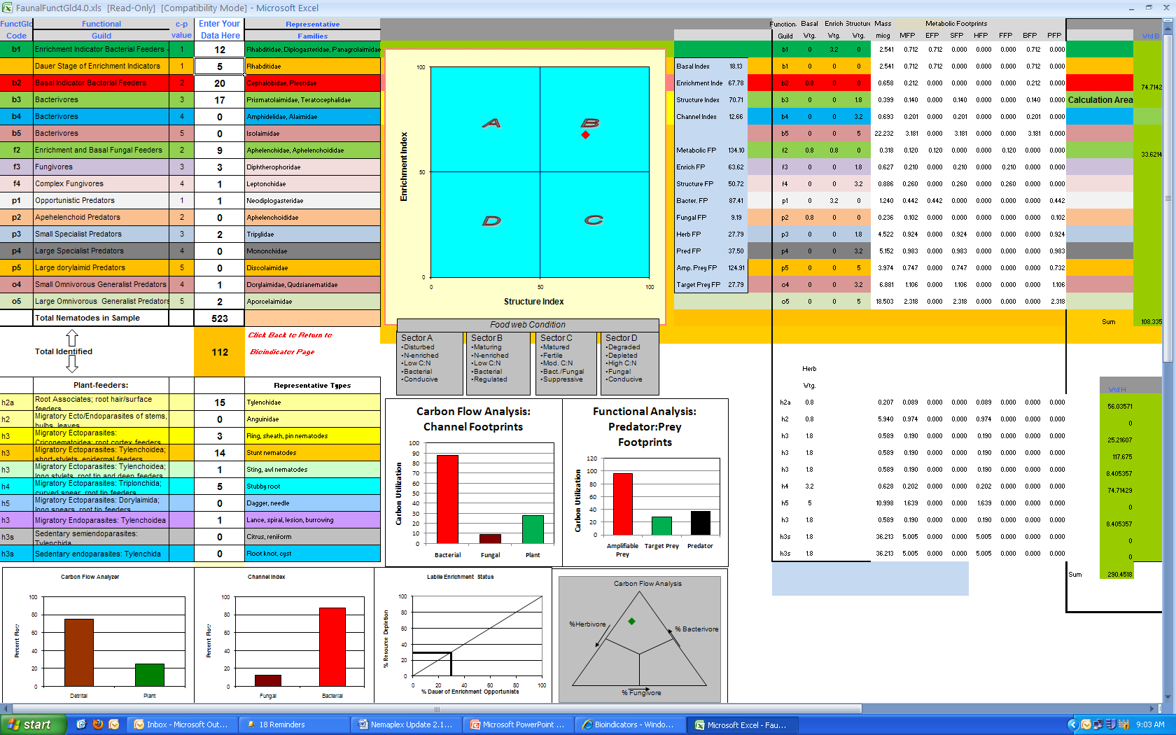
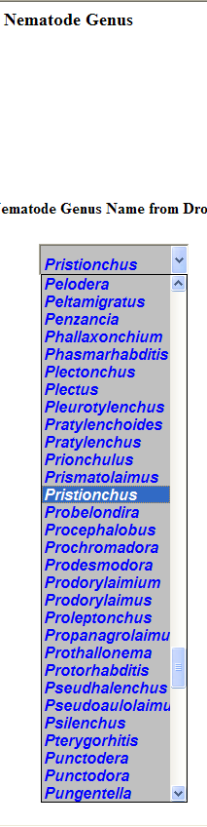
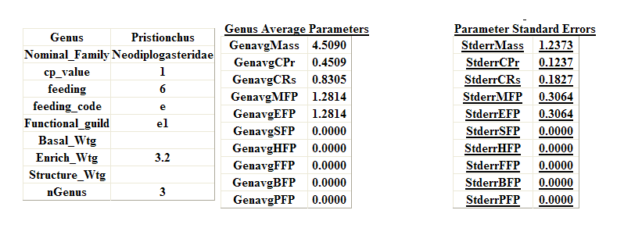
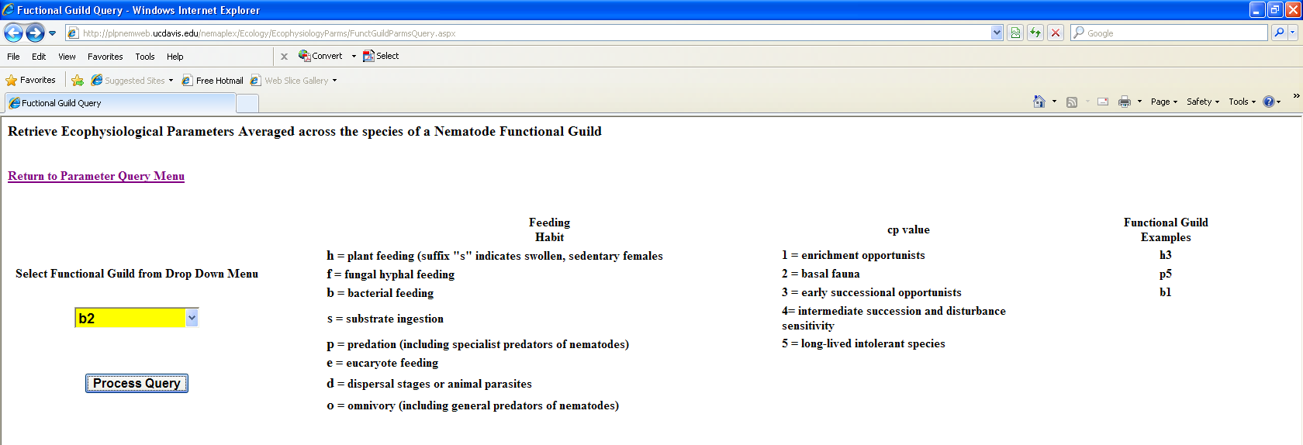
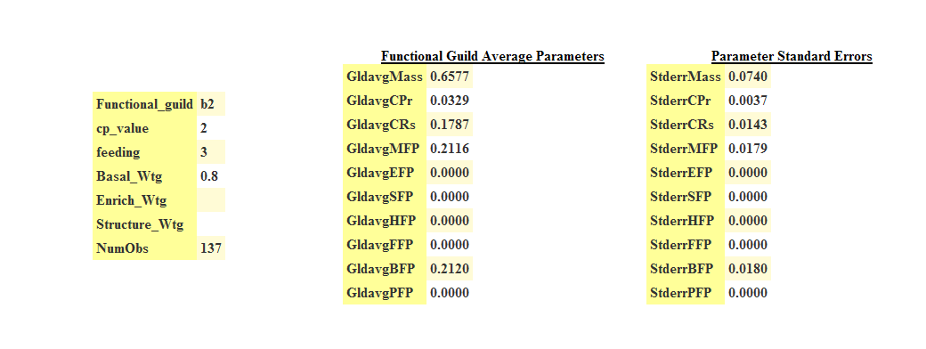
Faunal Analysis
Nematode Ecology
Nematode Faunal Analysis
A Database of Ecophysiological Parameters
in Nemaplex

Slide 21
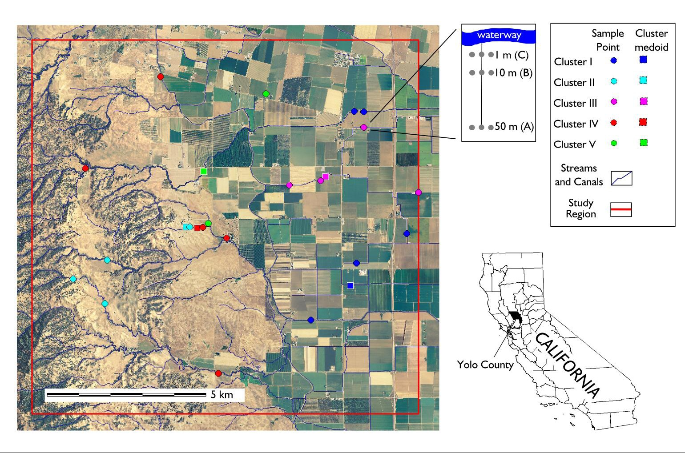
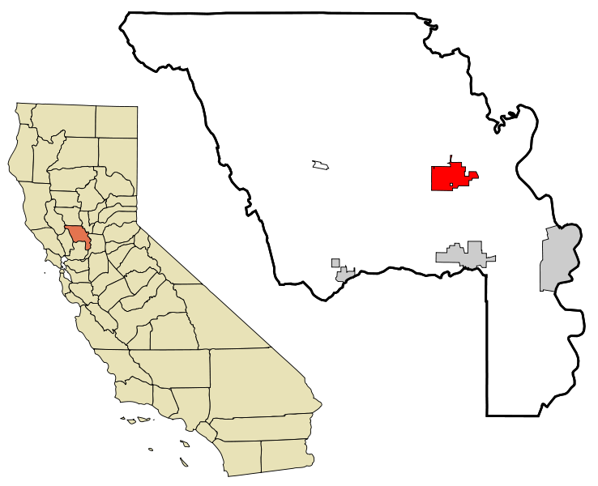
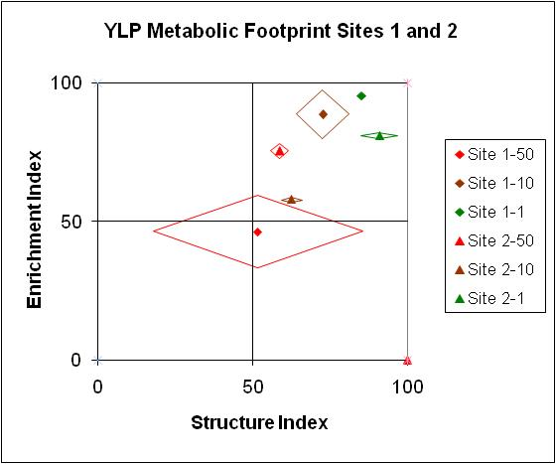
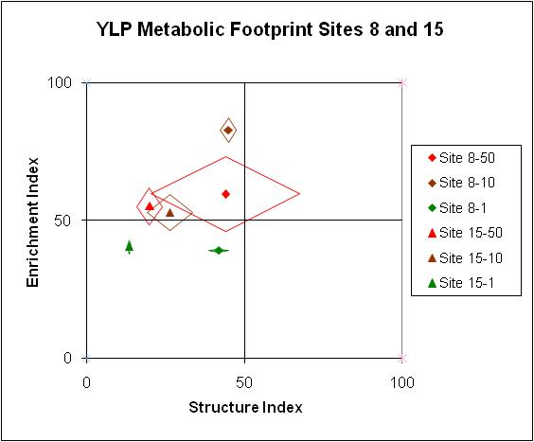
The Yolo Landscape Project
Sites 1 and 2
Sites 8 and 15
Yolo County, California

Slide 22




Nematode Fauna of a Hungarian Steppe Grassland – Péter Nagy, 1998
Four sampling dates
Faunal Analysis: Functional Indices
Faunal Analysis: Functional Indices and Metabolic Footprints
end of summer

Slide 23


Economies of Ecosystems: Carbon and Energy are the Currencies
CO₂
CO₂
CO₂
CO₂
Stewardship
bacteria
protozoa
nematodes
carbohydrates
and
proteins
C
N
nematodes
arthropods
fungi
carbohydrates
and
amino acids
other
organisms
nematodes
fungi
arthropods
nematodes
NO₃
Carbon and energy transfer
Carbon is respired by all organisms in the food web
The amounts of Carbon and Energy available limit the size and activity of the web
NH₃
NH₃
NH₃

Slide 24


Soil Food Web Stewardship
Winter cover crop – bell beans
California, 2006
Soil fertility
Organic matter
Food web activity
Soil structure
Fossil fuel reduction
Habitat conservation
Food web activity
Soil structure
No-till soybeans, Brazil, 2006

Slide 25


Stewardship - My Conclusion:
Keep roots in the soil, avoid resource punctuation and ecosystem disruption
Land-use change in Kansas:
Effects on Nematode Faunal
Structure
Resource Inputs:
Bottom up effects on Soil Food
Web Structure and Function
Consistent N-yield over 75 years without input
N-yield similar to that of high input wheat
Resources to support:
Biomass
Higher trophic levels
Diversity
Complementarity
Continuity
Structure Index
Basal Index
From Glover et al., 2010

Slide 26







sample
Technology?
count
extract
100 Years of Progress?
centrifuge
make slides
identify

Slide 27



Emergent Technologies
Barcoding
DNA fingerprinting
Functional Genomics
Helicotylenchus multicinctus
Pratylenchus penetrans
What is the functional significance of the genomic profile?

Slide 28



Hypothesis Testing and Proofs of Concepts: Getting beyond heroic assumptions!

Slide 29
Emergent Themes in Soil Stewardship and Faunal Analysis:
1. Provide adequate and continuous resource supply to support
desired functions
2. Preserve favorable conditions for component systems
Facilitate connectance of interacting guilds
Assess magnitude of services based on faunal analysis and
metabolic footprints of functional components
Validate and implement new technologies
http://plpnemweb.ucdavis.edu/nemaplex
Notes:
29
20 min talk
Interactions:
Nematodes affect other organisms, other organisms affect nematodes
Nematodes feed on plants – plants provide food for nematodes.
Nematodes feed on bacteria, nematodes farm bacteria – in soil, insects,
bacteria feed nematodes, bacteria kill nematodes
Nematodes feed on fungi and are fed upon by fungi.
Nematodes feed on protozoa and microarthropods, tardigrades, mites,
collembola and are fed upon
What are the ecosystem effects (effects on functions)?
Enrichment
Movement of and to resources
Nutrient and carbon cycling
Nutrient and carbon movement and sequestration
Effects on services?
Antagonists of nematodes occur in many groups of organisms that are components of the soil food web.
The interactions of many soil organisms results in biological buffering or regulation of the nematode population through the mechanisms of Exploitation, Competition, and Antibiosis
29

Slide 30

Thank you!
http://plpnemweb.ucdavis.edu/nemaplex

