Slide 1
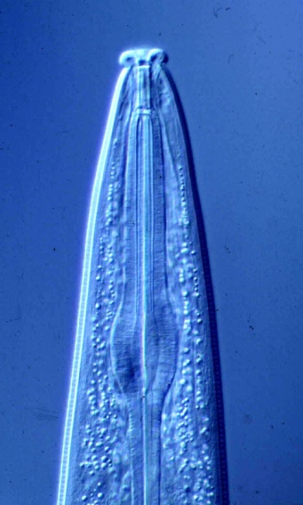
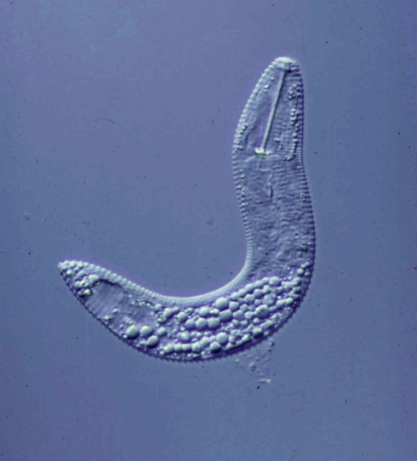
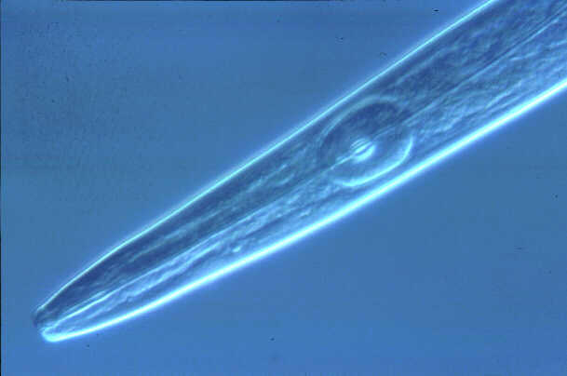
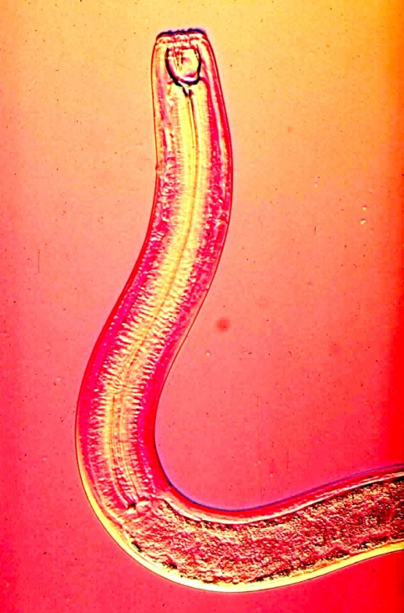
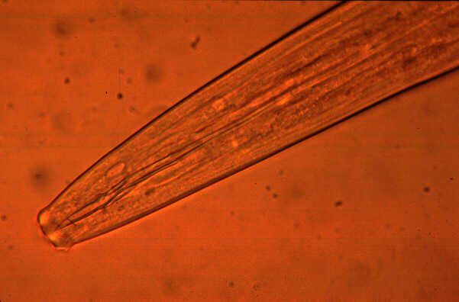
Plant and Soil Nematodes
Howard Ferris
Department of Entomology and Nematology
University of California, Davis
hferris@ucdavis.edu
November, 2015
http://plpnemweb.ucdavis.edu/Nemaplex

Slide 2
Nematodes, the most abundant multi-cellular animals on the planet, are unsegmented roundworms that inhabit soil, freshwater and marine environments.
They are usually microscopic.
Many feed on micro-organisms while some are important parasites of humans, animals or plants.
(Nematology 100 class – 2012)

Slide 3

Soil Nematodes
Abundant and Diverse Metazoa
Nematodes are among the simplest metazoa.
80% of multicellular animals are nematodes.
Nematodes occupy any niche that provides a source of carbon, in marine, freshwater and terrestrial environments.
Millions of nematodes can occupy 1 m² of soil; a handful may contain 50 species.
“.....if all the matter in the universe except the nematodes were swept away……we would find its mountains, hills, vales, rivers, lakes, and oceans represented by a film of nematodes.”
Nematodes vary in sensitivity to pollutants and environmental disturbance.
Nematodes occupy key positions in soil food-webs; they feed on many soil organisms and are food for many others.
Notes:
Nematode faunal analysis provides a useful tool in assessing this structure, function, and probably the resilience of the soil food web because:
The most abundant of the metazoa
Occupy key positions in soil food webs
Standard extraction procedures
Identification based on morphology
Clear relationship between structure and function
Each sample has high intrinsic information value :

Slide 4
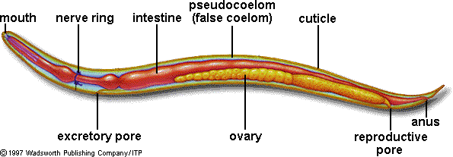
Basic Structure
esophagus
vulva

Slide 5
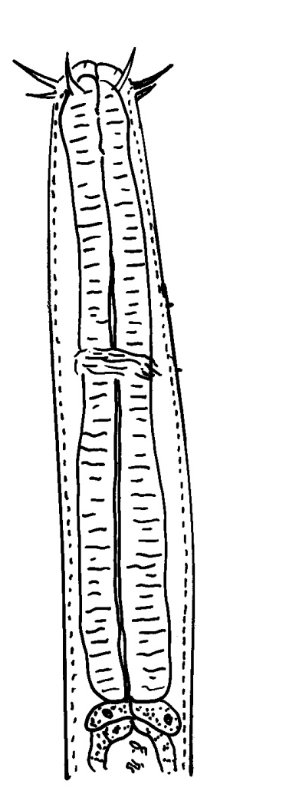
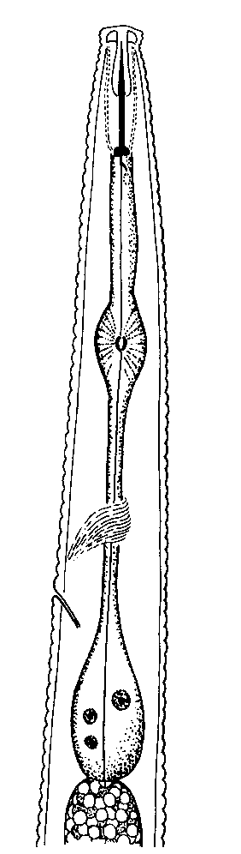
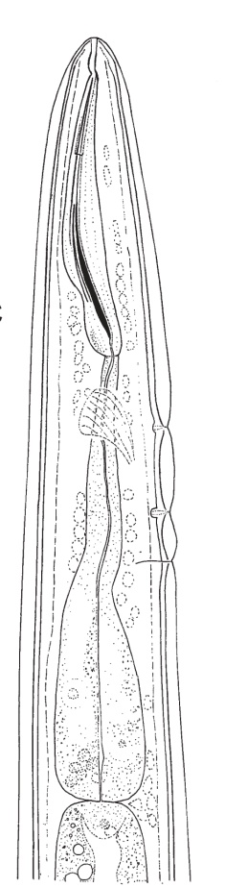
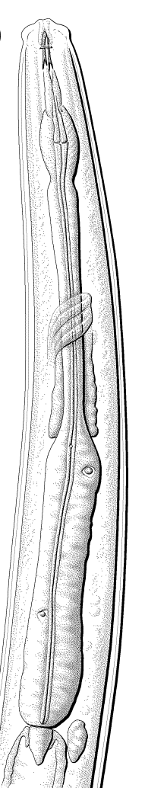
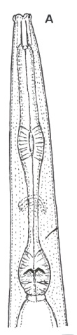
Esophageal Configuration
setae
odontostyle
stylet
teeth
stoma
procorpus
procorpus
median
bulb
isthmus
postcorpus
cardia
intestine
Enoplea
Chromadorea

Slide 6
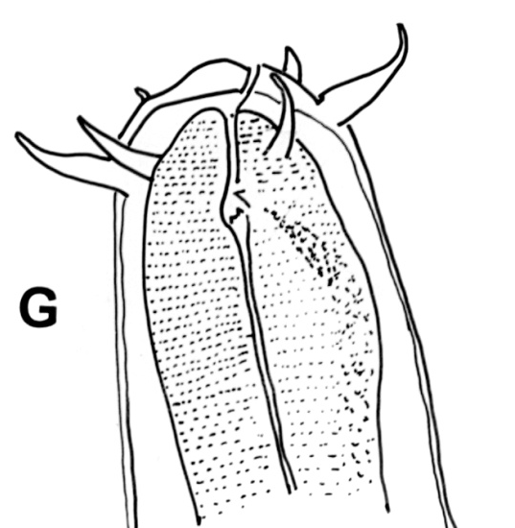
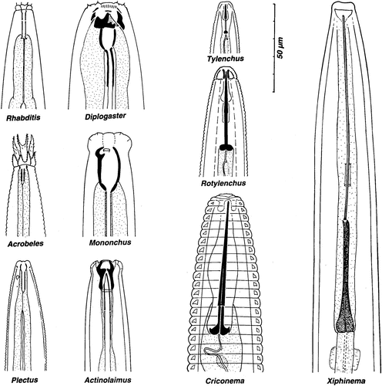
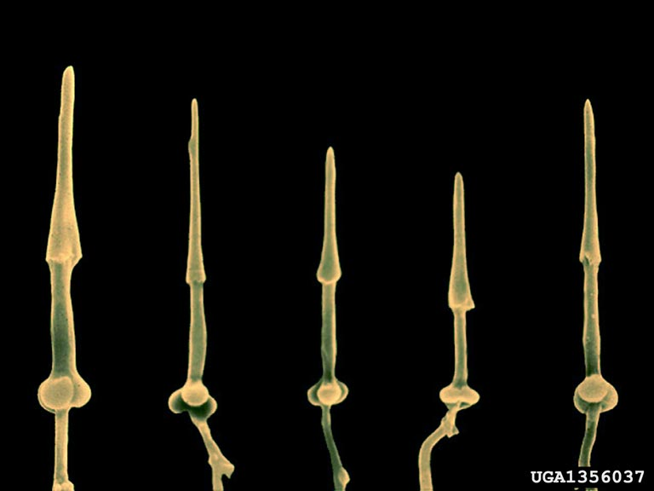
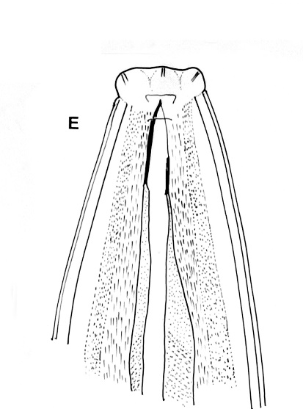
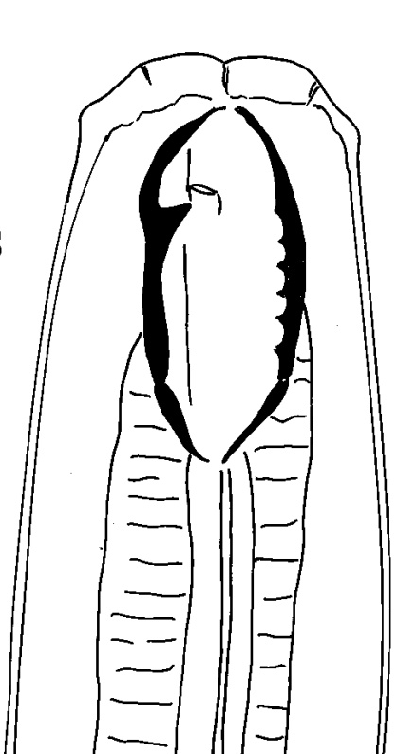
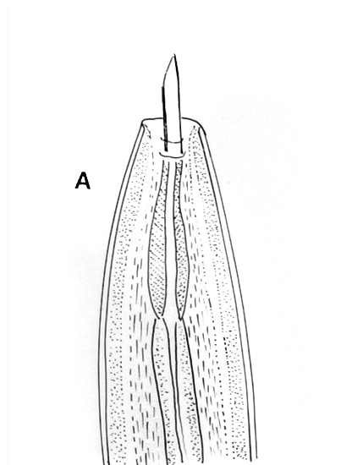
Teeth – immovable and moveable
stylet
cone
shaft
knobs
Chromadorea
Enoplea

Slide 7
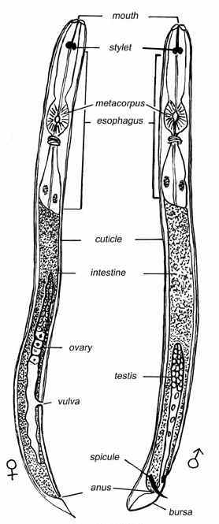
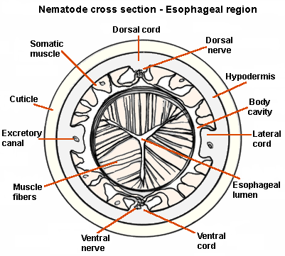
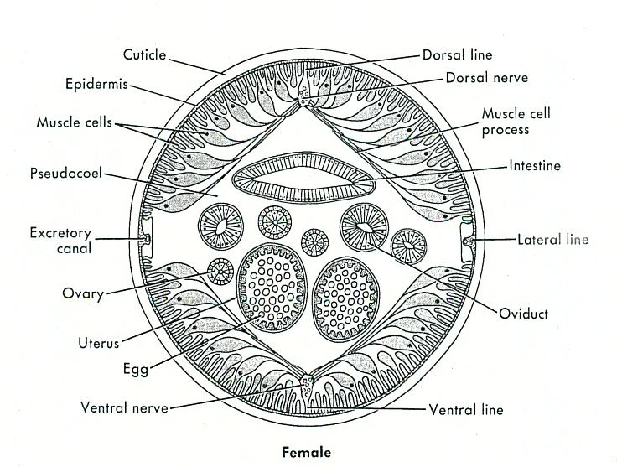
Plant-parasitic Nematodes: General Structure

Slide 8
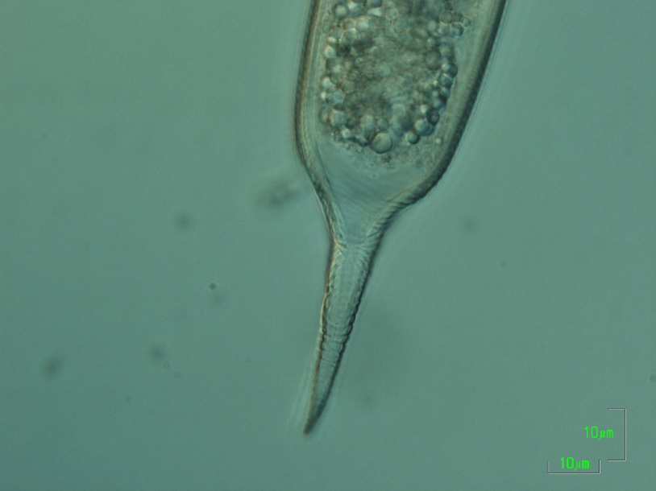
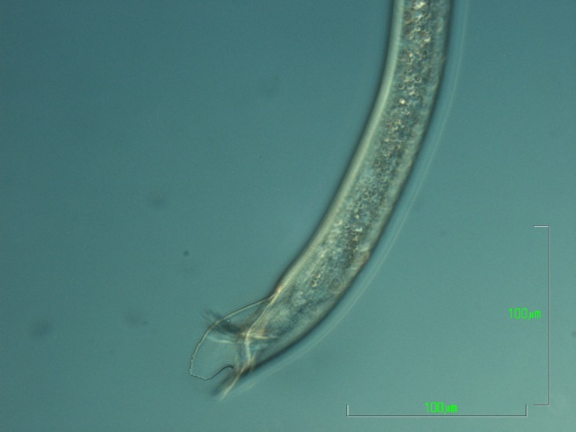
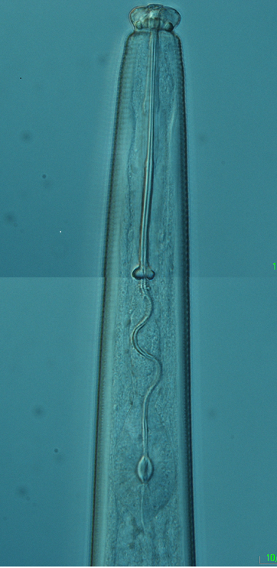
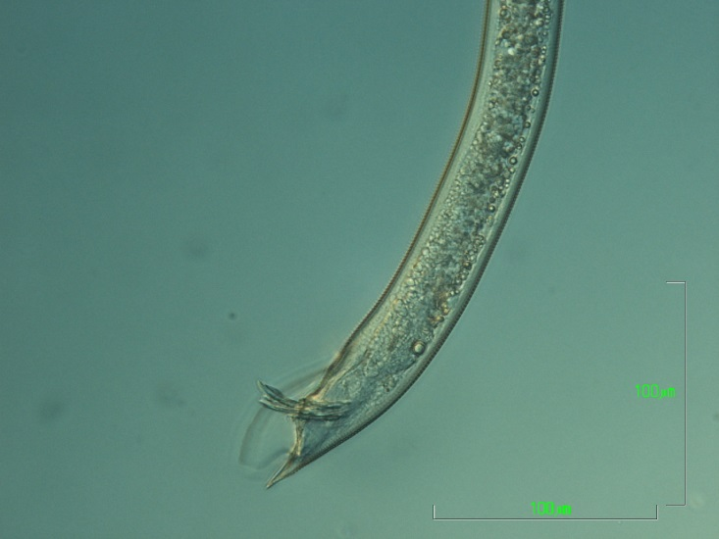
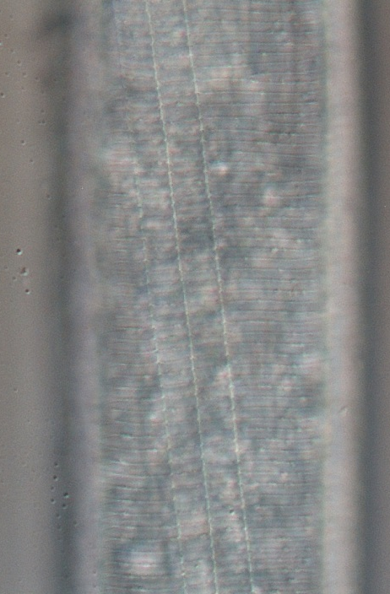
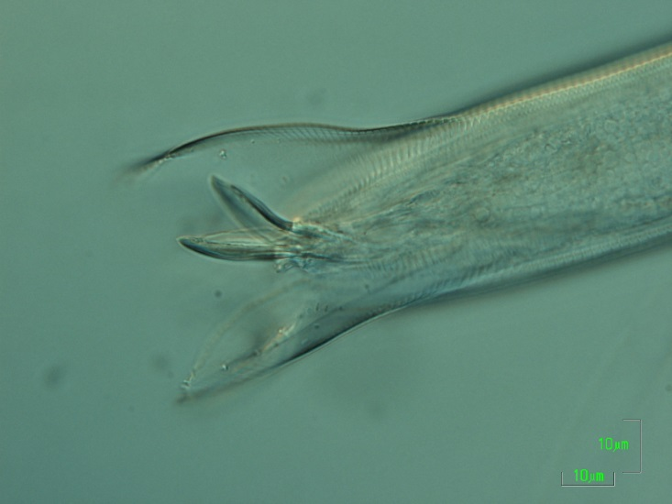
Dolichodorus sp.
Matapalo, Costa Rica
Feb., 2015

Slide 9

All plant-parasitic nematodes have a hollow stylet or spear
Those with long stylets generally feed as ectoparasites;
those with short stylets either as ecto- or endoparasites

Slide 10
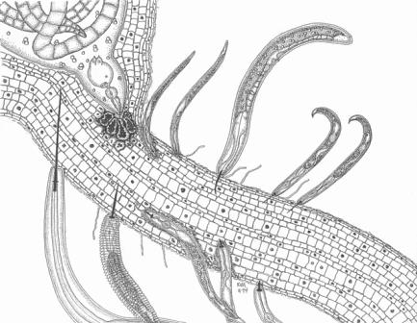

Slide 11
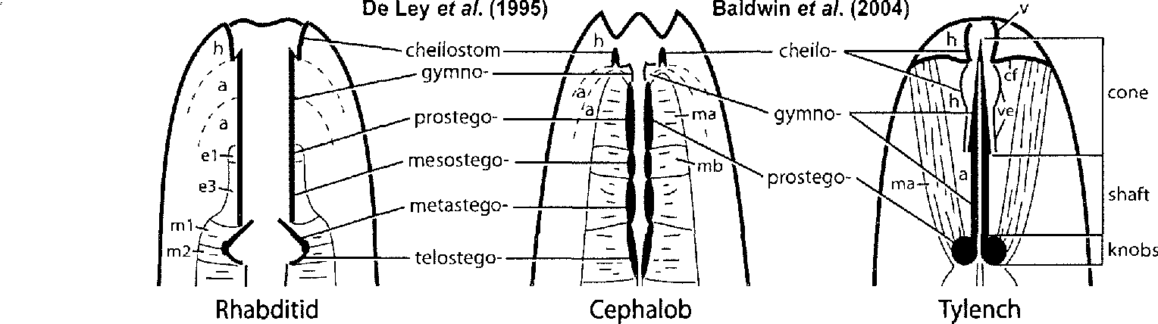
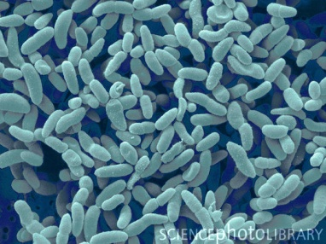
the evolution of plant parasitism
Rhabditoidea
Cephaloboidea
Tylenchoidea
horizontal gene transfer- HGT
cellulases – GHF5- glycoside hydrolase family
chorismate mutase
bacteria

Slide 12
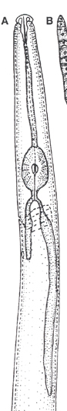
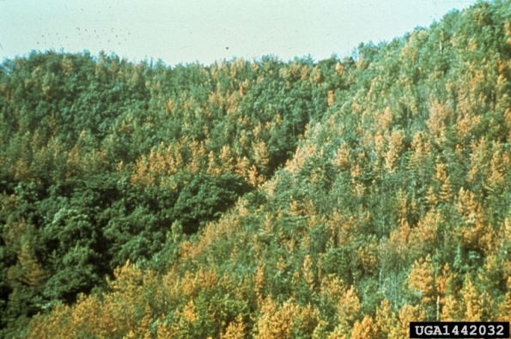
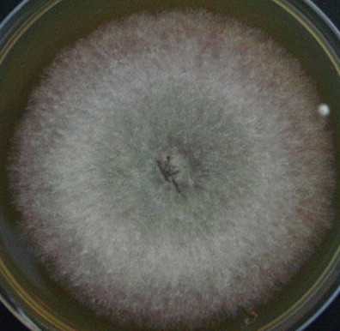
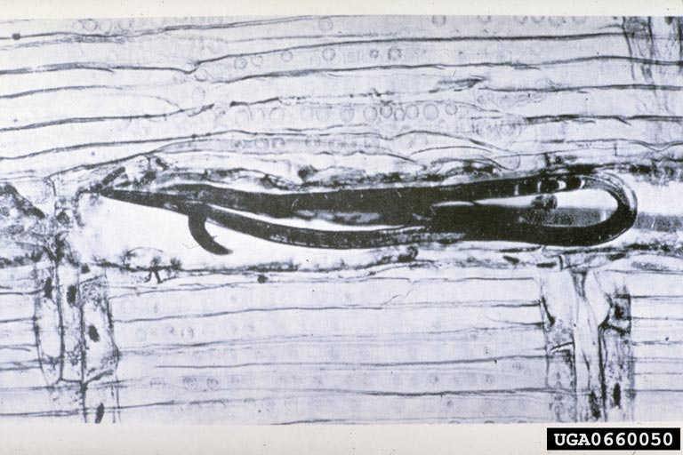
the evolution of plant parasitism
Aphelenchoidea
fungus
Bursaphelenchus xylophilus
horizontal gene transfer- HGT
cellulases – GHF45- glycoside hydrolase family

Slide 13
Biotrophic Parasites
Parasites that can only feed on a living host and must keep the host and its cells alive.
Sedentary ecto- and endoparasitic nematodes are in this category, for example, species of Meloidogyne, Heterodera, Xiphinema, Tylenchulus, Rotylenchulus.
Nematodes that withdraw contents from individual cells and then move to new feeding sites are considered cell grazers.

Slide 14
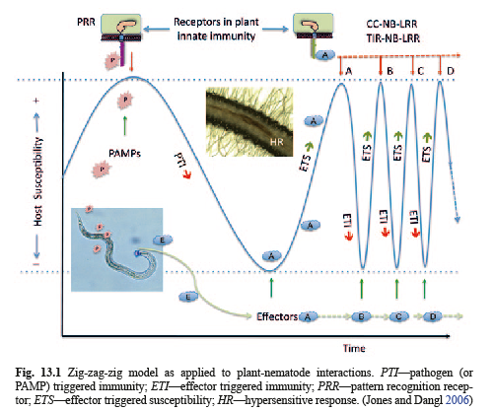
The sources of specific ETI systems are resistance genes.
Some nematode effector ETS molecules have been identified.
A recently-discovered candidate is the Hg30C02 effector protein of Heterodera glycines.

Slide 15
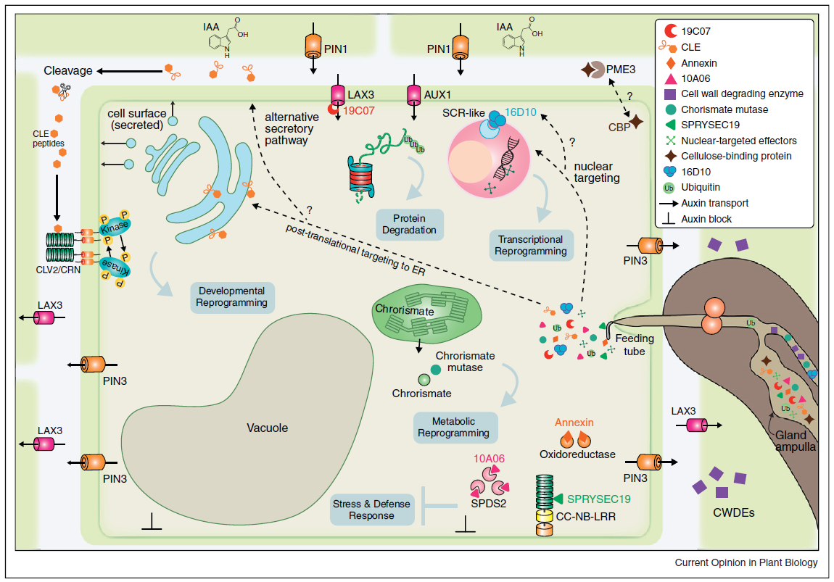
Summary:
Effector proteins originating from the esophageal glands are secreted
through the stylet.
Cell-wall degrading enzymes facilitate nematode migration through
root tissues.
Host proteins are targeted by nematode effectors.
Nematode secreted ubiquitin extension proteins alter protein degradation
pathways.
Chorismate mutase disrupts salicylic acid signaling.
Upregulation of auxin influx transport proteins and downregulation of
PIN1 auxin transporter leads to local accumulation of auxin.
Shifting of PIN3 auxin efflux carrier to the plasma membranes delivers
auxin to adjacent cells.
Other putative nematode effectors include proteases,
venom-allergen proteins, calreticulin, MAP-1, RBP-1 and NodL.
Gheysen, G. and Mitchum, M.G. 2011. How nematodes manipulate plant development pathways for Infection. Current Opinion in Plant Biology 14:415-421.
Notes:
Effector proteins originating from the subventral and dorsal esophageal gland cells are secreted through the stylet into plant cells.
Cell-wall degrading enzymes facilitate nematode migration through root tissues.
Host proteins are targeted by nematode effectors
Effector proteins containing a nuclear localization signals move to the plant nucleus
Nematode secreted ubiquitin extension proteins alter cell protein degradation pathways.
Chorismate mutase disrupts salicylic acid signaling.
Upregulation of auxin influx transport proteins and downregulation of PIN1 auxin transporter leads to local accumulation of auxin.
Shifting of PIN3 auxin efflux carrier to the plasma membranes delivers auxin to adjacent cells.
Other putative nematode effectors are not pictured, including include proteases, venom-allergen proteins, calreticulin, MAP-1, RBP-1, and NodL.

Slide 16
Plant-feeding nematodes……..
Suppress or avoid host defenses
Subvert the cell cycle
Alter photosynthate partitioning
Cause mechanical injury to cells and tissues
Cause cell death
Modify cell development
Modify cell function
Disrupt uptake of water and nutrients
Create avenues of ingress
Predispose plants to diseases and other stresses
Some vector plant viruses

Slide 17
Signs and symptoms…..
Stunting, slow growth, dieback
Chlorosis and nutrient deficiencies
Wilting
Reduced yield
Lack of response to other treatments
Root symptoms
  Root stunting
  Root branching and proliferation
  Galls at root tips or along roots
  Lesions on roots

Slide 18
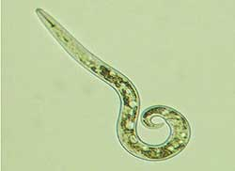
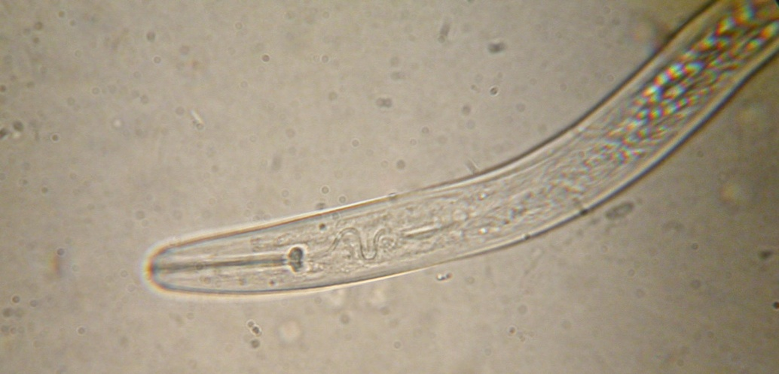
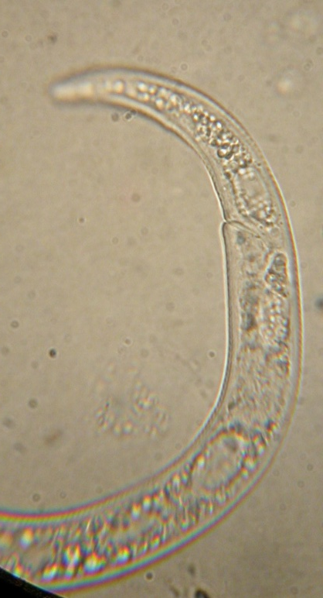
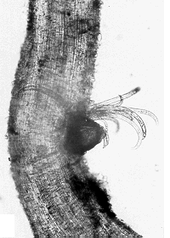
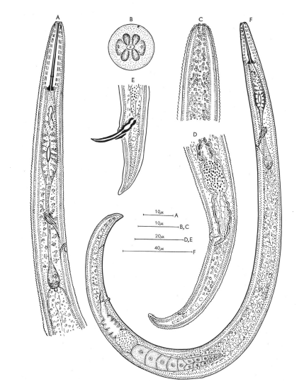
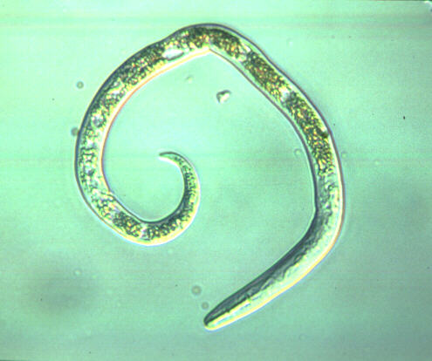
Paratylenchus spp.
pin nematode

Slide 19
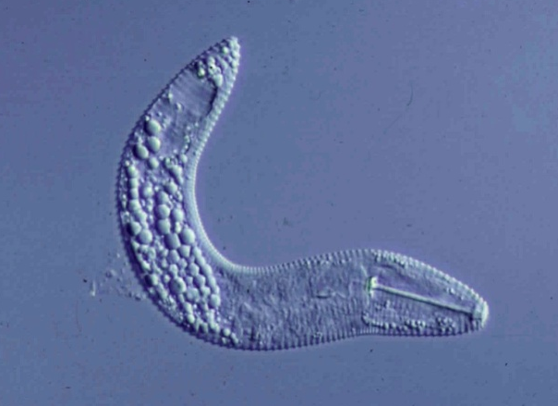
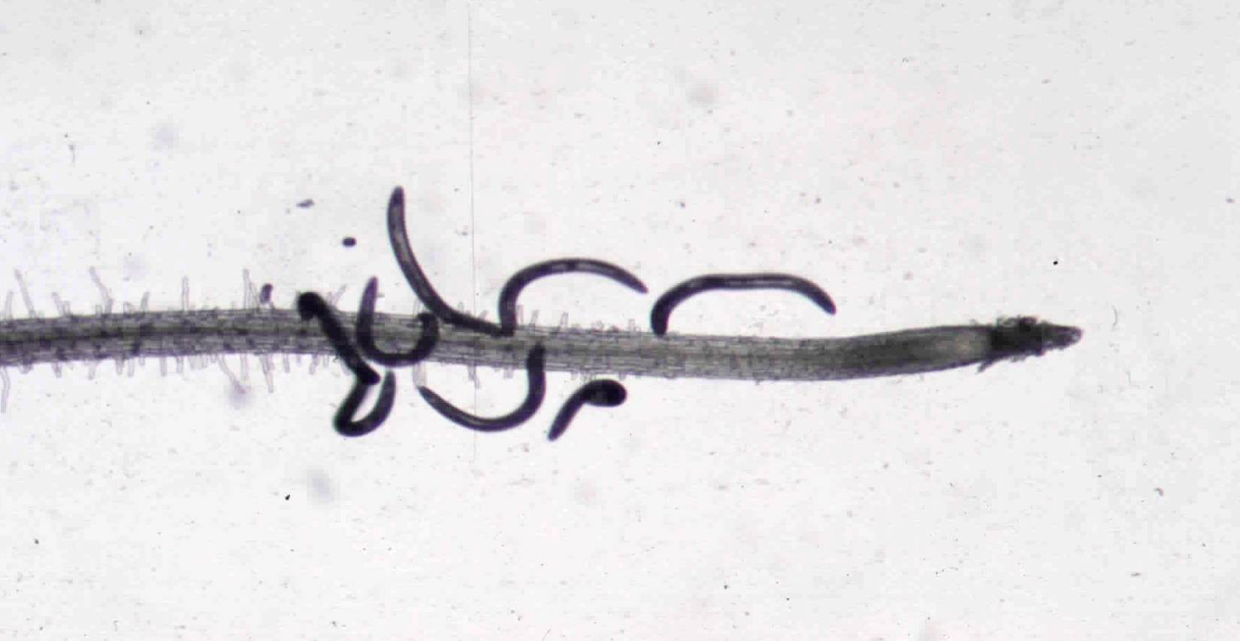
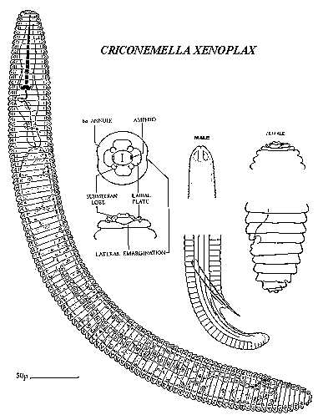
Mesocriconema xenoplax
ring nematode
-
+

Slide 20
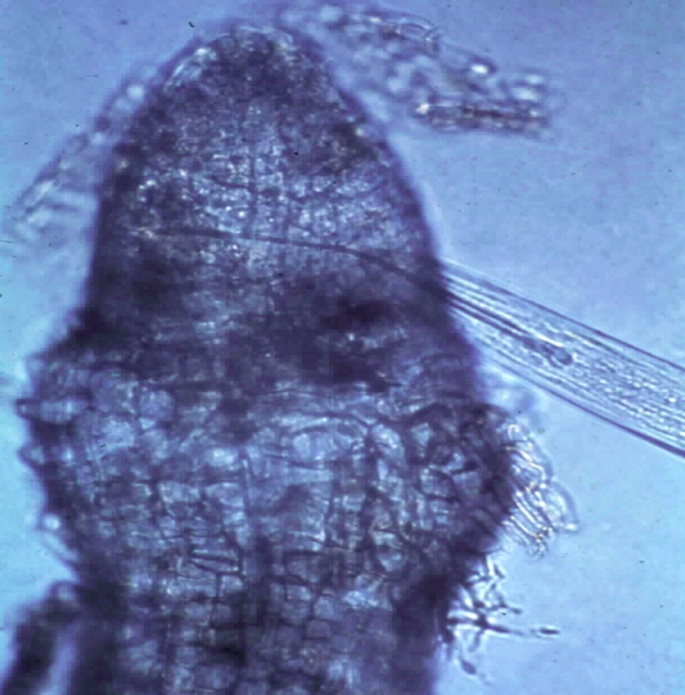
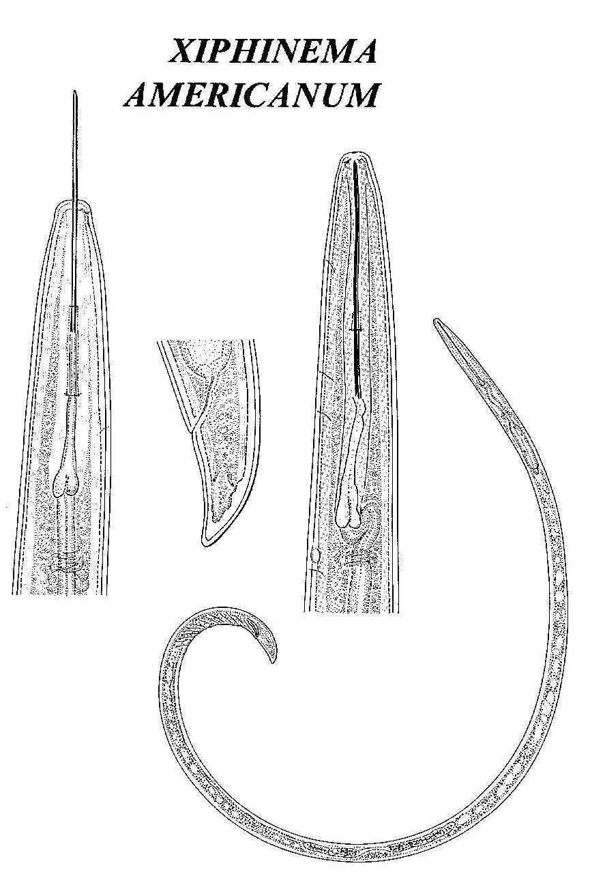
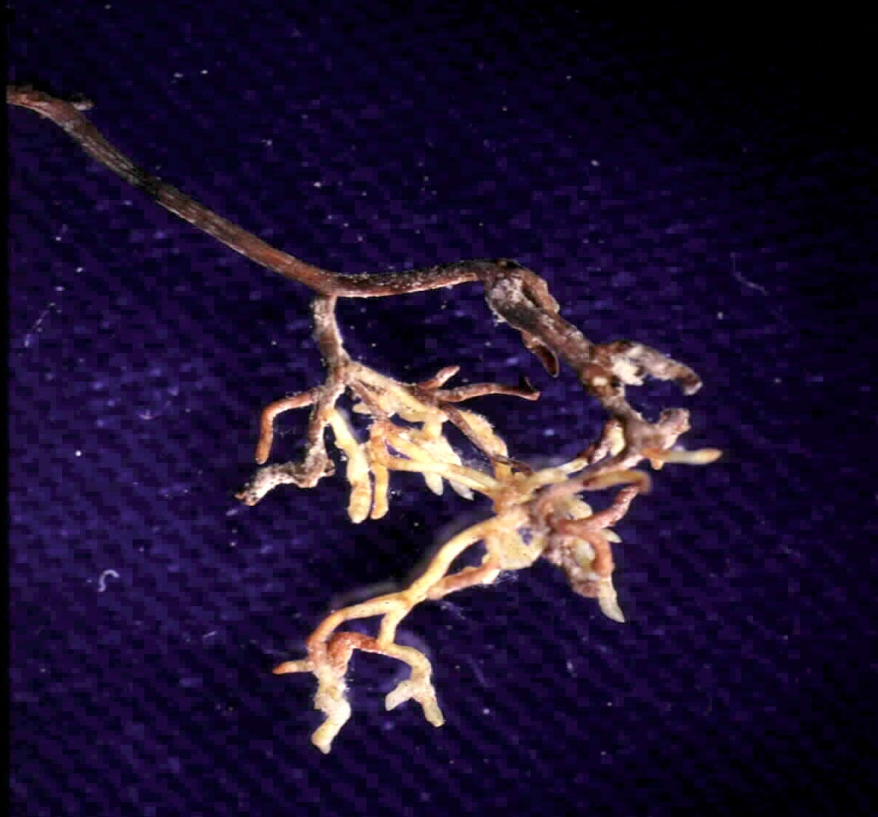
Xiphinema americanum
(sensu lato)
dagger nematode

Slide 21
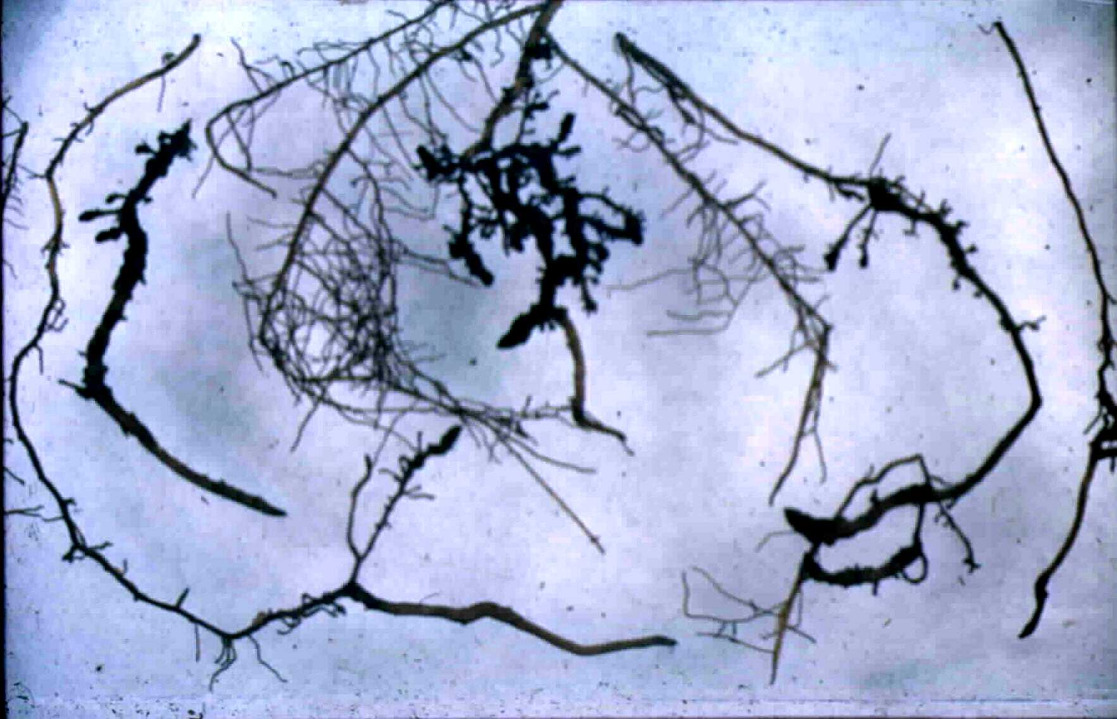
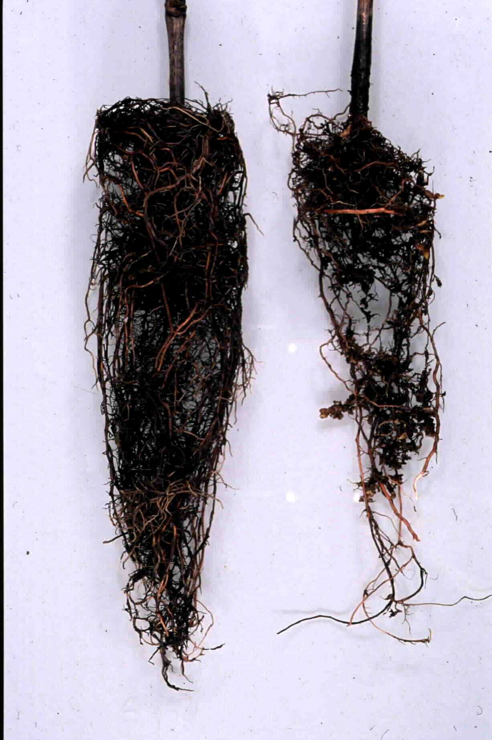
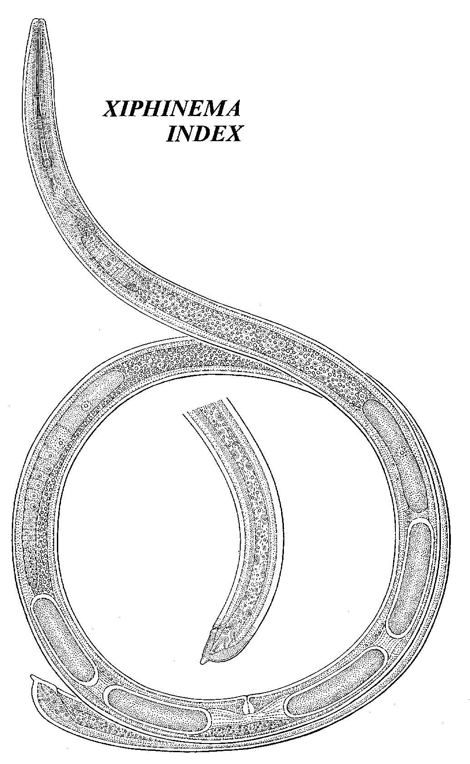


Xiphinema
index
dagger nematode

Slide 22
Xiphinema index - Dagger nematode
Vector of Grapevine Fanleaf Virus
Symptoms:
leaf malformations
yellow mosaic of leaves and shoots
veinbanding
abnormal shoot branching
small bunches, poor fruit set, irregular ripening

Slide 23


Pratylenchus vulnus
root lesion nematode

Slide 24




Tylenchulus
semipenetrans
citrus nematode

Slide 25




Heterodera and Globodera spp. Cyst Nematodes

Slide 26








Meloidogyne spp.
(arenaria, incognita, javanica, chitwoodi, and ??)
root-knot nematodes

Slide 27


Nematode Identification:
Morphological identification
Example: root-knot nematodes
Perineal patterns for species identification used since 1949
Requires adult female nematodes and skilled experts; interpretation is subjective.
Why do we need to
identify them to species?

Slide 28


2. Biochemical identification
Isozyme electrophoresis:
Females are dissected from roots, squashed and run on a gel.
Gels are stained to determine migration of activity bands of malate dehydrogenase and esterase then compared to a key with known species.
Identification Key:
Example of gel:
malate
dehydrogenase
esterase
Limitations:
Requires live, healthy adult females (not J2s)
Within species variability
Patterns available for only limited number of species

Slide 29

Molecular Identification
Species specific primers
Mitochondrial DNA polymorphisms
Isolation of nematode DNA
Step 1: Put nematodes into a PCR tube
Step 2: Dissolve or disrupt the nematodes
Step 3: Add specific primers and amplify
DNA in PCR machine
Step 4: Fractionate the amplified DNA in a
gel and examine pattern to determine species
vmwilliamson@ucdavis.edu
http://nematode.unl.edu/diagnostics.htm

Slide 30





Helicotylenchus multicinctus
“Ultimately, rapid and inexpensive DNA barcoding will replace PCR/RFLP as a preferred diagnostic method” Powers (2005)
Pratylenchus penetrans
Molecular Barcoding
Identification based on sequence of a specific DNA fragment from an organism
rDNA regions: 18S, D-loop, ITS
Mitochondrial DNA regions
Specific protein-coding genes

Slide 31
Approaches in Nematode Taxonomy and Identification
Accurate species-level identification is essential for implementation of management strategies:
.
Morphometrics
The traditional approach
Constraints:
o There is intraspecific variation in virulence and biology
o The approach is time consuming, requiring multiple measurements
o Requires specific skills and training
Biochemical
Including antibodies, ELISA tests and isoenzymes
Constraints
o Known patterns are limited to a few genera
o Depends on high quality of proteins
DNA-based Technologies
Techniques that originated with use of RFLPs and have expanded with developments in technology.
Evolving Methods:
o Real-time PCR – portable equipment available, 90-minute process.
o LAMP – loop-mediated isothermal amplification, requires <1 hour.
o Barcoding – based on mithochondrial DNA or Ribosomal DNA
o Barcode of Life project currently has >1600 barcodes available.
Integrated Taxonomy
Requirements for future development of Nematode Systematics.
o Need morphological, morphometric and biological taxonomy to delineate ‘species” boundaries
at whatever level of difference is considered sufficient or useful as a category designation.
o Need to establish and assign a taxonomic binomial to a molecular signature

Slide 32













Functional Diversity of Nematodes

Slide 33



Pristionchus pacificus
Adapted from Bento et al., 2010; Hartenstein and Jacobs, 2013; Ragsdale et al., 2013

Slide 34





Spatial Diversity of Microsites and their Temporal Dynamics
gradient drivers:
temperature
moisture
aeration
organic residues
roots
soil texture
particle size
temporal drivers:
diurnal
seasonal
life course
phenology
degree-days
stochastic factors:
roots
patch distribution
patch composition
weather events
burrows
stones
restrictive layers
Ferris and Tuomisto, subm.

Slide 35






Comparison of Organic and Conventional Banana Production Systems: Costa Rica
Management practices in industrialized agriculture result in:
Soil food web simplification
Reduction in higher trophic levels
Reduction of species diversity

Slide 36


Soil Health: Stewardship of Abundance and Diversity - Carbon and Energy
CO₂
CO₂
CO₂
CO₂
bacteria
protozoa
nematodes
carbohydrates
and
proteins
C
N
nematodes
arthropods
fungi
carbohydrates
and
amino acids
other
organisms
nematodes
fungi
arthropods
nematodes
NO₃
Carbon and energy transfer
Carbon is respired by all organisms in the food web
The amounts of Carbon and Energy available limit the size and activity of the web
NH₃
NH₃
NH₃

Slide 37



Soil Health: Minimize constraints on functional diversity
Nematode Sensitivity to Mineral Fertilizer
Solutions?
Composts
Organic Amendments
Manures
Fertigation
(slower release – as needed)
Ammonium sulfate
200
Nematode guild
150
c-p 1
Standardized Counts
c-p 2
100
X
c-p 3
50
c-p 4
X
c-p 5
X
X
0
X
X
0
0.02
0.05
0.1
0.5
1
Concentration (mM-N)
Tenuta and Ferris, 2004

Slide 38



Core Management Principles for Healthy Soil
1. Keep the soil covered with crops and crop residues.
2. Keep living roots in the soil throughout the year to feed the soil foodweb; avoid resource punctuation.
3. Diversify inputs through crop pattern, crop rotation, cover crops and cover crop mixtures.
4. Minimize soil disturbance to maintain soil structure and habitat suitability.
5. (Integrate livestock grazing).
A diversity of cover crops….
Sources: Jay Fuhrer, NRCS
Chad Ellis, Noble Foundation, 2013

Slide 39


Biological antagonists

Slide 40


Engineering Functional Connectance:
Winter cover crop – Vicia faba
California, 2006
Soil Food Web Stewardship
Soil fertility
Organic matter
Food web activity
Soil structure
Fossil fuel reduction
Habitat conservation
Food web activity
Soil structure
No-till soybeans, Brazil, 2006

Slide 41

Thank you!
http://plpnemweb.ucdavis.edu/nemaplex

