Slide 1
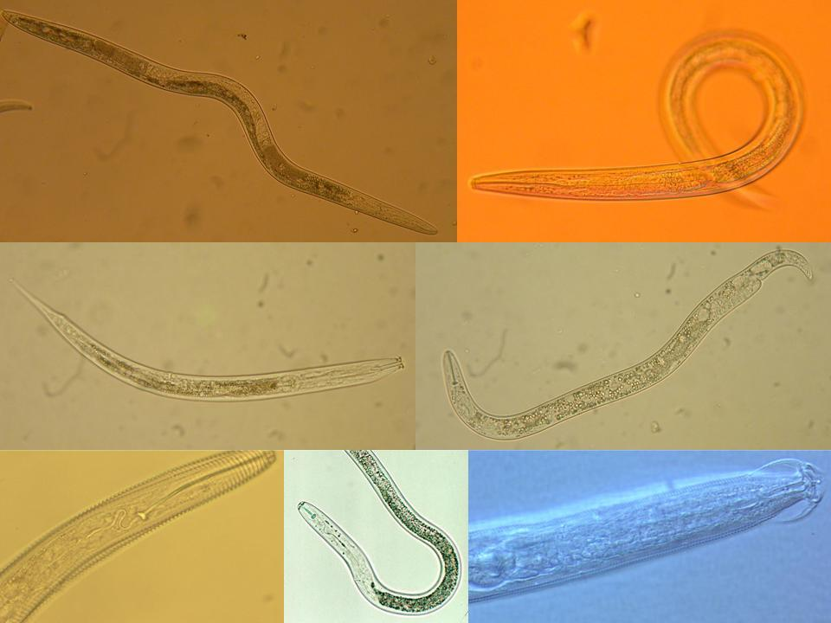
Stewardship
of
Soil Ecosystem Services
Howard Ferris
Department of Nematology
University of California, Davis
November, 2010
Notes:
30 min talk
Interactions:
Nematodes affect other organisms, other organisms affect nematodes
Nematodes feed on plants – plants provide food for nematodes.
Nematodes feed on bacteria, nematodes farm bacteria – in soil, insects,
bacteria feed nematodes, bacteria kill nematodes
Nematodes feed on fungi and are fed upon by fungi.
Nematodes feed on protozoa and microarthropods, tardigrades, mites,
collembola and are fed upon
What are the ecosystem effects (effects on functions)?
Enrichment
Movement of and to resources
Nutrient and carbon cycling
Nutrient and carbon movement and sequestration
Effects on services?
Antagonists of nematodes occur in many groups of organisms that are components of the soil food web.
The interactions of many soil organisms results in biological buffering or regulation of the nematode population through the mechanisms of Exploitation, Competition, and Antibiosis
1

Slide 2
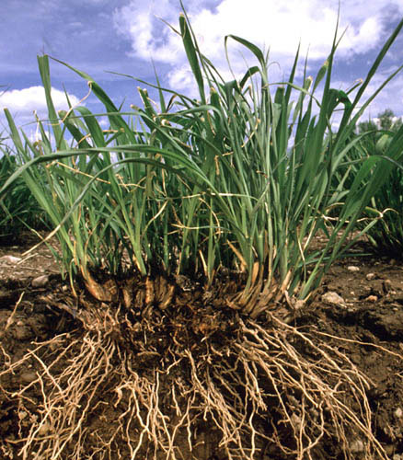
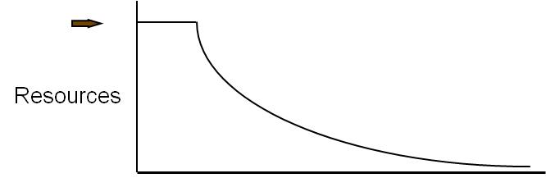
The soil ecosystem is strongly affected by type and frequency of Carbon and Energy input
CO₂
CO₂
CO₂
CO₂
bacteria
protozoa
nematodes
carbohydrates
and
proteins
C
N
nematodes
arthropods
fungi
carbohydrates
and
amino acids
other
organisms
nematodes
fungi
arthropods
nematodes
NO₃
Carbon and energy transfer
Carbon is respired by all organisms in the food web
The amounts of Carbon and Energy available limit the size and activity of the web
NH₃
NH₃
NH₃

Slide 3
Carbon and Energy
Subsidy Effects
Prey resources
Predators
Infrequent (Punctuated) Resource Input

Slide 4
Carbon and Energy
Subsidy Effects
Prey resources
Predators
Frequent (Continuous) Resource Input

Slide 5
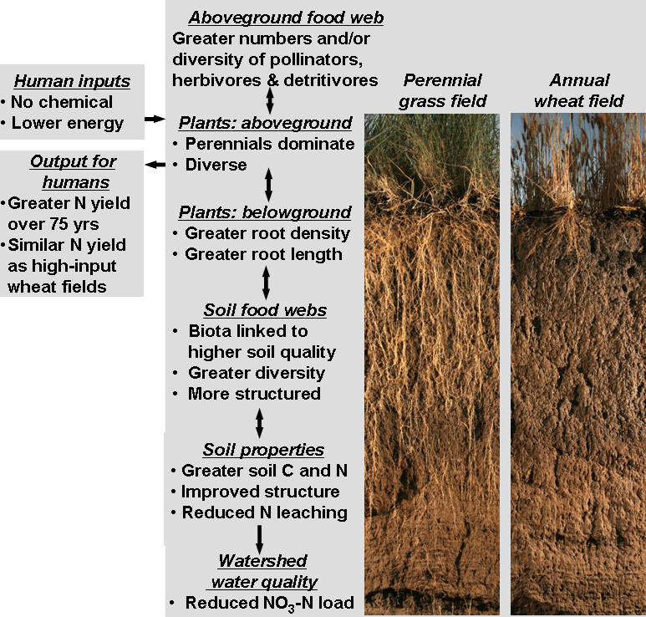
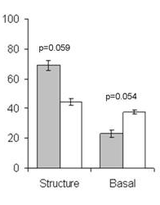
Land-use change in Kansas
Resource Inputs:
Bottom up effects on
Soil Ecosystem Structure
and Function
Consistent N-yield over 75 years without input
N-yield similar to that of high input wheat
Community Ecology
Structure Index
Basal Index
From Glover et al., 2010

Slide 6
Soil Ecosystem Functions - metabolic and behavioral activities
of organisms that impact the biotic or abiotic components of the ecosystem
Feeding: Ingestion, assimilation, defecation and excretion
Behavior: Movement, activity, migration
Functions may be classified, subjectively, as Services, Disservices
(or Neutral)
Disservices:
Damage plants of agricultural or ornamental significance
Injure humans and vertebrate animals
Services:
Sequester and redistribute minerals
  Mineralize organic molecules
  Accelerate turnover
  Regulate and suppress pests
Alter substrate to provide access to other organisms
Redistribute organisms in space
Biodegrade toxins
Reduce soil erosion
Increase agricultural production
Individual species
services
Aggregate
ecosystem services
Notes:
Interactions:
Nematodes affect other organisms, other organisms affect nematodes
Nematodes feed on plants – plants provide food for nematodes.
Nematodes feed on bacteria, nematodes farm bacteria – in soil, insects,
bacteria feed nematodes, bacteria kill nematodes
Nematodes feed on fungi and are fed upon by fungi.
Nematodes feed on protozoa and microarthropods, tardigrades, mites,
collembola and are fed upon
What are the ecosystem effects (effects on functions)?
Enrichment
Movement of and to resources
Nutrient and carbon cycling
Nutrient and carbon movement and sequestration
Effects on services?
Antagonists of nematodes occur in many groups of organisms that are components of the soil food web.
The interactions of many soil organisms results in biological buffering or regulation of the nematode population through the mechanisms of Exploitation, Competition, and Antibiosis
6

Slide 7
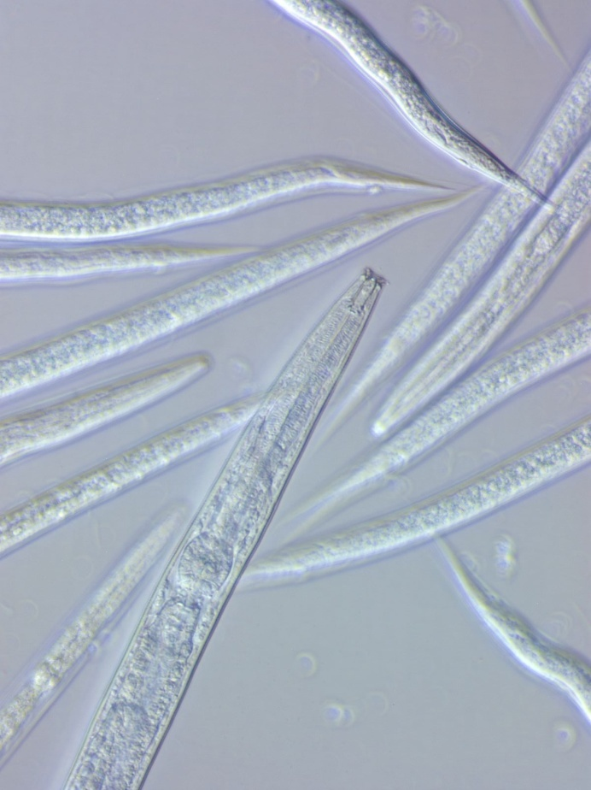
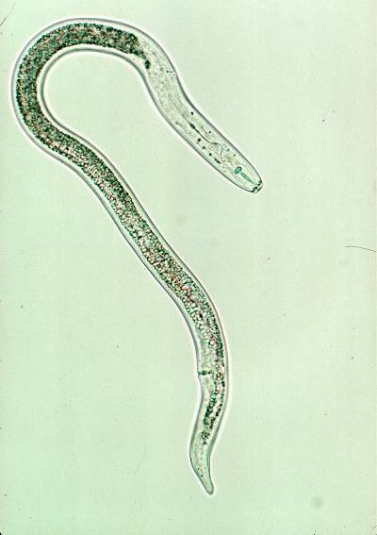
Management of Soil Organisms….
  to enhance services and reduce disservices
Provide Services
Provide Disservices
Management tradeoffs?

Slide 8
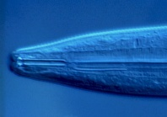
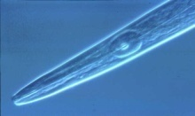
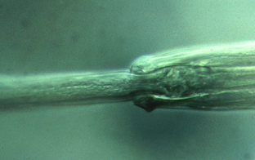
Soil Ecosystem – environmental effects on Structure
Nematode Sensitivity to Mineral Fertilizer
Ammonium sulfate
200
Nematode guild
150
c-p 1
Standardized Counts
c-p 2
100
X
c-p 3
50
c-p 4
X
c-p 5
X
X
0
X
X
0
0.02
0.05
0.1
0.5
1
Concentration (mM-N)
Tenuta and Ferris, 2004

Slide 9
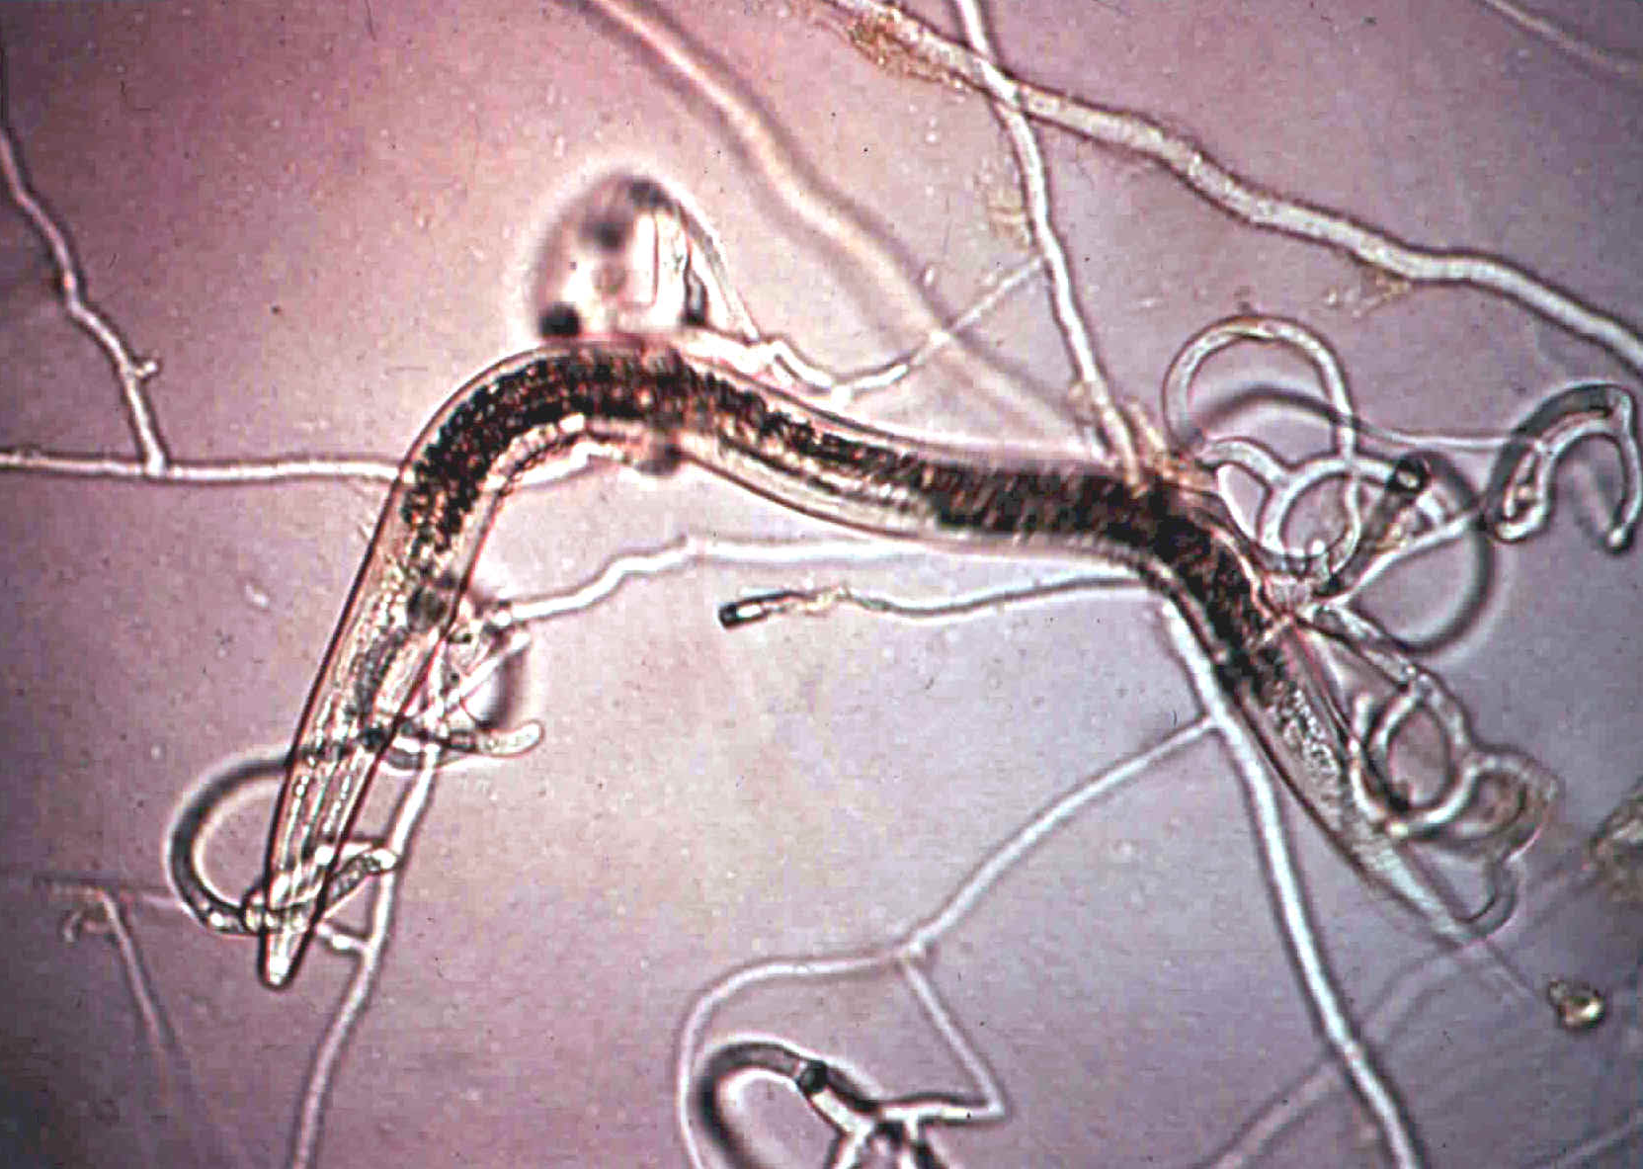
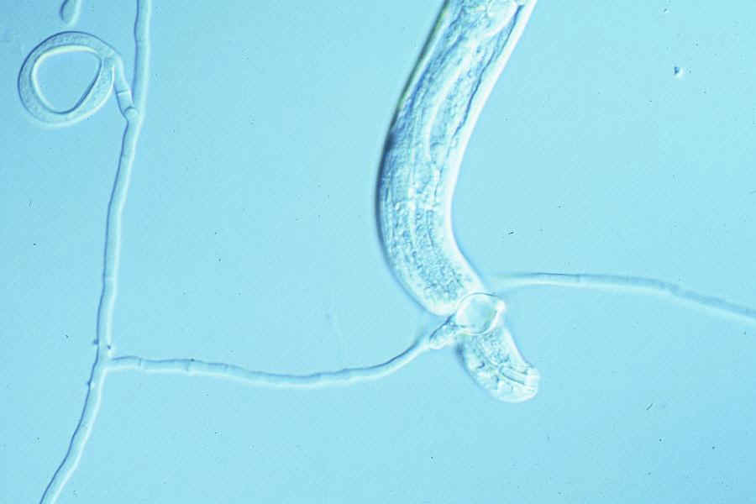
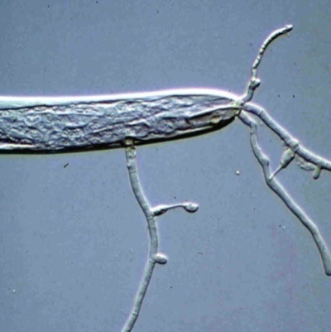
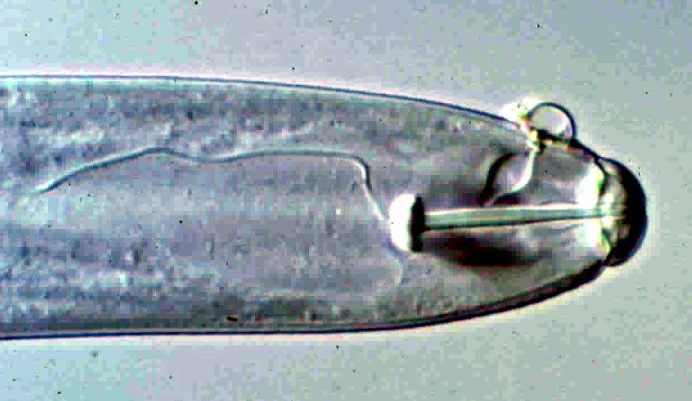


Some Ecosystem Functions
Feeding and Redistributing Organisms
Fungi exploit nematodes through:
traps and networks that remain
attached to the hyphae.
2. spores that detach from hyphae

Slide 10
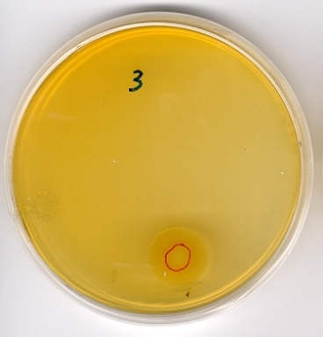
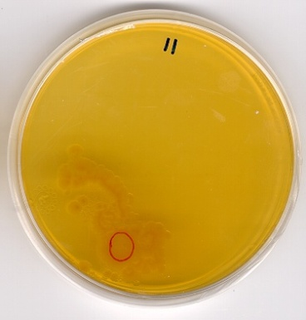
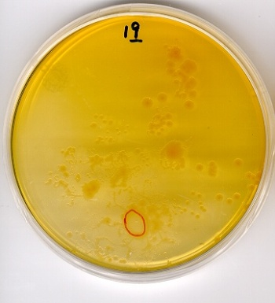
Distribution of organisms to new resources
Behavioral Ecology
bacteria and bacterivore nematodes
0 nematodes
5 nematodes
20 nematodes
Fu et al. 2005

Slide 11
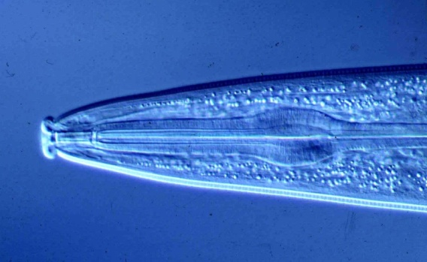
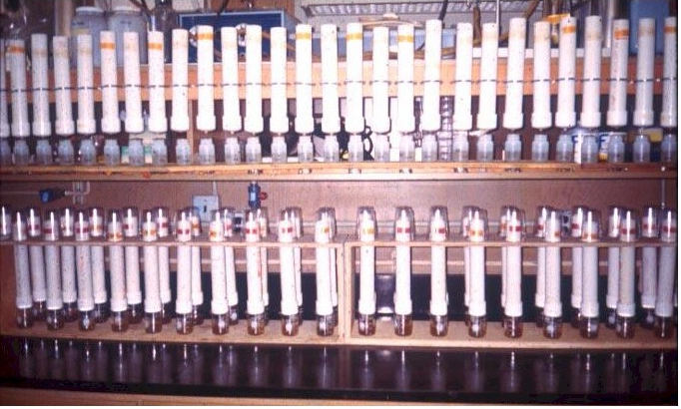
Exploiting Ecosystem Services:
The N-Mineralization Service of Bacterivore Nematodes

Slide 12
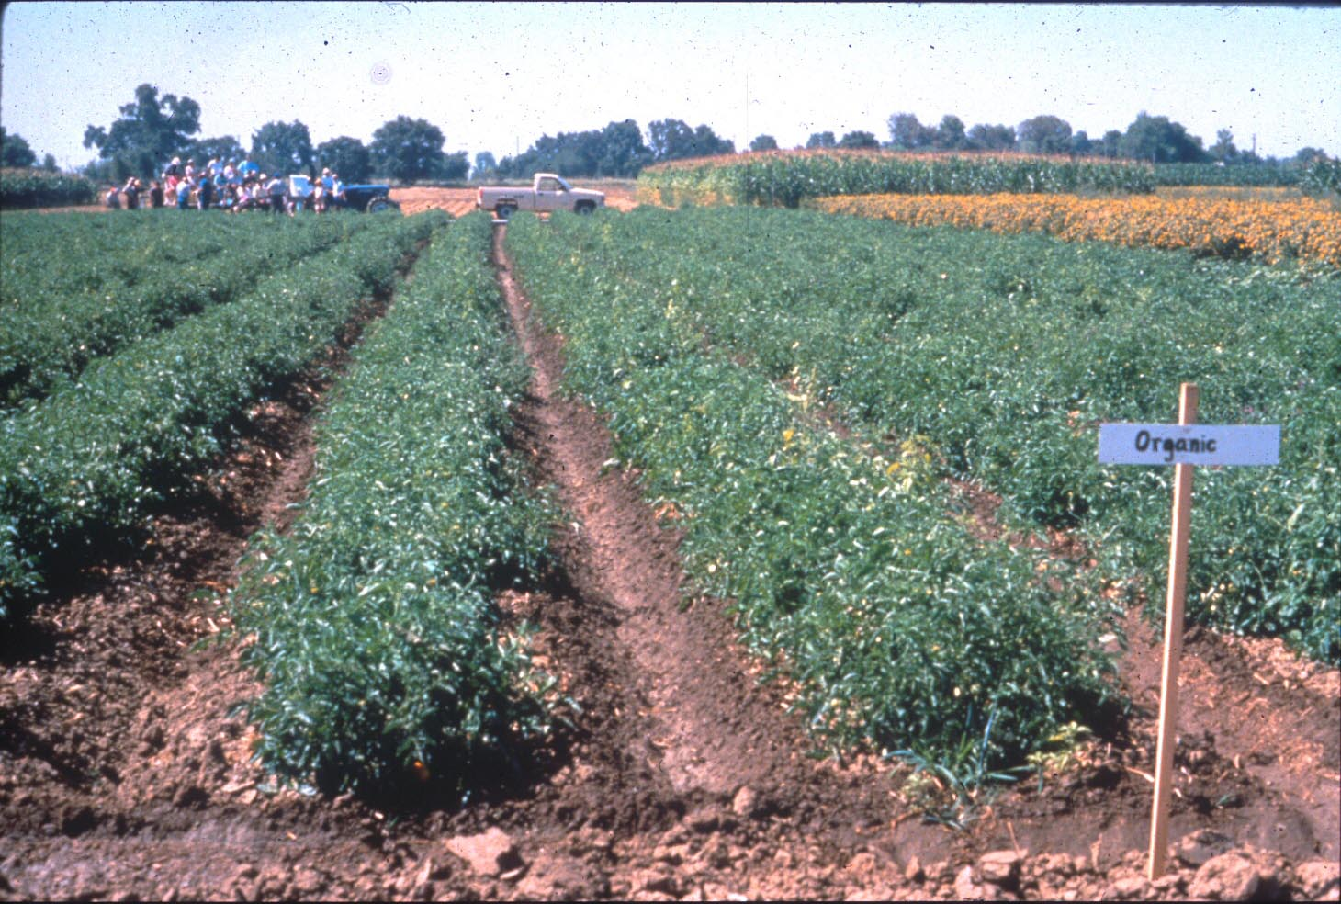
Taking it to the field……
Soil Ecosystem Management – an experiment
Cover crop
Cover crop
Irrigation
temperature
moisture
T₀
activity
M₀
Ferris et al., 2004
Notes:
12

Slide 13
Nitrogen mineralization
A diverse functional guild
of bacterivores supports….
Ferris et al., 2004

Slide 14
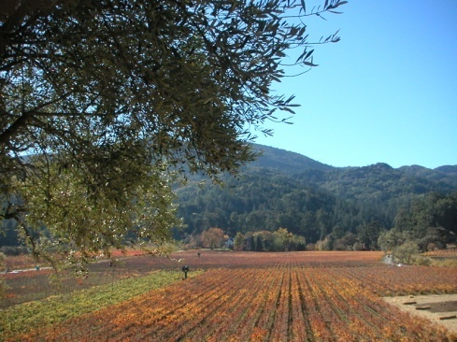
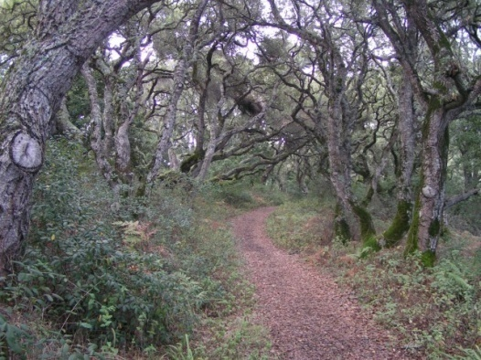
Another Ecosystem Service: Regulation of Opportunistic Species
Density-dependent predation
Predator: Prey Ratio
Sánchez-Moreno and Ferris, 2007
Notes:
14
We expected to have greater suppressiveness in samples with higher abundances of P and O. But predation depended not on the abundance of the high trophic levels but on the ratio of predator/prey, following a density-dependent function. Suppressiveness is optimized when predator/prey ratio is high; so few preys are available for each predator. When the biomass of prey is very high, suppressiveness in reduced. In agricultural fields, where fertilizers and organic matter are incorporated to the soil, the consequent increase of microbial populations are used by microbial-feeders to increase their population size, and this relationship is altered. When many other prey are available, the predation pressure on the target nematode reduces.

Slide 15
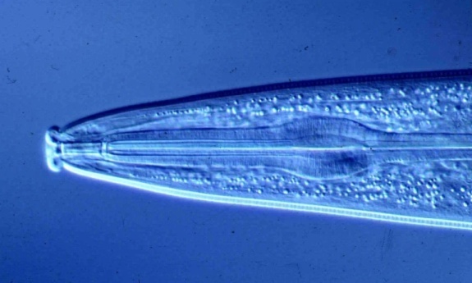
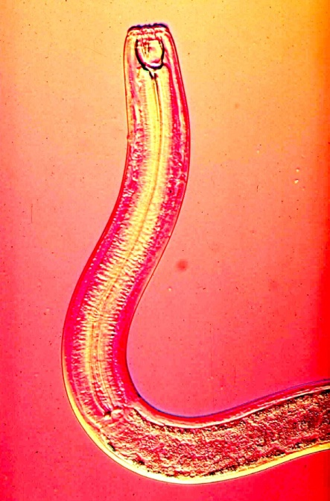
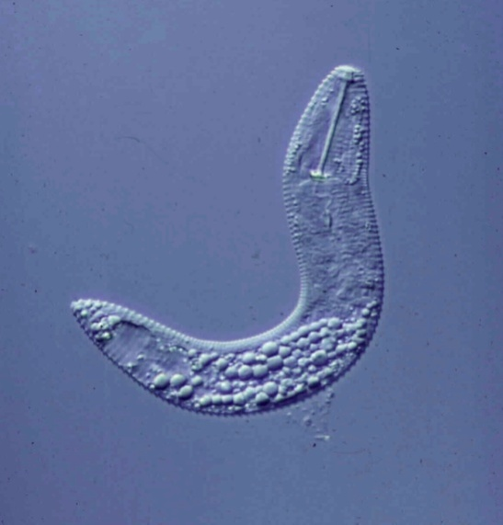
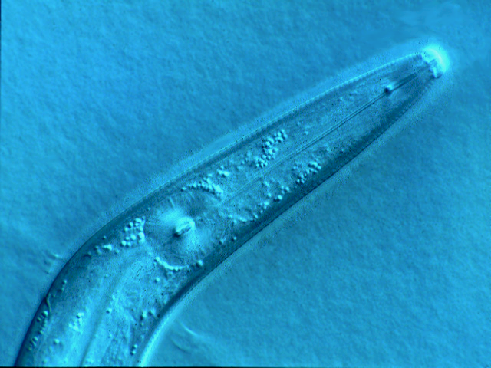
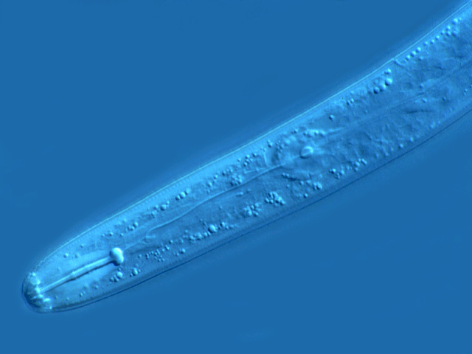

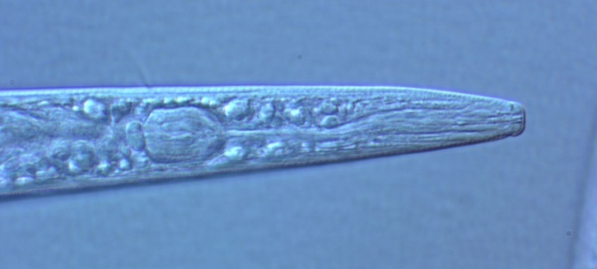
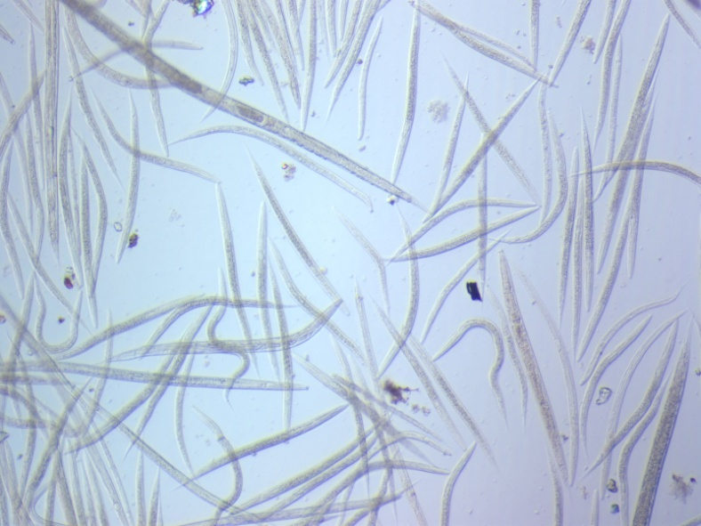
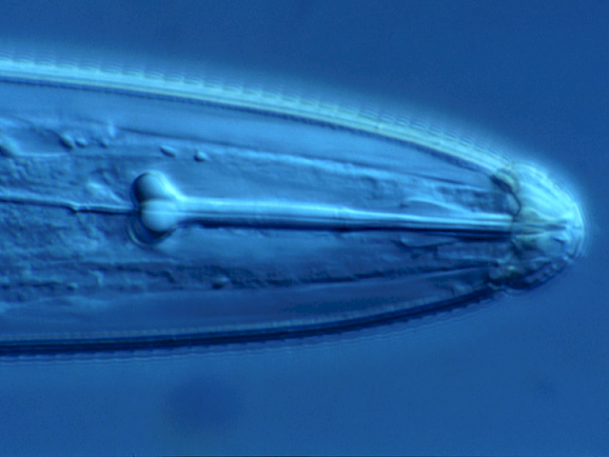
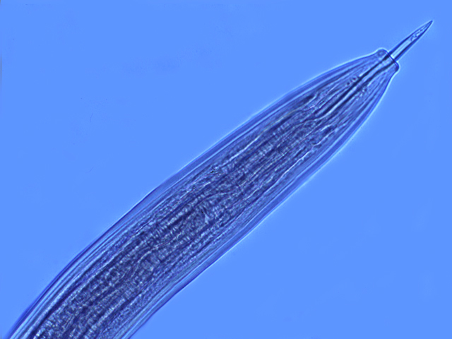
Predators and prey
Generalist and
Specialist Predators
Amplifiable Prey
Target Prey

Slide 16
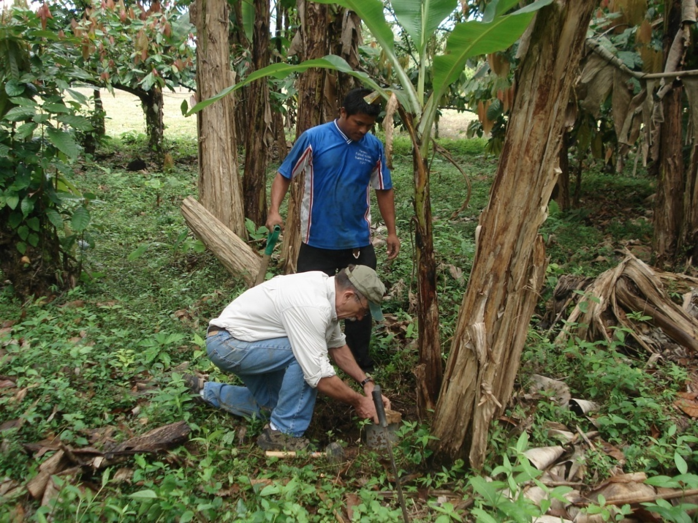
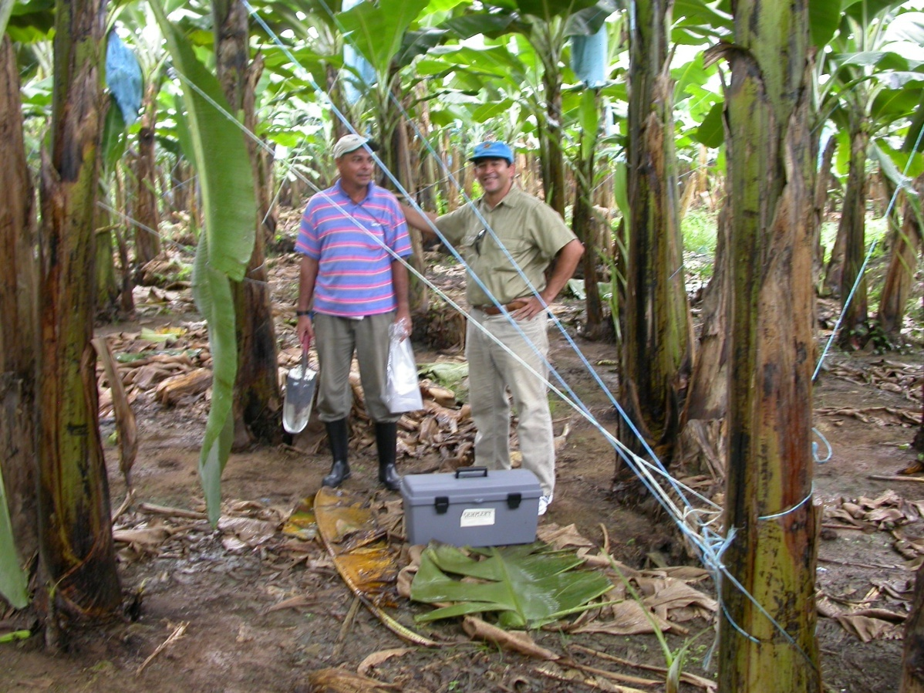
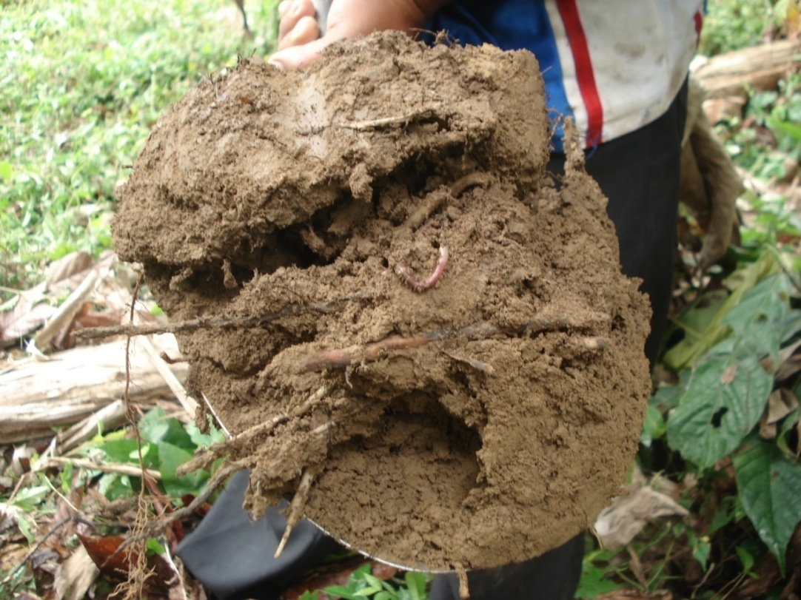
Soil Ecosystem Complexity and the
Regulation Function
Management practices in industrialized agriculture result in:
Soil ecosystem simplification
Reduction in higher trophic levels
We tested nematode predator:prey hypotheses with data from banana plantations in four Central American countries……….
Costa Rica, 2008

Slide 17
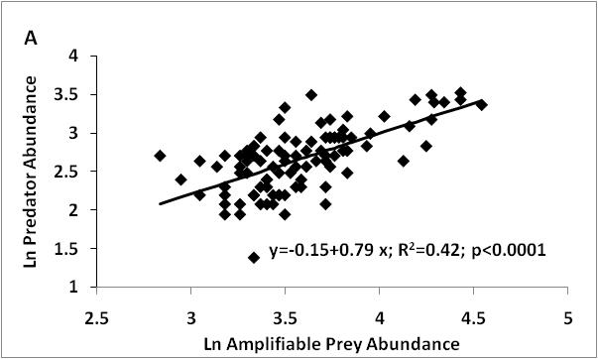
Banana Plantations - Panama
The relationships are fuzzy
because…………….
Ferris, Pocasangre, et al., subm.

Slide 18
Trophic cascades: amplifiable and target prey – the expanded model
+
Other Prey
E3
A
Predator Nematodes
Other Predators
-
+
B
-
A
+
B
E1
Amplifiable Prey
+
Target Prey
E4
+
-
+
B
Protozoa
+
B
-
E2
Root Associate
Nematodes
Microbial Biomass
-
E5
E7
Nematophagous fungi
+
+
E6
+
+
+
Organic Matter
Plant Roots
Rhizosphere bacteria
Notes:
18
18

Slide 19
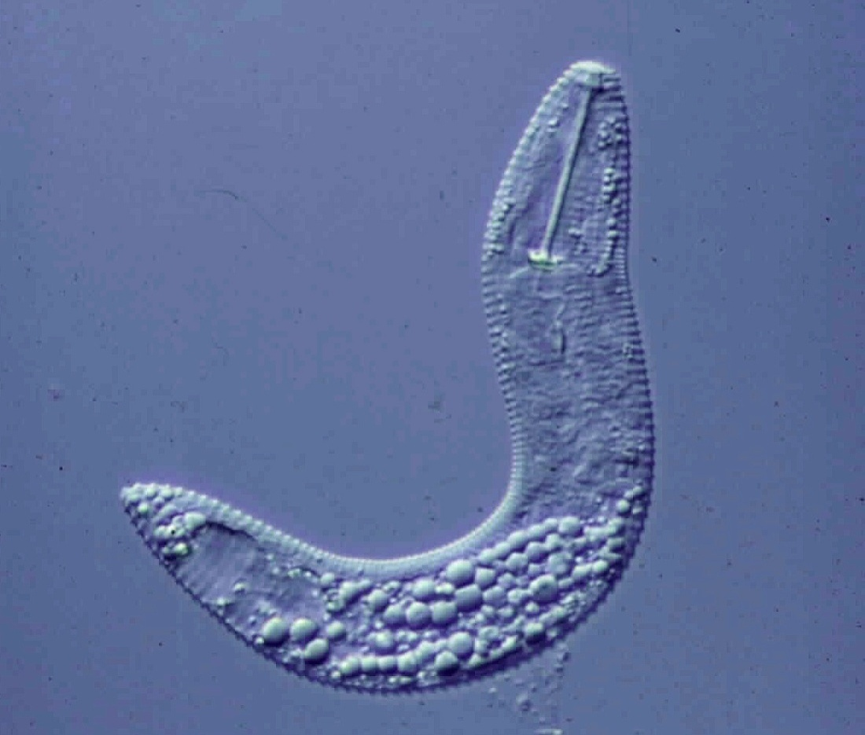
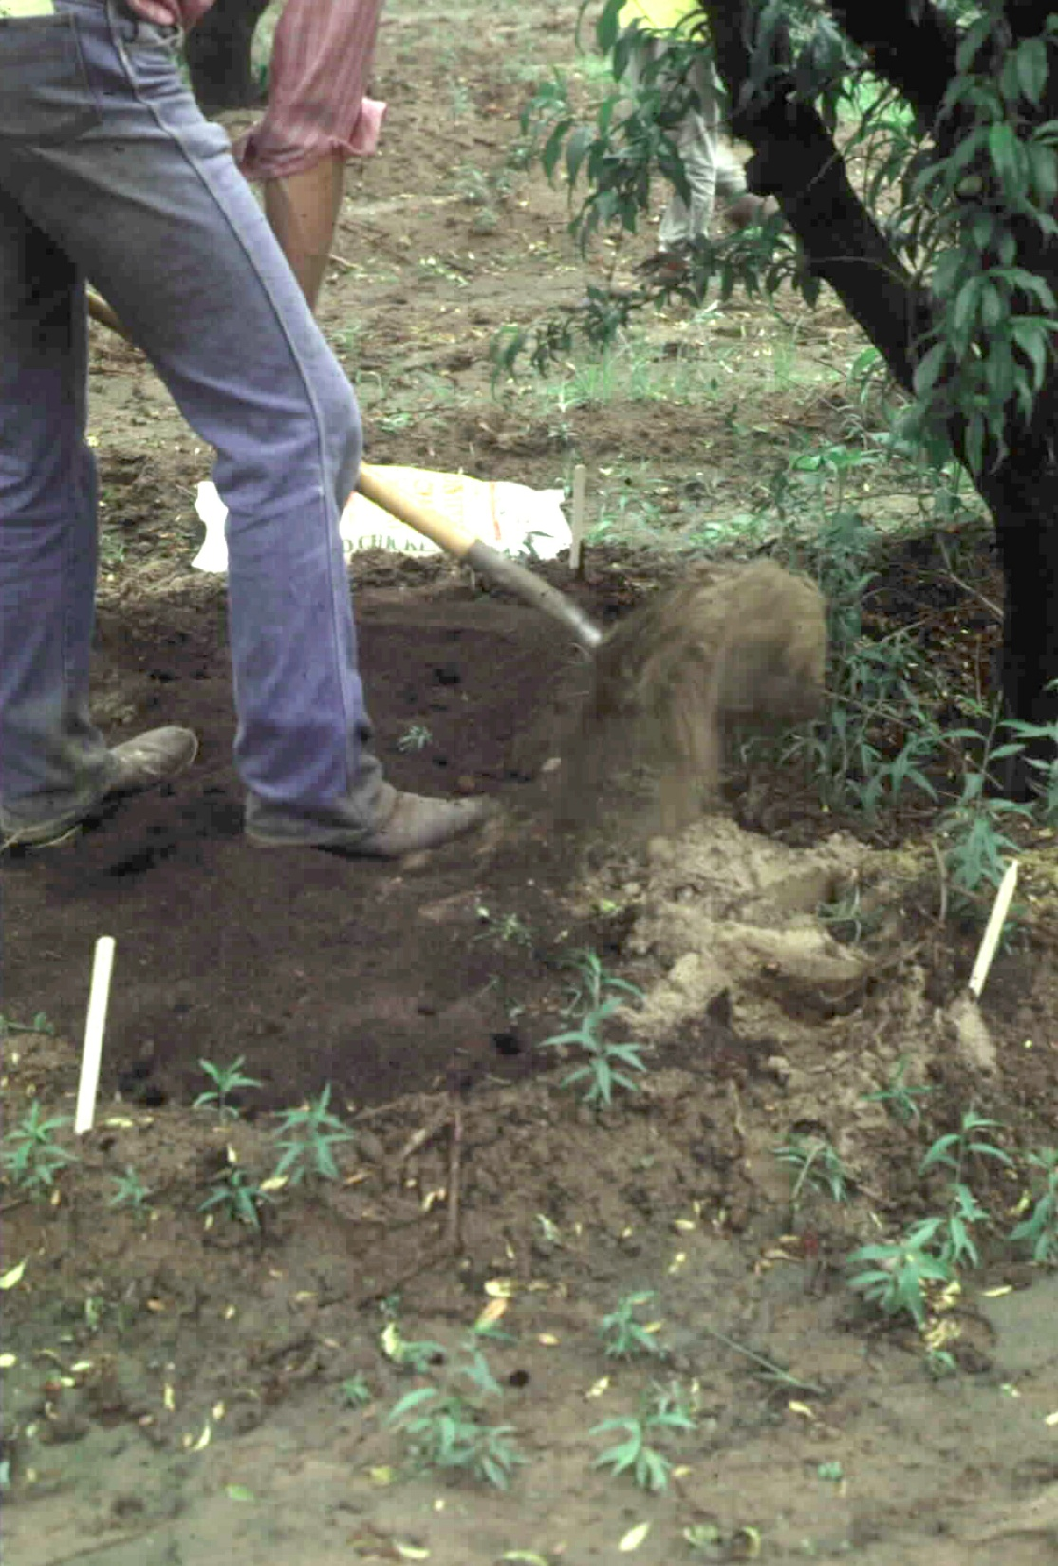
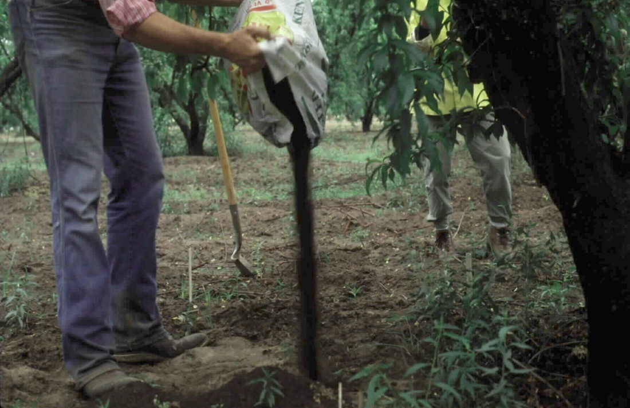
Target Prey:
the ring nematode
Enhancing Amplifiable Prey

Slide 20
Soil Ecosystem – environmental factors affecting Structure
Environmental heterogeneity
Separate
metacommunities?
Zones and
Gradients:
texture
structure
temperature
water
O₂
CO₂
NO₃
NH₄
minerals

Slide 21
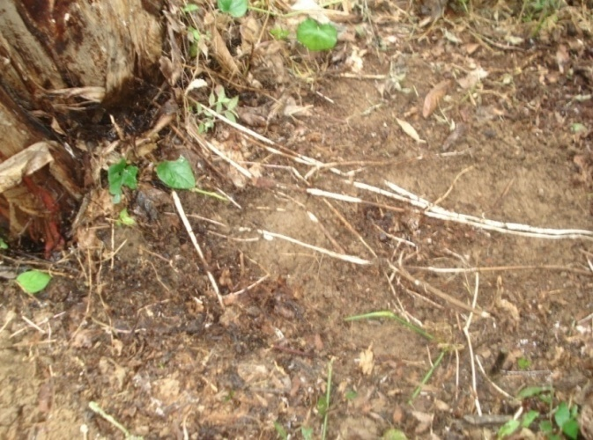
Predator-prey Connectance
Organic Bananas and Cover Crop – Costa Rica

Slide 22
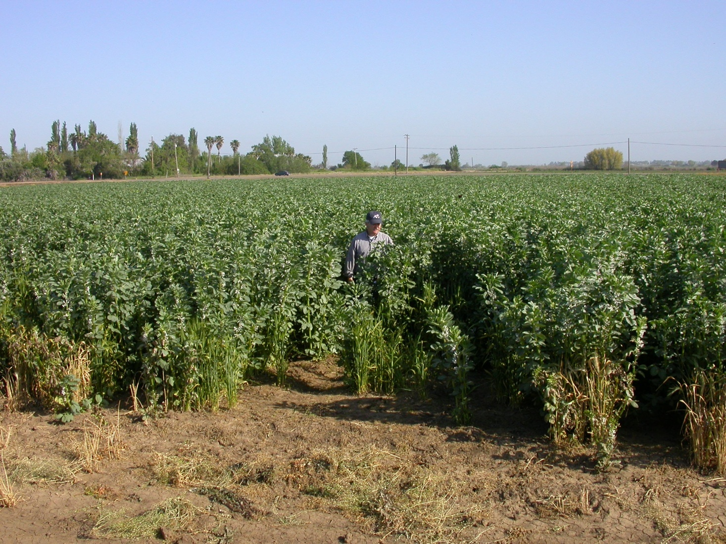
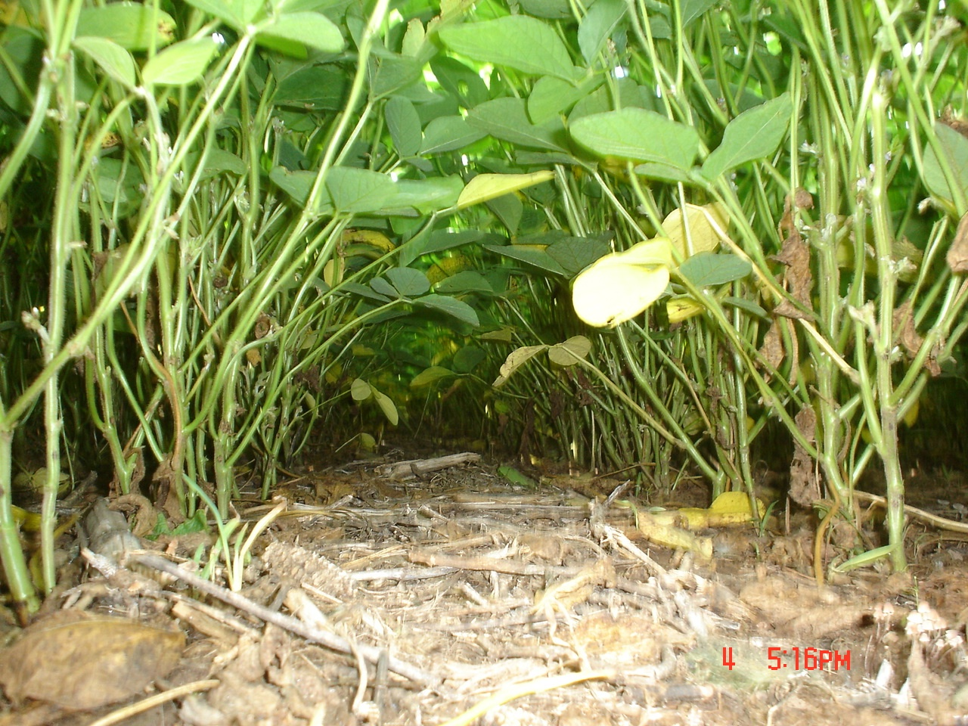
Feeding the Amplifiable Prey
Winter cover crop – bell beans
California, 2006
Soil fertility
Organic matter
Food web activity
Soil structure
Fossil fuel reduction
Habitat conservation
Food web activity
Soil structure
No-till soybeans, Brazil, 2006

Slide 23
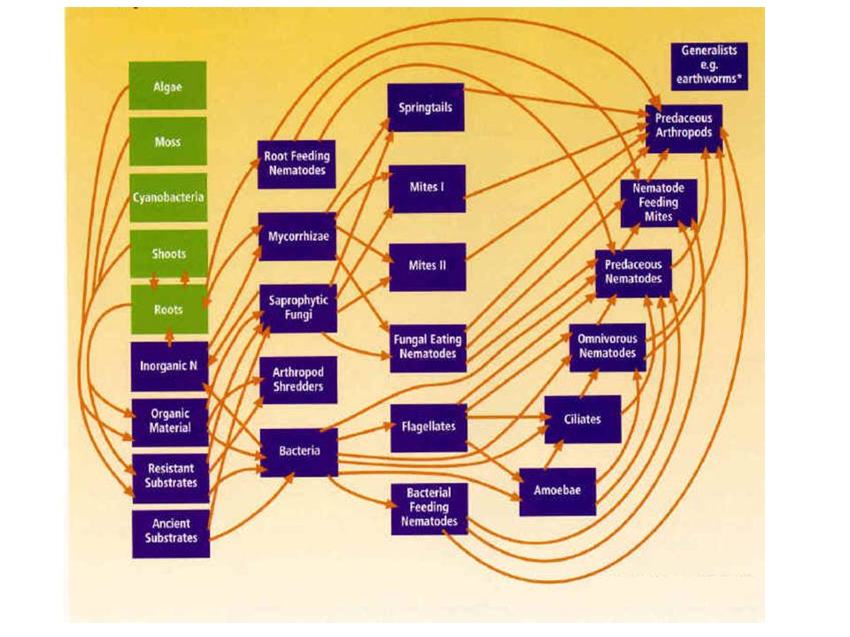
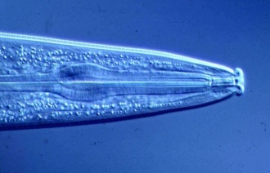

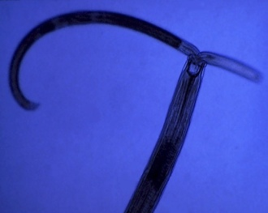
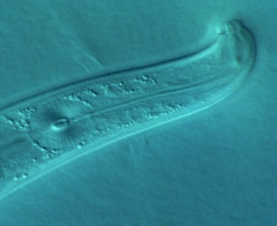
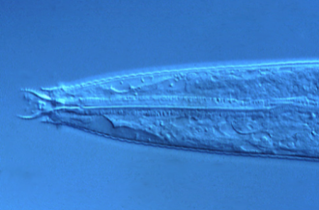
Fungus-feeding
nematodes
Generalist predator
nematodes
Enrichment Indicators
Structure Indicators
Plant-feeding
nematodes
Bacteria-feeding
nematodes
Specialist predator
nematodes
Rhabditidae
Panagrolaimidae
etc.
Short lifecycle
Small/ Mod. body size
High fecundity
Small eggs
Dauer stages
Wide amplitude
Opportunists
Disturbed conditions
Protozoa-feeding
nematodes
Aporcelaimidae
Nygolaimidae
etc.
Long lifecycle
Large body size
Low fecundity
Large eggs
Stress intolerant
Narrow amplitude
Undisturbed conditions
Basal Fauna
Cephalobidae
Aphelenchidae, etc.
Moderate lifecycle
Small body size
Stress tolerant
Feeding adaptations
Present in all soils
Nematodes at each trophic level

Slide 24
Nematode Faunal Profiles
and the Metabolic Footprint
Enriched
bacterivores
fungivores
Enrichment index
100 (w1.cp1 + w2.Fu2)
/ (w1.cp1 + w2.cp2 )
Ba₁
Enrichment trajectory
Structured
Fu₂
fungivores
bacterivores
Fu₂
Basal
Ba₂
Om₄
Om₅
Basal
condition
omnivores
Ca₃
Ca₄
Ca₅
carnivores
Fu₃
Fu₄
Fu₅
fungivores
Ba₃
Ba₄
Ba₅
bacterivores
Structure trajectory
Ferris et al., 2001
Structure Index = 100 wi.cpi / (wi.cpi + w2.cp2 ) for i = 3-5

Slide 25
Emergent Themes in Soil Ecosystem Stewardship:
1. Provide adequate and continuous resource supply to support
desired functions
2. Preserve favorable conditions for component systems
Engineer co-location or range overlap of interacting guilds
Assess magnitude of services based on faunal analysis and
metabolic footprints of functional components
http://plpnemweb.ucdavis.edu/nemaplex
Notes:
25
20 min talk
Interactions:
Nematodes affect other organisms, other organisms affect nematodes
Nematodes feed on plants – plants provide food for nematodes.
Nematodes feed on bacteria, nematodes farm bacteria – in soil, insects,
bacteria feed nematodes, bacteria kill nematodes
Nematodes feed on fungi and are fed upon by fungi.
Nematodes feed on protozoa and microarthropods, tardigrades, mites,
collembola and are fed upon
What are the ecosystem effects (effects on functions)?
Enrichment
Movement of and to resources
Nutrient and carbon cycling
Nutrient and carbon movement and sequestration
Effects on services?
Antagonists of nematodes occur in many groups of organisms that are components of the soil food web.
The interactions of many soil organisms results in biological buffering or regulation of the nematode population through the mechanisms of Exploitation, Competition, and Antibiosis
25

