Slide 1
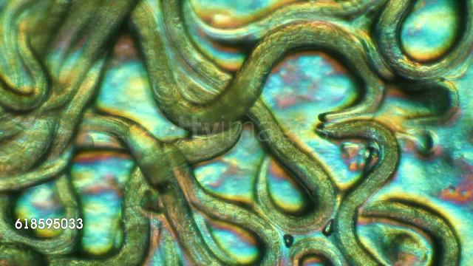
Plant-feeding Nematodes
Integrated Pest Management
Soil Stewardship and Soil Health
Howard Ferris
Department of Entomology & Nematology
University of California, Davis, USA
November, 2019

Slide 2
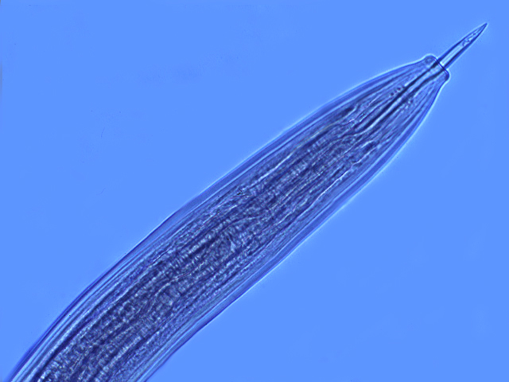
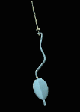
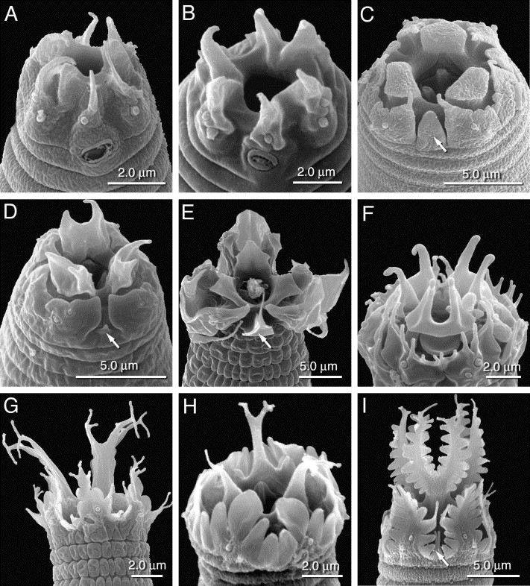
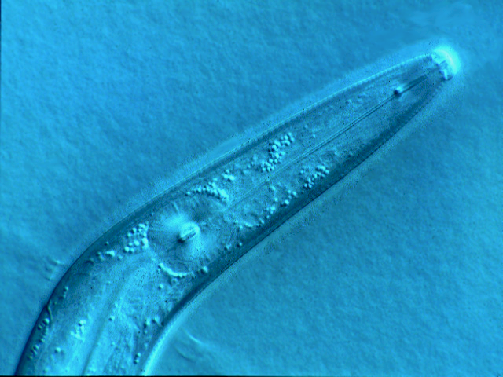
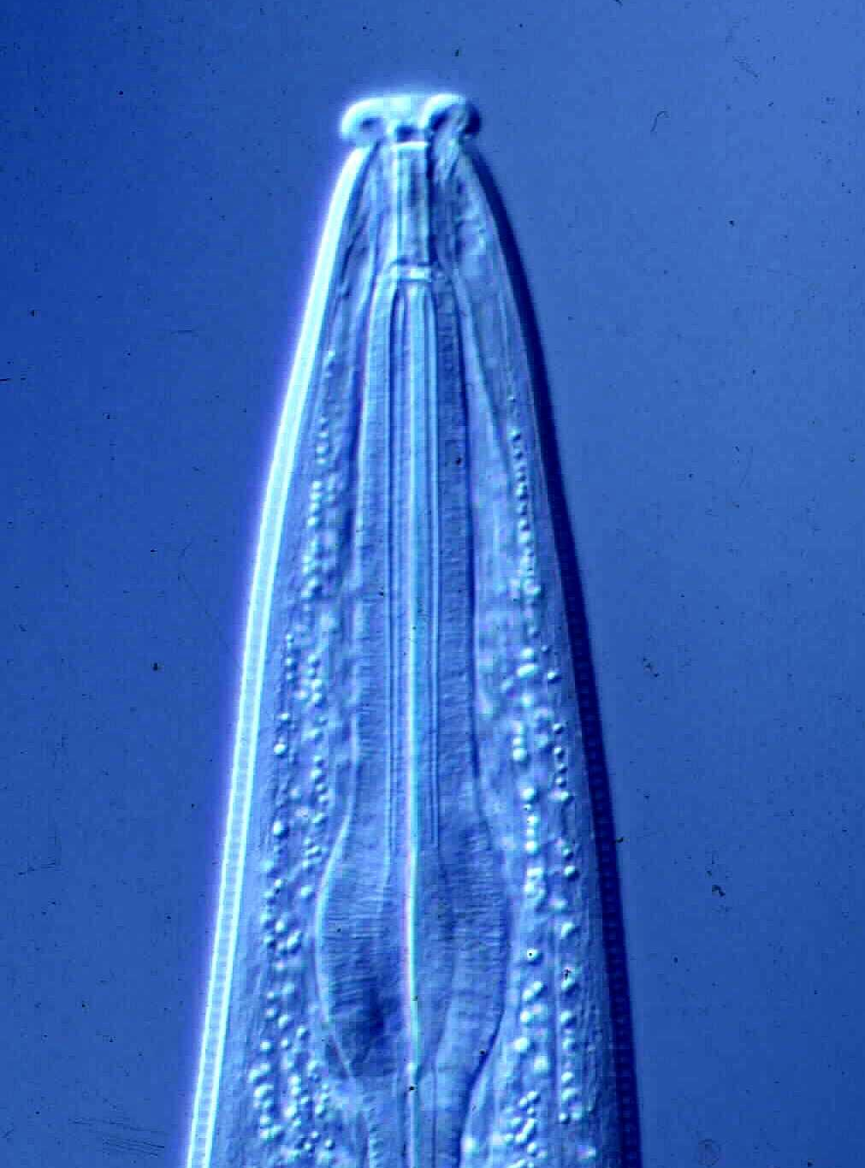
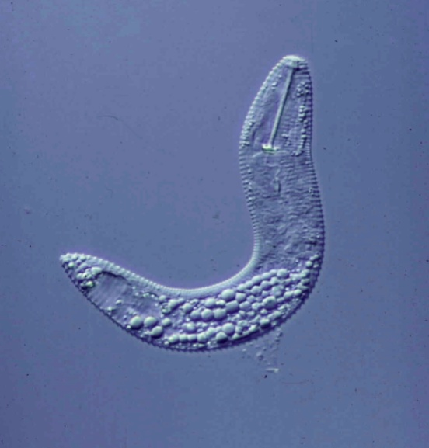
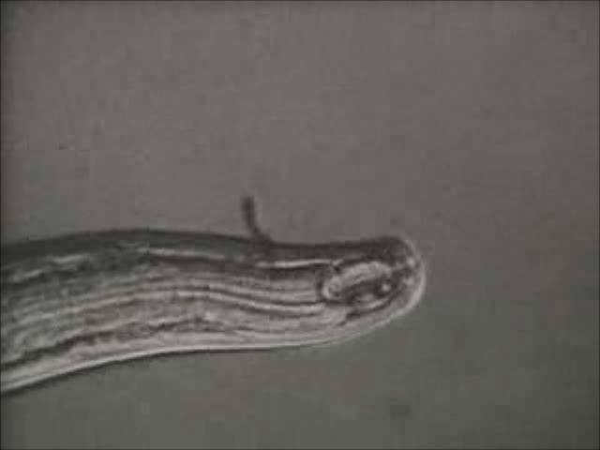
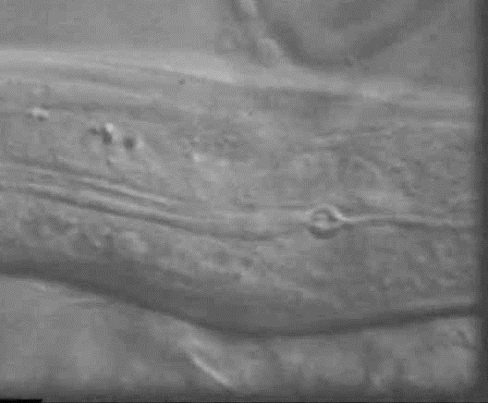
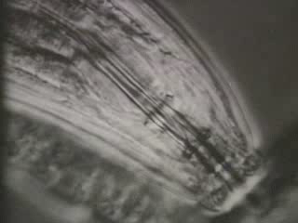
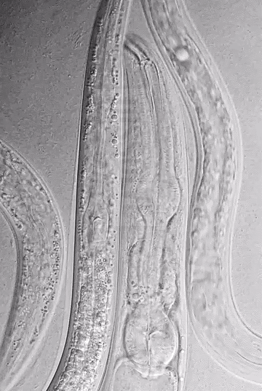
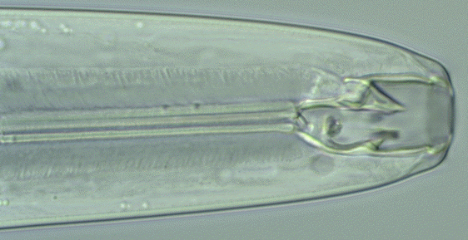
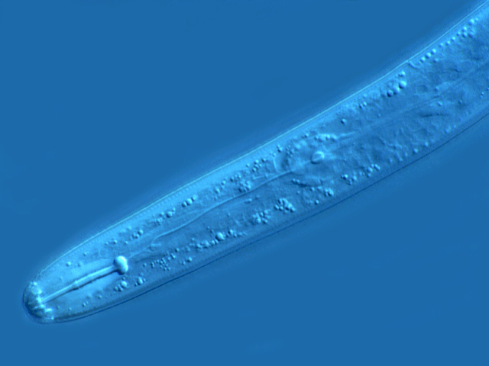
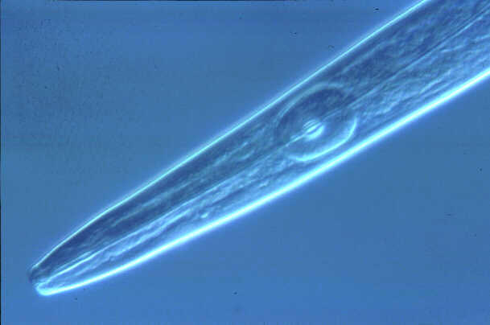
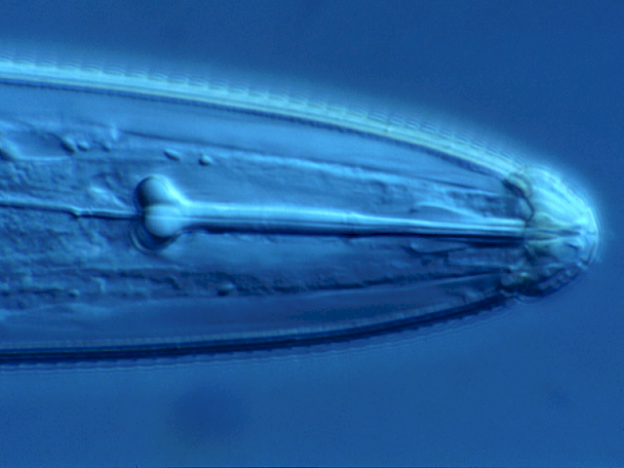
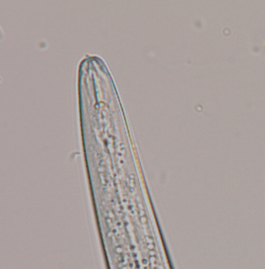
Functional Diversity of Soil Nematodes:
relationships between form and function

Slide 3
Soil nematodes….
Abundant and diverse (species and trophic categories)
Generally elongate, cylindrical worms
Length range of 0.3-1.5 mm (0.05-5.5µg); some 2-10 mm
Aquatic organisms living in water films surrounding soil particles
Move through soil pore spaces, do not burrow through soil
Body surrounded by a protective cuticle that is variously striated
No respiratory or circulatory systems, gas exchange by diffusion across cuticle
Reproduce sexually or by parthenogenesis
Feeding through a tubular or toothed mouth or a protrusible stylet

Slide 4
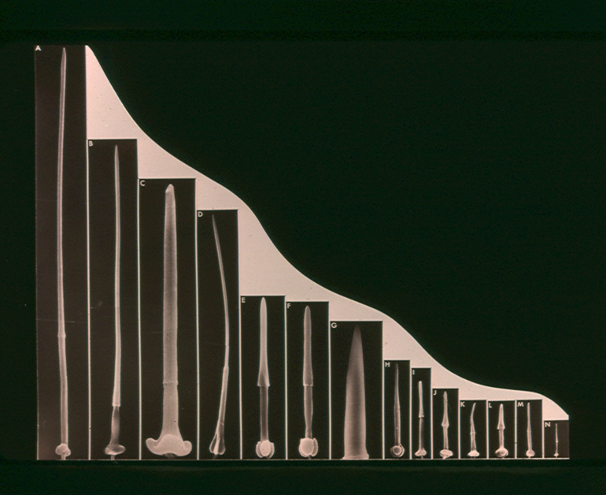
All plant-parasitic nematodes have a hollow stylet or spear
Those with long stylets generally feed as ectoparasites;
those with short stylets either as ecto- or endoparasites

Slide 5
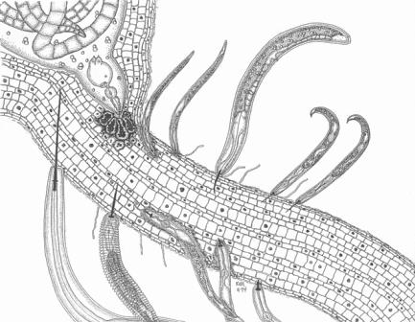

Slide 6
Plant-feeding nematodes……..
Suppress or avoid host defenses
Subvert the cell cycle
Alter photosynthate partitioning
Cause mechanical injury to cells and tissues
Cause cell death
Modify cell development
Modify cell function
Disrupt uptake of water and nutrients
Create avenues of ingress
Predispose plants to diseases and other stresses
Some vector plant viruses

Slide 7
Signs and symptoms…..
Stunting, slow growth, dieback
Chlorosis and nutrient deficiencies
Wilting
Reduced yield
Lack of response to other treatments
Root symptoms
  Root stunting
  Root branching and proliferation
  Galls at root tips or along roots
  Lesions on roots

Slide 8
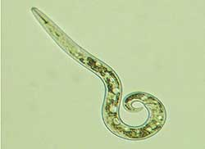
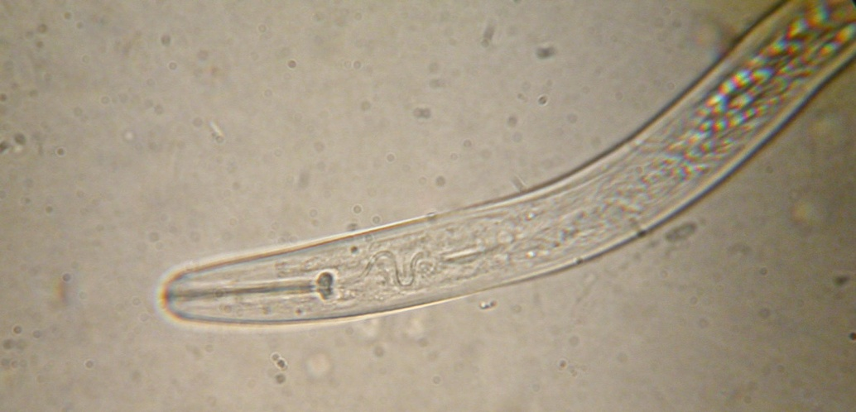
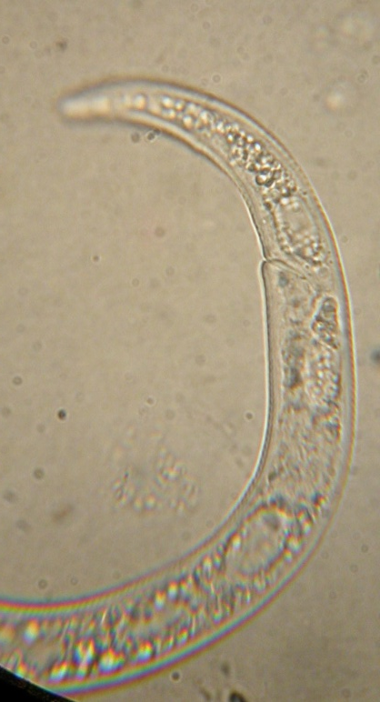
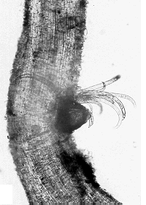
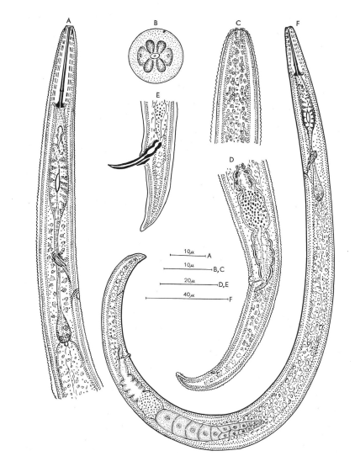
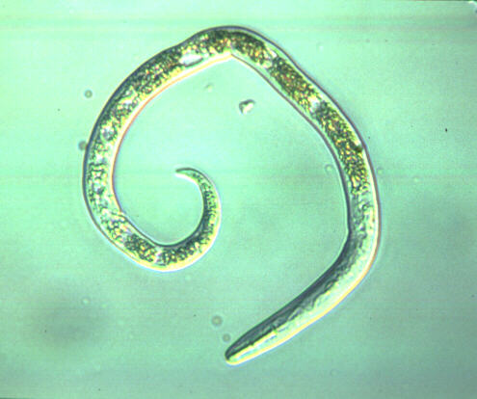
Paratylenchus spp.
pin nematodes

Slide 9
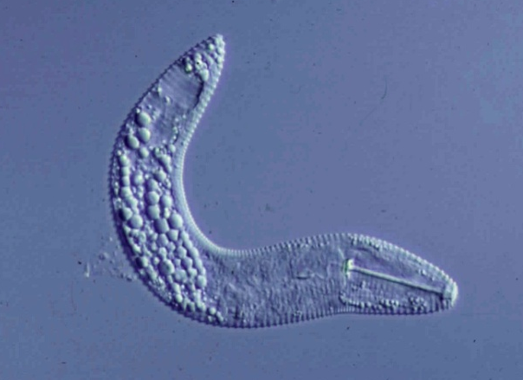
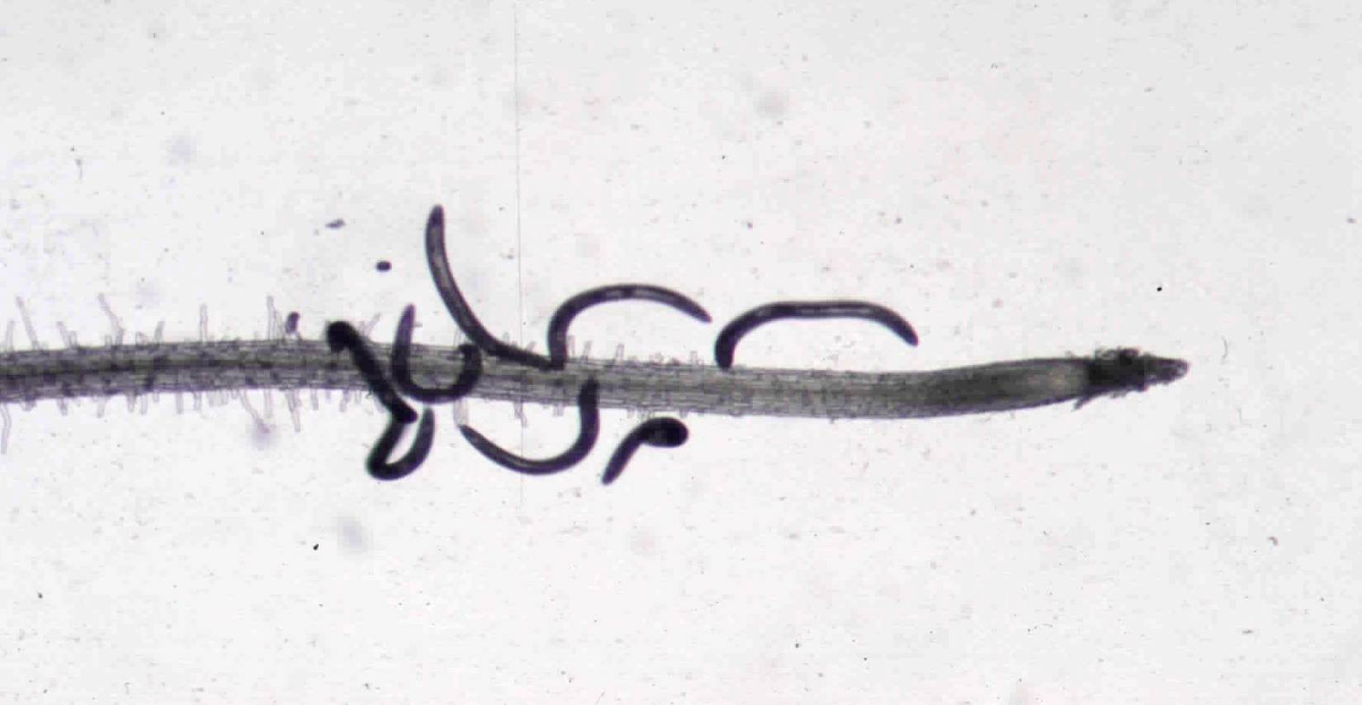
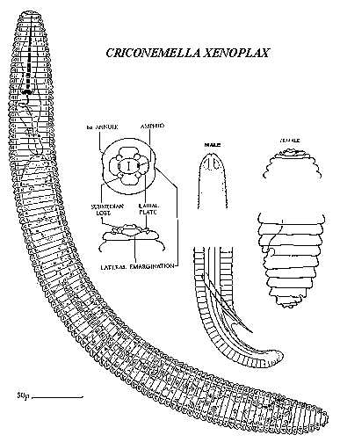
Mesocriconema xenoplax
ring nematode
-
+

Slide 10
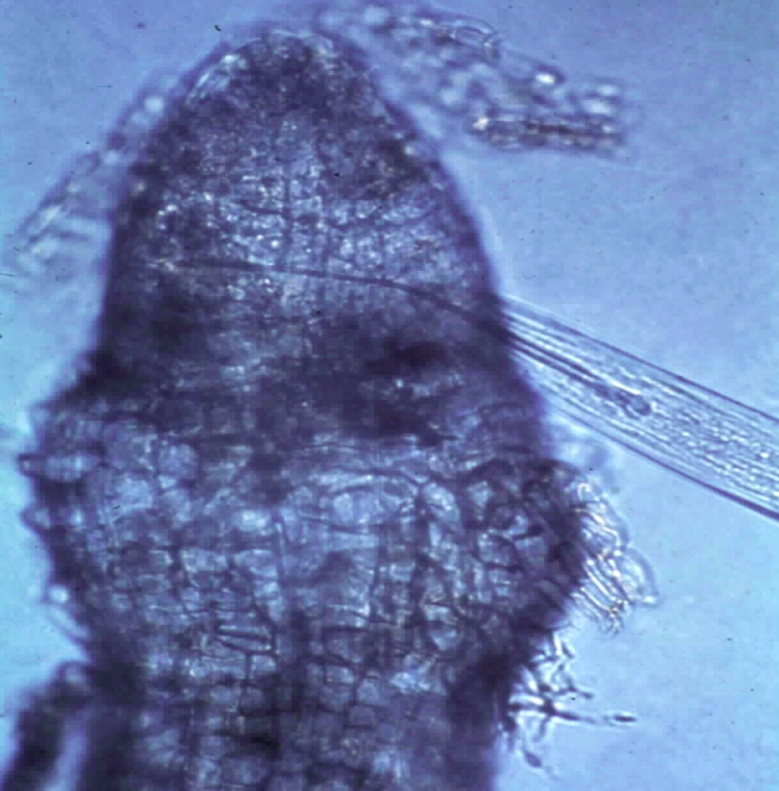
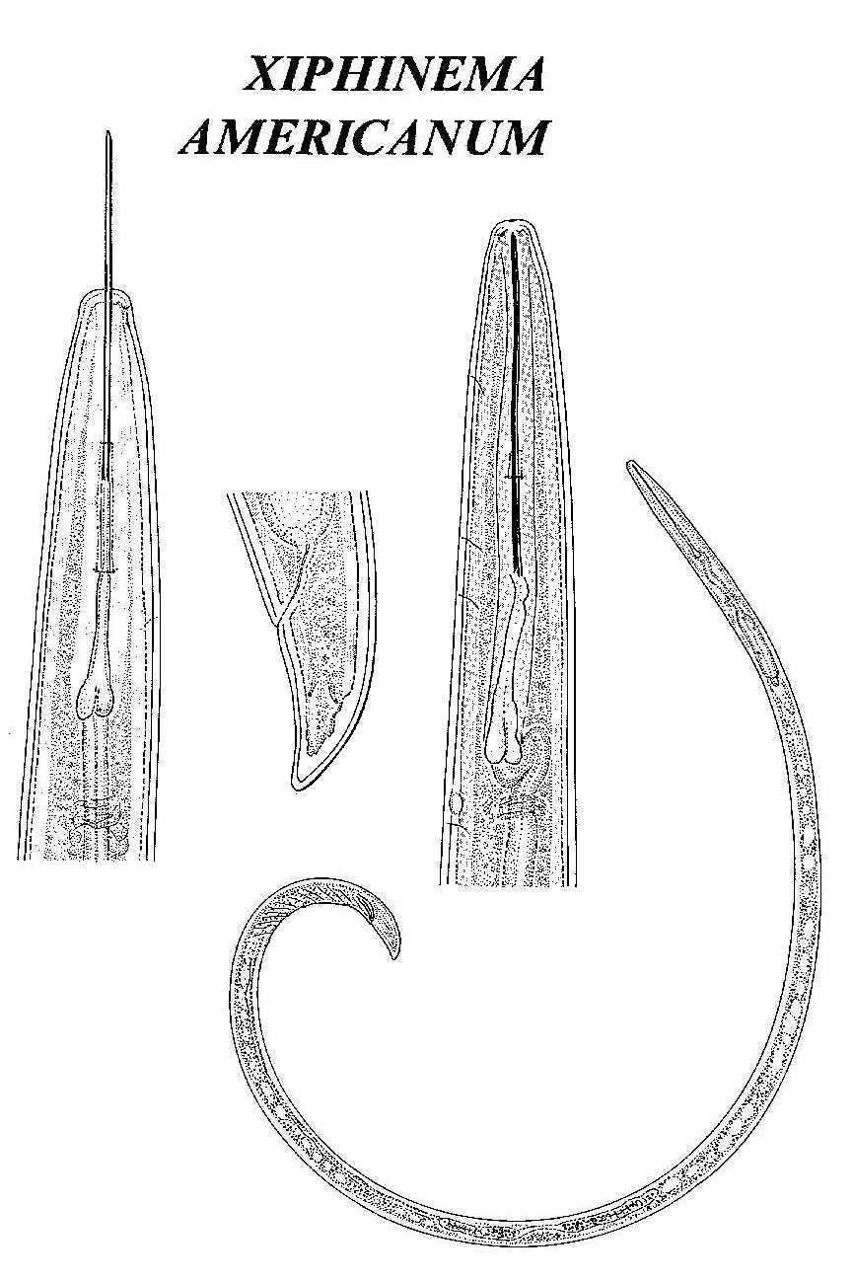
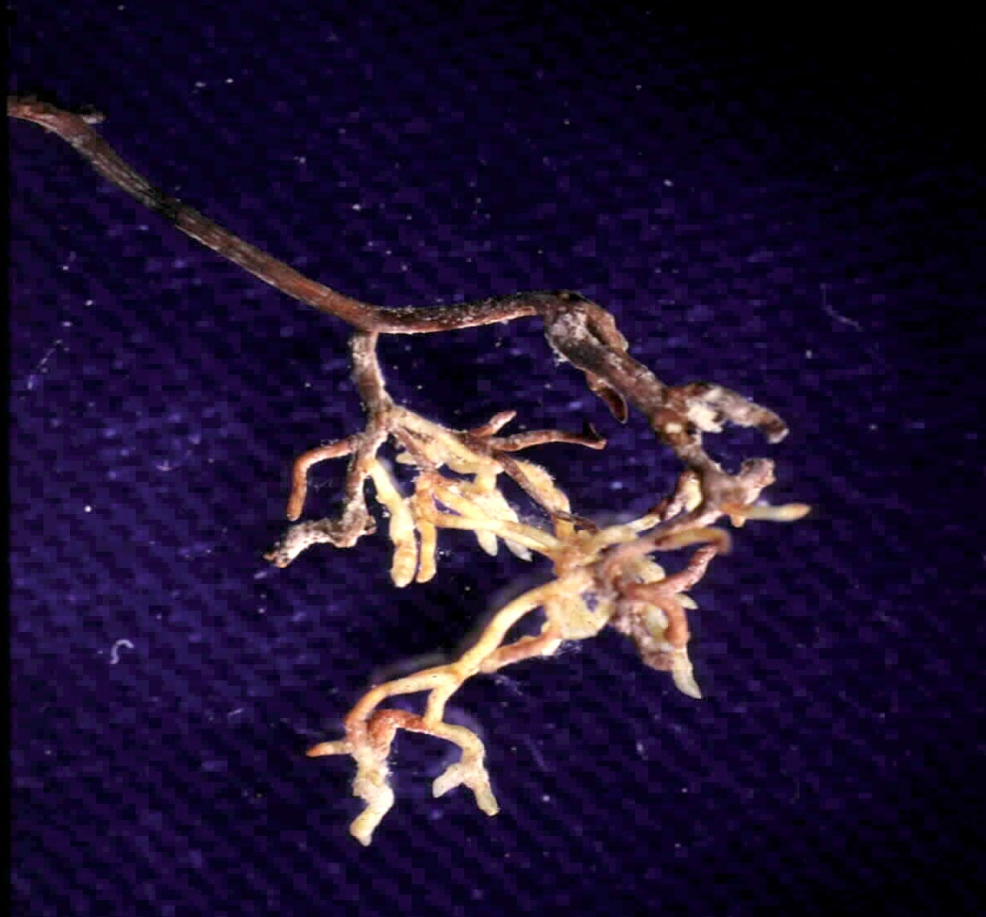
Xiphinema americanum
dagger nematode

Slide 11
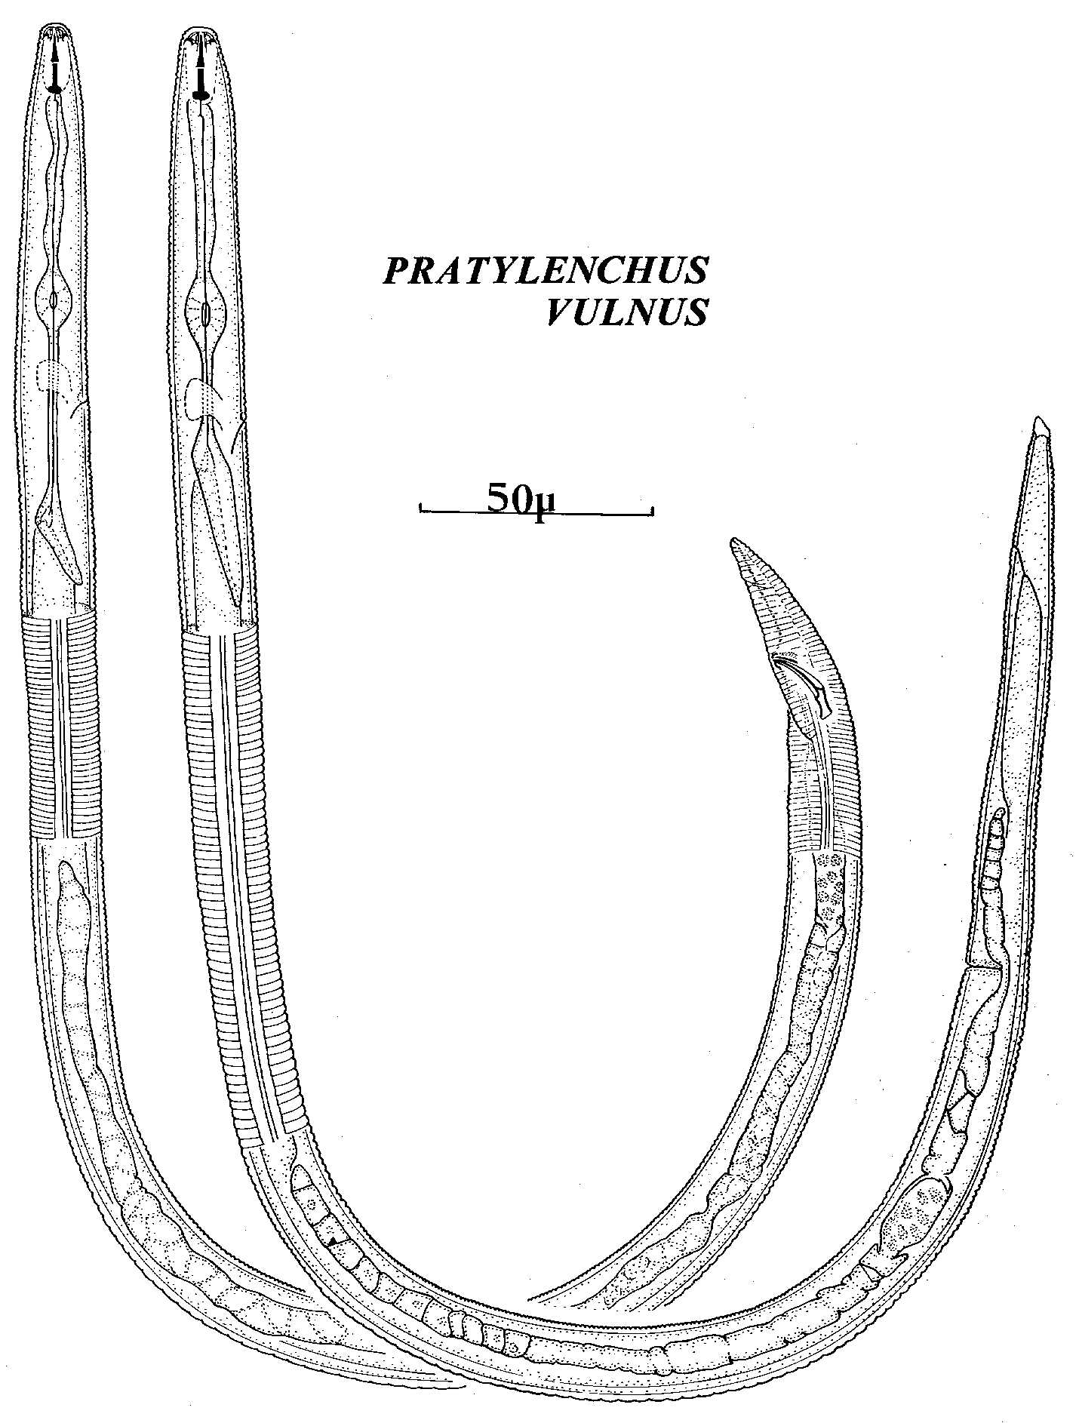
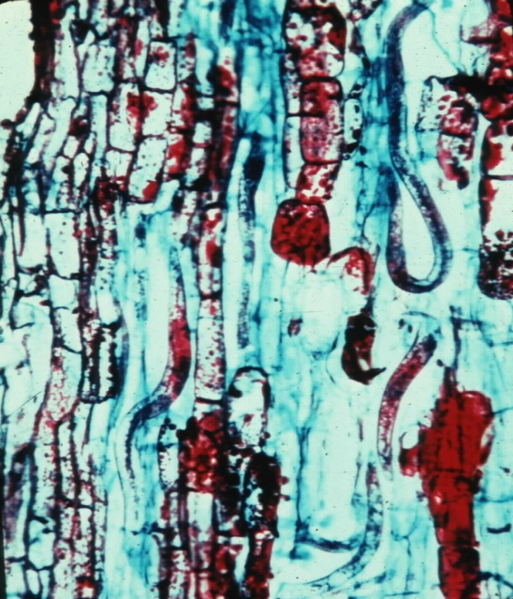
Pratylenchus vulnus
root lesion nematode

Slide 12
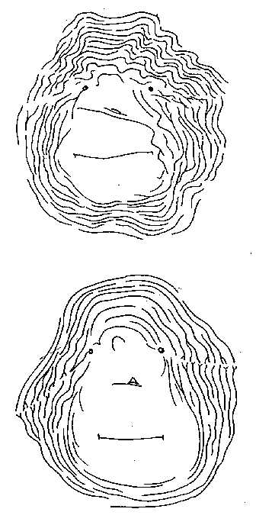
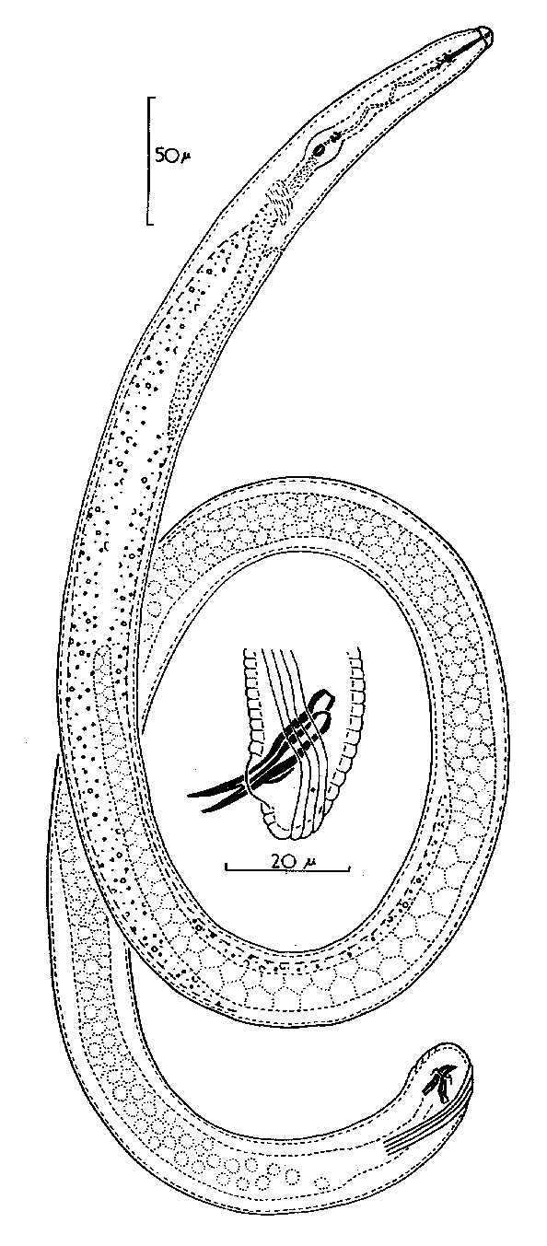
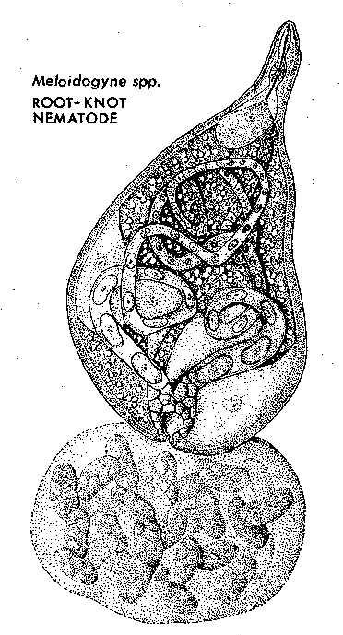
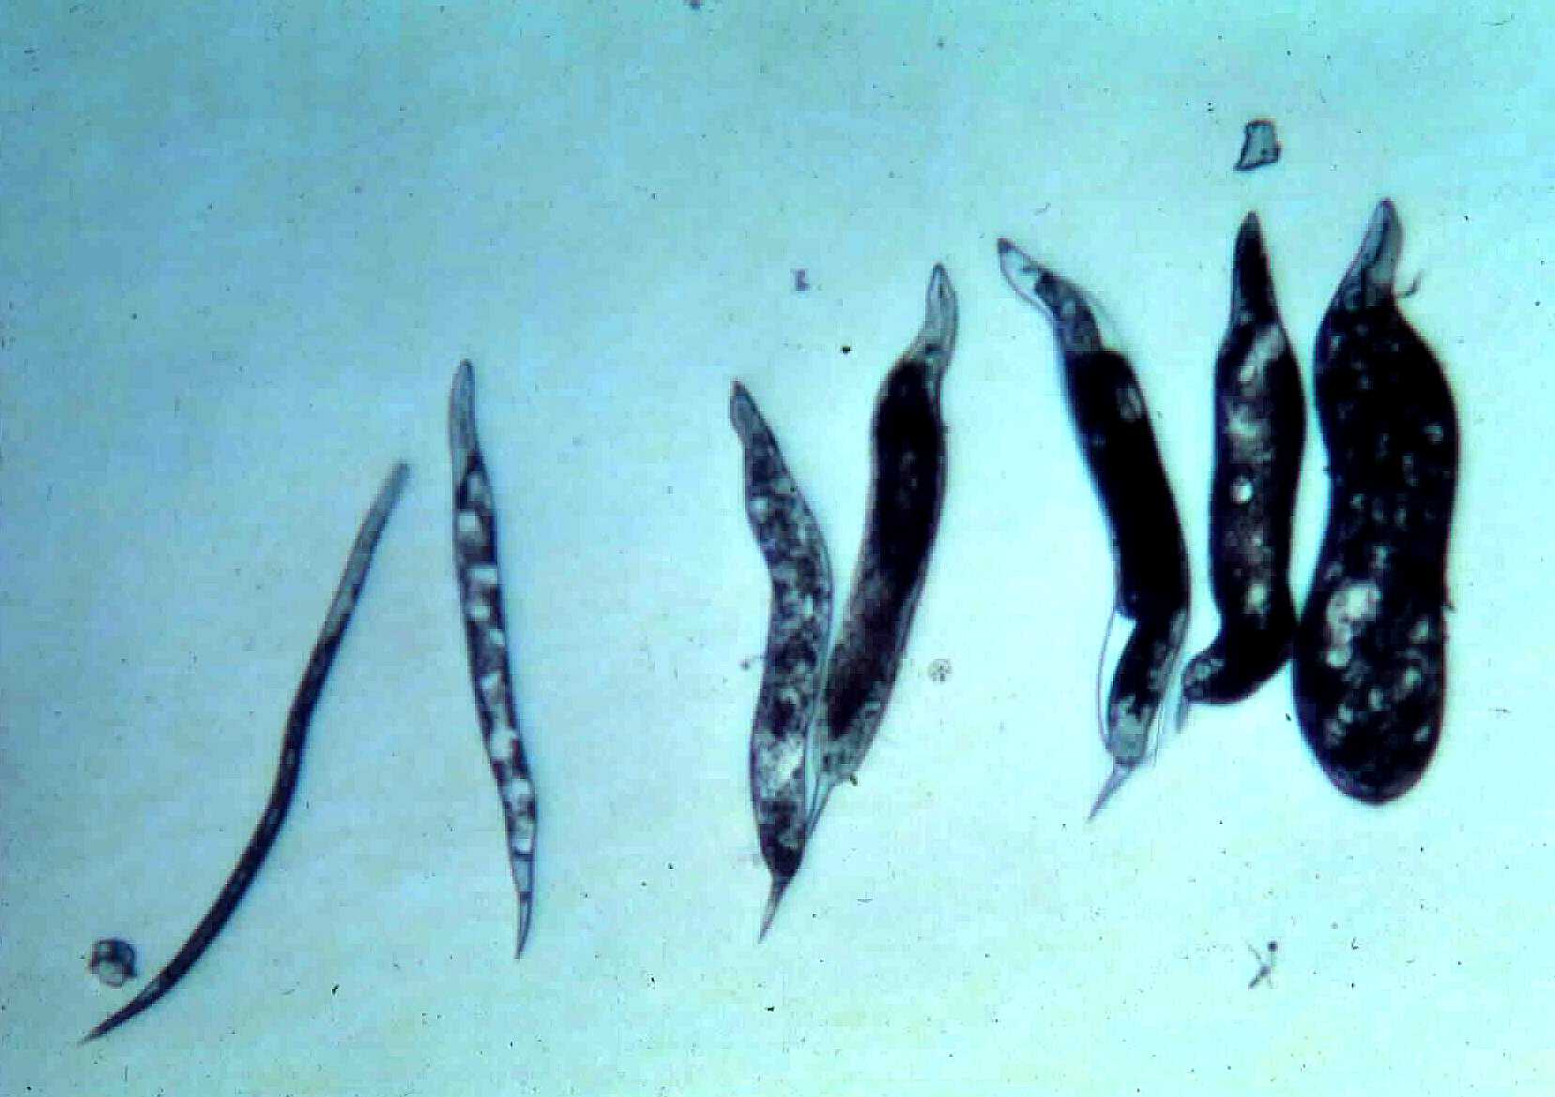
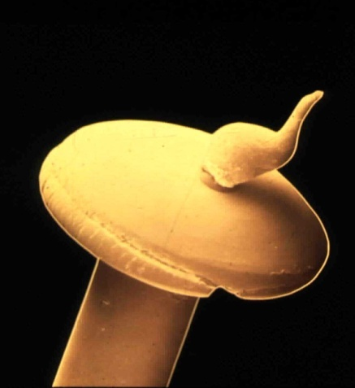
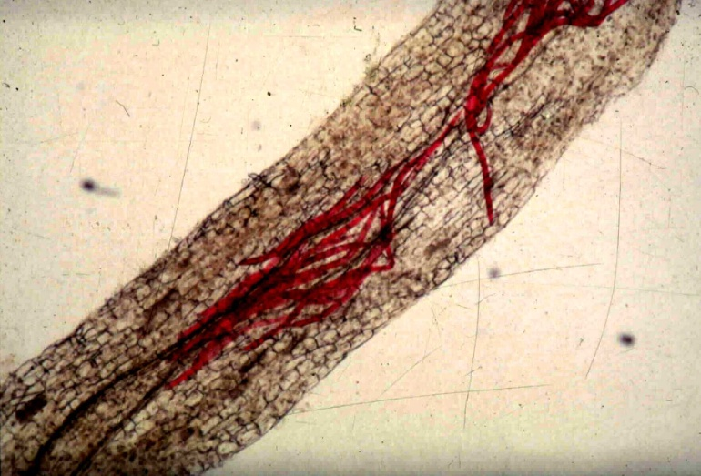
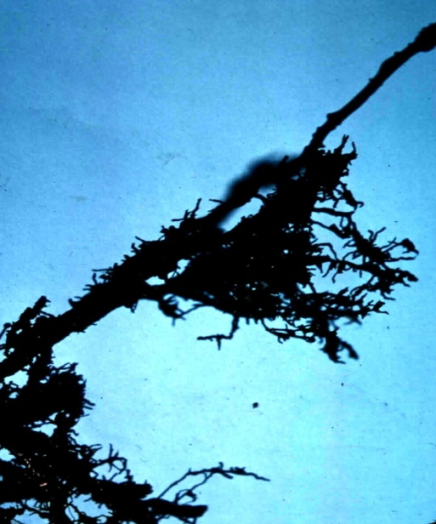
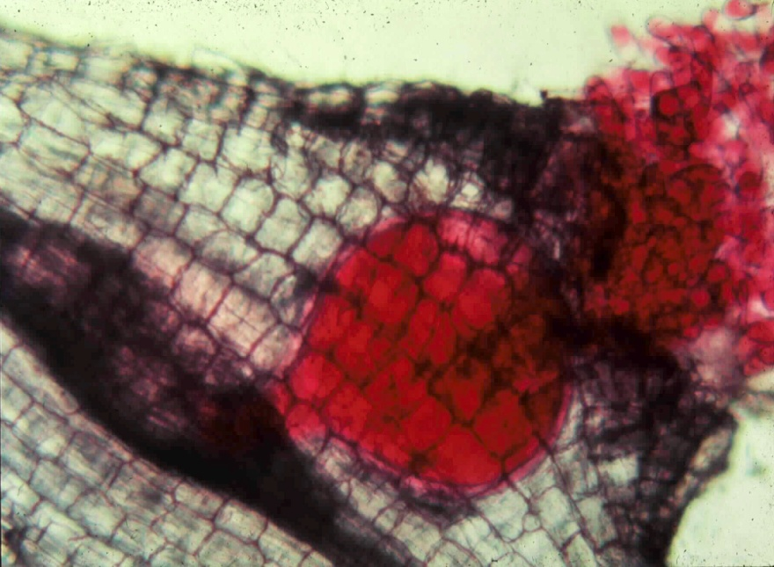
Meloidogyne spp.
root-knot nematodes

Slide 13
Management tactics for plant-parasitic nematodes….
Preplant management
  Planting site selection, non-host rotation
  Deal with replant problem issues
  Soil disinfestation, nematicides
  Clean equipment, water
  Certified planting stock
  Rootstock selection
  Biological antagonists and soil food web health
Postplant management
  Organic amendments
  Non-phytotoxic nematicides
  Soil building cover crops
  Biological antagonists and soil food web health

Slide 14
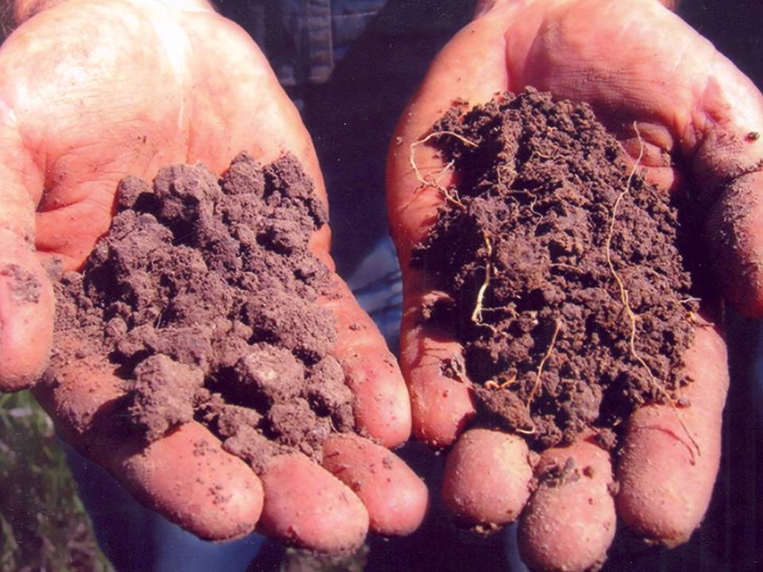
Soil Health and the Soil Food Web
The ability of soil to perform its ecosystem functions
Major Functions: Sustain plant and animal productivity
Maintain and enhance water and air quality
Support human health and habitation
Ecosystem Services:
Decompose organic materials
Sequester and redistribute minerals
  Mineralize organic molecules
  Regulate and suppress pests
Alter substrate to provide access to other organisms
Redistribute organisms in space
Improve soil structure
Biodegrade toxins
Reduce soil erosion

Slide 15
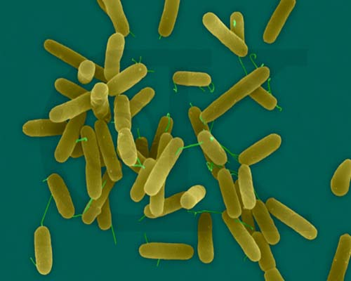
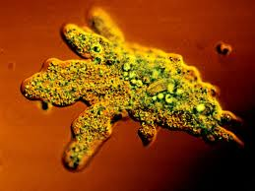
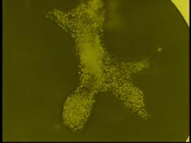
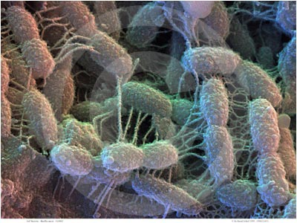
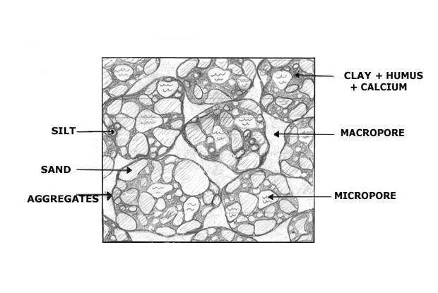
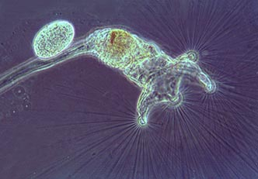
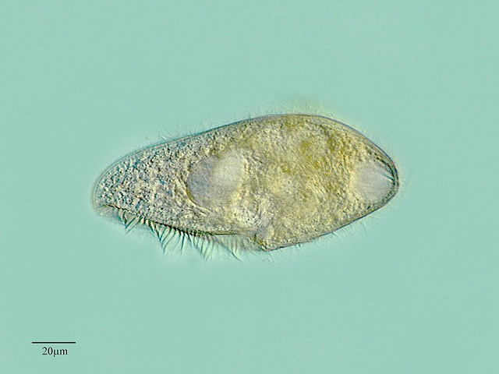
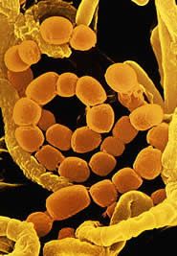
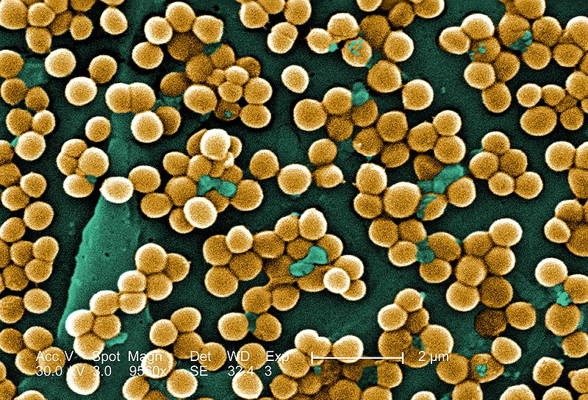














Bacteria
many soil organisms
Protozoa
in many microhabitats
Microarthropods
Nematodes
performing many
ecosystem services
Notes:
The soil provides habitat for myriad organisms of different type, size, and physiological activity. Their activities, which
are integral to the ecosystem functions of a healthy soil, include the decomposition of organic materials, sequestration
and mineralization of nutrients, facilitation of access of organisms to new resources, improvement of soil structure for
percolation and penetration, biodegradation of contaminants, and regulation and suppression of opportunistic pest
species. In many cases, the productivity of managed systems has been developed through manipulation of the chemical
and physical components of the soil, with consideration of the biological component mainly focused on those species
that are detrimental to productivity. Often that focus has resulted in soils which support high crop productivity but which
are quite unhealthy from the standpoint of their ecological functions; their productivity requires a continuous or frequent
input, which may be environmentally and economically unsustainable. Once a desired ecosystem function is not
performed by any of the contributing species, the soil is no longer healthy relative to that function. Biodiversity provides
a greater range of organism types and adaptations contributing to each ecosystem function and consequently increases
the range of conditions in which the function is performed, the magnitude of the function and the health of the soil. The
challenge in soil management is to promote and maintain the beneficial functions of the soil biota. Nematodes are
convenient bioindicators of soil condition; they contribute directly to ecosystem services and are indicators of the
presence and activities of other organisms. As representatives of the resident biota, nematode assemblages indicate
three attributes of the biological component of the soil: the nature of ecosystem services available, the magnitude of
those services, and the complementarity of services across time, space and microhabitat. Current and anticipated
advances in molecular techniques for determination of nematode abundance, diversity and function will facilitate
application of bioindicator-based measures of soil health.

Slide 16


Assessing Soil Health
1. Nematode Faunal Analysis
Disturbed
N-enriched
Low C:N
Bacterial
Conducive
Enriched
Maturing
N-enriched
Low C:N
Bacterial
Regulated
Ba₁
Enrichment index
Structured
Fu₂
Degraded
Depleted
High C:N
Fungal
Conducive
Matured
Fertile
Mod. C:N
Bact./Fungal
Suppressive
Fu₂
Basal
Ba₂
Om₄
Om₅
Basal
condition
Ca₃
Ca₄
Ca₅
Fu₃
Fu₄
Fu₅
Ba₃
Ba₄
Ba₅
The indices are useful, but…..…
They do not indicate biomass, metabolic activity or magnitude
of functions/services
Structure index
Ferris et al., 2001

Slide 17

2. Metabolic Footprints of Functional Guilds
What is the magnitude of the function or service?
How much carbon is being processed?
How much energy is being used?

Slide 18
Nematode Faunal Profiles
and the Metabolic Footprint
Enriched
bacterivores
fungivores
Enrichment index
100 (w1.cp1 + w2.Fu2)
/ (w1.cp1 + w2.cp2 )
Ba₁
Enrichment trajectory
Structured
Fu₂
fungivores
bacterivores
Fu₂
Basal
Ba₂
Om₄
Om₅
Basal
condition
omnivores
Ca₃
Ca₄
Ca₅
carnivores
Fu₃
Fu₄
Fu₅
fungivores
Ba₃
Ba₄
Ba₅
bacterivores
Structure trajectory
Ferris, 2010
Structure Index = 100 w_{i}.cp_{i} / (w_{i}.cp_{i} + w₂.cp₂ ) for i = 3-5
Ferris et al, 2001

Slide 19


An ecosystem service example:
N-mineralization by bacterial-feeding nematodes
Nitrogen Mineralization

Slide 20


Other Ecosystem Services:
The regulation of opportunistic (pest) species
100
Enrichment Index
50
0
Woodland
0
50
100
Vineyard
Structure Index

Slide 21





The regulation of opportunistic (pest) species
Predator: Prey Ratio
Sánchez-Moreno and Ferris, 2007
Notes:
21

Slide 22






Comparison of Organic and Conventional Banana Production Systems: Costa Rica
Management practices in industrialized agriculture result in:
Soil food web simplification
Reduction in higher trophic levels
Reduction of species diversity

Slide 23



Consider the complexity of the soil environment
macropore
So Species Diversity within Functional Guilds must be important
micropore
aggregate

Slide 24
True Species Diversity (the Effective Number of Species or Hill Number):
abundance of a species can be measured as:
number of individuals
biomass of individuals
metabolic footprint of individuals
which leads to the measure of functional diversity based on the effective number of species:
 |  |  | Fungivores |  |  |  |  | Bacterivores |  |  |  |  | Predators
Genus |  | Aphel. | Aphoid | Dityl. | Filen. | Cruzn. | Mesor. | Panag. | Rhabd. | Ceph. | Acrob. | Mononc | Prodor. | Discol. | Actinol.
Abundance - Individuals |  | 1 | 65 | 7 | 15 | 288 | 12 | 133 | 2 | 16 | 12 | 3 | 5 | 7 | 1
Weight/individual |  | 0.23 | 0.16 | 0.56 | 0.09 | 4.95 | 0.57 | 0.66 | 7.50 | 0.27 | 0.15 | 4.03 | 5.16 | 2.93 | 19.6
Abundance - Biomass |  | 0.2 | 10.5 | 3.9 | 1.4 | 1406.9 | 6.8 | 87.8 | 15.0 | 4.3 | 1.8 | 12.1 | 25.8 | 20.5 | 19.6
True species diversity in whole assemblage
Effective # of species |  |  |  | 1.3 | 3.0
True species diversity within functional guilds
Effective # of species/guild |  |  |  | 2.0 | 1.7 |  |  | 1.2 | 2.1 |  |  |  |  | 3.8 | 2.0
Ferris and Tuomisto, 2015

Slide 25






Relationship Between Magnitude of the Function and the Diversity and Biomass of the Functional Guild
Effective Number of Species in Functional Guild = 2.04
Effective Number of Species in Functional Guild = 7.03
Metabolic Footprint of Functional Guild = 1000
Metabolic Footprint of Functional Guild = 1000
Diversity-weighted Footprint = 2040
Diversity-weighted Footprint = 7030
The Product Model: Is this a good measure of the magnitude of the function?
3. Abundance and Diversity of Functional Guilds

Slide 26


Redesigning the system to improve soil health
Consistent N-yield over 75 years without input
N-yield similar to that of high input wheat
1. Avoid destroying it!
Land-use change in Kansas:
Effects on Nematode Faunal
Structure
Structure Index
Basal Index
From Glover et al., 2010

Slide 27

Redesigning the system to improve soil health
2. Minimize stressors that damage the system
Nematode Sensitivity to Mineral Fertilizer
Ammonium sulfate
Solutions?
Composts
Organic Amendments
Manures
Fertigation
(slower release – as needed)
200
Nematode guild
150
c-p 1
Standardized Counts
c-p 2
100
X
c-p 3
50
c-p 4
X
c-p 5
X
X
0
X
X
0
0.02
0.05
0.1
0.5
1
Concentration (mM-N)
Tenuta and Ferris, 2004

Slide 28
Redesigning the System:
Banana Production – Central America
3. Provide resources that build the system
Predator Nematodes
-
+
x
Amplifiable Prey
Target Prey
-
x
+
+
Parasitic Fungi
Microbial Biomass
+
Goal: x.Pred > y.TgtPrey
+
y
Organic Matter
+
+
+
Plant Roots
Litter
+
External Sources

Slide 29


Banana Plantations - Panama
Co-location of Amplifiable Prey, Predators and Target Prey
Ferris et al., 2012

Slide 30



Redesigning the system to improve soil health
3. Provide resources that build the system
PoxC = permanganate-oxidizable carbon = active C
Data from Jackson et al., 2019
Vegetable Crop Farming Systems: France

Slide 31


3. Provide resources that build the system
Redesigning the system:
Engineering form to provide function – amplifiable prey
Testing the diversity-weighted
abundance hypothesis……
Data from Jackson et al., 2019

Slide 32


Redesigning the System
4. Engineering functional connectance
Soil Food Web Stewardship
Soil fertility
Organic matter
Food web activity
Soil structure
Winter cover crop – Vicia faba
Russell Ranch - California, 2006
Fossil fuel reduction
Habitat conservation
Food web activity
Soil structure
No-till soybeans, Brazil, 2006

Slide 33



Redesigning the System
Keep living roots in the soil throughout the year to feed the soil food web; avoid resource punctuation.
Keep the soil covered with crops and crop residues.
Diversify inputs through crop pattern, crop rotation, cover crops and cover crop mixtures.
Minimize soil disturbance to maintain soil structure and habitat suitability.
Soil Food Web Stewardship
Step-wise Transition?
……..this is where to start
But, remember the principles of
Integrated Pest Management!
A diversity of cover crops….
A sources of information and tools:
http://Nemaplex.UCDavis.edu
Adapted from: Jay Fuhrer, NRCS
Chad Ellis, Noble Foundation, 2013

Slide 34

Thank you very much!
http://Nemaplex.UCDavis.edu

Slide 35


Medicago truncatula
Redistribution of organisms
Caenorhabditis elegans
location of nodulating bacterium colony
- Sinorhizobium meliloti
Escherichia coli OP50
Medicago truncatula
or
Arabidopsis thaliana
Caenorhabditis elegans or
Acrobeloides maximus
Chemotaxis specificity:
Caenorhabditis elegans attracted to Medicago truncatula
C. elegans not attracted to Arabidopsis thaliana
Acrobeloides maximus not attracted to M. truncatula
Sinorhizobium meliloti adheres to both nematodes
Horiuchi et al., 2005

Slide 36
Soil Health………….
Emergent Themes and Take-home Messages
soil nematode assemblages (and many other organisms) contribute to ecosystem services
species diversity augments functional complementarity and functional succession
Management goals:
Preserve and conserve the natural system
Provide adequate and continuous resource supply to support services
Preserve and design favorable conditions for component guilds
Engineer co-location or range overlap of interacting guilds
here’s a goal!

