Slide 1
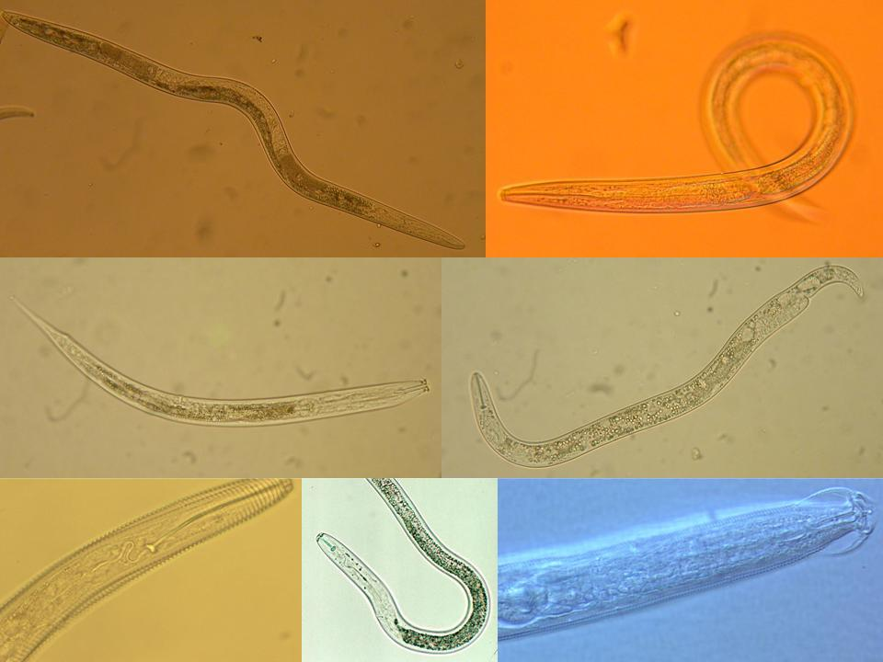


The BIOLOGiCAL COMPONENT OF SOIL HEALTH
Nematodes as Facilitators and Bioindicators
Howard Ferris¹ and Hanna Tuomisto²
¹Department of Entomology & Nematology
University of California, Davis, USA
²Department of Biology, University of Turku, Finland
October, 2013
Notes:
1

Slide 2
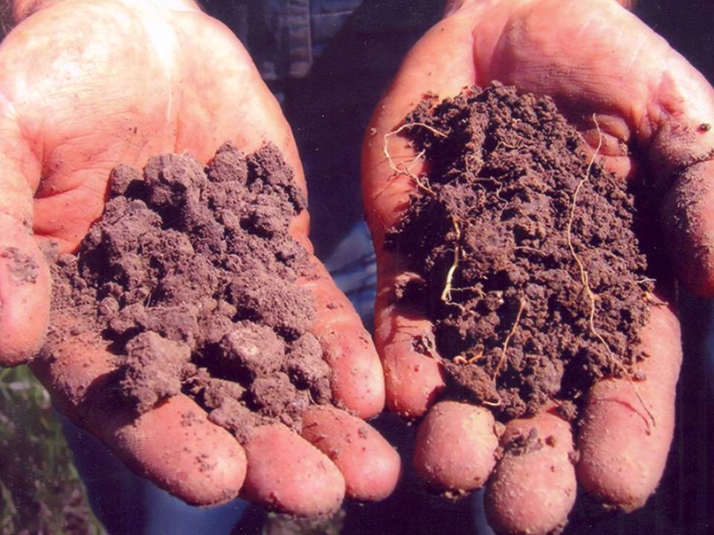
Soil Health
a subjective assessment of physical, chemical and biological components
we address the biological component while recognizing that all are interconnected
we select the nematode assemblage due to its diversity of function, species richness,
bioindicator potential, and the availability of exemplary data
our approach could be applied to any assemblage of soil organisms

Slide 3
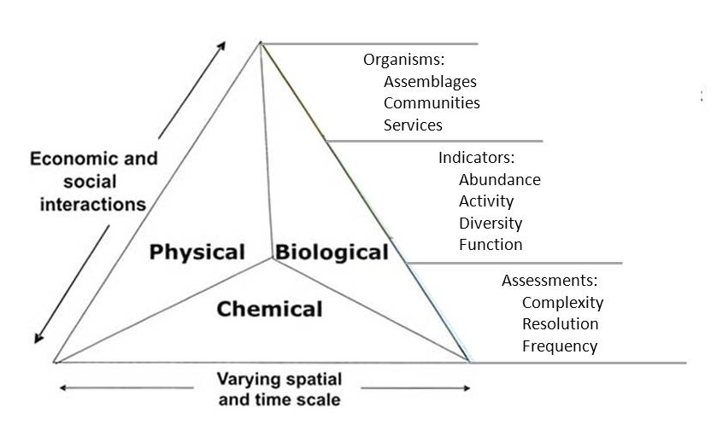
Soil Health

Slide 4
Nematodes as Bioindicators
Abundance; diversity of form and function; distribution
Direct contact with their aquatic microenvironment
Relatively permanent residents; assessments not complicated by influx or efflux
Occupy key positions in soil food webs, both as predators and prey
Standardized sampling, extraction and assessment procedures
Readily identified by both microscopic and molecular methods
Clear relationship between structure and function
High intrinsic information value per sample on resource-flow channels, nutrient status, soil contaminants, environmental stress
Bongers and Ferris, 1999

Slide 5
Nematodes as Bioindicators of Soil Health
Three legs of the assessment of the biological component of soil health are:
Faunal Analysis - habitat quality and available ecosystem services based on proportions of functional guilds
Metabolic Footprints –the magnitude of the ecosystem services
Functional Diversity –the complementarity and successional potential of ecosystem functions and services

Slide 6
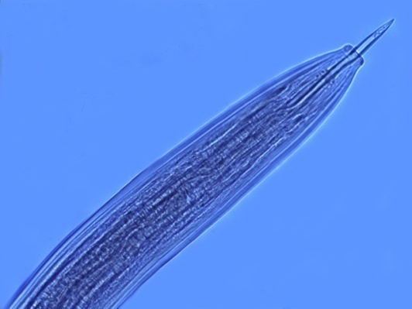
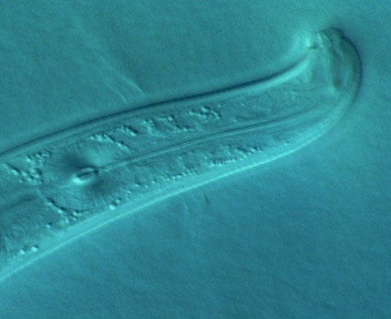
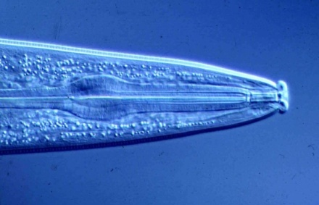
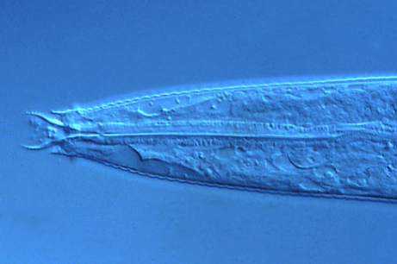
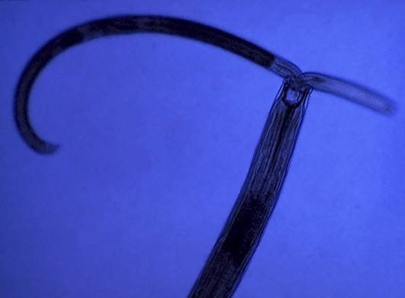
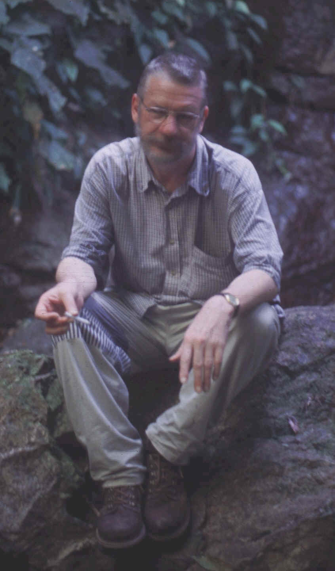
1
2
3
4
5
opportunism
structure
enrichment
stability
Colonizer-persister Series
Structure Indicators
Basal Fauna
Enrichment Indicators
Life course duration
Growth rates
Response to resources
Sensitivity to disturbance
1. Nematode Faunal Analysis
Bongers

Slide 7
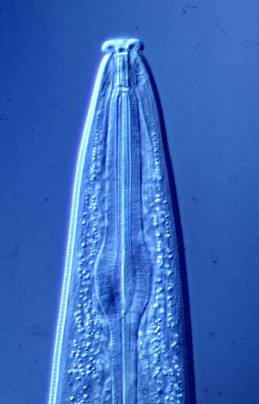

Food Web Structure and Function
Disturbed
N-enriched
Low C:N
Bacterial
Conducive
Enriched
Maturing
N-enriched
Low C:N
Bacterial
Regulated
Ba₁
Enrichment index
Structured
Fu₂
Degraded
Depleted
High C:N
Fungal
Conducive
Matured
Fertile
Mod. C:N
Bact./Fungal
Suppressive
Fu₂
Basal
Ba₂
Om₄
Om₅
Basal
condition
Ca₃
Ca₄
Ca₅
Fu₃
Fu₄
Fu₅
Ba₃
Ba₄
Ba₅
Structure index
Ferris et al., 2001

Slide 8
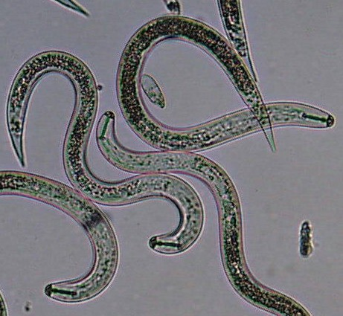
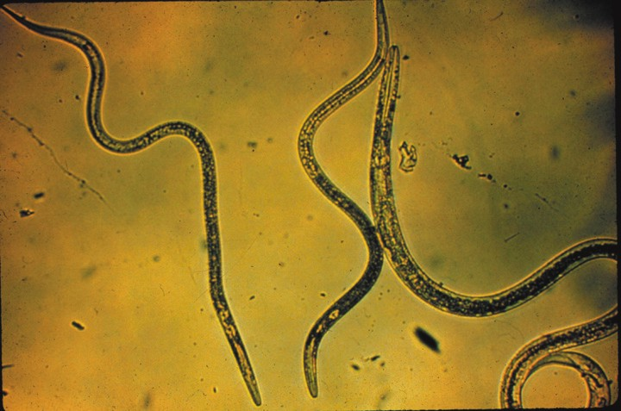
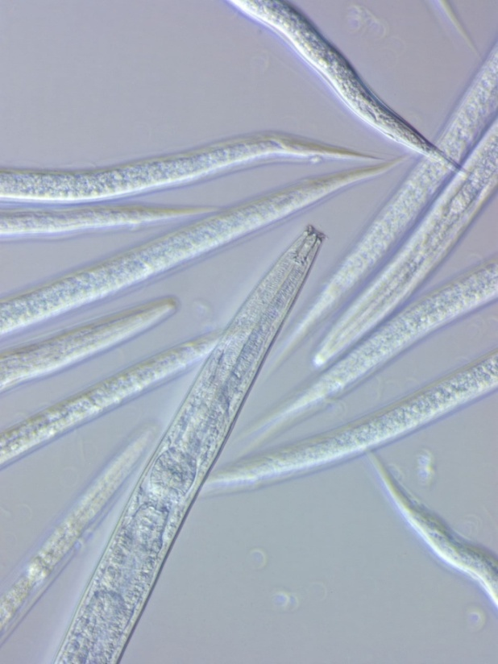
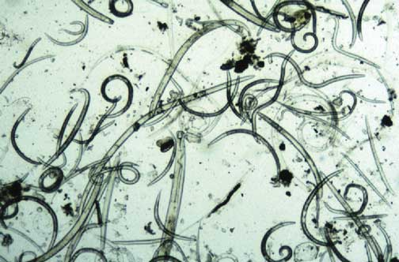
What is the magnitude of the function or service?
How much carbon is being processed?
How much energy is being used?
The indices are useful, but…..…
They do not indicate biomass, metabolic activity or magnitude
of functions/services – so, we develop:
2. The Metabolic Footprint

Slide 9
Nematode Faunal Profiles
and the Metabolic Footprint
Enriched
bacterivores
fungivores
Enrichment index
100 (w1.cp1 + w2.Fu2)
/ (w1.cp1 + w2.cp2 )
Ba₁
Enrichment trajectory
Structured
Fu₂
fungivores
bacterivores
Fu₂
Basal
Ba₂
Om₄
Om₅
Basal
condition
omnivores
Ca₃
Ca₄
Ca₅
carnivores
Fu₃
Fu₄
Fu₅
fungivores
Ba₃
Ba₄
Ba₅
bacterivores
Structure trajectory
Ferris, 2010
Structure Index = 100 w_{i}.cp_{i} / (w_{i}.cp_{i} + w₂.cp₂ ) for i = 3-5
Ferris et al, 2001

Slide 10
3. Functional Diversity

Slide 11

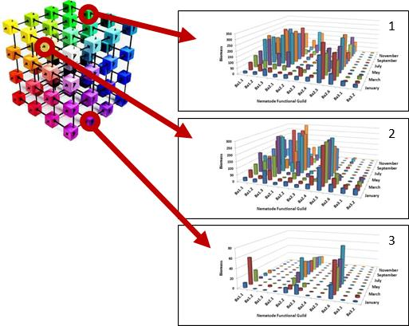
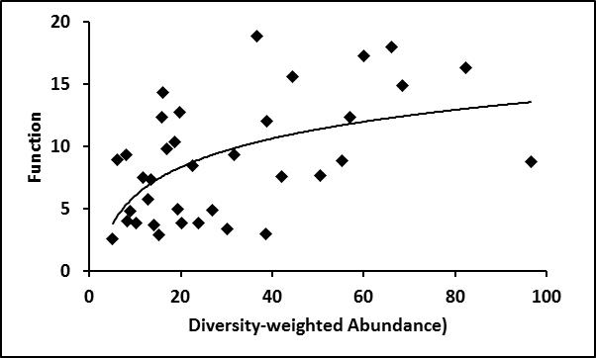
Soil Ecosystem Function: Diversity and Abundance are Important
edaphic, climatic,
anthropogenic
determinants of soil
microenvironments
differences in size, behavior,
adaptations and
physiological activity
among species of soil organisms
facilitate maximum exploitation
of myriad soil microhabitats
and maximize
ecosystem function

Slide 12
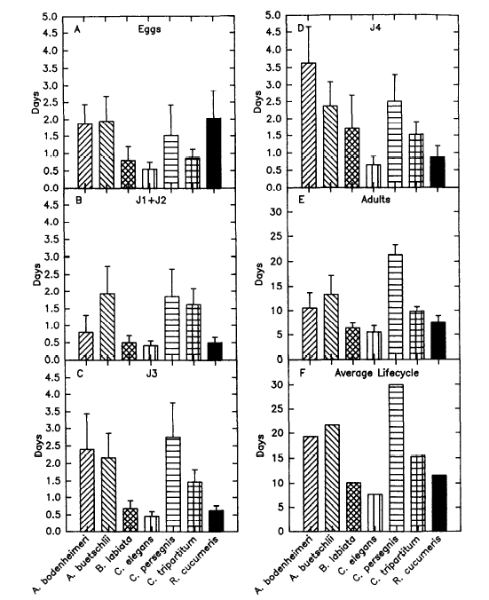
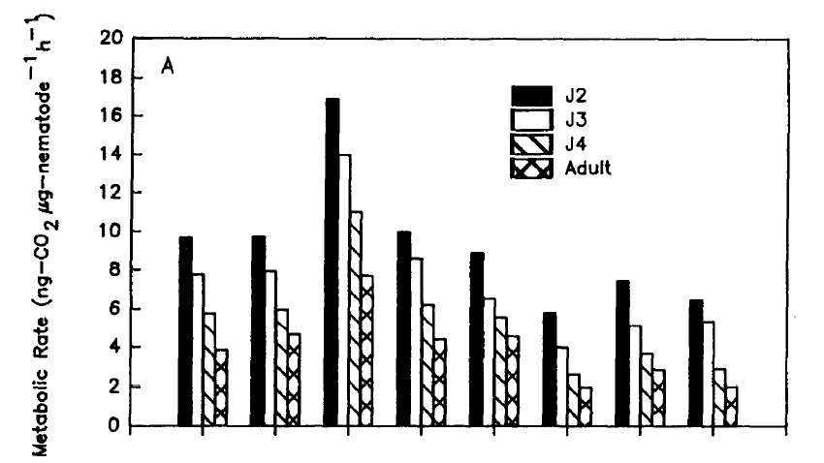
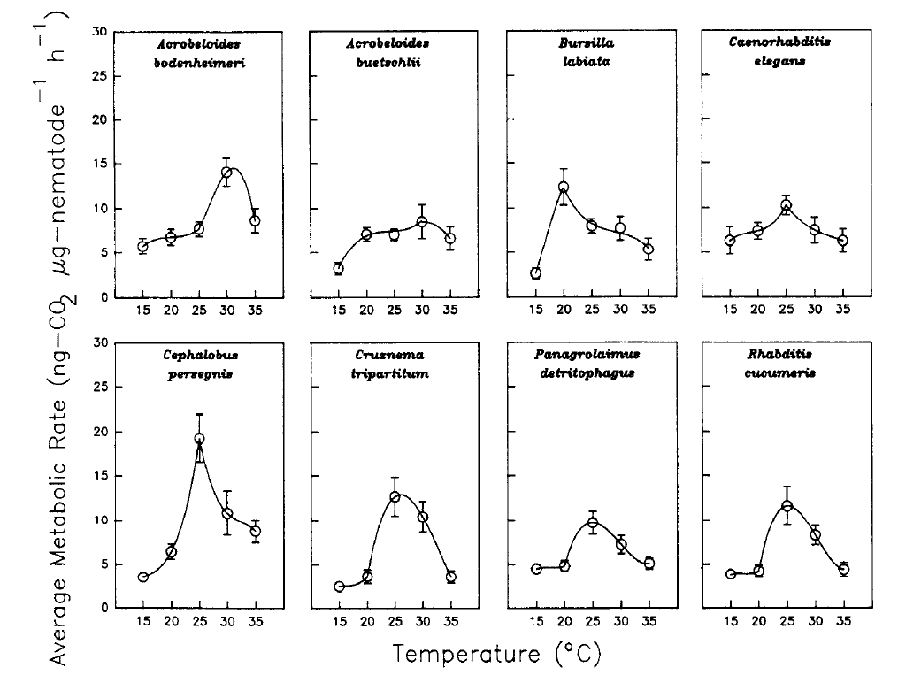
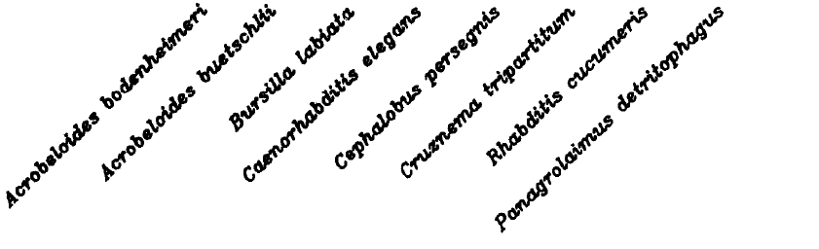
Spatial Diversity of Microsites and their Temporal Dynamics
gradient drivers:
temperature
moisture
aeration
organic residues
roots
soil texture
particle size
The Soil Environment
temporal drivers:
diurnal
seasonal
life course
phenology
degree-days
stochastic factors:
roots
patch distribution
patch composition
weather events
burrows
stones
restrictive layers

Slide 13
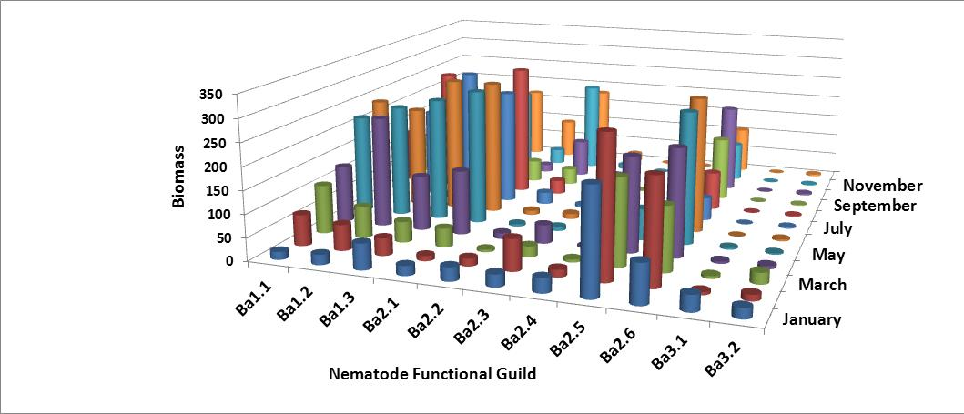
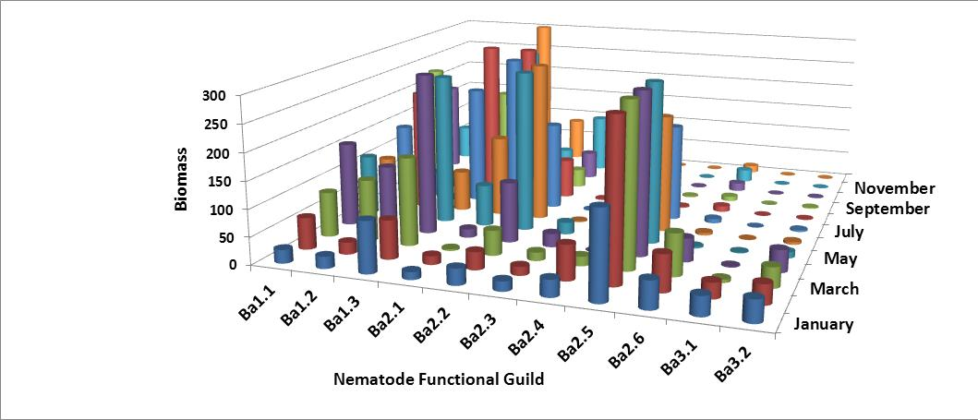
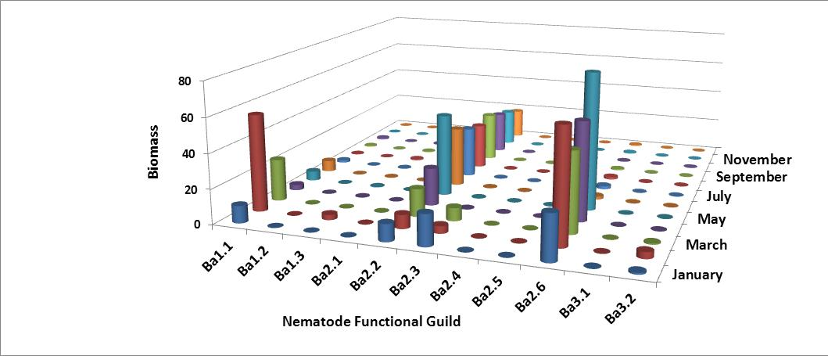
1
2
Different numbers of species of each
functional guild in each patch
The abundance of individuals of each
species varies among patches and
through time
3
Spatial and Temporal Activity
of Functional Guilds

Slide 14
Ecological diversity can be partitioned across different spatial scales (Whittaker, 1972) :
point-diversity (within sample)
pattern-diversity (between samples)
α-diversity (within habitat)
β-diversity (between habitats)
γ-diversity (within landscape)
δ-diversity (between landscapes)
ε-diversity (within biogeographic province)
Diversity
Functional diversity is the diversity of organisms performing the same function
We apply similar partitioning to functional diversity:
Total or true diversity of species with the same function (D)
Within functional-guild* species diversity (D_{w})
Functional guild diversity (D_{g})
* each guild is made up of different species and a species can only occur in one guild

Slide 15
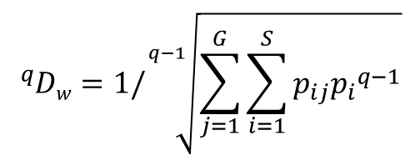
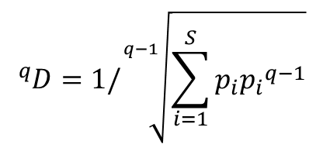
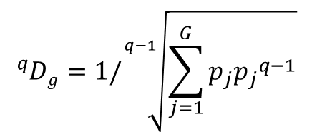
Functional Species Diversity Calculations
$${}_{}^{q}D=1/\sqrt[q−1]{\sum_{i=1}^{S}{p_{i}{p_{i}}^{q−1}}}$$
where p_{i} is the proportional
abundance of taxon i of the S taxa
Total species diversity
$${}_{}^{q}{Dw}=1/\sqrt[q−1]{\sum_{j=1}^{G}{\sum_{i=1}^{S}{p_{ij}{p_{i}}^{q−1}}}}$$
where p_{ij} is the proportional
abundance of taxon i
in guild j
Within guild species diversity
$${}_{}^{q}{Dg}=1/\sqrt[q−1]{\sum_{j=1}^{G}{p_{j}{p_{j}}^{q−1}}}$$
where p_{j} is the proportional
abundance of guild j of the G guilds
Guild diversity
Abundance may be measured as number of individuals, biomass, metabolic footprint of each type
Maximum possible species diversity (D) = species richness
Maximum within guild diversity (D_{w}) = species richness/number of guilds
Maximum guild diversity (D_{g}) = number of guilds*
* when all guilds have the same number of species

Slide 16
Functional Diversity based on Abundance as Number of Individuals
1 | 2 | 3 | 4 | 5 | 6 | 7 | 8 | 9 | 10 | 11 | 12 | 12 | 14 | 15 | 16 | 17 | 18
Cruz | Mesor | Panag | Rhab | A’boid | Acrob | Ceph | Monh | Plect | Wilso | Aphel | Aphoi | Dityl | Filen | Achro | Dipht | Alaim | Tylol | Total
b1 | b1 | b1 | b1 | b2 | b2 | b2 | b2 | b2 | b2 | f2 | f2 | f2 | f2 | b3 | f3 | b4 | f4
75 | 22 | 82 | 55 | 120 | 18 | 5 | 13 | 10 | 2 | 15 | 22 | 2 | 5 | 1 | 6 | 5 | 6 | 464
Total species diversity = 6.8 (effective number of species)
Mean within-guild species diversity = 2.7
Guild diversity = 2.5 (effective number of guilds)
True Diversity is the effective number of types

Slide 17
Functional Diversity Based on Biomass of Individuals
1 | 2 | 3 | 4 | 5 | 6 | 7 | 8 | 9 | 10 | 11 | 12 | 12 | 14 | 15 | 16 | 17 | 18
Cruz | Mesor | Panag | Rhab | A’boid | Acrob | Ceph | Monh | Plect | Wilso | Aphel | Aphoi | Dityl | Filen | Achro | Dipht | Alaim | Tylol | Total
b1 | b1 | b1 | b1 | b2 | b2 | b2 | b2 | b2 | b2 | f2 | f2 | f2 | f2 | b3 | f3 | b4 | f4
75 | 22 | 82 | 55 | 120 | 18 | 5 | 13 | 10 | 2 | 15 | 22 | 2 | 5 | 1 | 6 | 5 | 6 | 464
776 | 12 | 50 | 412 | 18 | 15 | 1 | 15 | 10 | 0.1 | 3 | 4 | 1 | 0.5 | 0.3 | 4 | 2 | 5 | 1330
Total species diversity = 2.3 (effective number of species)
Mean within-guild species diversity = 2.1
Guild diversity = 1.1 (effective number of guilds)
True Diversity is the effective number of types

Slide 18
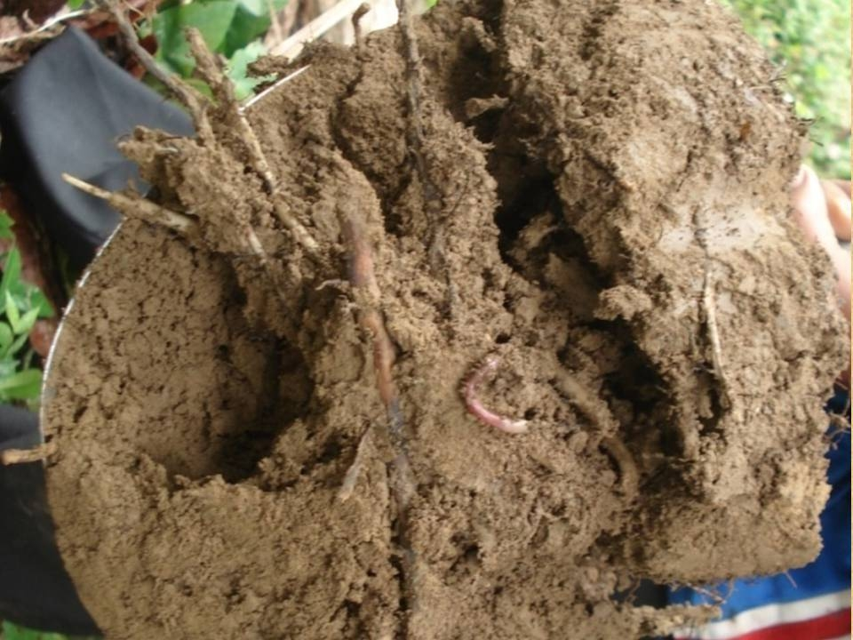
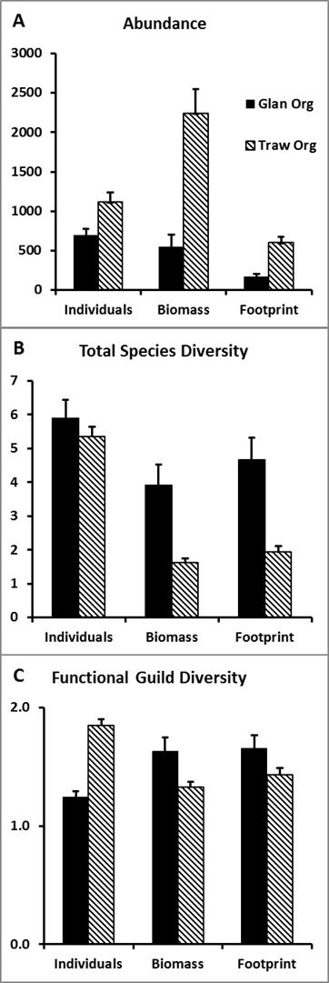
Data from Yeates and Cook, 1998

Slide 19


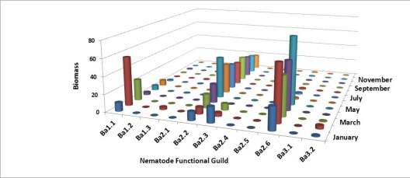
Working hypotheses:
1. Complementarity of ecosystem function in relation to species diversity within
and among functional guilds
2. Biomass or Metabolic Footprints are better functional measures of species diversity
than numbers of individuals
exploitative
species
diversity
sustained
function
effective number of species within guilds
(mean within-guild species diversity)
1
successional
guild
diversity
2
effective number of guilds
(total guild diversity)
3

Slide 20
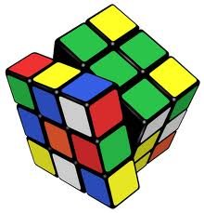
Working hypotheses:
3. Support of a diversity of predator species will require a diversity of prey species
Prey
sustained
function
Total predator diversity
Predators
Total prey diversity

Slide 21
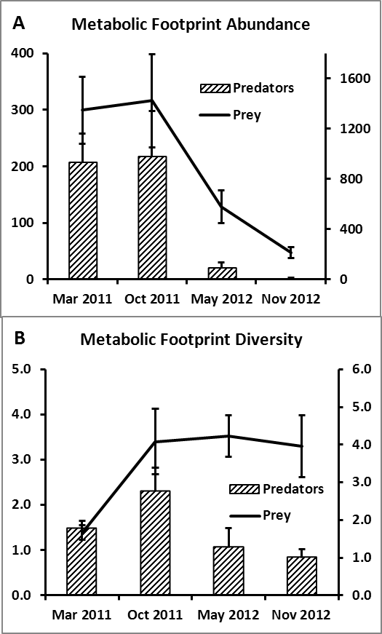
Field plots amended
with green waste,
December, 2010
Ferris and Tuomisto, in prep

Slide 22
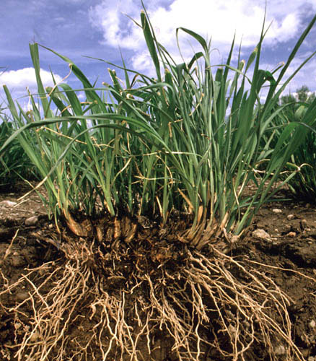
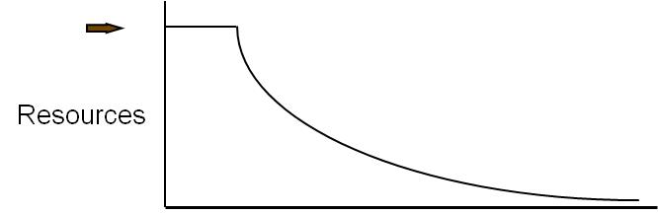
Stewardship of Abundance and Diversity: Carbon and Energy
CO₂
CO₂
CO₂
CO₂
bacteria
protozoa
nematodes
carbohydrates
and
proteins
C
N
nematodes
arthropods
fungi
carbohydrates
and
amino acids
other
organisms
nematodes
fungi
arthropods
nematodes
NO₃
Carbon and energy transfer
Carbon is respired by all organisms in the food web
The amounts of Carbon and Energy available limit the size and activity of the web
NH₃
NH₃
NH₃

Slide 23
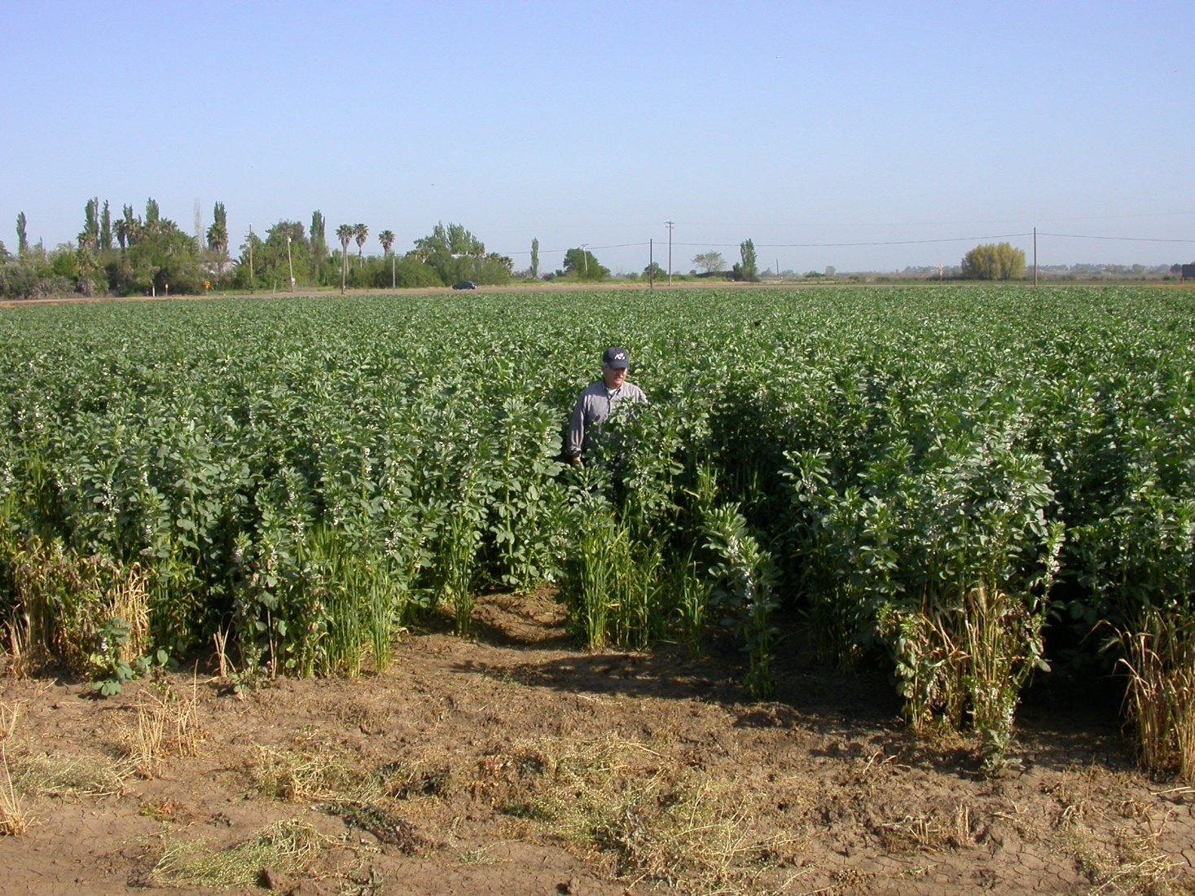
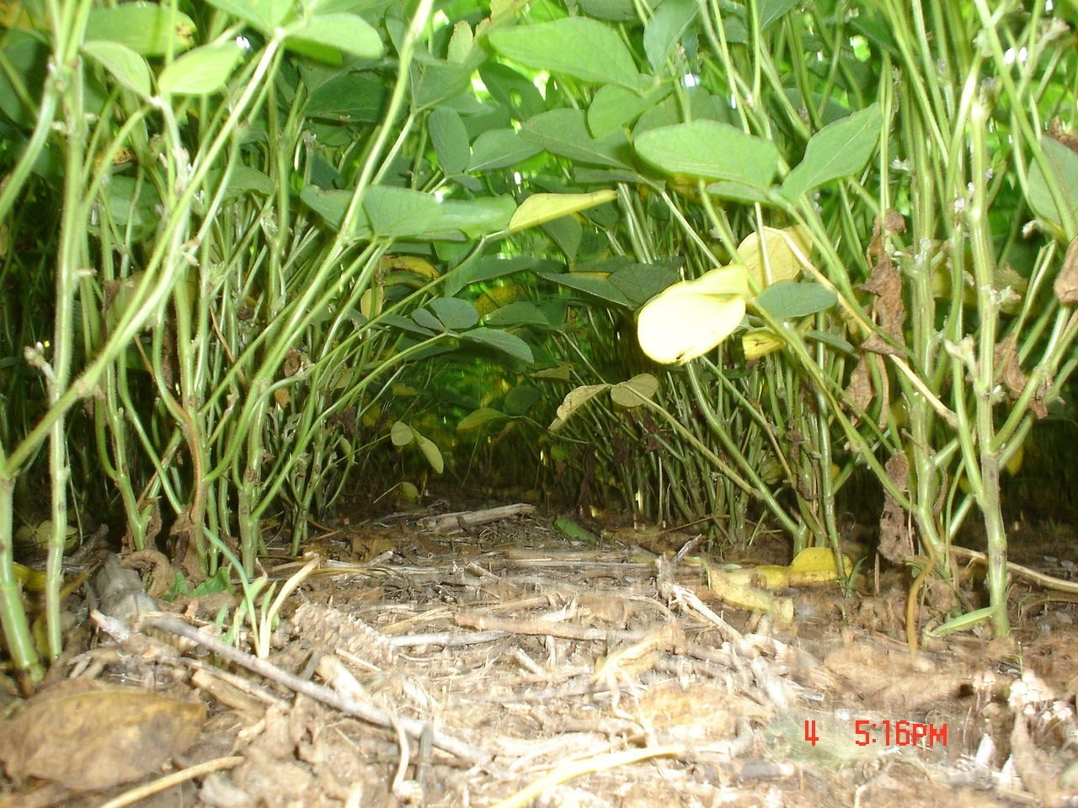
Soil Food Web Stewardship
Winter cover crop – bell beans
California, 2006
Soil fertility
Organic matter
Food web activity
Soil structure
Minimizing Disturbance
Fossil fuel reduction
Habitat conservation
Food web activity
Soil structure
No-till soybeans, Brazil, 2006

Slide 24
Sugarcane roots
under organic mulch or deeper soil layers
Photo from Stirling et al., 2011

Slide 25
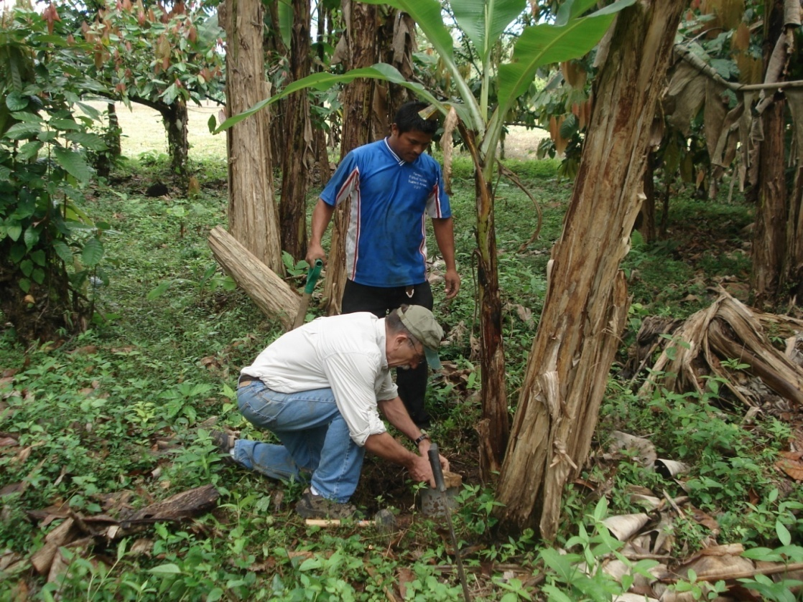
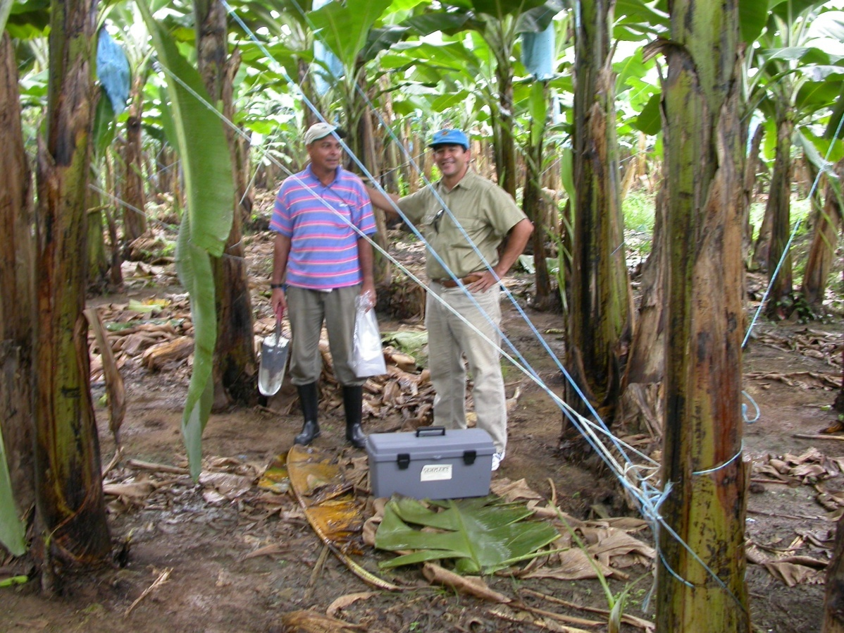
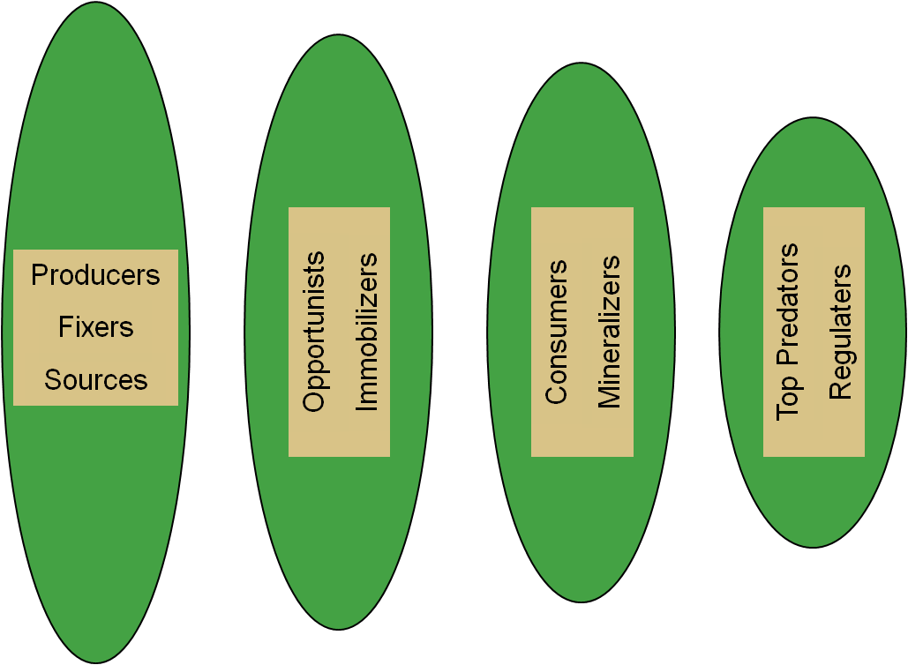
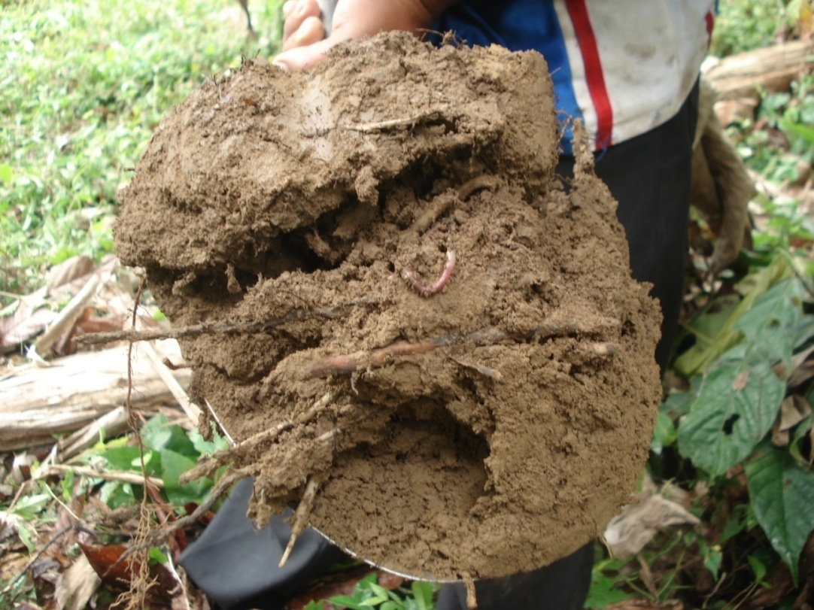
Comparison of Two Systems
The Nematode Assemblage - Tools for Soil Health Assessment
Nematode Faunal Analysis: Enrichment and Structure Indices
Metabolic Footprints: Magnitude of Ecosystem Services
Functional Diversity: Complementarity of Ecosystem Services
Costa Rica, 2008

Slide 26
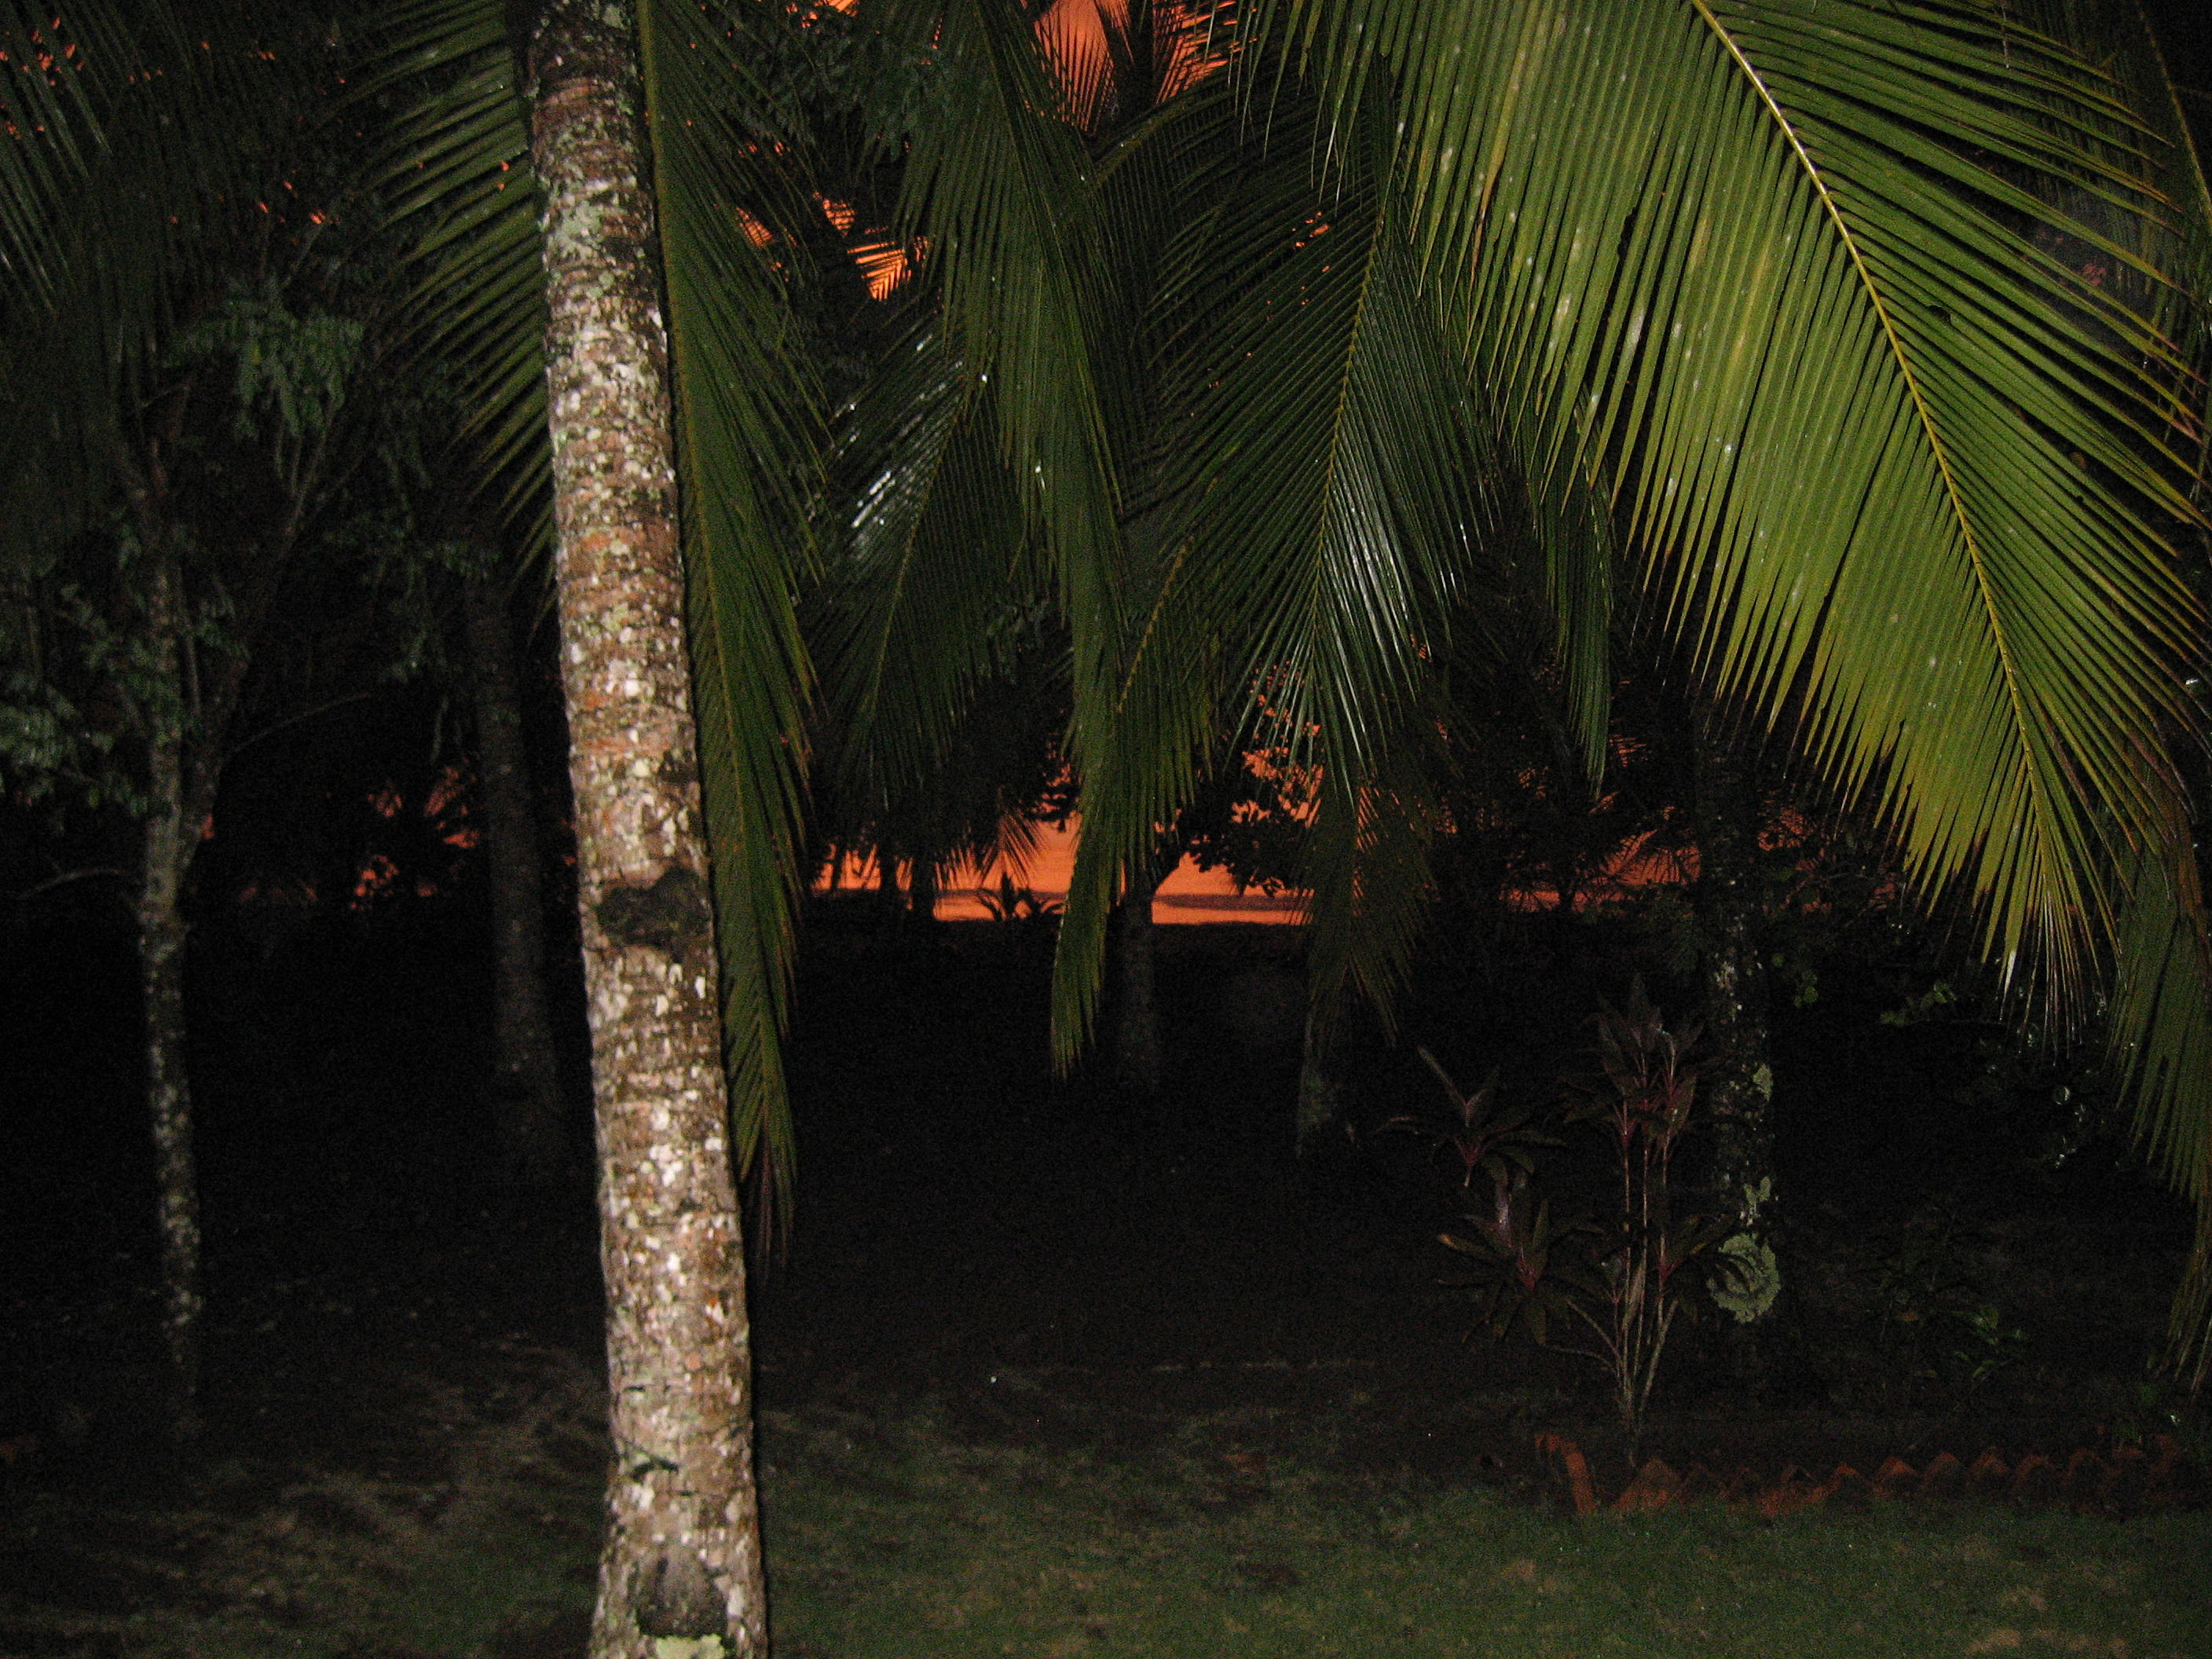
Thank you!
http://plpnemweb.ucdavis.edu/nemaplex

