Slide 1
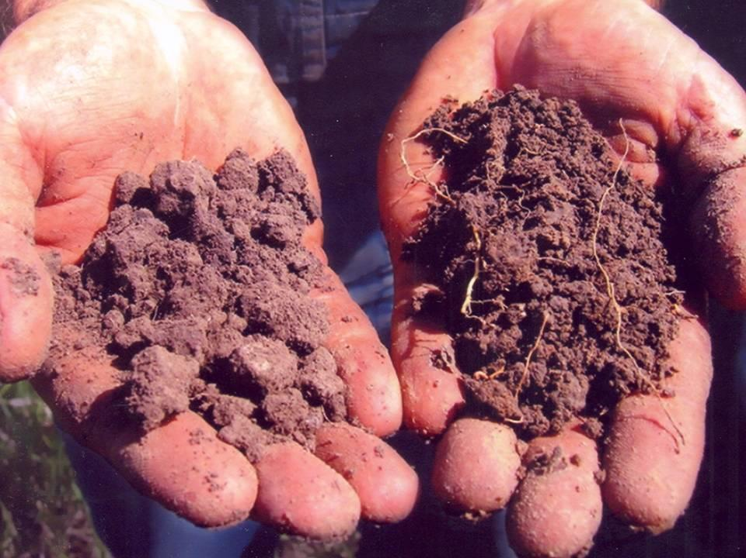
Nematode ECOLOGY and SOIL HEALTH
Howard Ferris
Department of Entomology & Nematology
University of California, Davis, USA
6th International Congress of Nematology, 2014

Slide 2

Soil Health
The ability of soil to perform its major and minor ecosystem functions within the constraints of its environment
Major Functions: Sustain plant and animal productivity and diversity
Maintain or enhance water and air quality
Support human health and habitation
Physical
Services:
Sequester and redistribute minerals
  Mineralize organic molecules
  Accelerate turnover
  Regulate and suppress pests
Alter substrate to provide access to other organisms
Redistribute organisms in space
Biodegrade toxins
Reduce soil erosion
Increase agricultural production
+++
---
Physical
Biological
Chemical
+++++++

Slide 3
Understanding Soil Health: The Latitude of Health Concept
Adapting from Paul Sorauer (1908) Handbuch der Pflanzenkrankheiten.
Consider the soil as a living organism, then:
Each Ecosystem Function operates between maximum and minimum limits.
The fields of oscillation of the functions indicate the “latitude of health" of the system.
Many conventionally-managed agricultural soils are outside the latitude of health and some may be outside the latitude of life.
1
2
ecosystem
functions
3
unhealthy
healthy
unhealthy
latitude of health
latitude of life
zone of optimum health

Slide 4
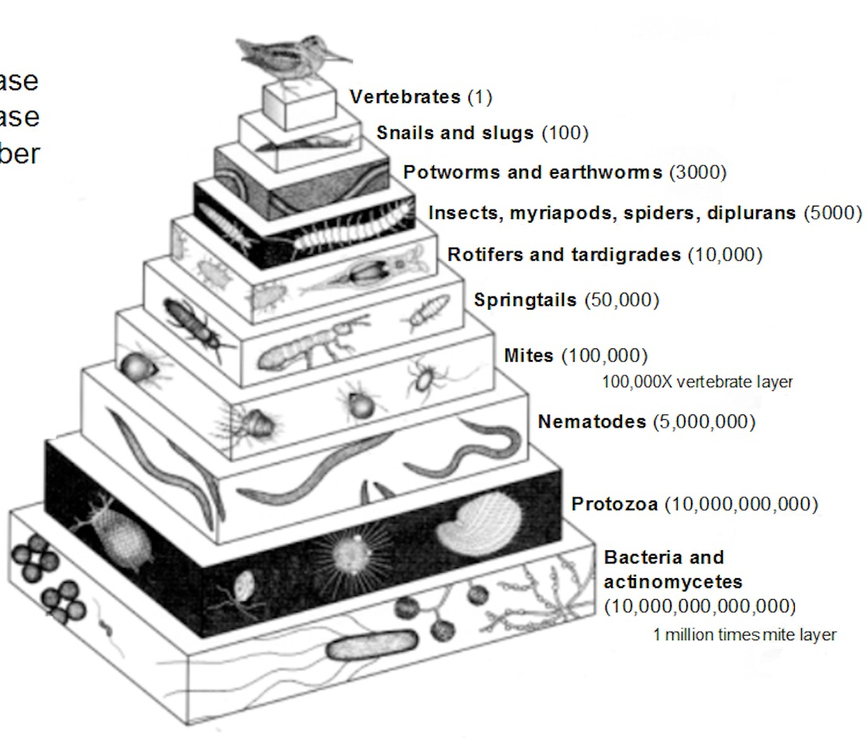
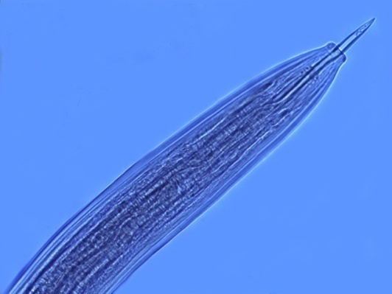
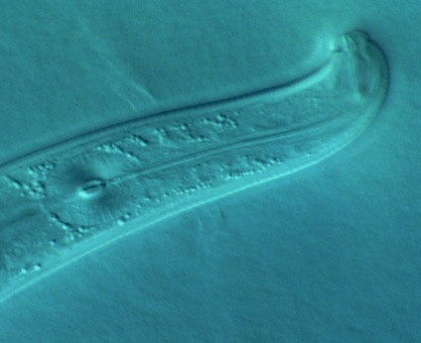
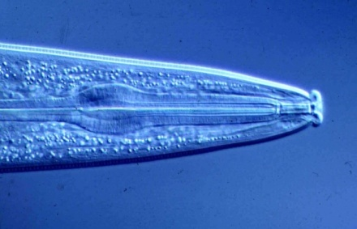
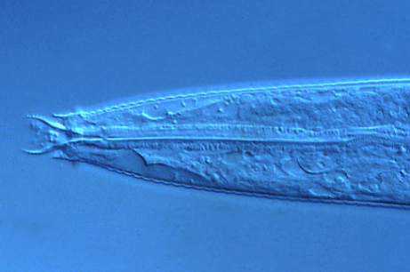
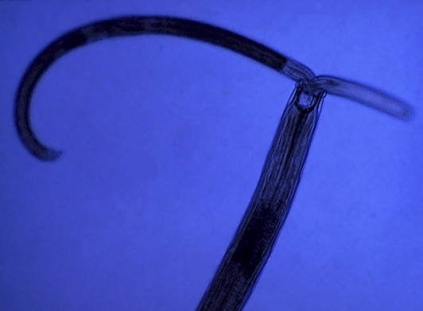
Soil Ecosystem Complexity: the Need for Bioindicators
1
2
3
4
5
opportunism
structure
enrichment
stability
Colonizer-persister Series
bacteria
protozoa
algivorous mites
fungi
bacteria
fungivorous mites
predaceous mites
omnivorous mites
tardigrades
Ferris and Bongers, 2006
Ferris et al., 2012
Georgieva et al., 2005
Sánchez-Moreno et al., 2008
Sánchez-Moreno et al., 2009
Yeates et al., 2009
Nematodes as Bioindicators
of other Soil Organisms

Slide 5
Nematodes as Bioindicators of Soil Health
Three measures of the assessment of the biological component of soil health are:
Faunal Analysis – the types of ecosystem services available
Metabolic Footprints - the magnitude of the ecosystem services
Diversity of Functional Classes - the complementarity of ecosystem services across microhabitats and through time
Physical
+++
---
Physical
Biological
Chemical
+++++++

Slide 6
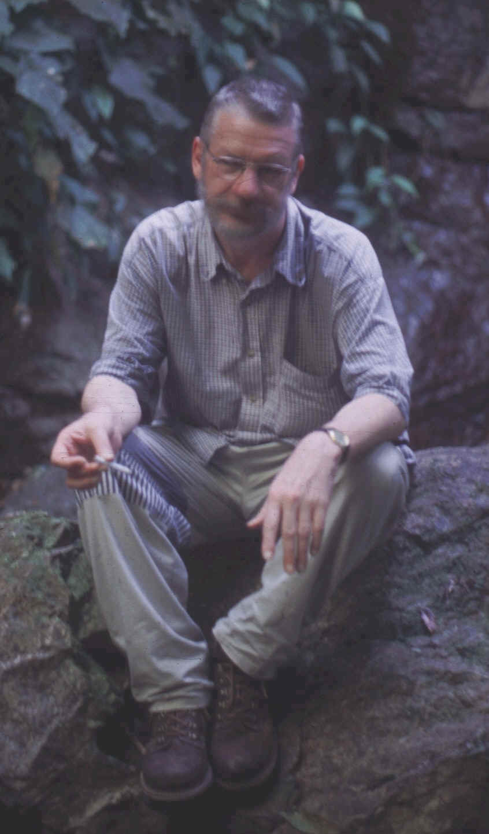
1
2
3
4
5
opportunism
structure
enrichment
stability
Colonizer-persister Series
Structure Indicators
Basal Fauna
Enrichment Indicators
Life course duration
Growth rates
Response to resources
Sensitivity to disturbance
1. Nematode Faunal Analysis
Bongers

Slide 7
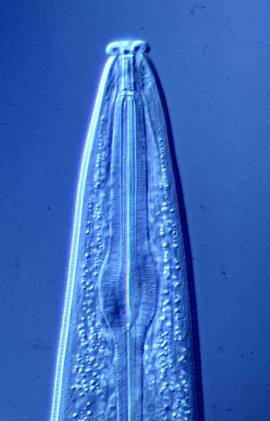

Hypotheses of Food Web Structure and Function
Disturbed
N-enriched
Low C:N
Bacterial
Conducive
Enriched
Maturing
N-enriched
Low C:N
Bacterial
Regulated
Ba₁
Enrichment index
Structured
Fu₂
Degraded
Depleted
High C:N
Fungal
Conducive
Matured
Fertile
Mod. C:N
Bact./Fungal
Suppressive
Fu₂
Basal
Ba₂
Om₄
Om₅
Basal
condition
Ca₃
Ca₄
Ca₅
Fu₃
Fu₄
Fu₅
Ba₃
Ba₄
Ba₅
The indices are useful, but…..…
They do not indicate biomass, metabolic activity or magnitude
of functions/services
Structure index
Ferris et al., 2001

Slide 8
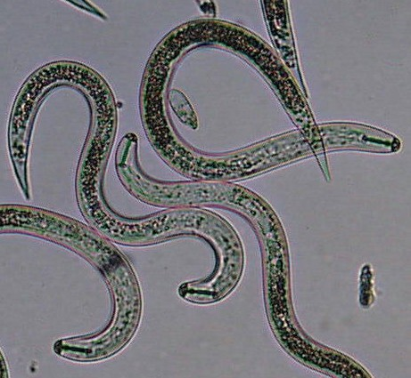
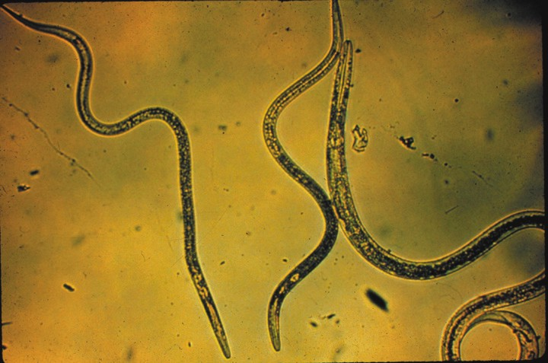
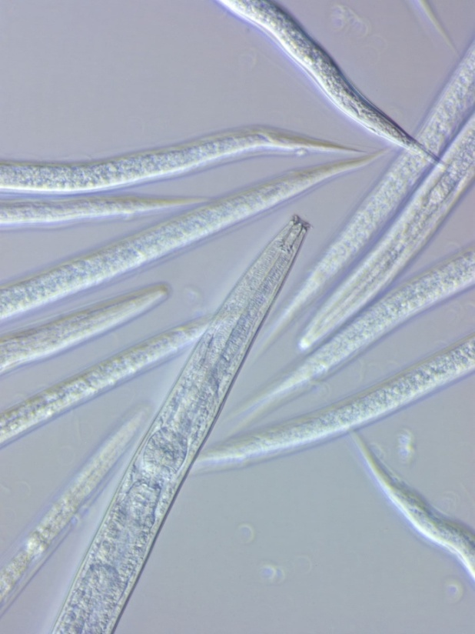
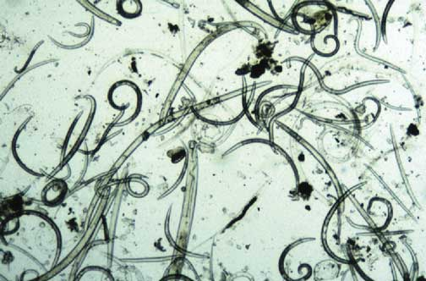
2. Metabolic Footprints of Functional Classes
What is the magnitude of the function or service?
How much carbon is being processed?
How much energy is being used?

Slide 9
Nematode Faunal Profiles
and Metabolic Footprints
Enriched
bacterivores
fungivores
Enrichment index
100 (w1.cp1 + w2.Fu2)
/ (w1.cp1 + w2.cp2 )
Ba₁
Enrichment trajectory
Structured
Fu₂
fungivores
bacterivores
Fu₂
Basal
Ba₂
Om₄
Om₅
Basal
condition
omnivores
Ca₃
Ca₄
Ca₅
carnivores
Fu₃
Fu₄
Fu₅
fungivores
Ba₃
Ba₄
Ba₅
bacterivores
Structure trajectory
Ferris, 2010
Structure Index = 100 w_{i}.cp_{i} / (w_{i}.cp_{i} + w₂.cp₂ ) for i = 3-5

Slide 10
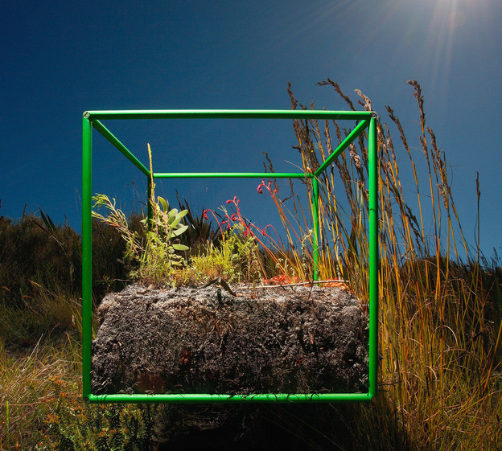
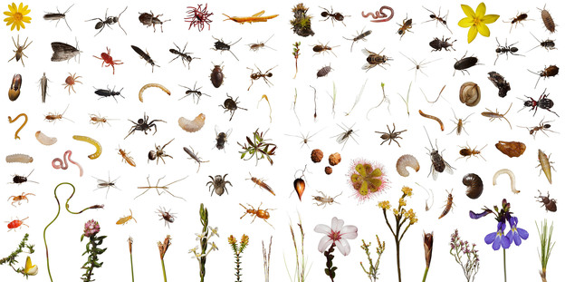
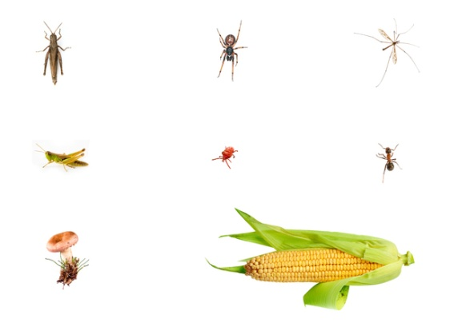
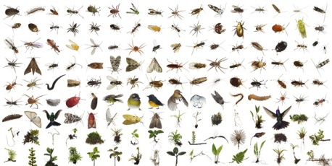
But what does this tell us about function?
The species belong to different functional classes
Biological Diversity – species richness
(visible organisms in 2700 cm³ in 24 hours)
Lawn, South Africa
Corn field, Iowa, USA
Fig tree canopy, Costa Rica
David Liittschwager 2012, A World in One Cubic Foot – Portraits of Biodiversity. Univ. Chicago Press

Slide 11
3. Diversity of species in Functional Classes

Slide 12
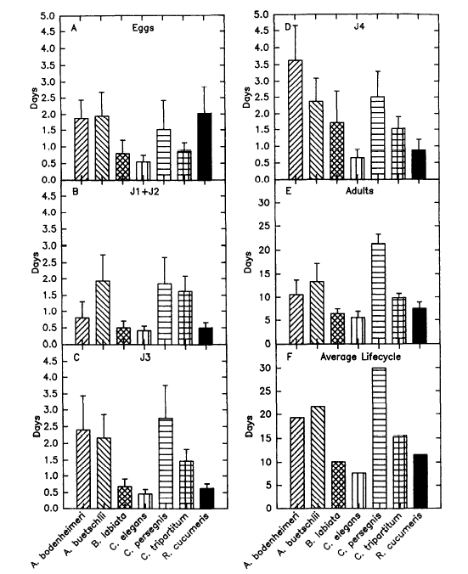

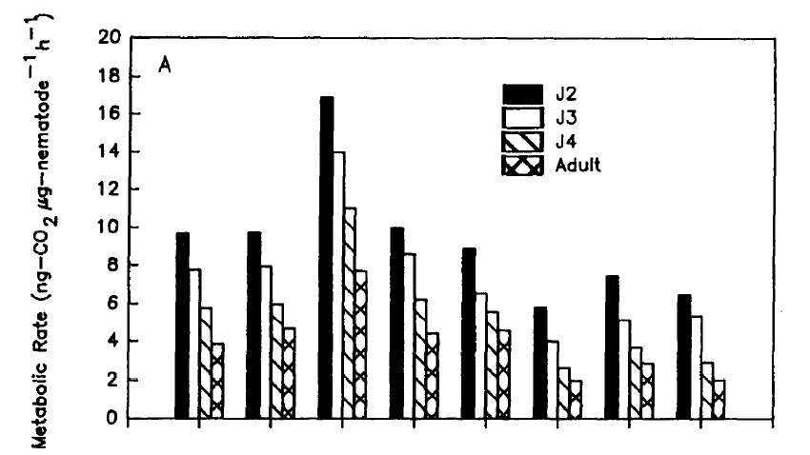
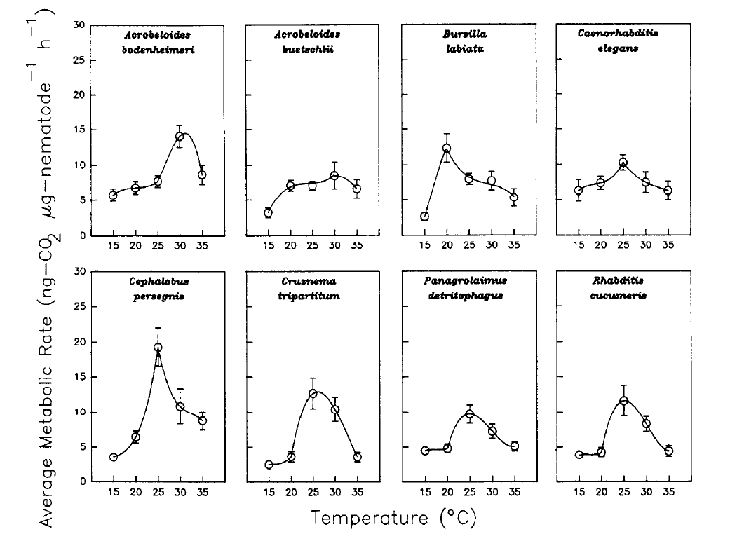
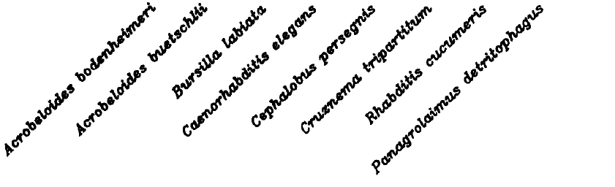
Spatial Diversity of Microsites and their Temporal Dynamics
gradient drivers:
temperature
moisture
aeration
organic residues
roots
soil texture
particle size
temporal drivers:
diurnal
seasonal
life course
phenology
degree-days
stochastic factors:
roots
patch distribution
patch composition
weather events
burrows
stones
restrictive layers
Ferris and Tuomisto, subm.

Slide 13
Diversity, the Latitude of Health and the Amplitude of Ecosystem Functions
1
2
ecosystem
functions
3
unhealthy
healthy
unhealthy
latitude of health
latitude of life
zone of optimum health
ecosystem function 1
Guild 1
amplitude
of
function 1
G1
Guild 2
G2
Guild 3
G3
healthy (function 1)
unhealthy
latitude of health
unhealthy
latitude of life
Ferris and Tuomisto, subm.

Slide 14


Nematode Guilds in Bacterial and Fungal Decomposition Channels
Abundance of Individuals
1 | 2 | 3 | 4 | 5 | 6 | 7 | 8 | 9 | 10 | 11 | 12 | 12 | 14 | 15 | 16 | 17 | 18
Cruz | Mesor | Panag | Rhab | A’boid | Acrob | Ceph | Monh | Plect | Wilso | Aphel | Aphoi | Dityl | Filen | Achro | Dipht | Alaim | Tylol | Total
b1 | b1 | b1 | b1 | b2 | b2 | b2 | b2 | b2 | b2 | f2 | f2 | f2 | f2 | b3 | f3 | b4 | f4
75 | 22 | 82 | 55 | 120 | 18 | 5 | 13 | 10 | 2 | 15 | 22 | 2 | 5 | 1 | 6 | 5 | 6 | 464
234 |  |  |  | 168 |  |  |  |  |  | 44 |  |  |  | 18 |  |  |  | 464
Total species diversity = 6.8 (effective number of species)
Guild diversity = 2.5 (effective number of guilds)
Mean within-guild species diversity = 2.7
But….
Does each species process the same amount of carbon and at the same rate?
Are they equally effective?
$${}_{}^{q}D=1/\sqrt[q−1]{\sum_{i=1}^{R}{p_{i}{p_{i}}^{q−1}}}$$
$${}_{}^{q}D=\exp{−}\sum_{i=1}^{R}{pi.ln⁡(pi)}$$
for q<>1
for q=1

Slide 15
Nematode Guilds in Bacterial and Fungal Decomposition Channels
Biomass or Metabolic Footprint Abundance
1 | 2 | 3 | 4 | 5 | 6 | 7 | 8 | 9 | 10 | 11 | 12 | 12 | 14 | 15 | 16 | 17 | 18
Cruz | Mesor | Panag | Rhab | A’boid | Acrob | Ceph | Monh | Plect | Wilso | Aphel | Aphoi | Dityl | Filen | Achro | Dipht | Alaim | Tylol | Total
b1 | b1 | b1 | b1 | b2 | b2 | b2 | b2 | b2 | b2 | f2 | f2 | f2 | f2 | b3 | f3 | b4 | f4
75 | 22 | 82 | 55 | 120 | 18 | 5 | 13 | 10 | 2 | 15 | 22 | 2 | 5 | 1 | 6 | 5 | 6 | 464
776 | 12 | 50 | 412 | 18 | 15 | 1 | 15 | 10 | 0.1 | 3 | 4 | 1 | 0.5 | 0.3 | 4 | 2 | 5 | 1330
1250 |  |  |  | 59.1 |  |  |  |  |  | 8.5 |  |  |  | 11.3
Total species diversity = 2.3 (effective number of species)
Guild diversity = 1.1 (effective number of guilds)
Mean within-guild species diversity = 2.1
But what level of species or guild diversity is optimal?

Slide 16
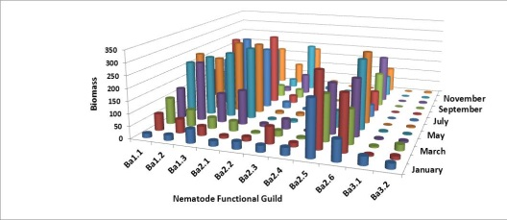
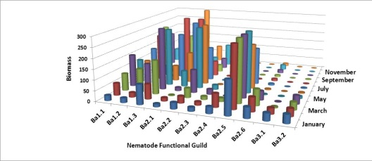
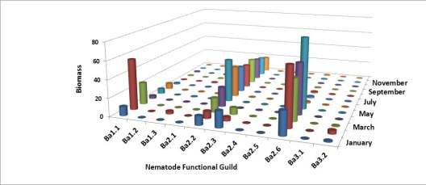
Working hypotheses:
1. Complementarity of ecosystem function is related to species diversity within
and among functional guilds
2. Biomass or Metabolic Footprints are better functional measures of species diversity
than numbers of individuals
exploitative
species
diversity
sustained
function
effective number of species within guilds
(mean within-guild species diversity)
1
successional
guild
diversity
2
effective number of guilds
(total guild diversity)
3

Slide 17
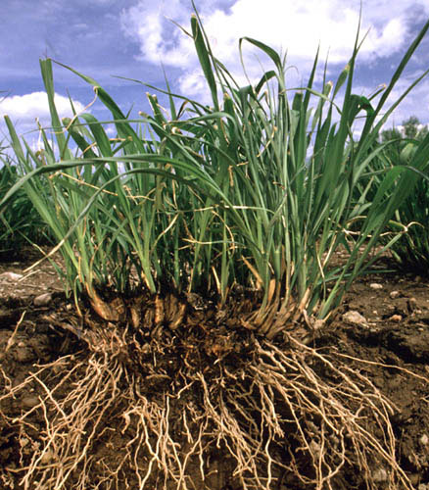
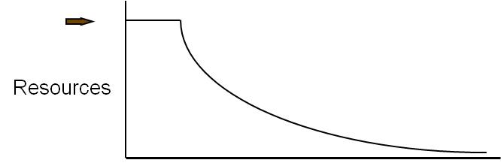
Stewardship of Abundance and Diversity: Carbon and Energy
CO₂
CO₂
CO₂
CO₂
bacteria
protozoa
nematodes
carbohydrates
and
proteins
C
N
nematodes
arthropods
fungi
carbohydrates
and
amino acids
other
organisms
nematodes
fungi
arthropods
nematodes
NO₃
Carbon and energy transfer
Carbon is respired by all organisms in the food web
The amounts of Carbon and Energy available limit the size and activity of the web
NH₃
NH₃
NH₃

Slide 18
Soil Stewardship
Core Management Principles for Healthy Soil
1. Keep the soil covered with crops and crop residues.
2. Keep living roots in the soil throughout the year to feed the soil food web; avoid resource punctuation.
3. Diversify inputs through crop pattern, crop rotation, cover crops and cover crop mixtures.
4. Minimize soil disturbance to maintain soil structure and habitat suitability.
5. (Integrate livestock grazing).
Sources: Jay Fuhrer, NRCS
Chad Ellis, Noble Foundation, 2013

Slide 19
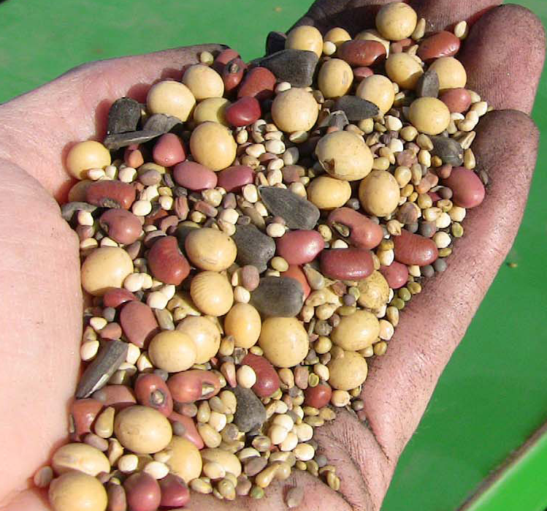
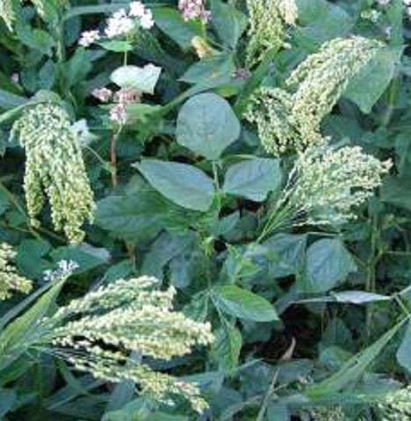
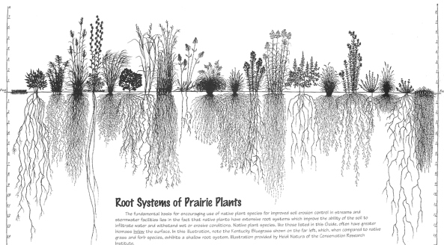
A diversity of cover crops….
Provides soil surface cover
Provides sustained resources for soil organisms
Builds soil aggregates
Improves water retention
Builds soil organic matter
Promotes nutrient cycling
Adjusts carbon/nitrogen ratios
Harbors natural enemies of pests
Enhances pollinators
Provides food & shelter for wildlife
Allows integration of livestock
Source: Jay Fuhrer, NRCS

Slide 20
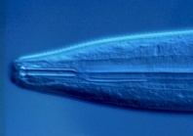
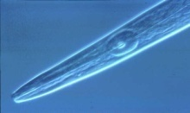
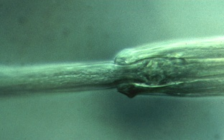
Remove the constraints to species and functional diversity in managed systems
Nematode Sensitivity to Mineral Fertilizer
Ammonium sulfate
200
Nematode guild
150
c-p 1
Standardized Counts
c-p 2
100
X
c-p 3
50
c-p 4
X
c-p 5
X
X
0
X
X
0
0.02
0.05
0.1
0.5
1
Concentration (mM-N)
Tenuta and Ferris, 2004

Slide 21
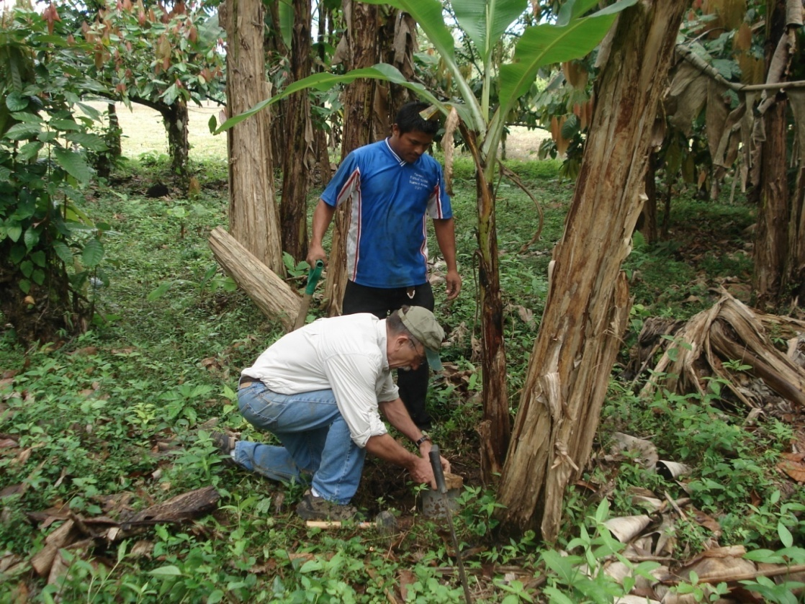
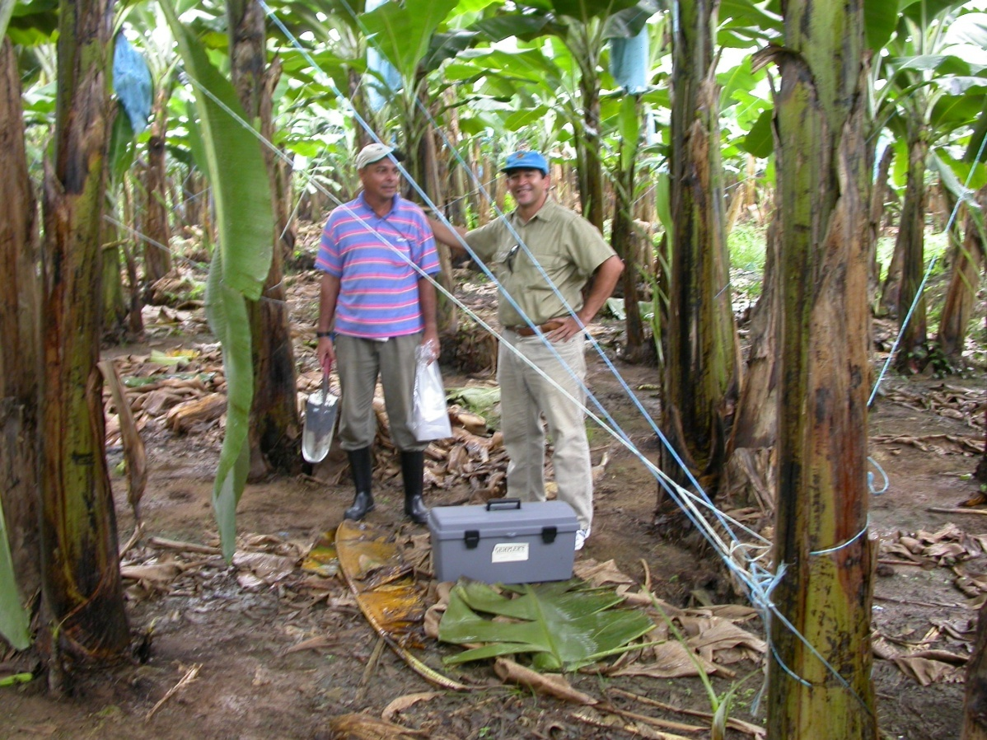
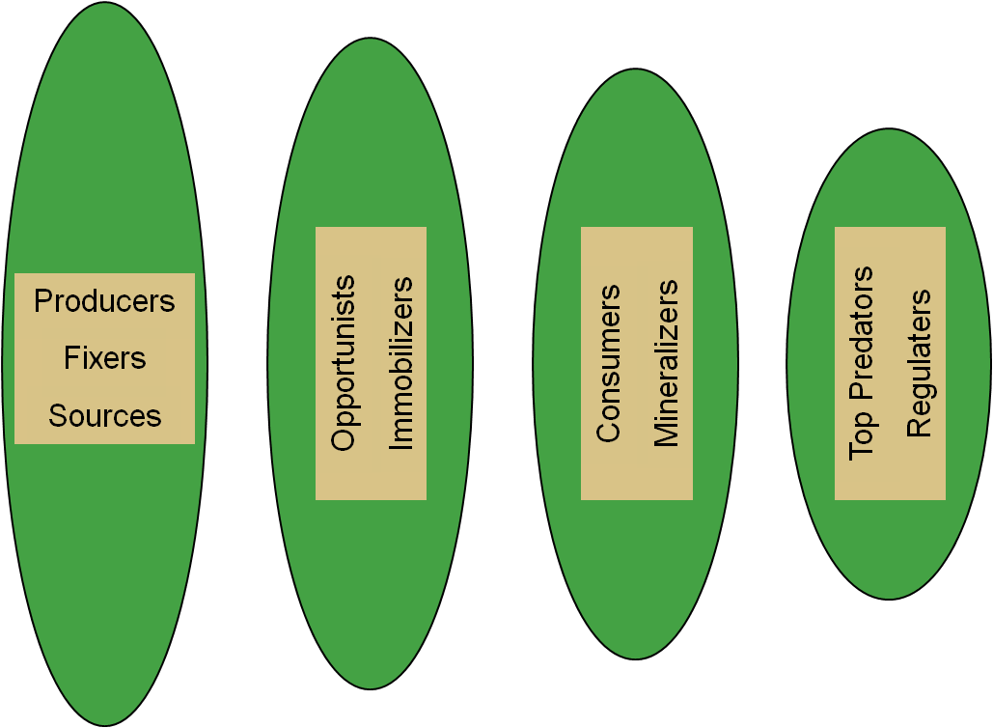
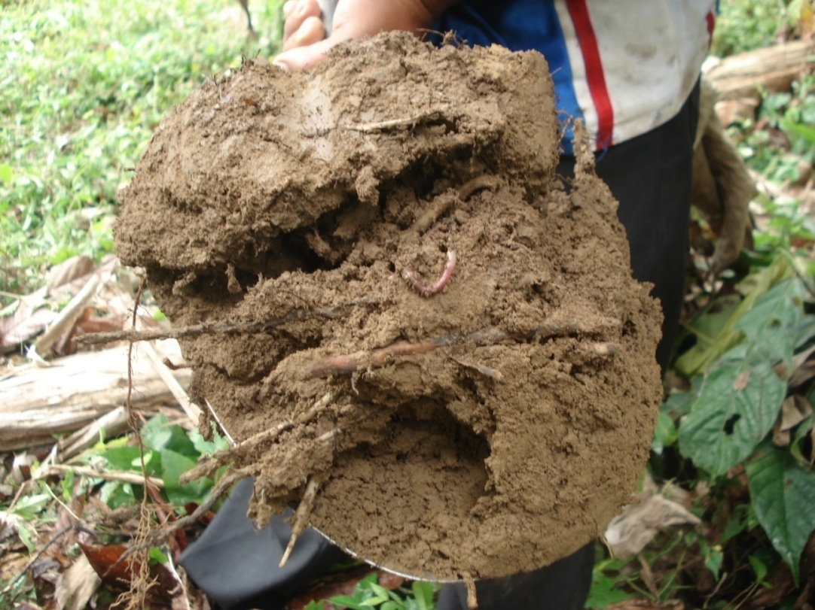
A Comparison of Two Systems
The Nematode Assemblage - Tools for Soil Health Assessment
  Nematode Faunal Analysis: Types of Ecosystem Services
  Metabolic Footprints: Magnitude of Ecosystem Services
  Functional Diversity: Complementarity of Ecosystem Services
Costa Rica, 2008

Slide 22
Management of soil health in sustainable systems requires:
• maintaining the flow of energy to each trophic level
• providing a favorable environment for the higher trophic levels
Physical
+++
---
Physical
Biological
Chemical
+++++++
Notes:
The soil food web provides essential services in sustainable farming systems.
The successful farm manager worries about producing a cover crop, supplying compost, providing mulches. All these provide resources to fuel the soil food web so that it can provide its essential services.

Slide 23
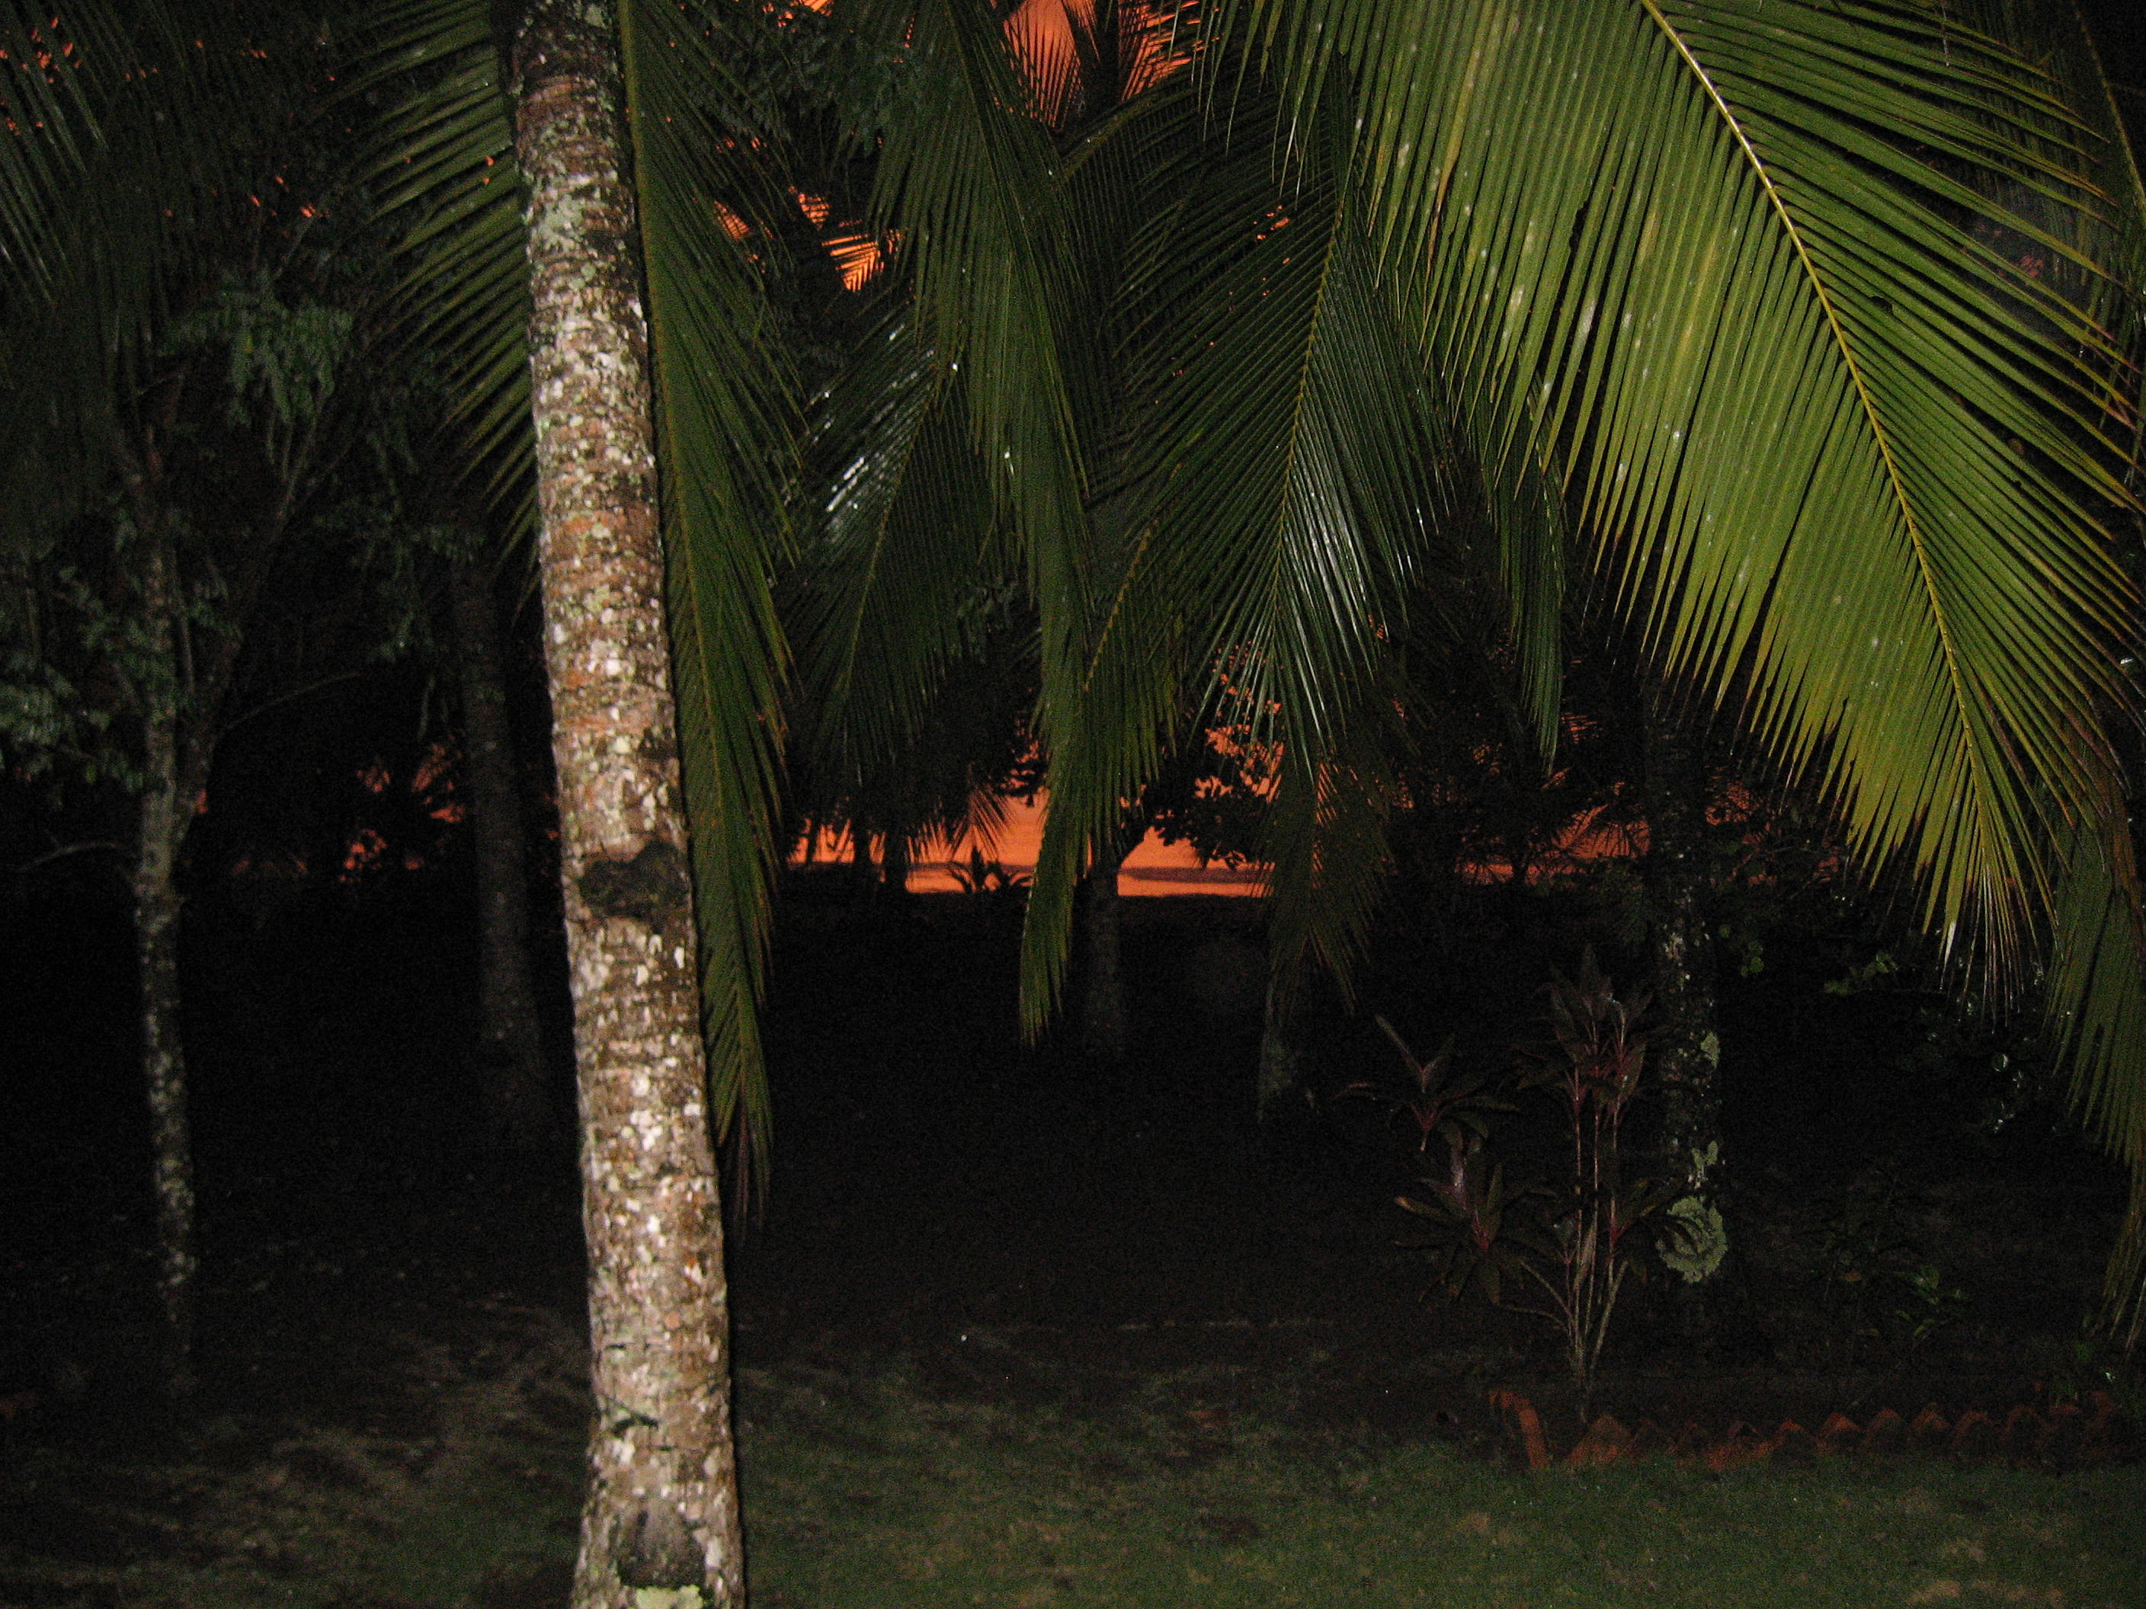

Thank you!
http://plpnemweb.ucdavis.edu/nemaplex

