Slide 1
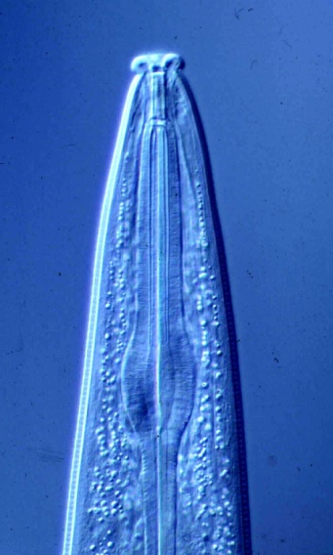
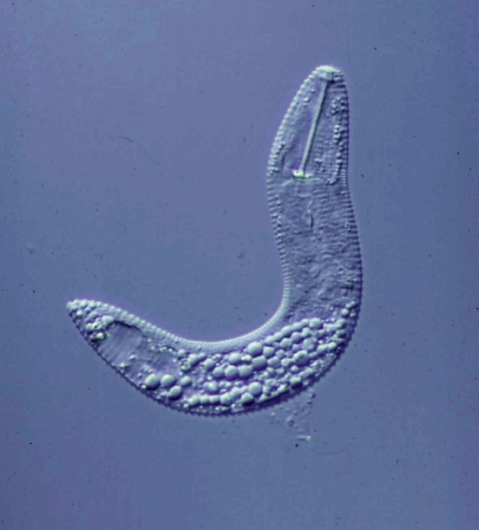
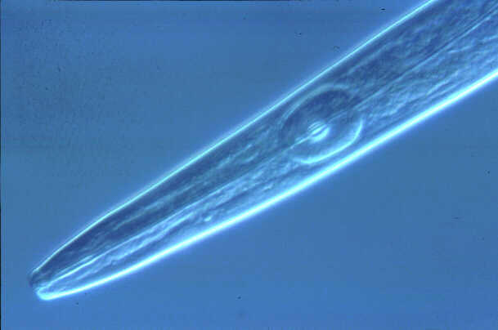
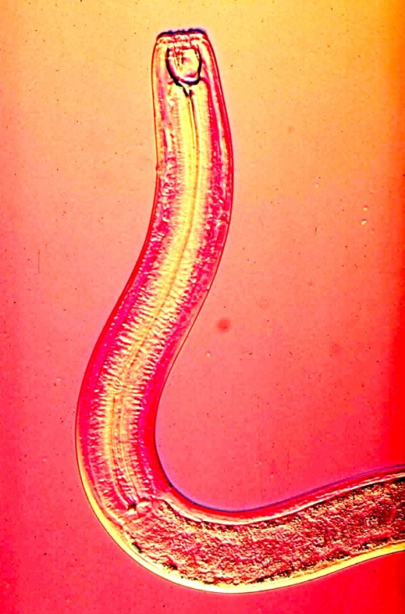
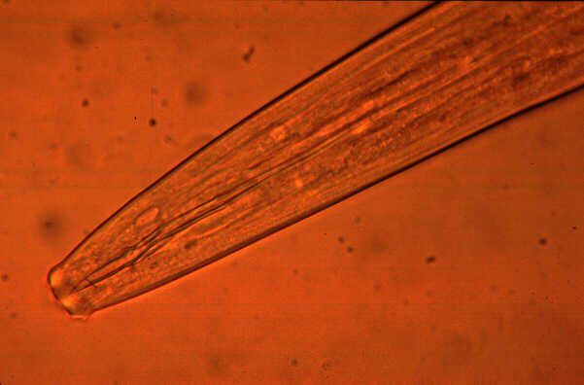
Nematodes and Grapevines
Howard Ferris
Department of Entomology and Nematology
University of California, Davis
hferris@ucdavis.edu
November 12, 2015

Slide 2
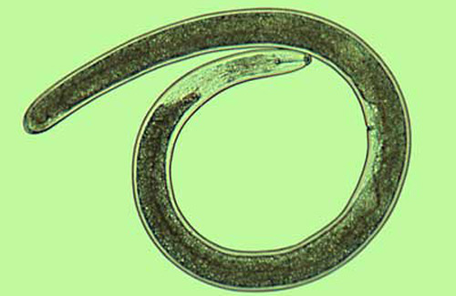
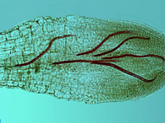
Introducing Nematodes……….
Nematodes, the most abundant multi-cellular animals on the planet, are unsegmented roundworms that inhabit soil, freshwater and marine environments.
Most are microscopic.
Many feed on micro-organisms while some are important parasites of humans, animals or plants.
Most soil forms are 1 mm or less in length. They live in water films around soil particles.
Species that are parasites of plants may feed externally or internally in roots or other tissues.

Slide 3
Nematodes are among the simplest metazoa.
80% of multicellular animals are nematodes.
Nematodes occupy any niche that provides water and a source of carbon.
Millions of nematodes can occupy 1 m² of soil; a handful may contain 50 species.
“.....if all the matter in the universe except the nematodes were swept away……we would find its mountains, hills, vales, rivers, lakes, and oceans represented by a film of nematodes.”
Nematodes vary in sensitivity to pollutants and environmental disturbance.
Nematodes occupy key positions in soil food-webs; they feed on many soil organisms and are food for many others.

Slide 4

All plant-parasitic nematodes have a hollow stylet or spear
Those with long stylets generally feed as ectoparasites
those with short stylets either as ecto- or endoparasites

Slide 5
Zoological Classification:
Kingdom: Animalia
Sub-kingdom: Metazoa
Phylum: Nematoda
Orders: (Plant-parasites in 3 of 17 Orders)
Families: (Plant-parasites constitute around 13 Families)
Genera: (Around 160 plant-parasitic genera distributed
      among the Families)
Species: (Multiple species in each Genus)
Races: (Variants within species that differ usually
with regards to virulence on resistant hosts)

Slide 6
Genera with species that are most important in California vineyards
(Large, Medium, Small)

Slide 7
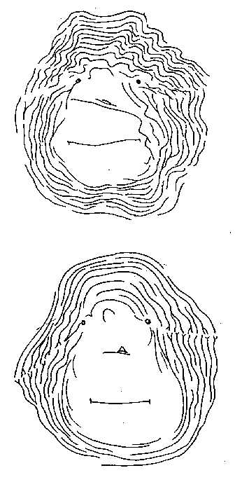
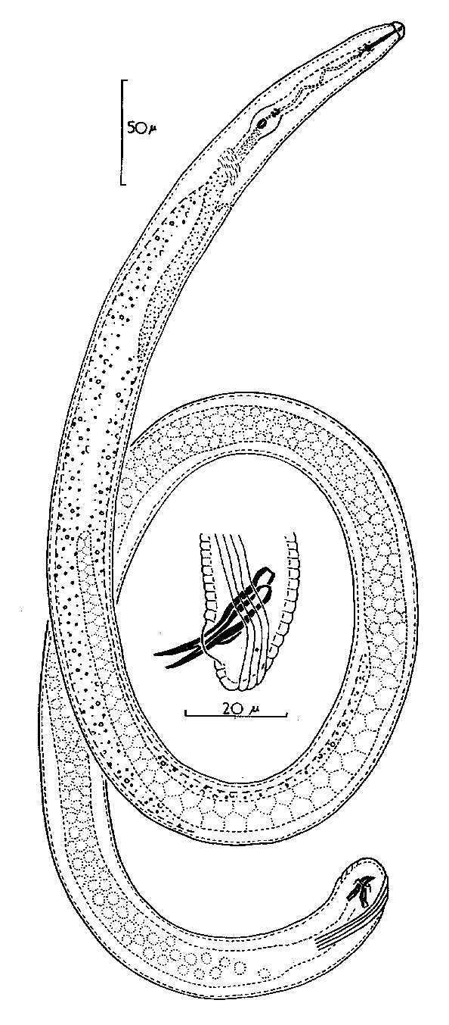
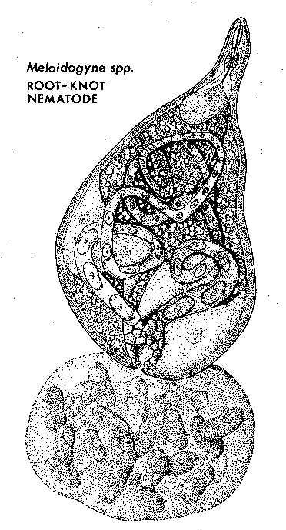
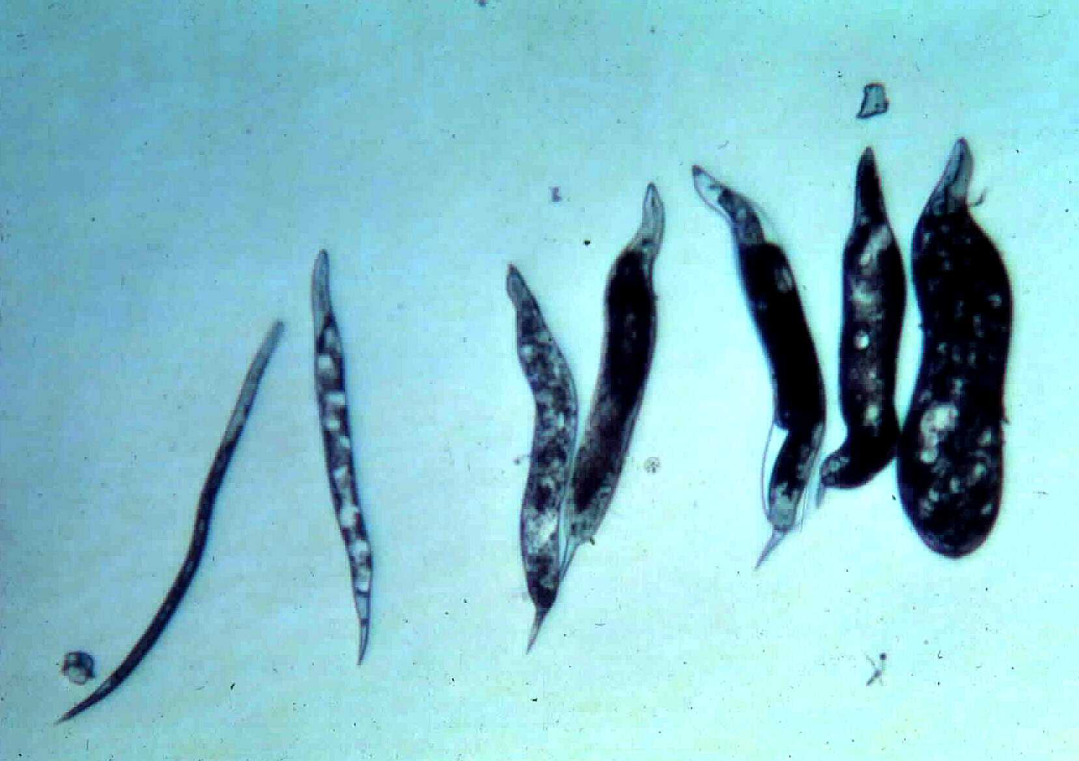
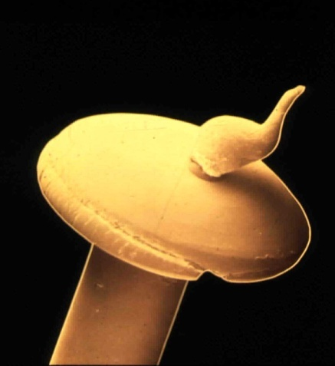
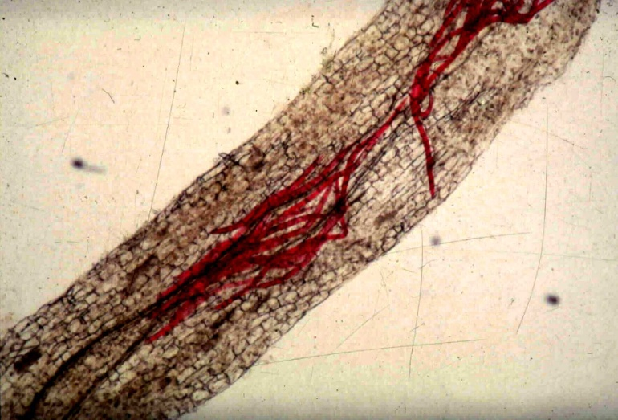
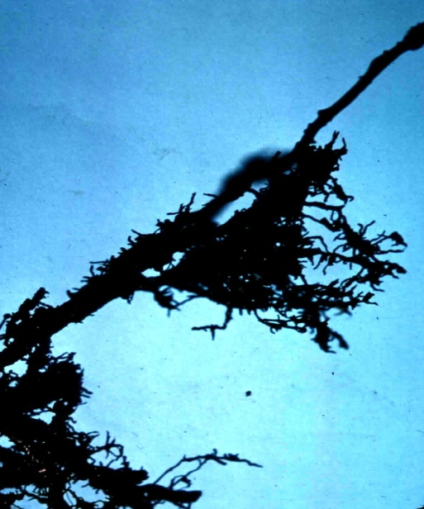
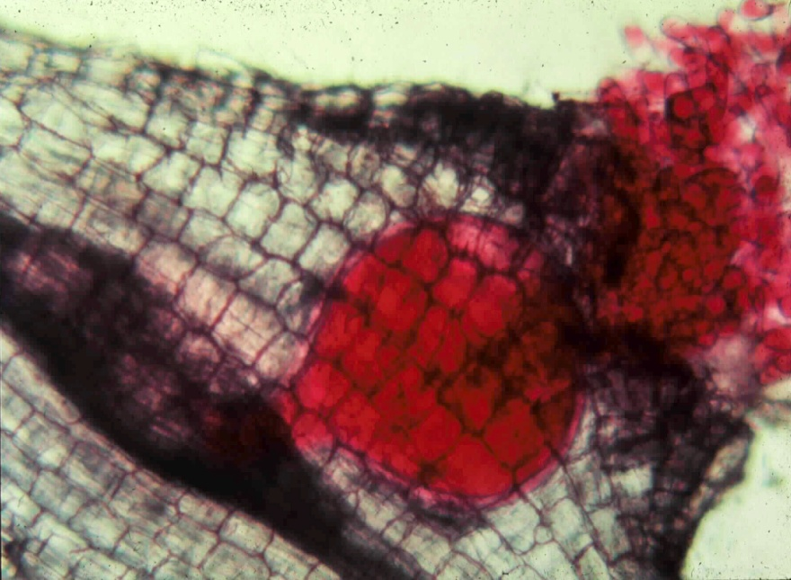
Meloidogyne spp.
(arenaria, incognita, javanica, chitwoodi, and ??)
root-knot nematodes

Slide 8
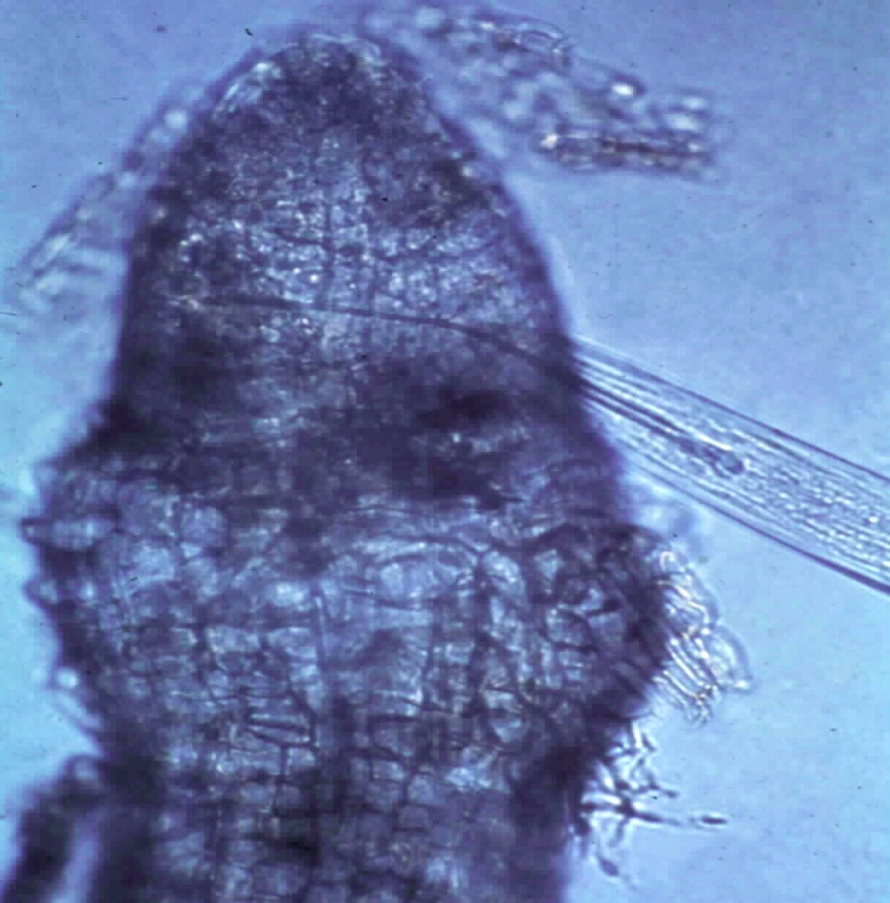
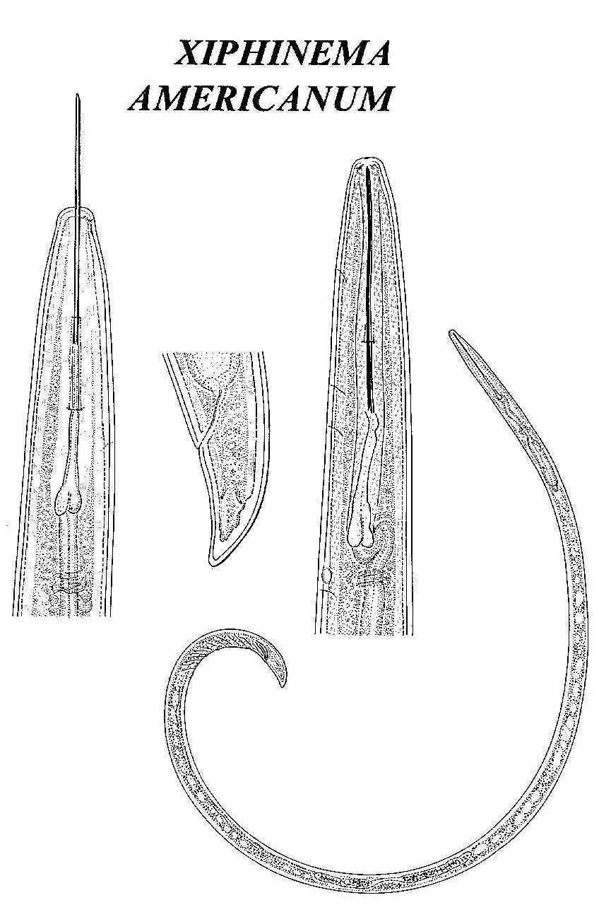
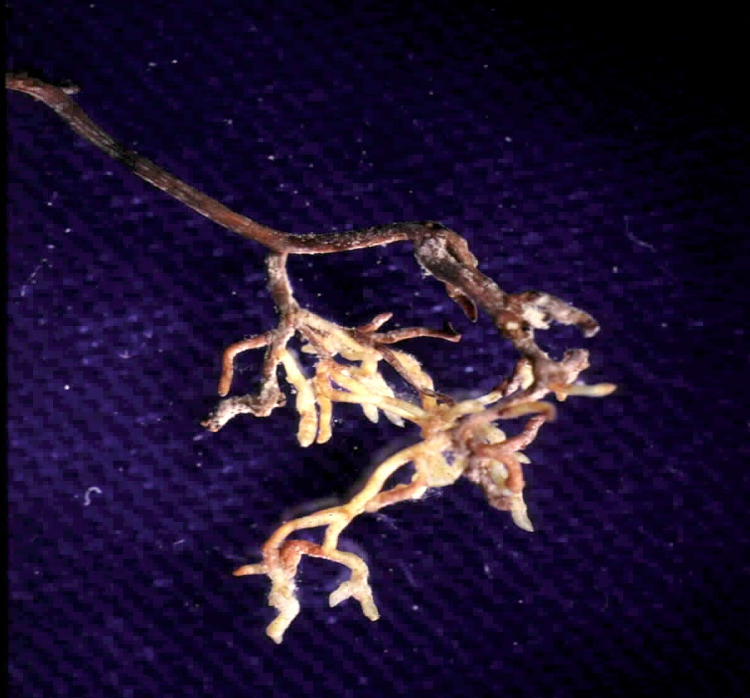
Xiphinema americanum
(sensu lato)
dagger nematode

Slide 9
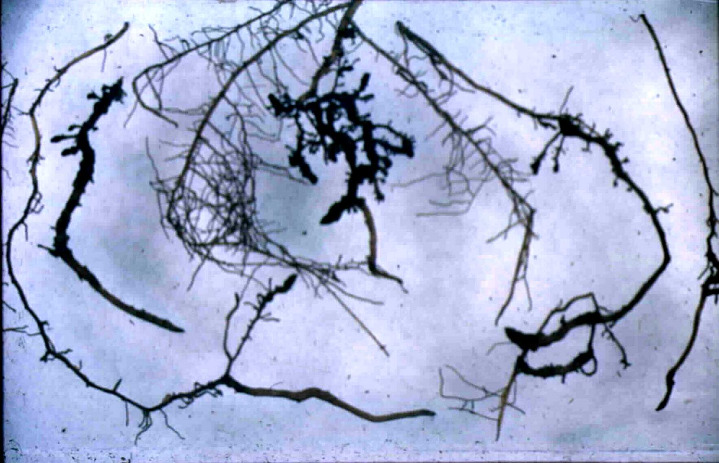
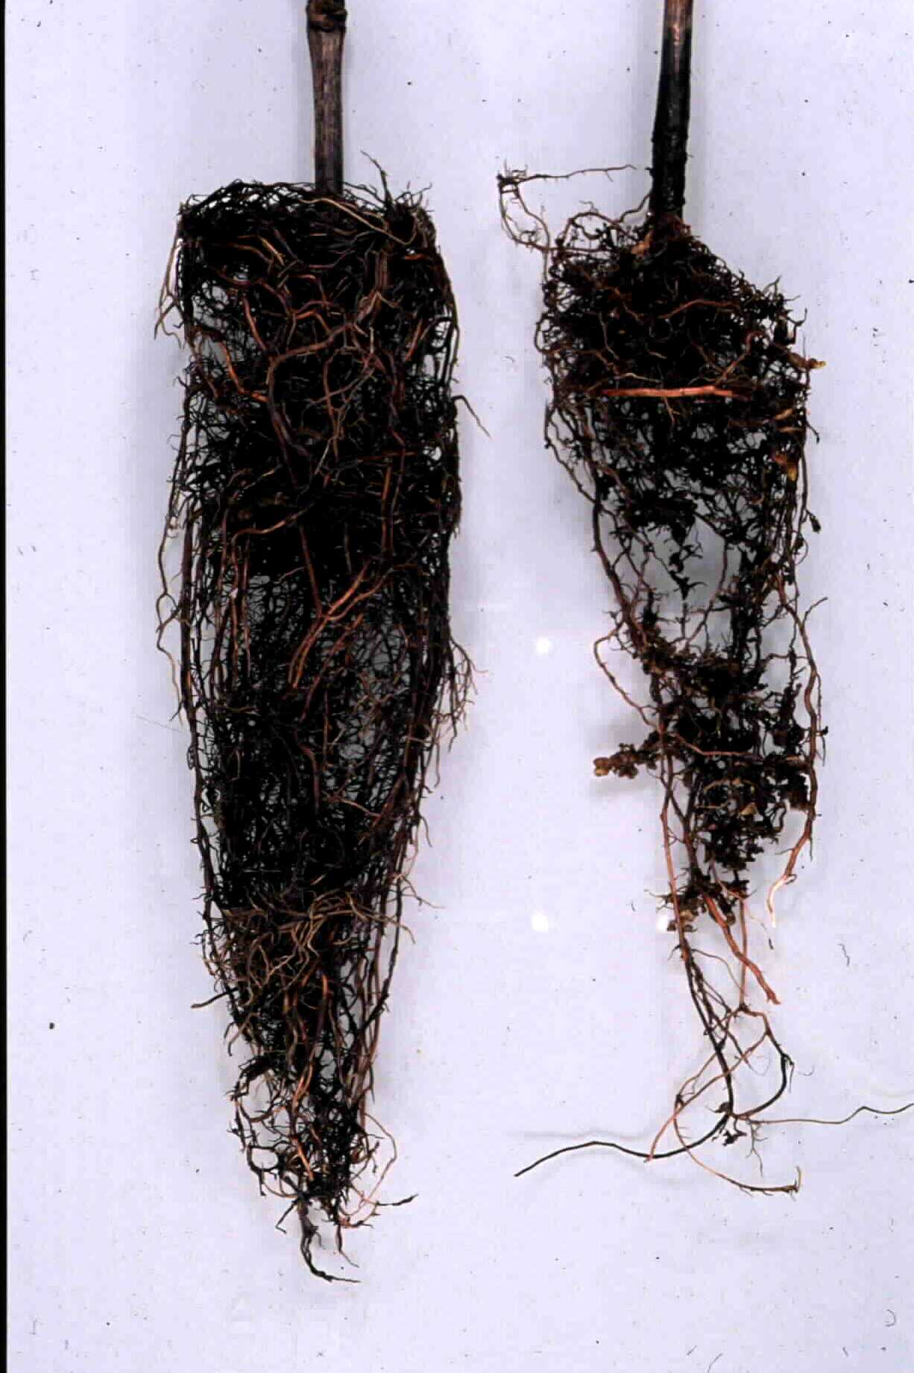
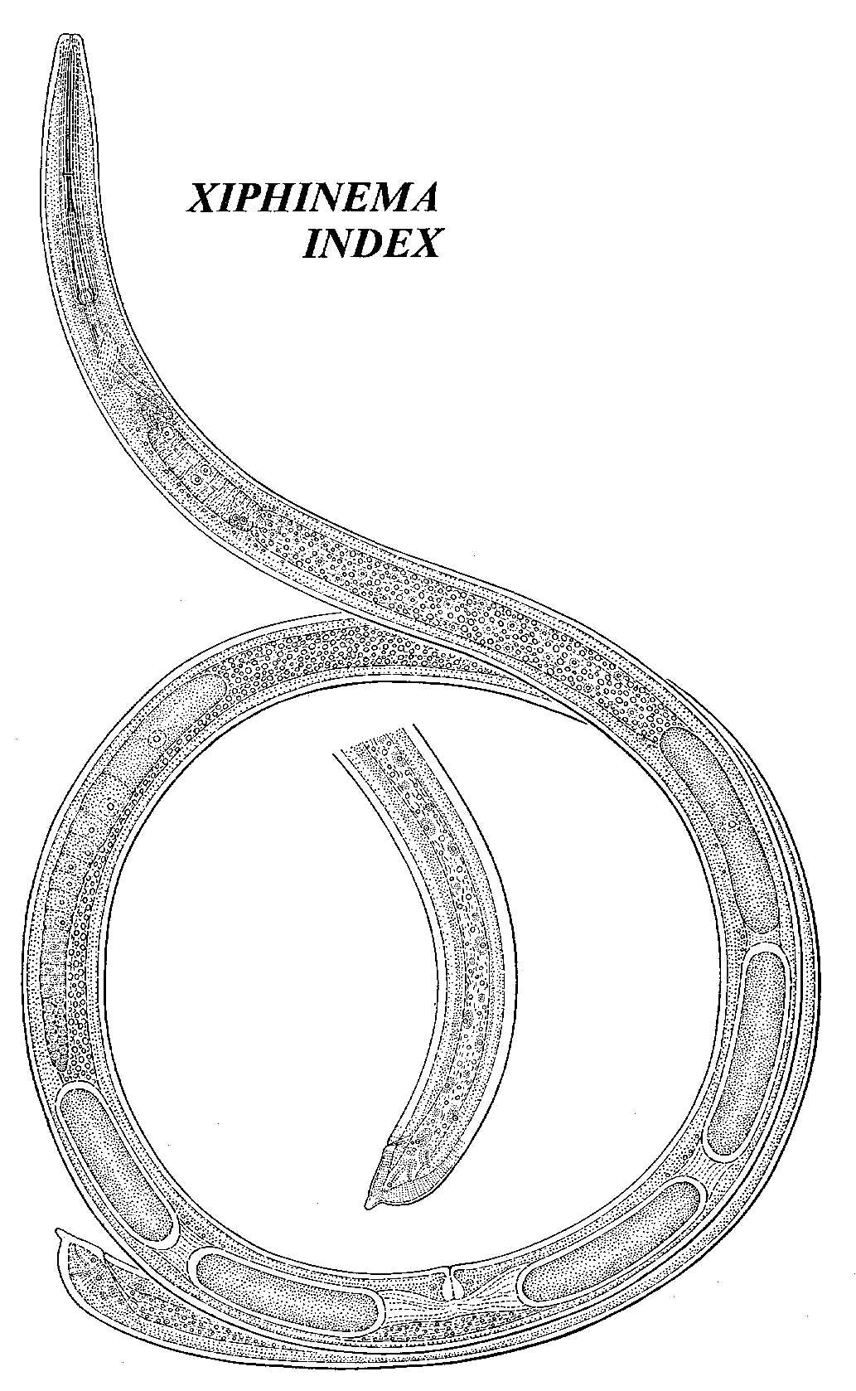

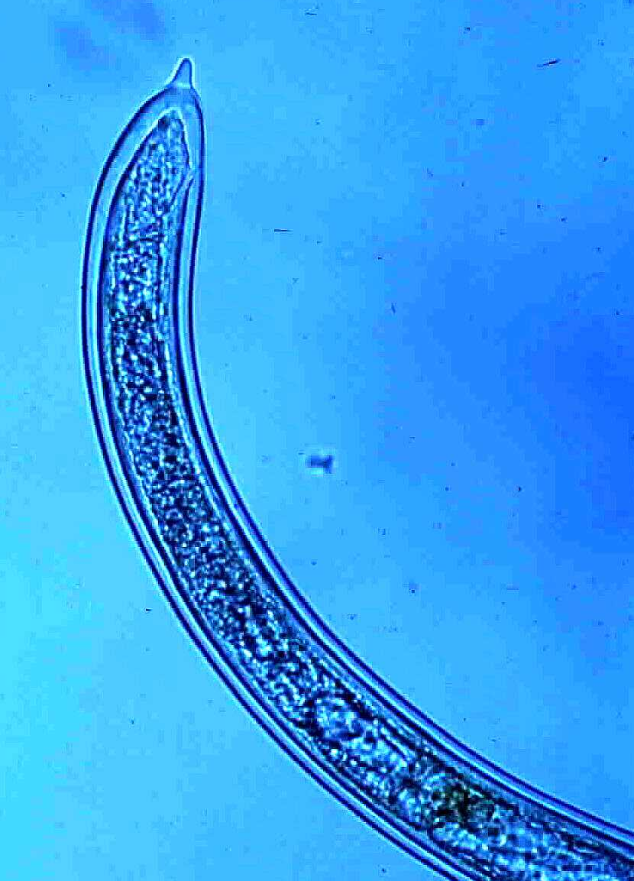
Xiphinema
index
dagger nematode

Slide 10
Xiphinema index - Dagger nematode
Vector of Grapevine Fanleaf Virus
Symptoms:
leaf malformations
yellow mosaic of leaves and shoots
veinbanding
abnormal shoot branching
small bunches, poor fruit set, irregular ripening

Slide 11
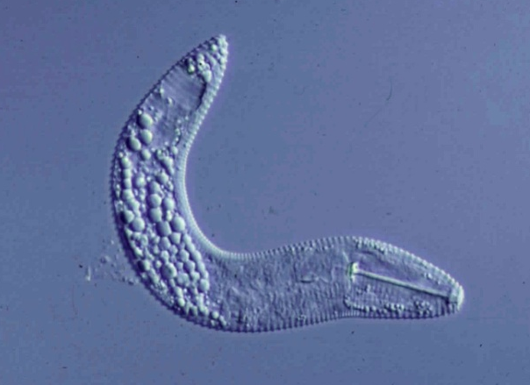
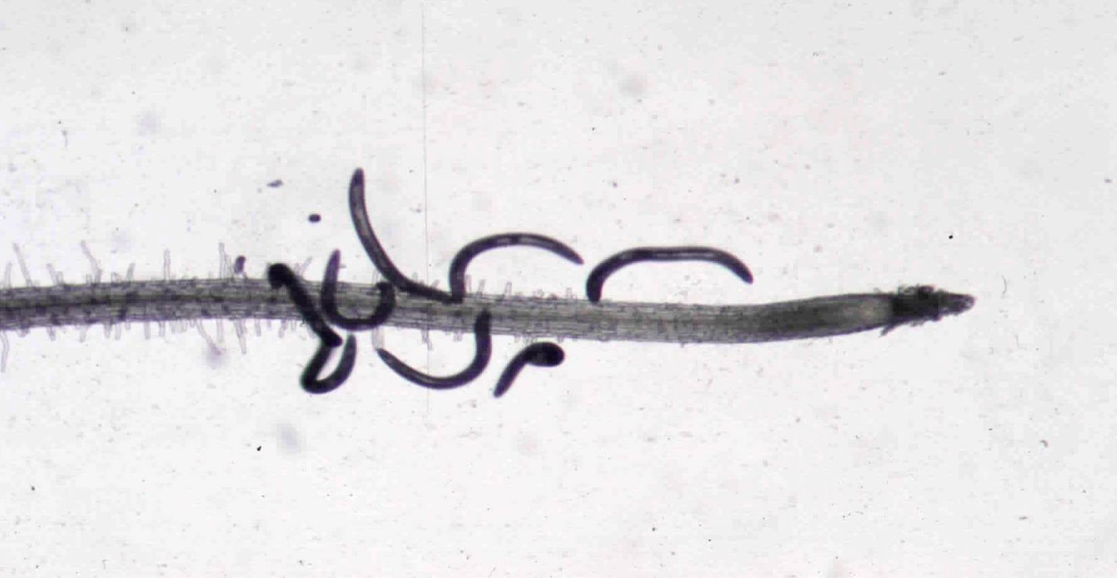
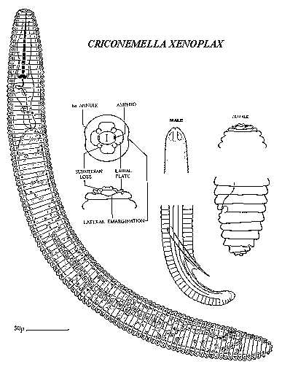
Mesocriconema xenoplax
ring nematode
-
+

Slide 12
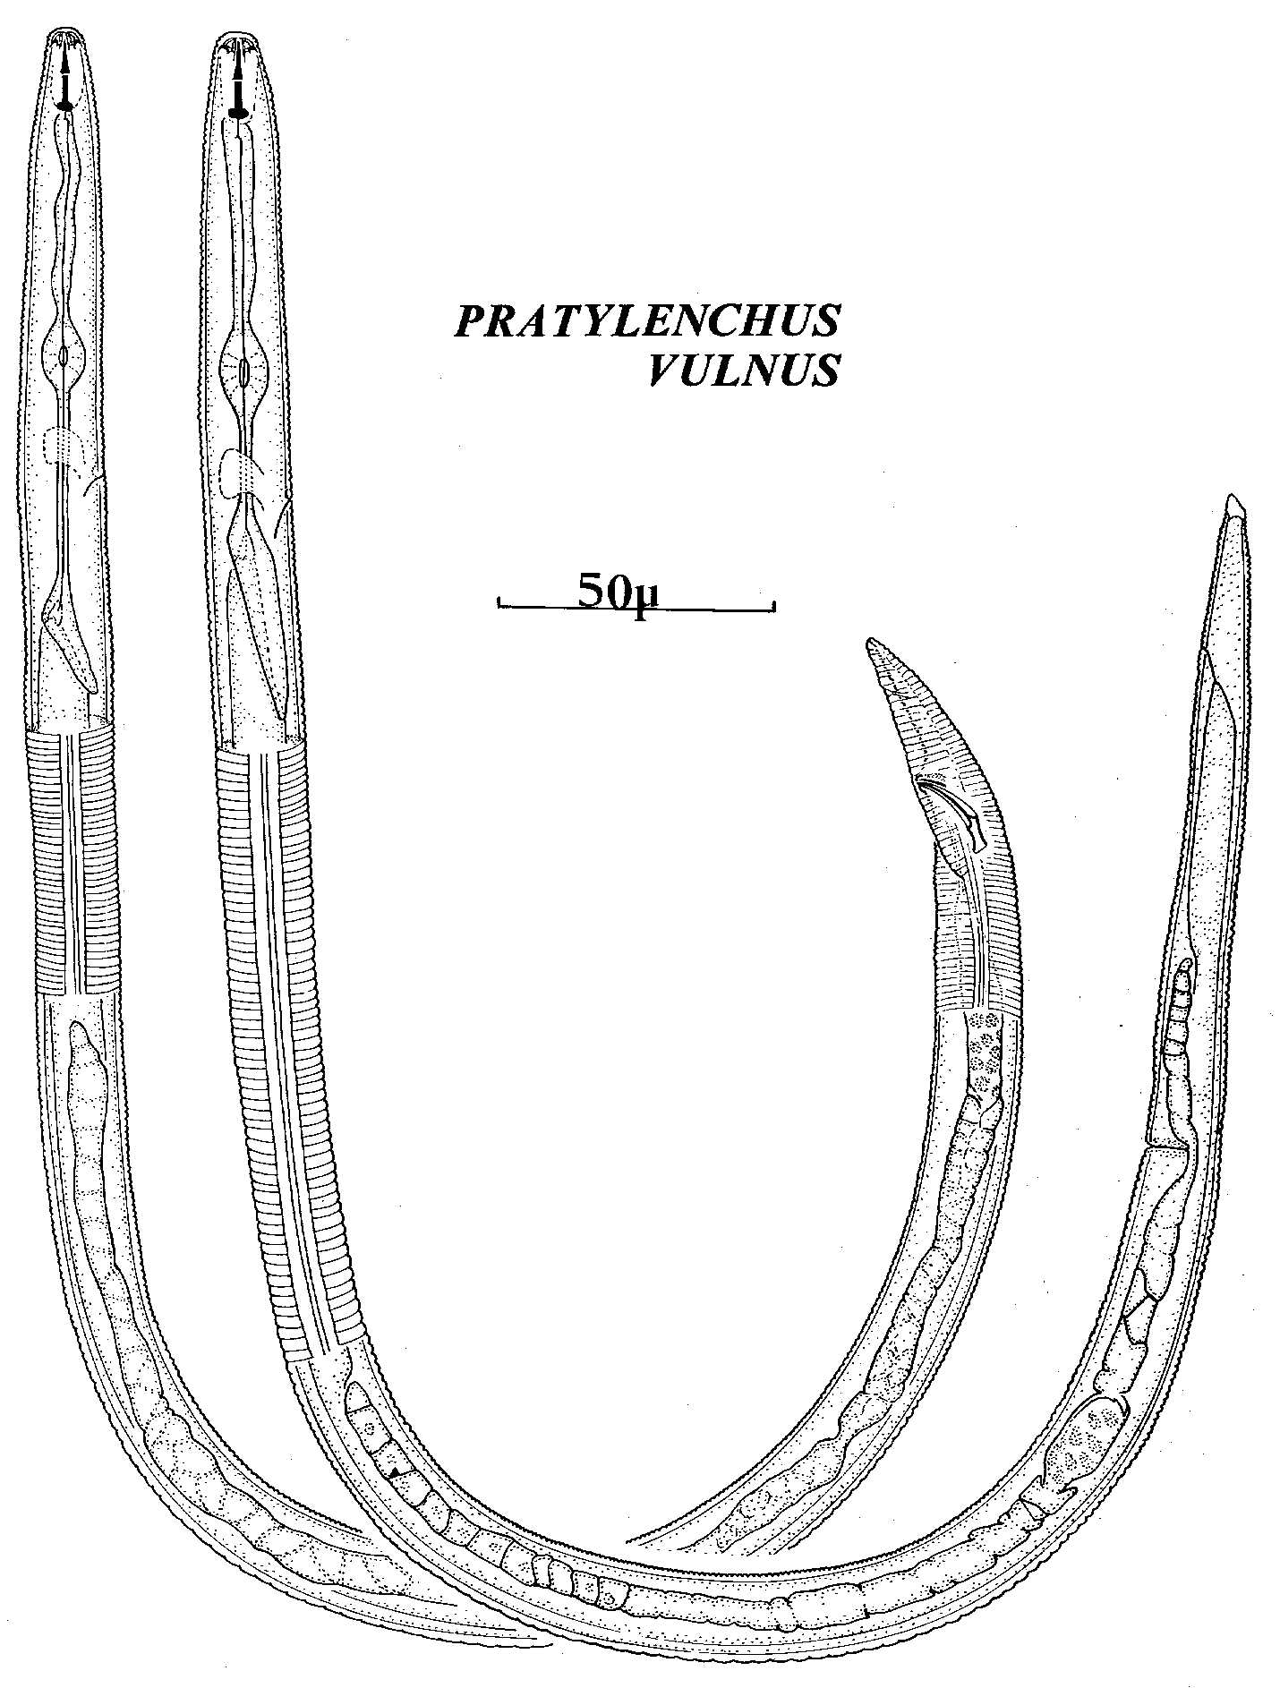
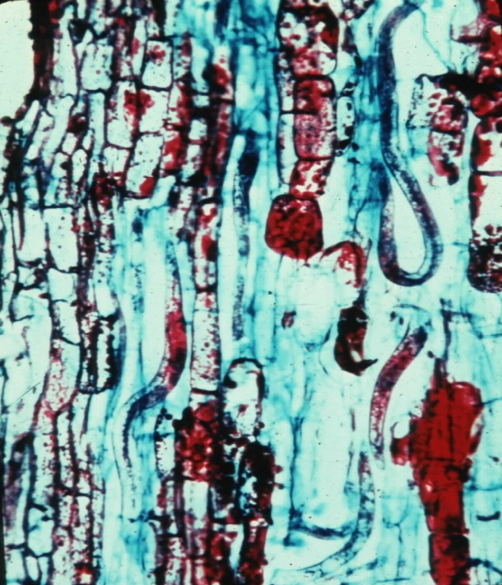
Pratylenchus vulnus
root lesion nematode

Slide 13
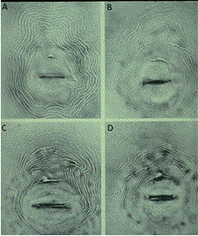
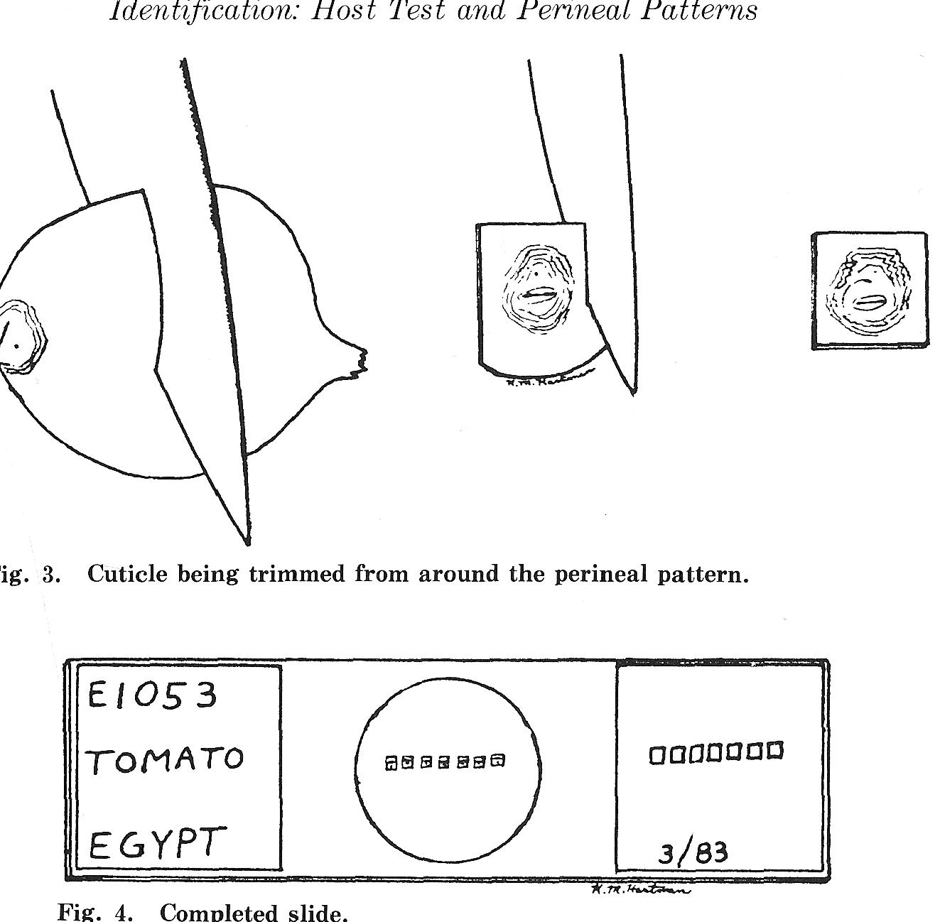
Nematode Identification:
Morphological identification
Example: root-knot nematodes
Perineal patterns for species identification used since 1949
Requires adult female nematodes and skilled experts; interpretation is subjective.
Why do we need to
identify them to species?

Slide 14
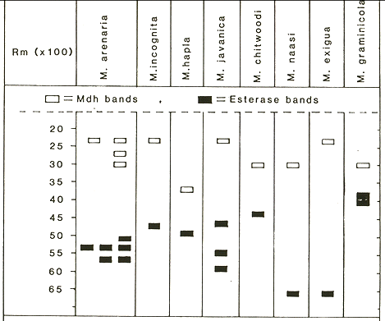
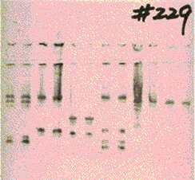
2. Biochemical identification
Isozyme electrophoresis:
Females are dissected from roots, squashed and run on a gel.
Gels are stained to determine migration of activity bands of malate dehydrogenase and esterase then compared to a key with known species.
Identification Key:
Example of gel:
malate
dehydrogenase
esterase
Limitations:
Requires live, healthy adult females (not J2s)
Within species variability
Patterns available for only limited number of species

Slide 15
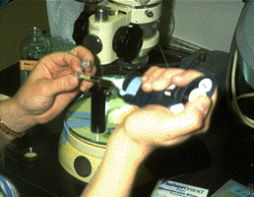
Molecular Identification
Species specific primers
Mitochondrial DNA polymorphisms
Isolation of nematode DNA
Step 1: Put nematodes into a PCR tube
Step 2: Dissolve or disrupt the nematodes
Step 3: Add specific primers and amplify
DNA in PCR machine
Step 4: Fractionate the amplified DNA in a
gel and examine pattern to determine species
vmwilliamson@ucdavis.edu
http://nematode.unl.edu/diagnostics.htm

Slide 16
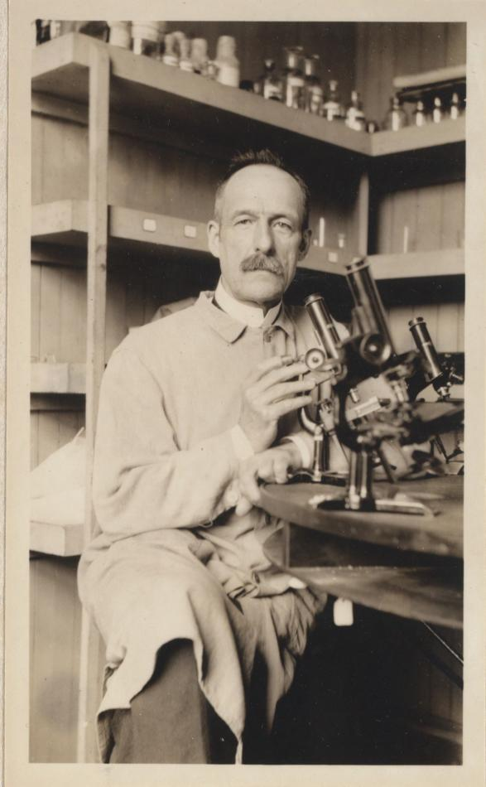
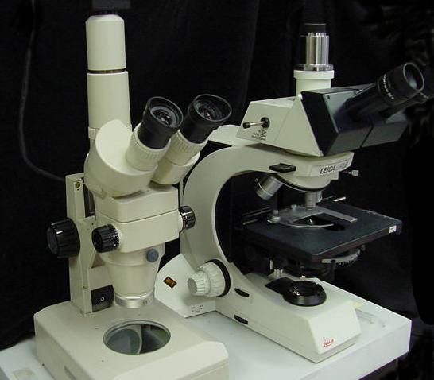
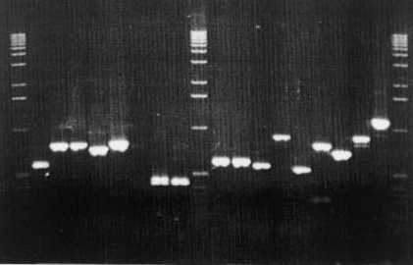
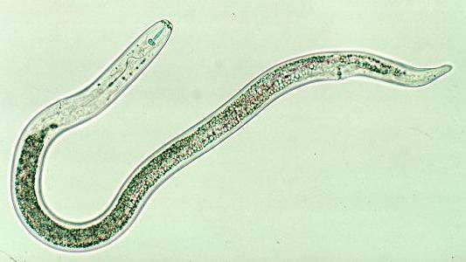

Helicotylenchus multicinctus
“Ultimately, rapid and inexpensive DNA barcoding will replace PCR/RFLP as a preferred diagnostic method” Powers (2005)
Pratylenchus penetrans
Molecular Barcoding
Identification based on sequence of a specific DNA fragment from an organism
rDNA regions: 18S, D-loop, ITS
Mitochondrial DNA regions
Specific protein-coding genes

Slide 17
Plant-feeding nematodes……..
Cause mechanical injury to cells and tissues
Cause cell death
Modify cell development
Modify cell function
Disrupt uptake of water and nutrients
Alter photosynthate partitioning
Create avenues of ingress
Predispose plants to diseases and other stresses
Some vector plant viruses

Slide 18
Signs and symptoms…..
Stunting, slow growth, dieback
Chlorosis and nutrient deficiencies
Wilting
Reduced yield
Lack of response to other treatments
Root symptoms
  Root stunting
  Root branching and proliferation
  Galls at root tips or along roots
  Lesions on roots

Slide 19
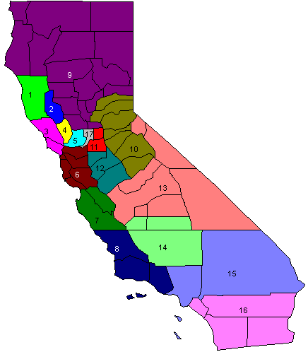
California Grapes: Co-distribution of Nematode species
Many of these are not native species. Why are they there?
Northern Interior/Foothills
Mesocriconema xenoplax
Pratylenchus vulnus
…..the importance of nursery certification and clean planting stock
North Coast
Xiphinema index
Mesocriconema xenoplax
Pratylenchus vulnus
Central Interior
Meloidogyne spp.
Xiphinema americanum
Tylenchulus semipenetrans
Mesocriconema xenoplax
Pratylenchus vulnus
Central Coast
Meloidogyne spp.
Xiphinema index
Mesocriconema xenoplax
Southern Interior
Meloidogyne spp.
Xiphinema americanum
Tylenchulus semipenetrans
Mesocriconema xenoplax

Slide 20
Management strategies for plant-parasitic nematodes….
Preplant management
  Planting site selection, non-host rotation
  Deal with replant problem issues
  Preplant soil disinfestation, nematicides, biofumigation
  Clean equipment, water
  Certified planting stock
  Rootstock selection
  Biological antagonists and soil food web health
Postplant management
  Amendments
  Nematicides
  Cover crops
  Biological antagonists and soil food web health

Slide 21
Nematode Management Cost Estimates: Grapevines
Consider Two Management Approaches:
Preplant Nematicide Treatment: Telone II - material and application = $950/acre
Amortize over 25 years = around $40/acre/year
This approach will require supplemental treatment either once or twice a year with a non-phytotoxic pesticide. There are not many available and they reduce populations of nematodes, not eliminate them:
DiTera, NemaQ, Movento, for example, around $200/acre/year.
Total Cost of this management approach around $250/acre/year.
Use of Resistant Rootstocks to provide resistance to some nematodes, phylloxera, desired horticultural characteristics, etc.
Grafted rootstock cost =$3.25/plant; own-rooted plants cost $1.50/plant
cost of this option = $3.25-1.50 = $1.75/plant. At 1,000 plants/acre = $1,750
Amortize over 25 years = around $75/acre/year
Since rootstocks are not resistant to all nematode species, may need supplemental nematicidal treatment every other year with DiTera, NemaQ, Movento, or other material = $100/acre/year
Total Cost of this management approach around $175/acre/year.

Slide 22
Host Plant Resistance
Rootstocks
-different nematode species
-horticultural characteristics
Dagger Nematode

Slide 23
Sources of Resistance to Nematodes
Snyder (1930s), Lider (1950s), Weinberger (1960s), Olmo (1980s), Walker (1990s+), Ferris et al. (2012, 2013)

Slide 24
Breeding and Selection for Broad and Durable Resistance
a 15-year process

Slide 25
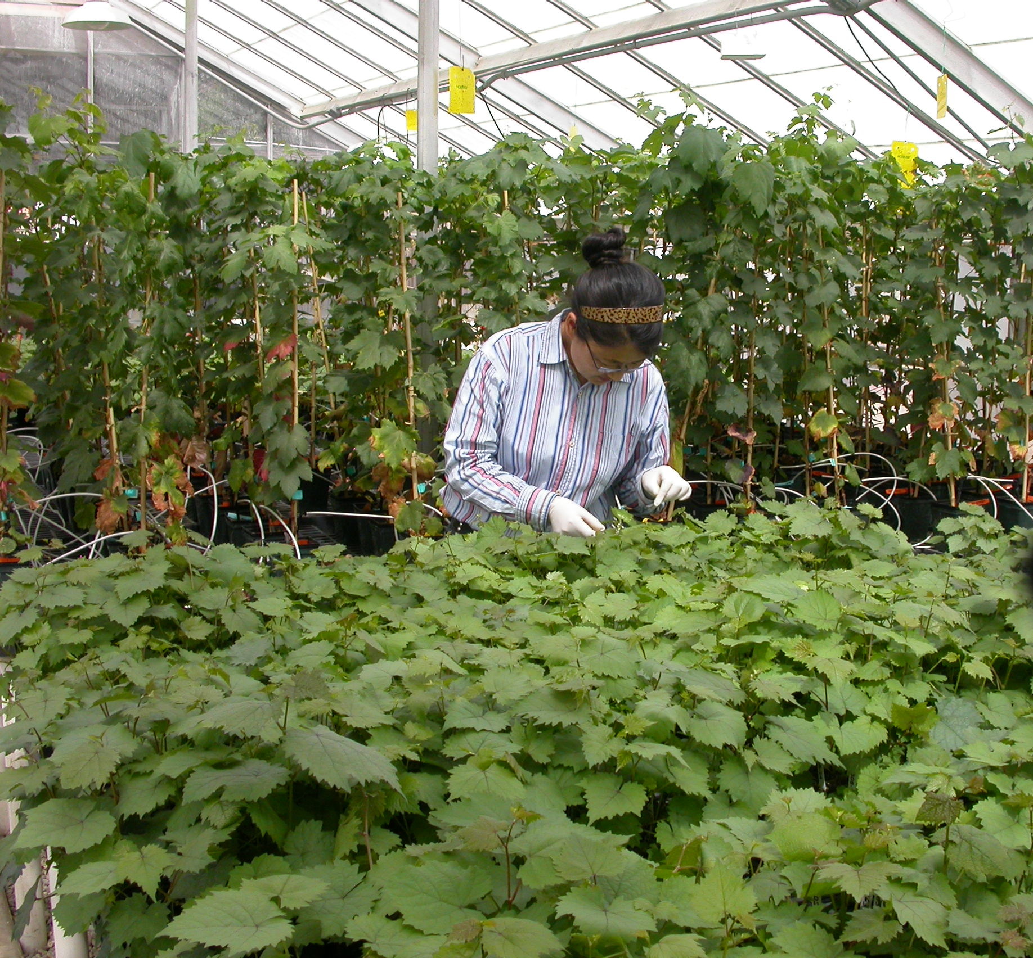
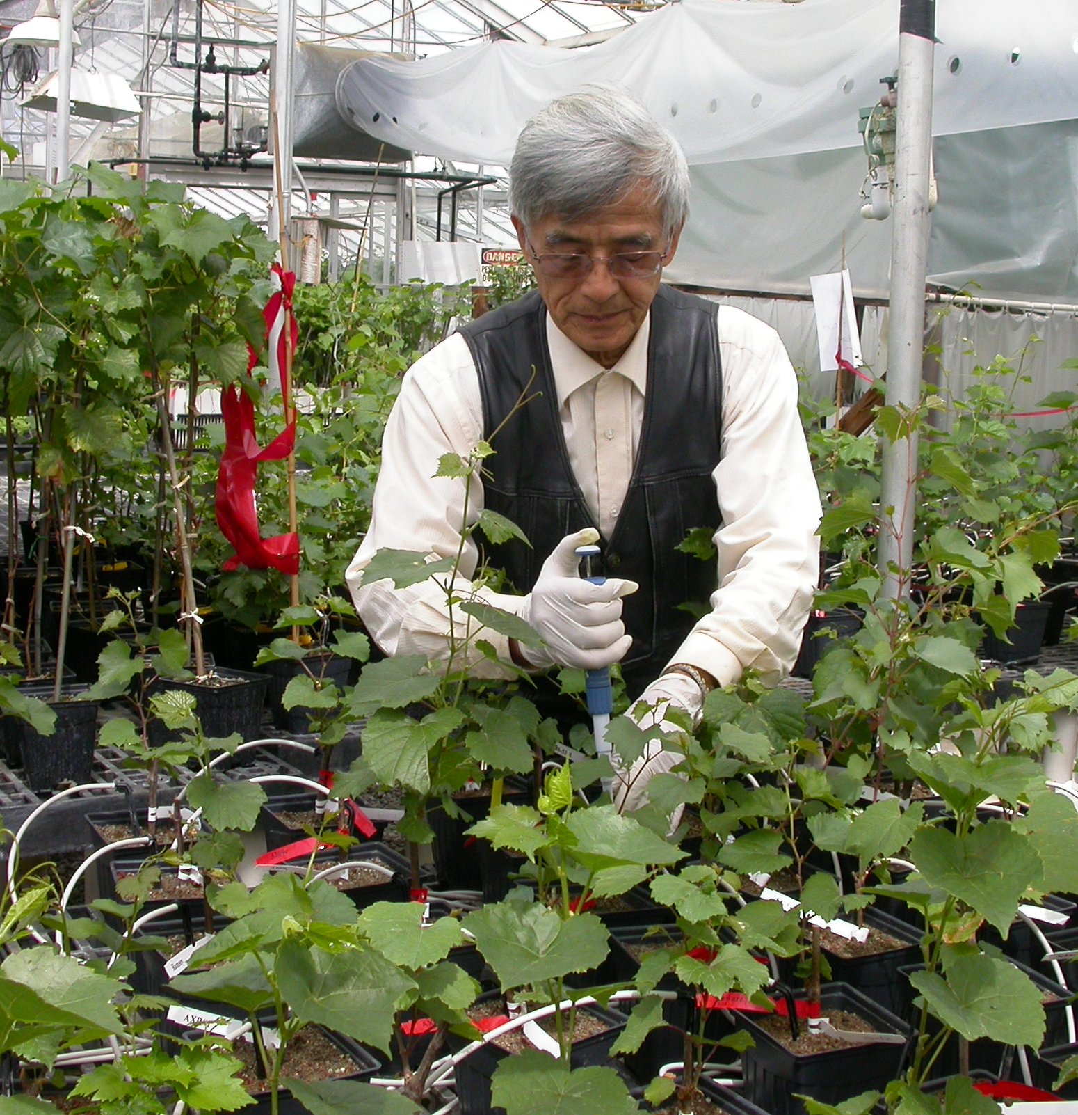

Slide 26
New Rootstock Characteristics
UCDGRN-1 | nematode resistance from Vitis rupestris and Muscadinia rotundifolia. 80% rooting and grafting success from dormant cuttings.
UCDGRN-2 | nematode resistance from V. rufotomentosa and V. champini (cv Dog Ridge). roots and grafts easily.
UCDGRN-3 | nematode resistance from V. rufotomentosa, V. champinii (cvs Dog Ridge and c9038). good rooting and grafting abilities.
UCDGRN-4 | nematode resistance from V. rufotomentosa, V. champinii (cvs Dog Ridge and c9038). good rooting and grafting abilities.
UCDGRN-5 | nematode resistance from V. champinii (cvs Ramsey and c9021). good rooting and grafting abilities.

Slide 27
Resistance Levels of UCDGRN series Rootstocks Exposed Separately
R
MR
MR
MR
MS
Mesocriconema xenoplax

Slide 28
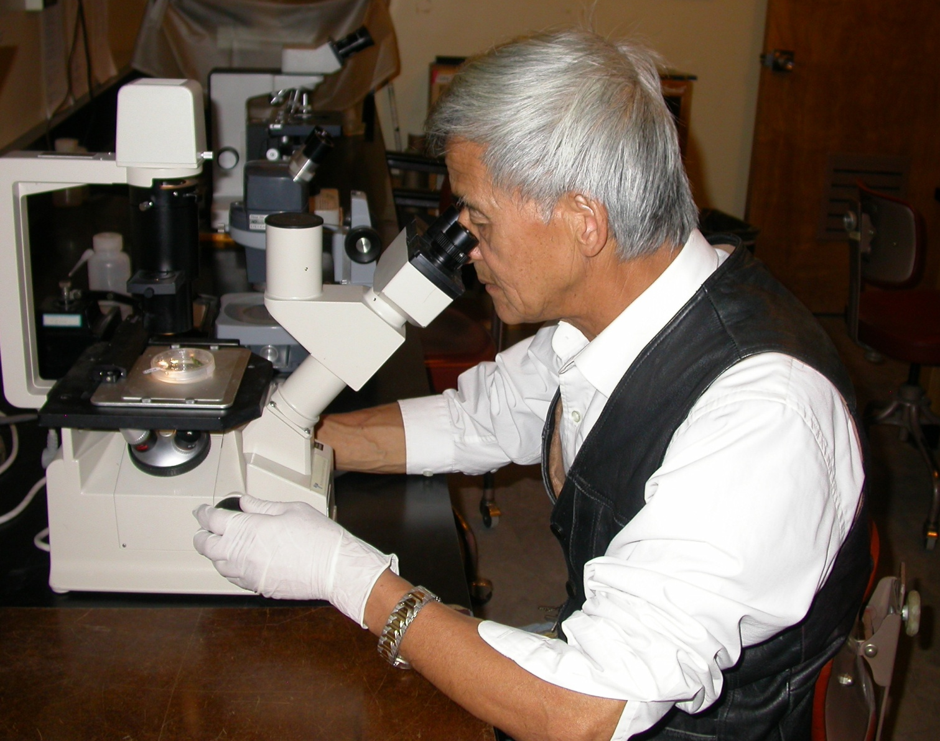
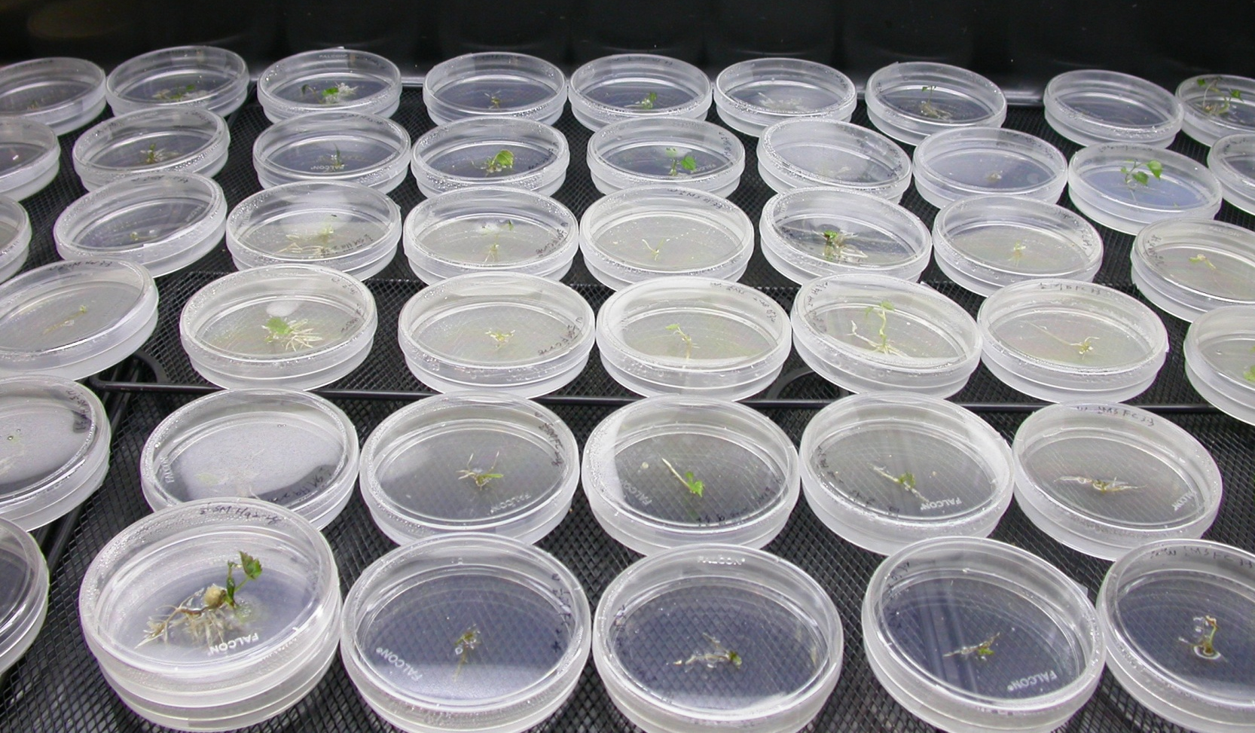
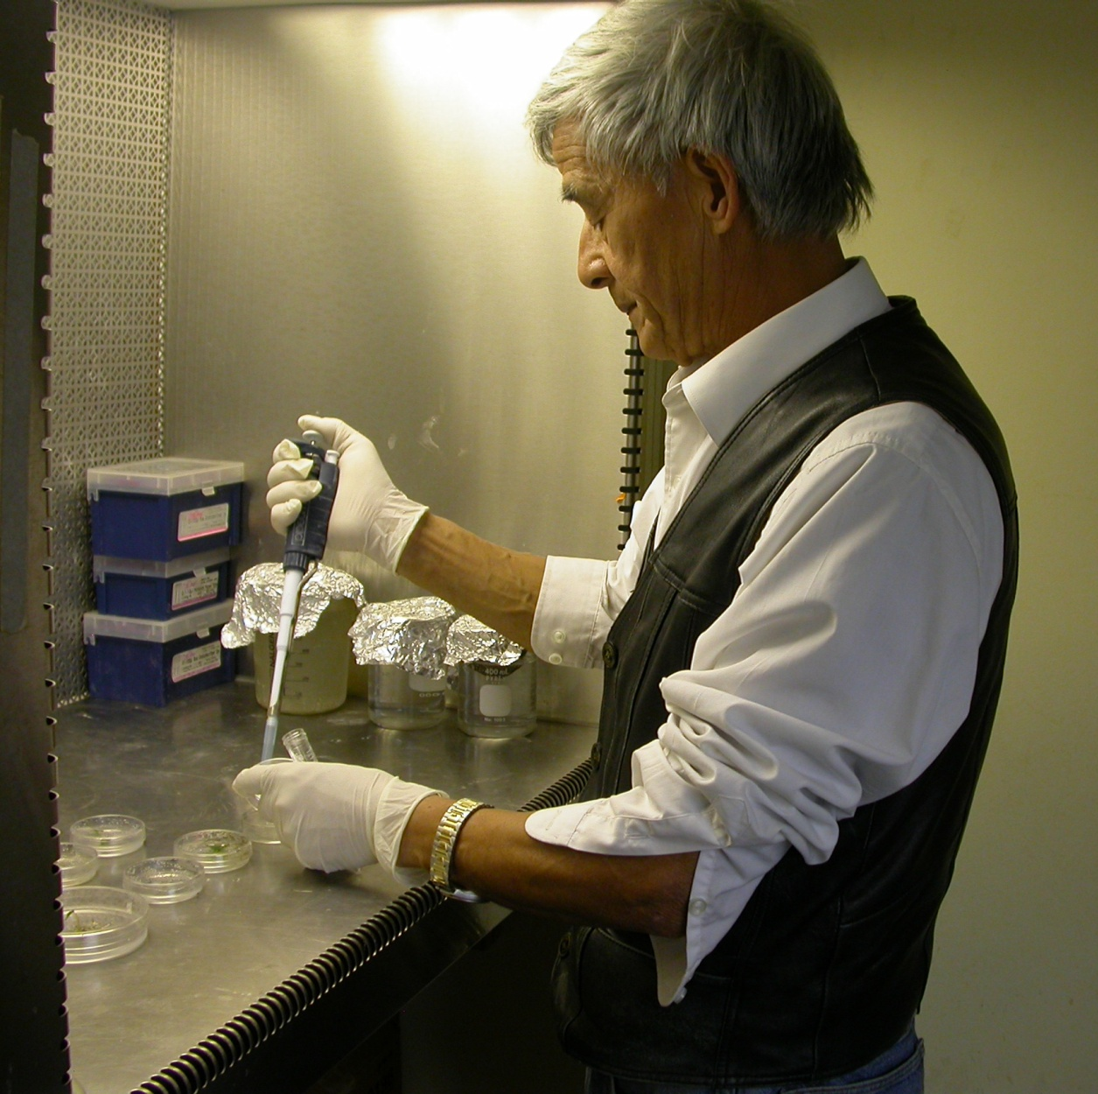
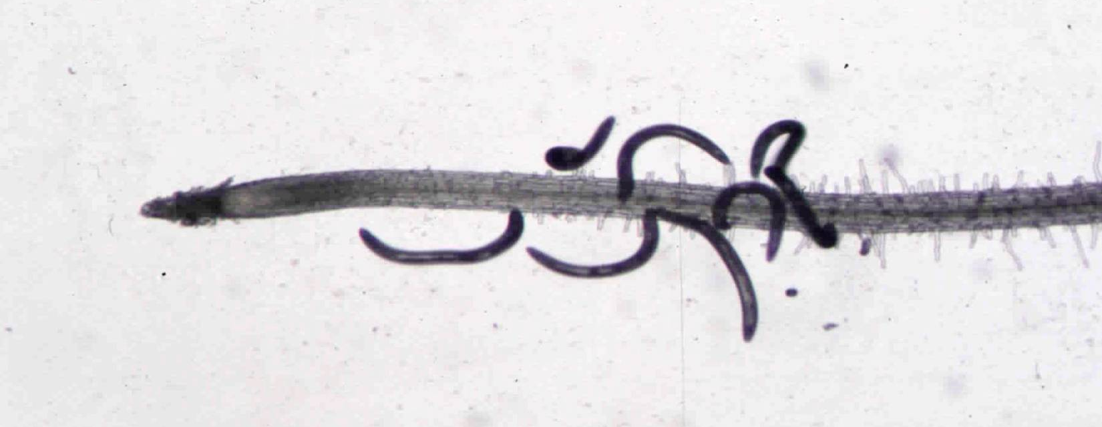
Determining the nature of resistance in the UCDGRN series and
candidate rootstocks

Slide 29
Genotype | Parentage | M. incognita Race 3 | M. javanica | Meloidogyne pathotypes Harmony A&C | M. chitwoodi | X. index | C. xenoplax | P. vulnu | T. semipenetrans | X. ameriacanum | Para. hamatus
101-14Mgt | V. riparia, V. rupestris |  |  | R |  | S | S | MR |  |  | S
1103Paulsen | V. solonis x V. riparia |  |  | S |  | S | S | MS |  |  | S
110Richter | V. berlandieri, V. rupestris |  |  | MR |  | S | S | S |  |  | S
140Ruggeri | V. berlandieri, V. rupestris |  |  | MR |  | S | S | S |  |  | MS
1613Couderc | V. solonis, V. othello | R | R | S | S | MR | S | MS | S | S
1616Couderc | V. solonis, V. riparia |  |  | MR |  | S | S | MS |  |  | S
3309Couderc | V. riparia, V. rupestris | S | S | S |  | MS | S | S | S | S | S
420A | V. berlandieri, V. riparia |  |  | R |  | S | S | MS |  |  | S
44-53Malegue | V. riparia, V. cordifolia, V. rupestris |  |  | S |  | S | MR | MS |  |  | S
AxR1 | V. vinifera, V. rupestris |  |  | S |  | S | S | S |  |  | S
Borner | V. riparia, V. cinerea |  |  | R |  | R | S | MS
Dog Ridge | V. champinii | R | R | S |  | S | S |  | MR | MR | MS
Freedom | V. champinii, V. longii, V. vinífera, V. riparia, V. labrusca | R | R | S | S? | R | MS | MS | S | MS | MR
Harmony | V. champinii, V. longii, V. vinífera, V. riparia, V. labrusca | R | R | S | S | MS | S | S | S | S | S
K51-32 | V. champinii, V. rupestris | MR |  |  |  | MS | S | R | S |  | S
Kober 5BB | V. berlandieri, V. riparia |  |  | R |  | S | S | MS |  |  | MR
Ramsey | V. champinii | R | R | S | S? | MR | S | MS | MS | S | S
Riparia Gloire | V. riparia |  |  | R |  | R | S | MR |  |  | S
RS-3 | V. candicans, V. riparia, V. rupestris | R | R | MR | MR | S | S | MR |  |  | S
hferris@ucdavis.edu http://plpnemweb.ucdavis.edu/Nemaplex

Slide 30
Genotype | Parentage | M. incognita Race 3 | M. javanica | Meloidogyne pathotypes Harmony A&C | M. chitwoodi | X. index | C. xenoplax | P. vulnu | T. semipenetrans | X. ameriacanum | Para. hamatus
RS-9 | V. candicans, V. riparia, V. rupestris | R | R | R | R | S | S | MS |  |  | S
Schwarzmann | V. riparia, V. rupestris | S | MR | S |  | MR | MS | S | S | MS | S
St. George | V. rupestris | S |  | S |  | S | S | MS |  |  | MS
Teleki 5C | V. berlandieri, V. riparia | MS | MR | S |  | MR | MS | S | S | S | MS
USDA 10-17A | V. simpsoni, M. rotundifolia | R | R | R | R | R | MS | R | R
USDA 10-23B | V. doanianna | R | R | R | R | R | MR | R | R
USDA 6-19B | V. champinii | R | R | MS | R | MR | MR | R | R | R
VR O39-16 | V. vinifera, M. rotundifolia | S | S | S |  | R | R | MR | S | MR | MR
UCD GRN1 | V. rupestris cv A. de Serres, M. rotundifolia cv Cowart | R |  | R |  | R | R | MR | R |  | MR
UCD GRN2 | V. rufotomentosa, V. champinii cv Dog Ridge, V. riparia cv Riparia Gloire | R |  | R |  | R | MS | MR | MS |  | MR
UCD GRN 3 | V. rufotomentosa, V. champinii cv Dog Ridge), V. champinii cv c9038, V. riparia cv Riparia Gloire | R |  | R |  | R | MR | MR | MR |  | MR
UCD GRN4 | V. rufotomentosa, V. champinii cv Dog Ridge), V. champinii cv c9038, V. riparia cv Riparia Gloire | R |  | R |  | R | MR | MR | MR |  | MS
UCD GRN5 | V. champinii cv Ramsey, V. champinii cv c9021), V. riparia cv Riparia Gloire | R |  | R |  | R | R | MR | MR |  | MR
hferris@ucdavis.edu http://plpnemweb.ucdavis.edu/Nemaplex

Slide 31
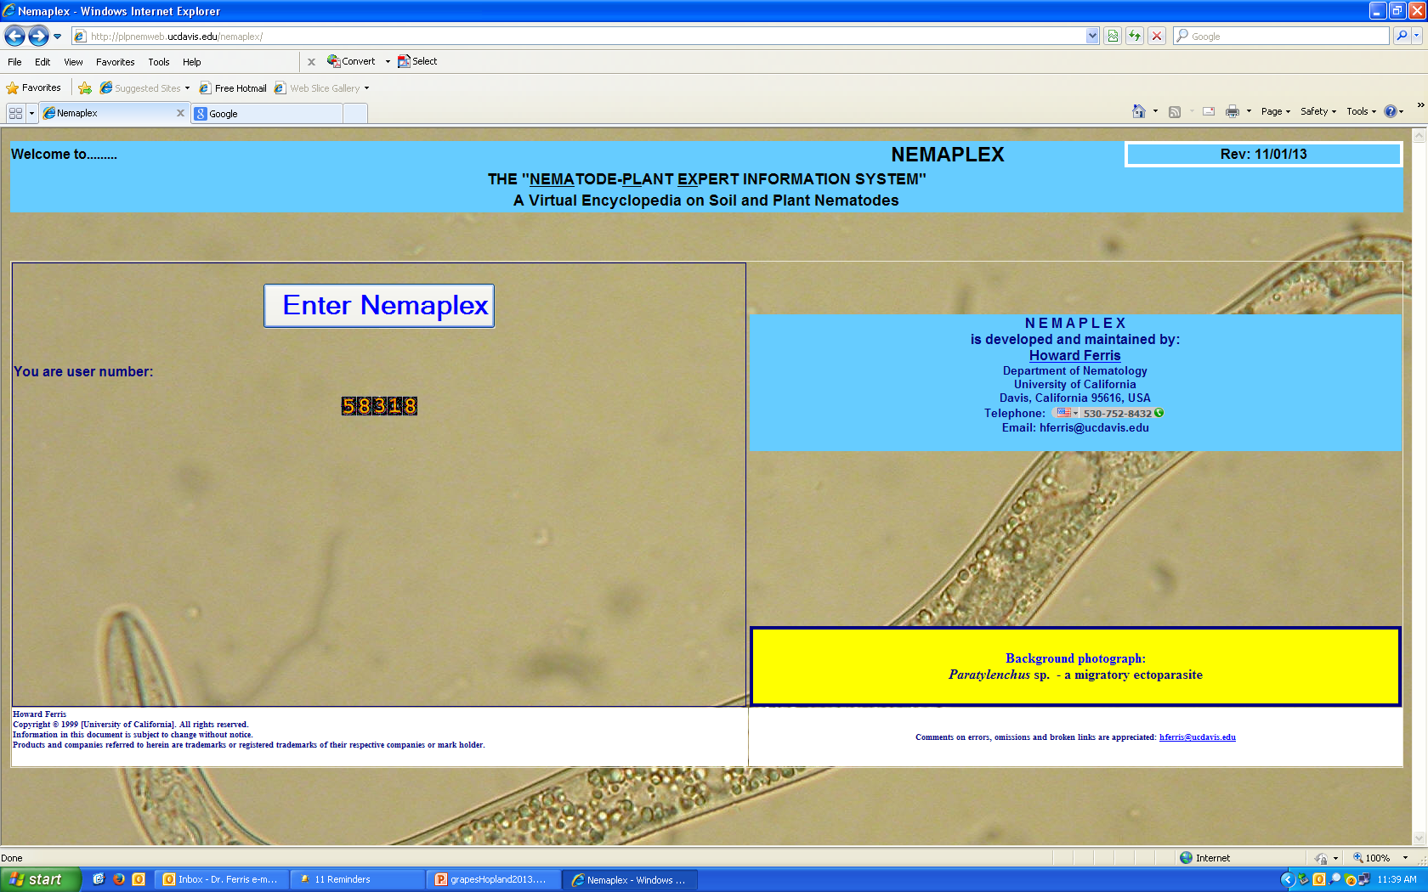
finding the information…….
Nemaplex: http://plpnemweb.ucdavis.edu/nemaplex

Slide 32
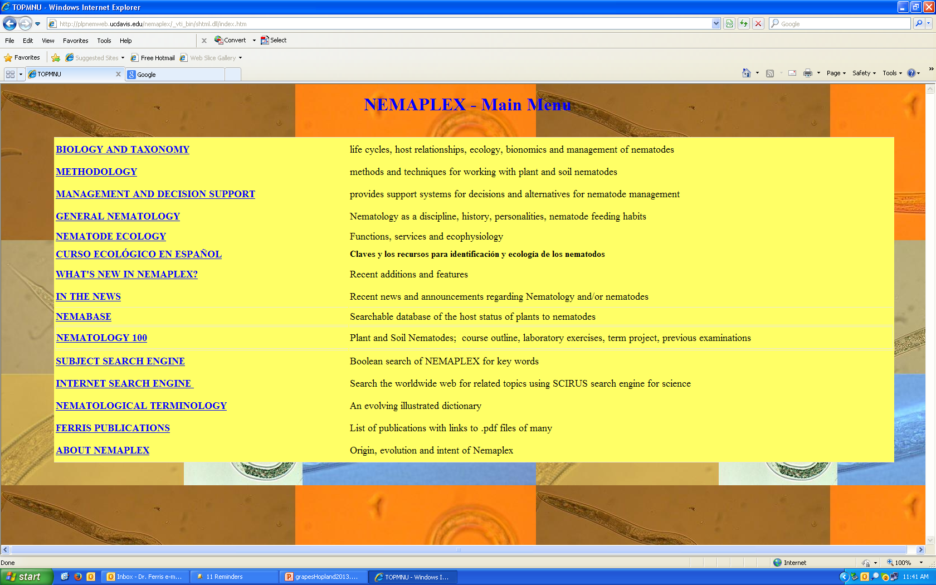
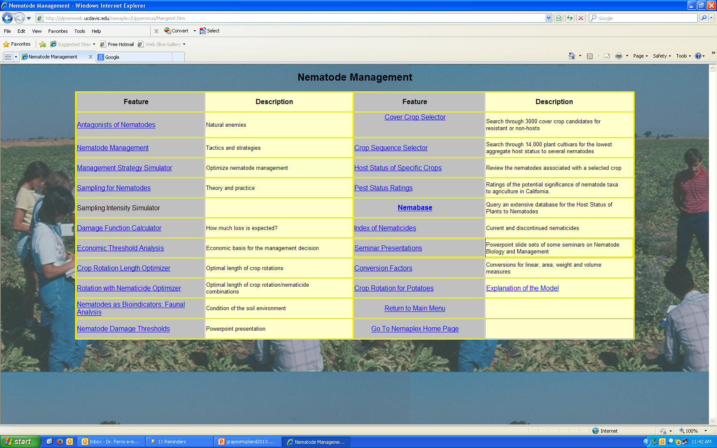
>53,700 entries

Slide 33
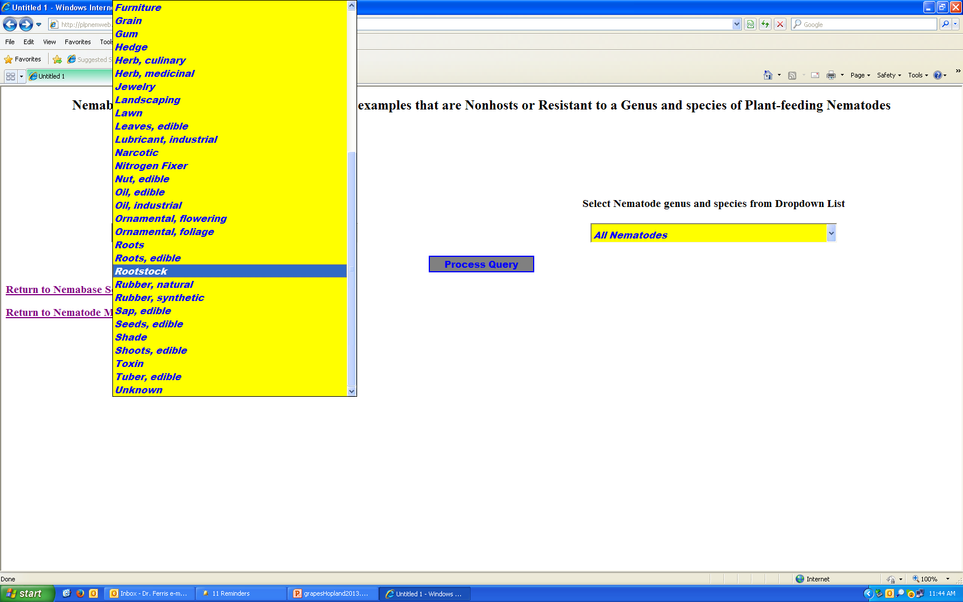
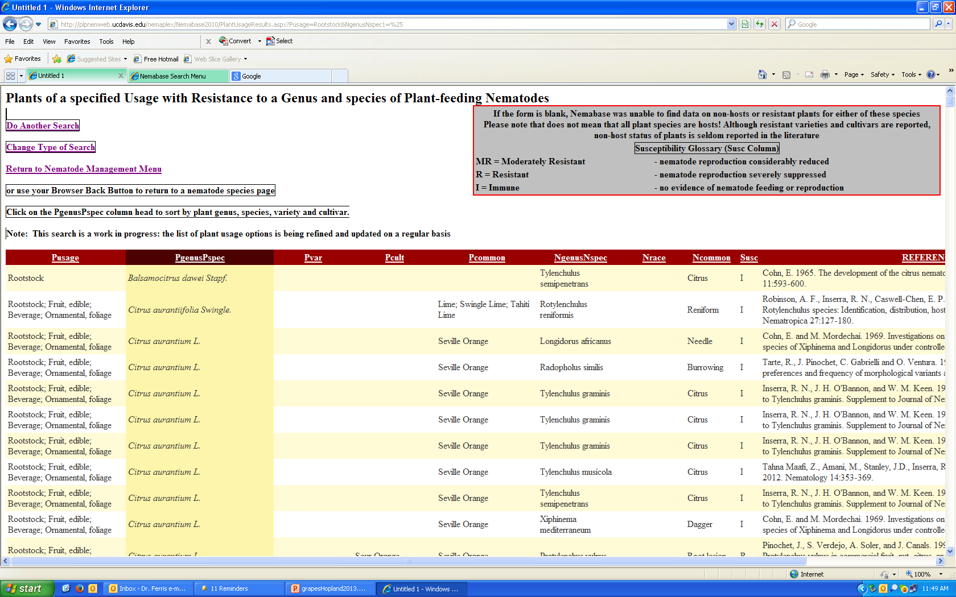
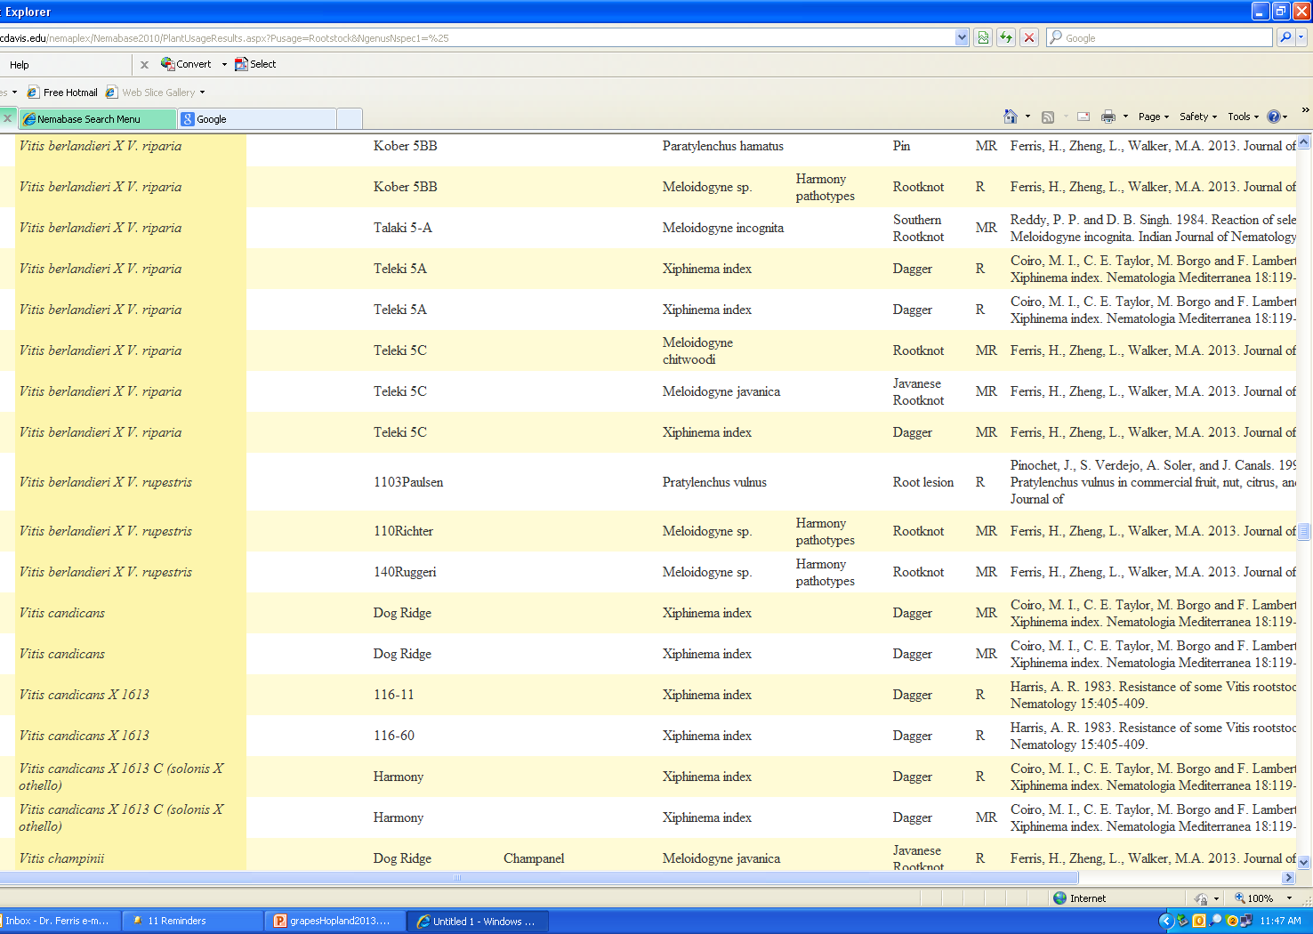

Slide 34
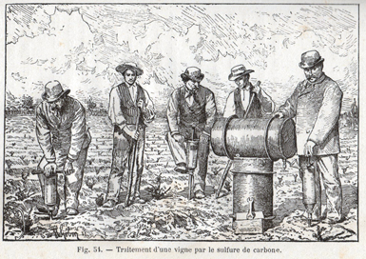


Chemical Control of Soil Pests……
injection of materials into soil
1870s
Zimbabwe 1965

Slide 35




Soil Chemicals – Nematicides….Environmental concerns………
Ozone Depletion: 1995 Nobel Prize in Chemistry
Paul Crutzen
F. Sherwood Rowland
The U.S. and other countries are signatories to the
Montreal Protocol on Ozone Depleting Substances
The protocol called for total phase out of methyl bromide
for horticultural uses in developed countries by 2005
Mario Molina
Paul Crutzen Max-Planck-Institute for Chemistry, Mainz, Germany
    born 1933 in Amsterdam. Dutch citizen.
    PhD in meteorology, Stockholm University, 1973.
  Nitrogen oxides as ozone depleters
Mario Molina MIT, Cambridge, MA, USA
    born 1943 in Mexico City, Mexico. U.S. citizen.
    PhD in physical chemistry, University of California, Berkeley.
  CFCs as ozone depleters
F. Sherwood Rowland University of California, Irvine CA, USA
    born 1927 in Delaware, Ohio, USA
    PhD in chemistry, University of Chicago, 1952.
  CFCs as ozone depleters
….consider new Volatile Organic Compounds (VOC) regulations
- effective 2009-2010

Slide 36
Nematicides Registered in California for Bare Soil Application 10/19/2015

Slide 37

A review of other options…..
Physical
Management
Flooding
-anaerobic conditions
-varied success
-water and terrain
constraints

Slide 38

Physical Management
Solarization (and biofumigation with
organic amendments
crop residues
animal manures)

Slide 39







Biofumigation Experiments - Mexico:
Nacobbus aberrans – peppers, tomatoes
Organic amendments:
Brassica spp. isothiocyanates
Sorghum cyanogenic glucosides
Poultry manure ammonia
Fungal parasite
Pochonia chlamydosporia

Slide 40
Postplant Nematode Management – Nematicides:
??
phytotoxic?
****Consider nematicide rotation to delay loss of efficacy

Slide 41
Postplant Vineyard Management
Cultural:
avoid introducing nematodes on equipment, people, water
water and fertility management to compensate for compromised root system
pruning to reduce crop load in nematode-stressed conditions
increase organic matter for soil structure, water-holding capacity, nutrient value and to build soil food web
winter cover crops for soil building and nematicidal effects
Note that chemical nematicides may disrupt food web effects

Slide 42
Postplant nematode management – cover crops and organic amendments
onion
garlic
pumpkin
rapeseed
other brassicas
Chinese herbal remedies
cover crops and green manures

Slide 43
Selection of Non-host Cover Crops or
Rotation Crops

Slide 44


Nemaplex – http://plpnemweb.ucdavis.edu/nemaplex

Slide 45

Some plants resistant or immune to Xiphinema index…..

Slide 46

Natural Plant Defense Products
Example: marigolds and α-terthienyl

Slide 47
Recent Examples of Commercial Soil Amendments
…for nematode management and soil health
Farewell Microlife
Microplex F-68 Soil Conditioner
Clandosan 618 Superbac
Agrosyn Guano Plus
Quinoa Sesame
Humic acid Compost
Agri-50 Pent-a-vate
Arise Fertilaid
Zap Ammonium sulfate
Ozone Probiotic
…….and more

Slide 48
Soil Amendments: Potential Modes of Action
Contain beneficial microbes
Stimulate or provide resources for antagonists
Compete for root surface
Reduce plant stress (improved soil structure, moisture
retention, plant nutrition)
Nematicidal breakdown products
…..and sometimes……no effect
B. A. JAFFEE

Slide 49




Nematode Ecology and the Soil Food Web

Slide 50



















Soil Bacteria
Protozoa
Some Organisms of the Soil Ecosystem
-Services and Disservices
Soil Microarthropods
Soil Nematodes

Slide 51


Biological antagonists of nematodes

Slide 52


Economies of Ecosystems: Carbon and Energy are the Currencies
CO₂
CO₂
CO₂
CO₂
Stewardship
bacteria
protozoa
nematodes
carbohydrates
and
proteins
carbohydrates
and
amino acids
nematodes
arthropods
fungi
C
N
nematodes
other
organisms
fungi
arthropods
nematodes
NO₃
Carbon and energy transfer
Carbon is respired by all organisms in the food web
The amounts of Carbon and Energy available limit the size and activity of the web
NH₃
NH₃
NH₃

Slide 53









Fueling the Soil Food Web
external sources
rhizodeposition
old root death
C
herbivory
external sources
rhizodeposition
old root death
C
herbivory

Slide 54


Soil Food Web Stewardship
Winter cover crop – bell beans
California, 2006
Soil fertility
Organic matter
Food web activity
Soil structure
Fossil fuel reduction
Habitat conservation
Food web activity
Soil structure
No-till soybeans, Brazil, 2006

Slide 55
Sugarcane roots
under organic mulch or deeper soil layers
Photo from Stirling et al., 2011

Slide 56





Slide 57




Food Web Complexity and the
Regulation Function
Management practices in industrialized agriculture result in:
Soil food web simplification
Reduction in higher trophic levels
Costa Rica, 2008

Slide 58
Management strategies - Summary
Preplant management
  Planting site selection, non-host rotation
  Deal with replant problem issues
  Preplant soil disinfestation, nematicides
  Clean equipment, water
  Certified planting stock
  Rootstock selection
  Biological antagonists and soil food web health
Postplant management
  Amendments
  Nematicides
  Cover crops
  Biological antagonists and soil food web health

Slide 59

Thank you!
http://plpnemweb.ucdavis.edu/nemaplex

