Slide 1
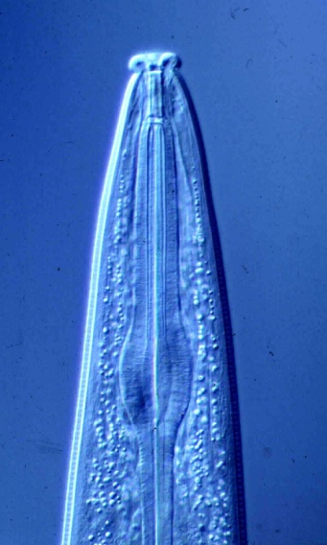
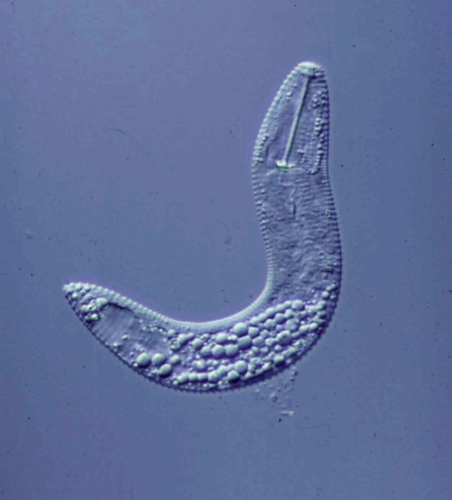
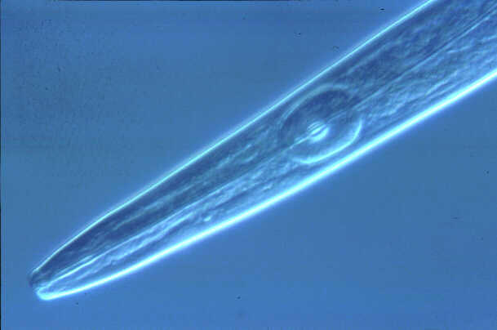
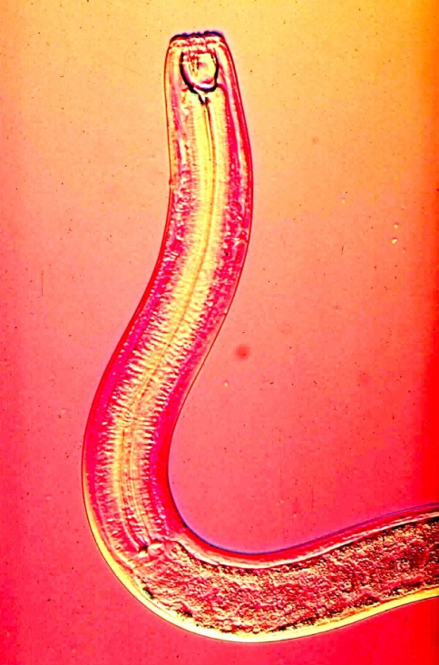
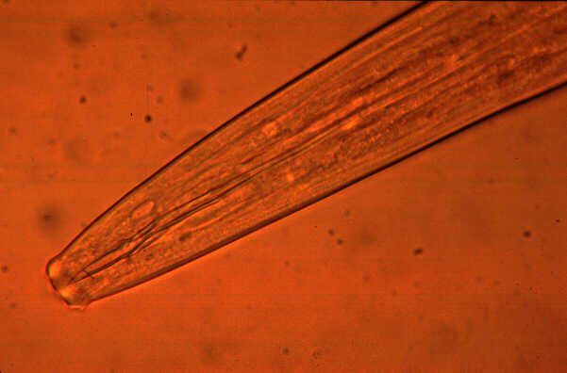
Nematodes in Vineyards
important species, biology, soil ecology, management
Howard Ferris
Department of Entomology and Nematology
University of California, Davis
hferris@ucdavis.edu
July, 2012

Slide 2
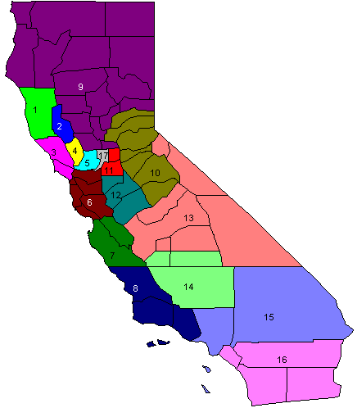
California Grapes: Co-distribution of Nematodes
Northern Interior/Foothills
Criconemoides xenoplax
Pratylenchus vulnus
North Coast
Xiphinema index
Criconemoides xenoplax
Pratylenchus vulnus
Central Interior
Meloidogyne spp.
Xiphinema americanum
Tylenchulus semipenetrans
Criconemoides xenoplax
Pratylenchus vulnus
Central Coast
Meloidogyne spp.
Xiphinema index
Criconemoides xenoplax
Southern Interior
Meloidogyne spp.
Xiphinema americanum
Tylenchulus semipenetrans
Criconemoides xenoplax

Slide 3
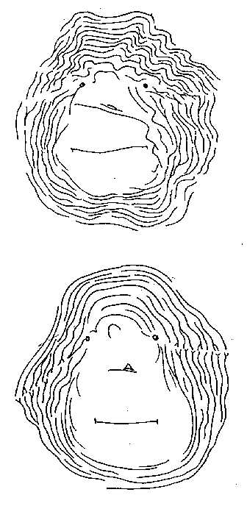
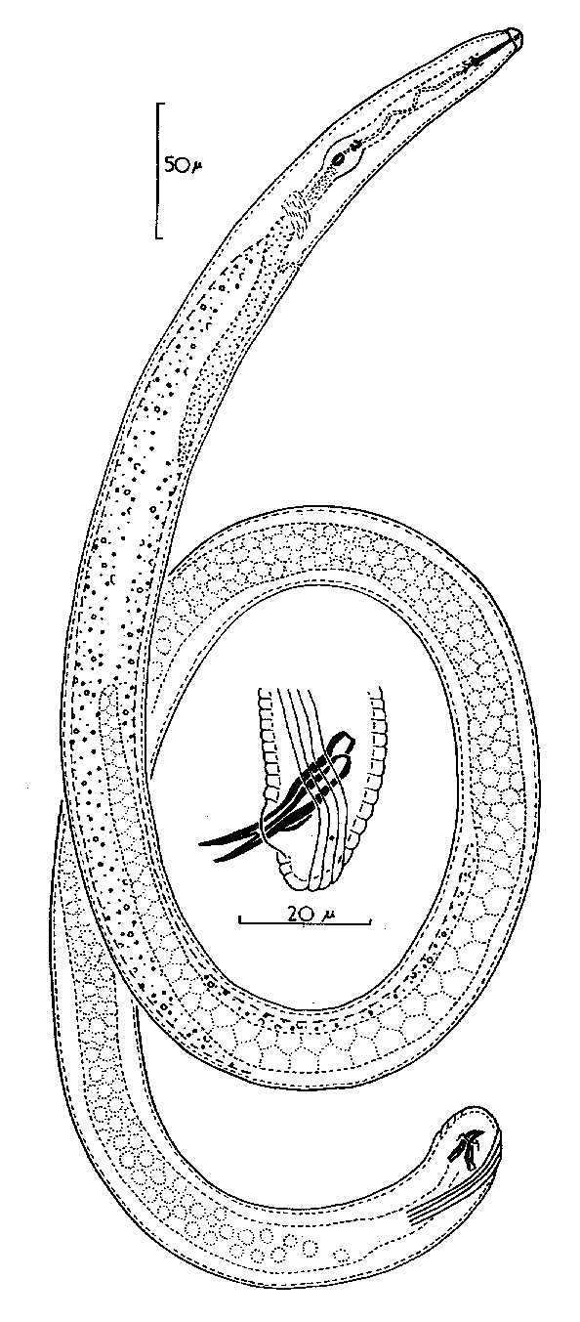
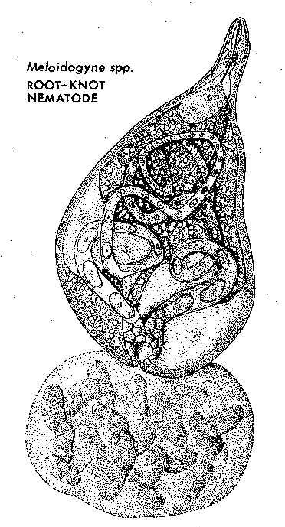
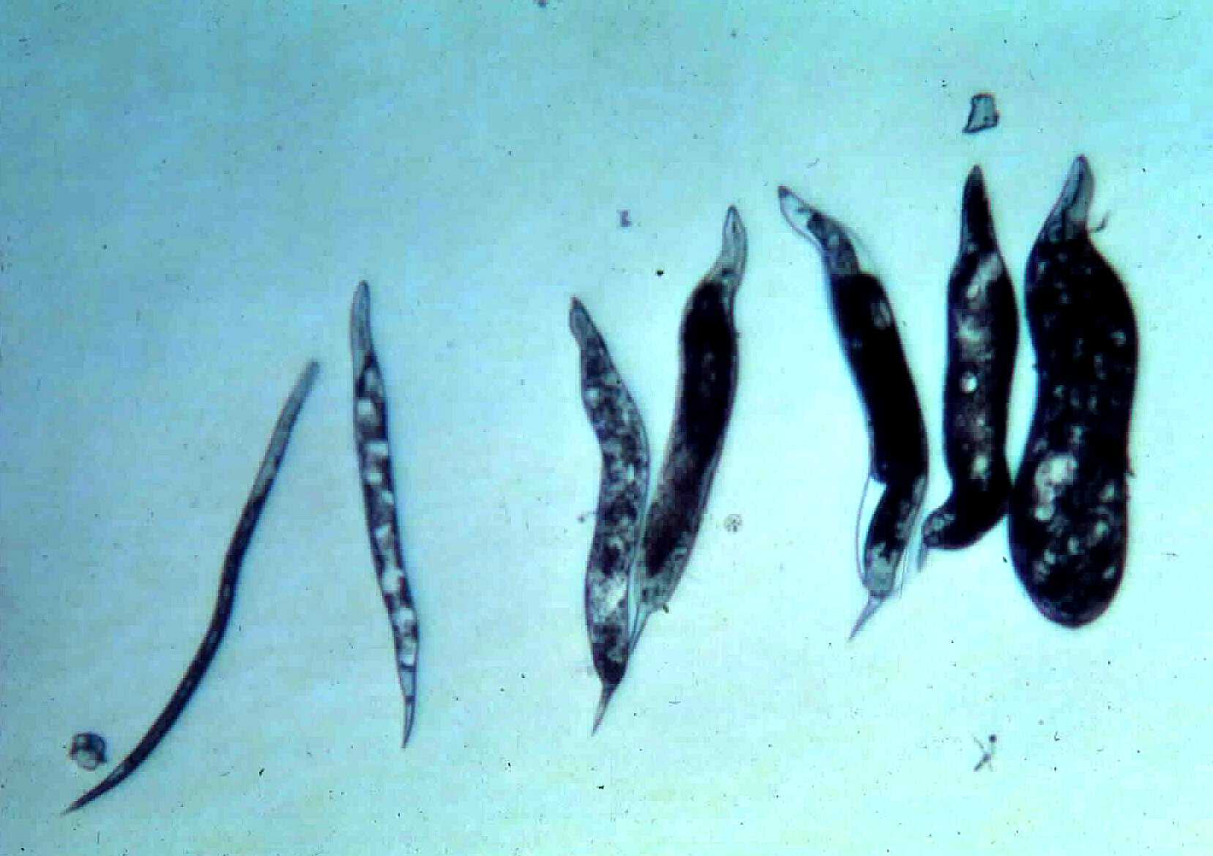
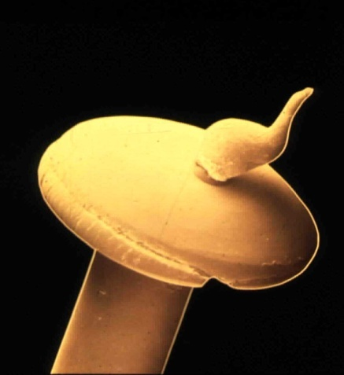
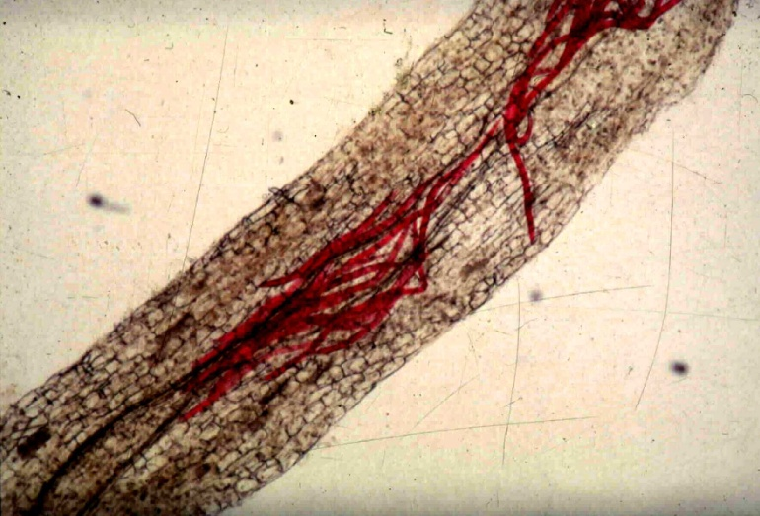
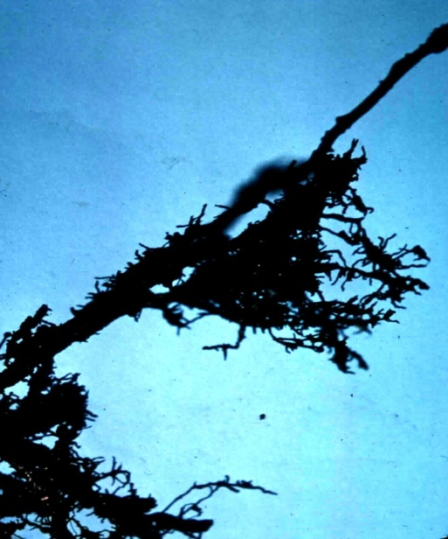
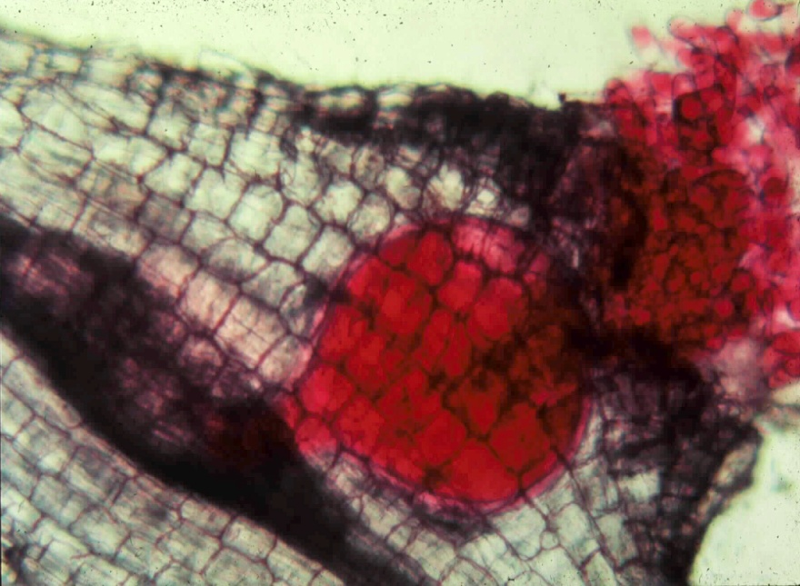
Meloidogyne spp.
(arenaria, incognita, javanica, chitwoodi, and ??)
root-knot nematodes

Slide 4
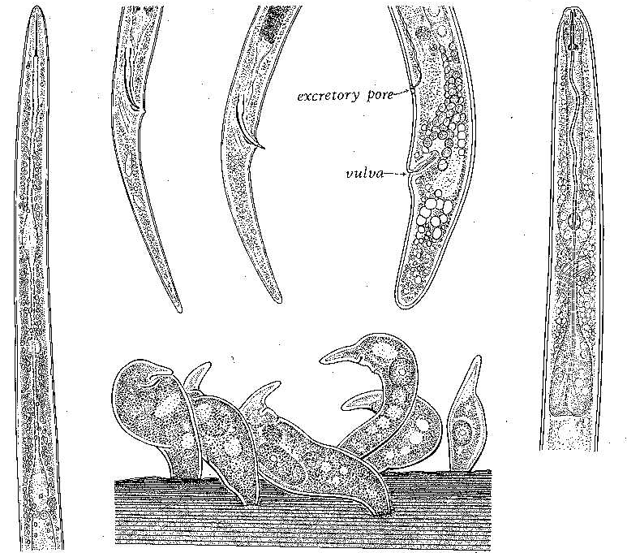
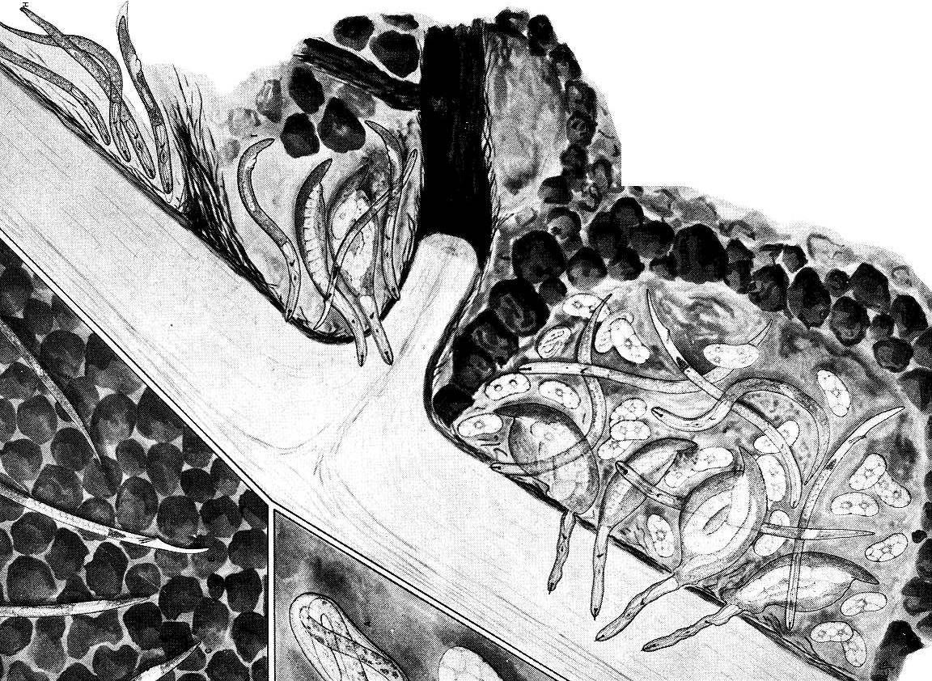
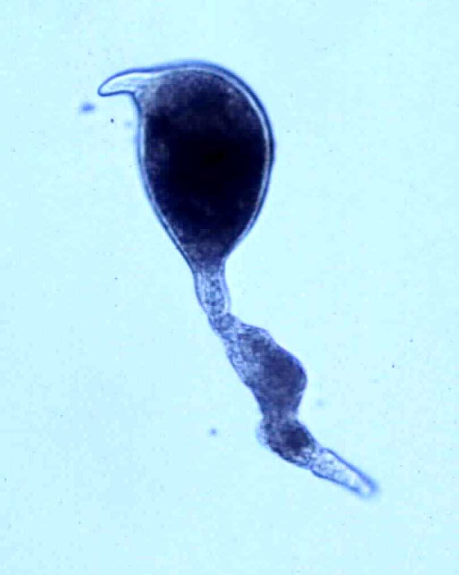
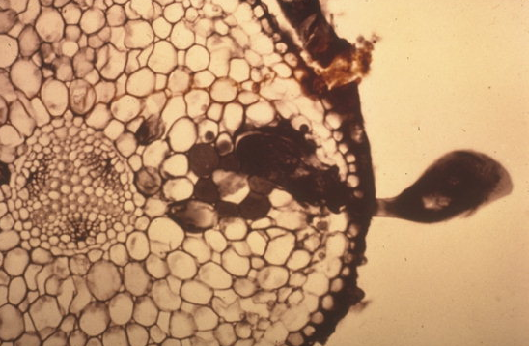
Tylenchulus
semipenetrans
citrus nematode

Slide 5
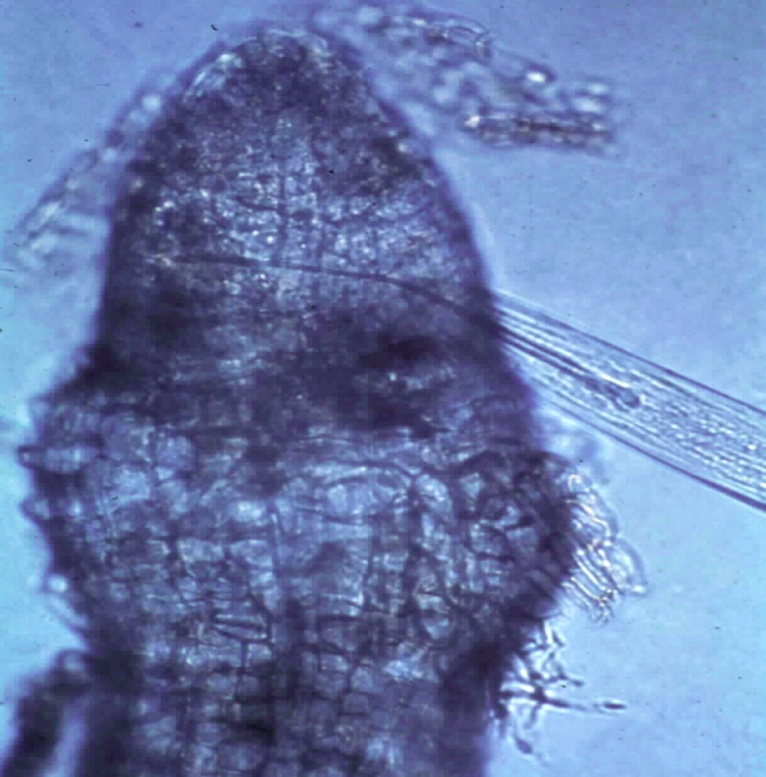
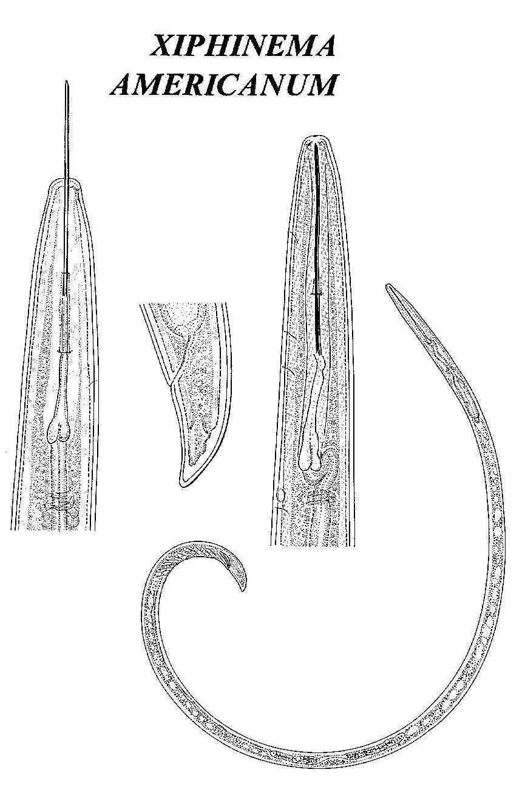
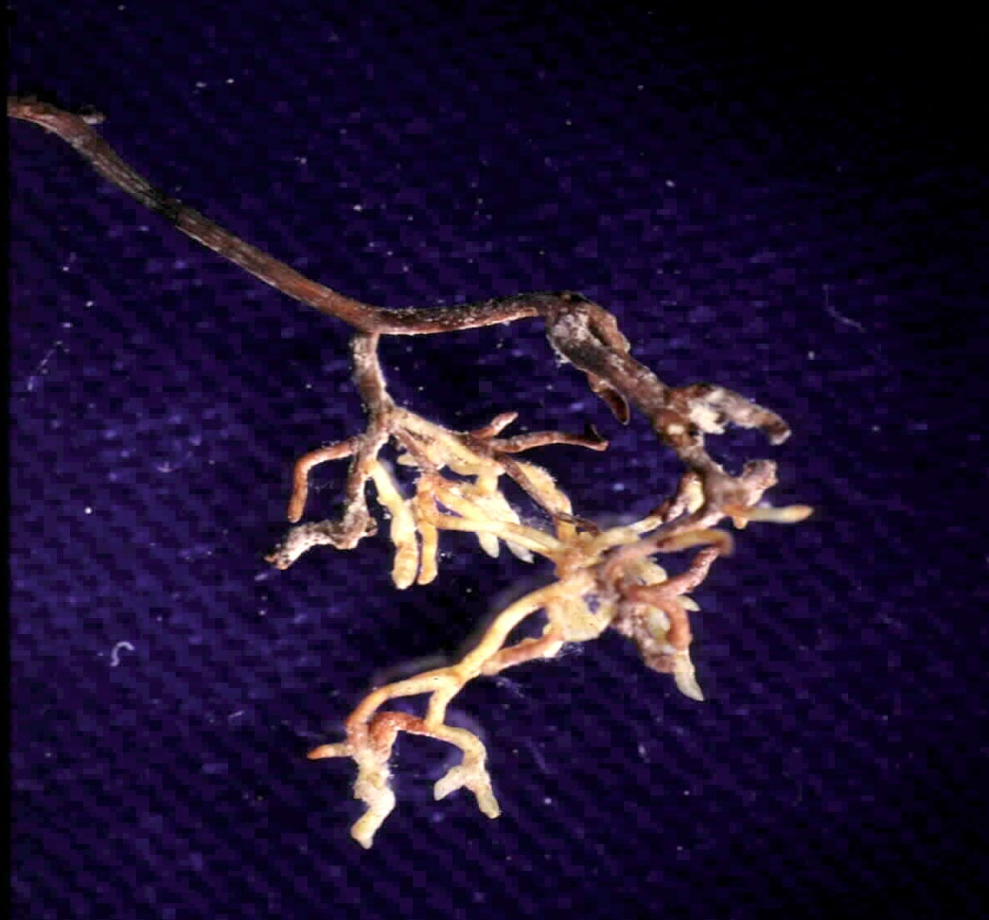
Xiphinema americanum
(sensu lato)
dagger nematode

Slide 6
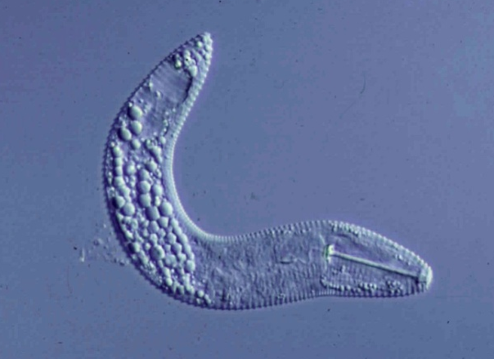
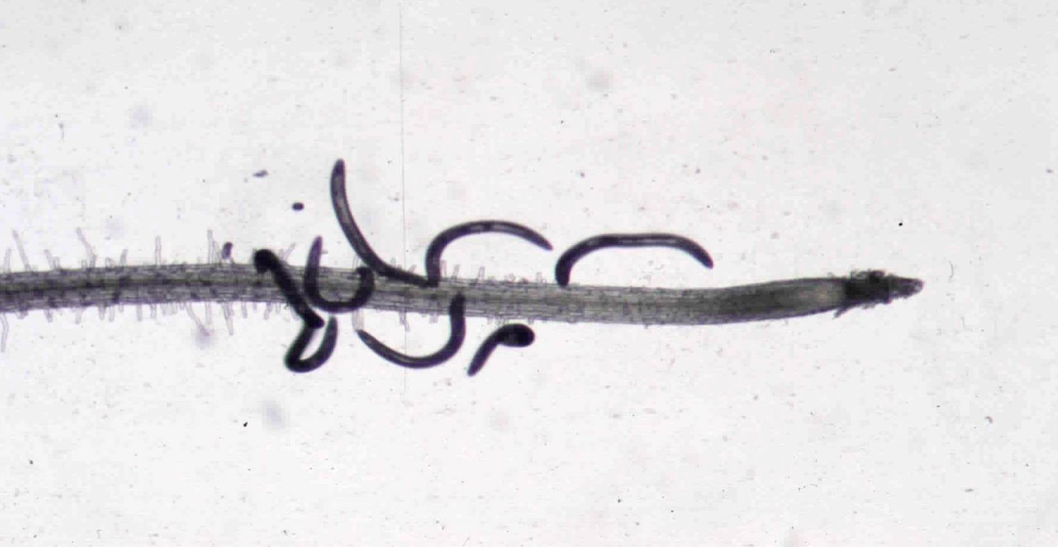
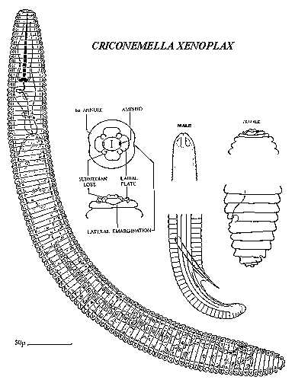
Criconemoides xenoplax
ring nematode
-
+

Slide 7
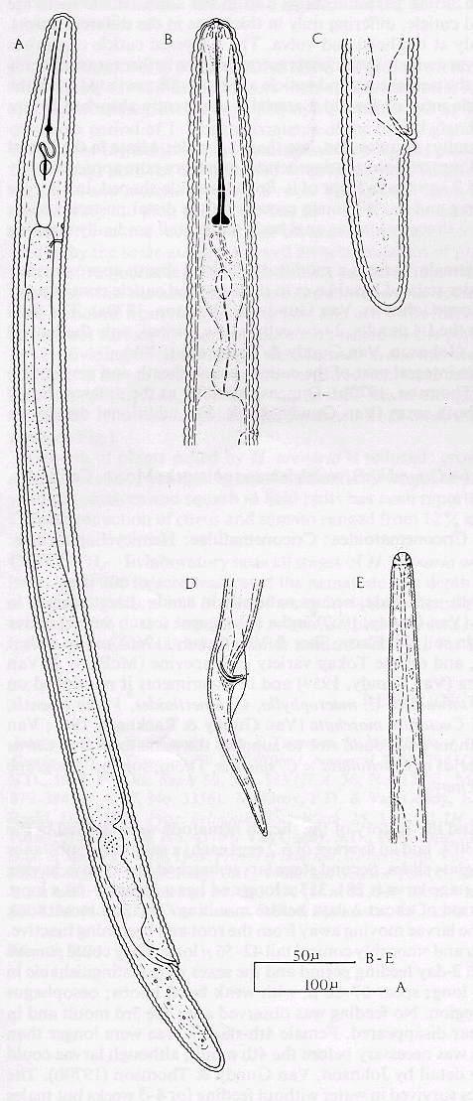
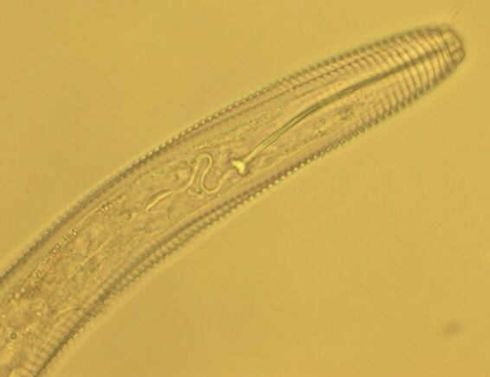
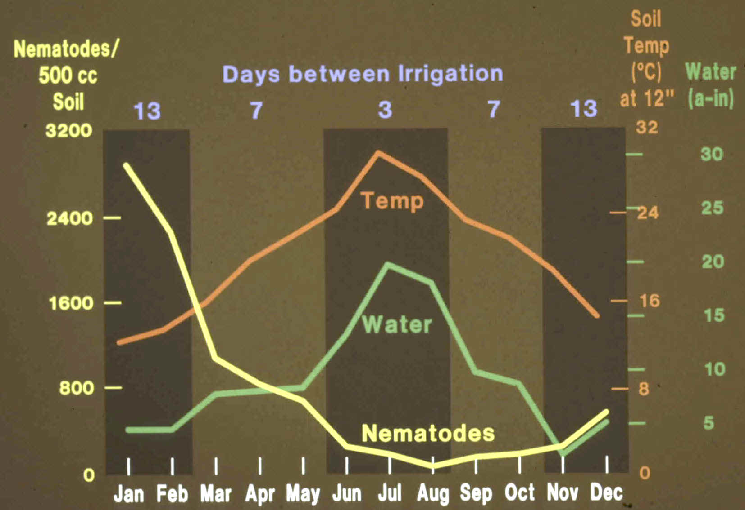
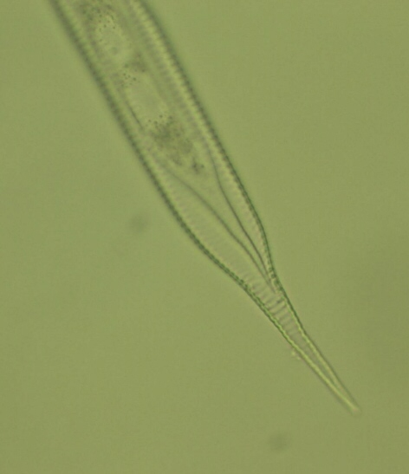
Hemicycliophora
sheath nematode
H. arenaria
H. similis
cranberry bogs
riverine sedges

Slide 8
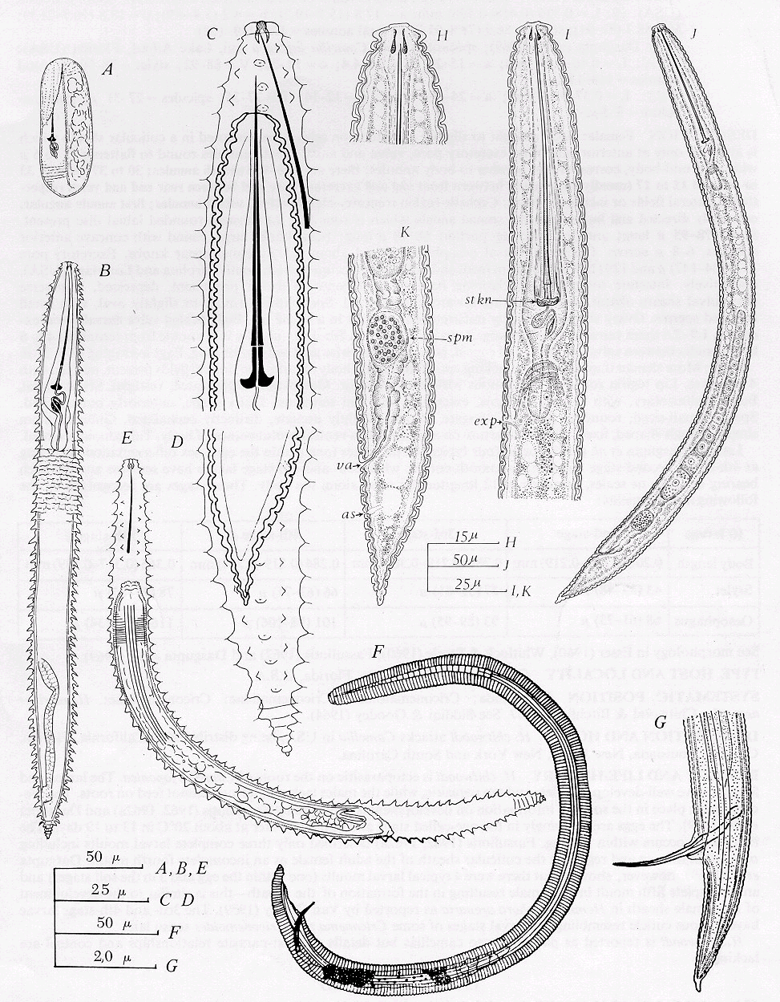
Hemicriconemoides
sheathoid nematode

Slide 9
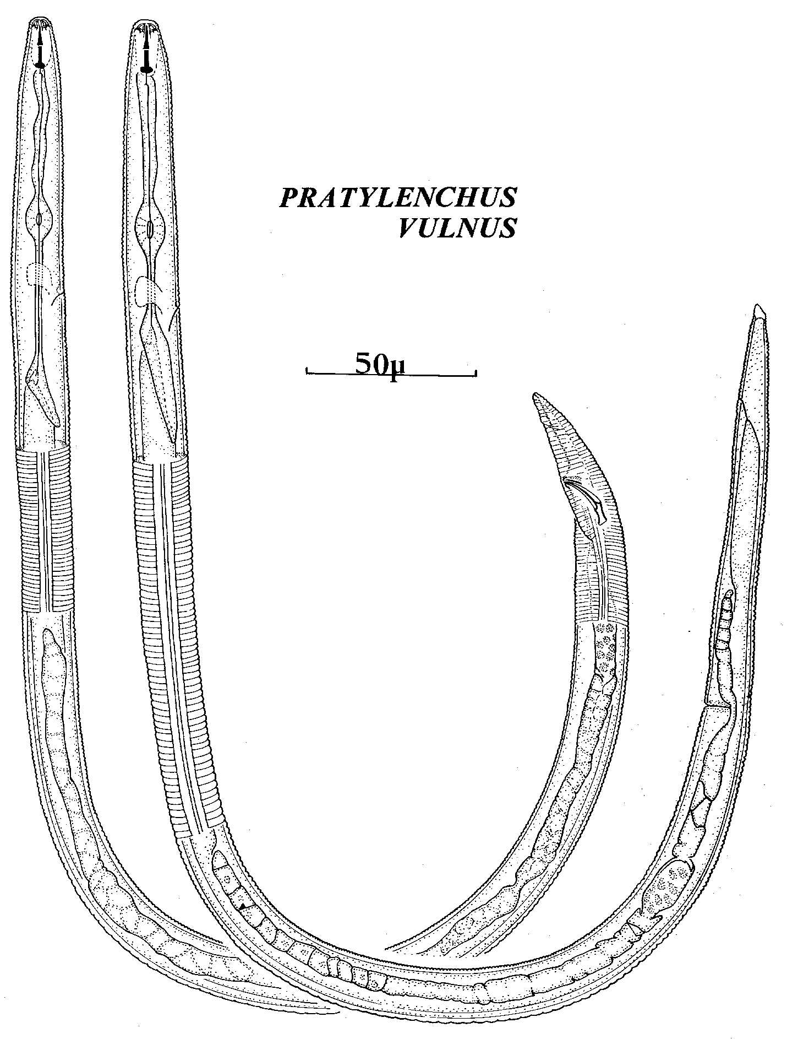
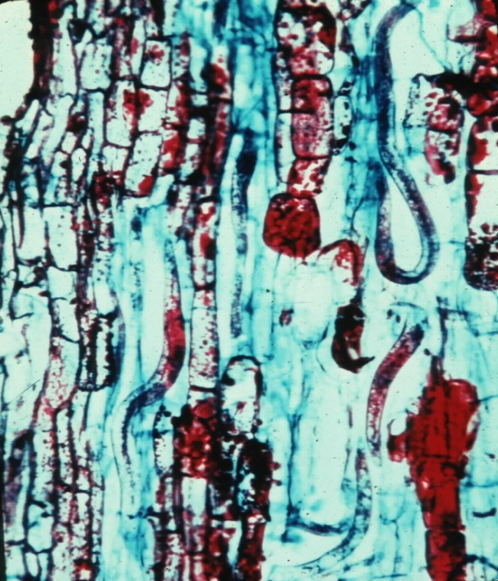
Pratylenchus vulnus
root lesion nematode

Slide 10
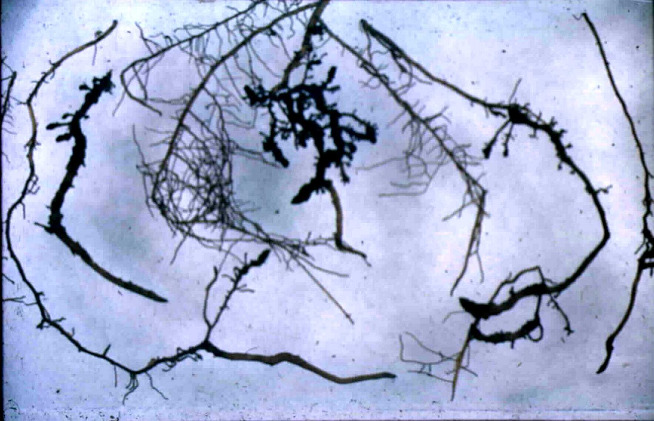
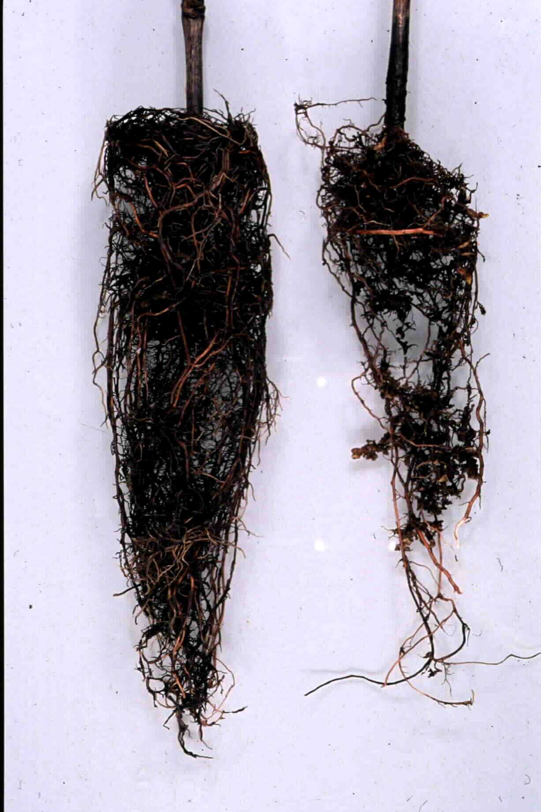
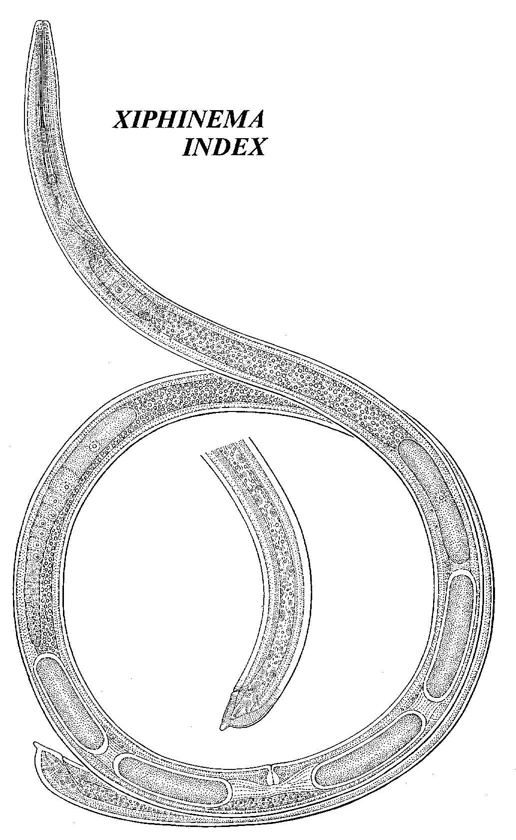

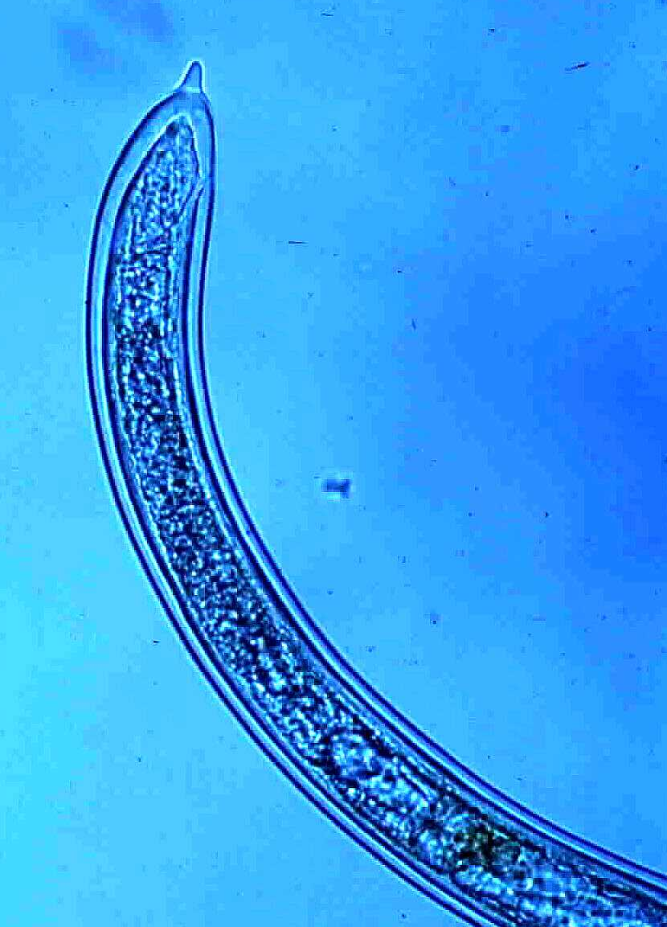
Xiphinema
index
dagger nematode

Slide 11
Xiphinema index - Dagger Nematode
Vector of Grapevine Fanleaf Virus
Symptoms:
leaf malformations
yellow mosaic of leaves and shoots
veinbanding
abnormal shoot branching
small bunches, poor fruit set, irregular ripening

Slide 12
Management strategies for plant-parasitic (and other) nematodes….
Preplant management
  Planting site selection, non-host rotation
  Preplant soil disinfestation, nematicides
  Clean equipment, water
  Certified planting stock
  Rootstock selection
  Biological antagonists and soil food web health
Postplant management
  Amendments
  Nematicides
  Cover crops, mulching, reduced tillage
  Biological antagonists and soil food web health

Slide 13



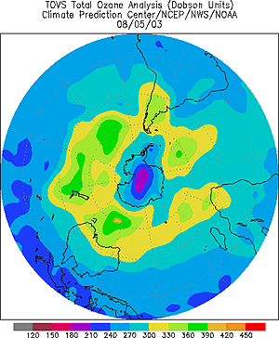
Ozone Depletion: 1995 Nobel Prize in Chemistry
Paul Crutzen
F. Sherwood Rowland
Mario Molina
Paul Crutzen Max-Planck-Institute for Chemistry, Mainz, Germany
    born 1933 in Amsterdam. Dutch citizen.
    PhD in meteorology, Stockholm University, 1973.
  Nitrogen oxides as ozone depleters
Mario Molina MIT, Cambridge, MA, USA
    born 1943 in Mexico City, Mexico. U.S. citizen.
    PhD in physical chemistry, University of California, Berkeley.
  CFCs as ozone depleters
F. Sherwood Rowland University of California, Irvine CA, USA
    born 1927 in Delaware, Ohio, USA
    PhD in chemistry, University of Chicago, 1952.
  CFCs as ozone depleters
The U.S. and other countries are signatories to the
Montreal Protocol on Ozone Depleting Substances
The protocol called for total phase out of methyl bromide
for horticultural uses in developed countries by 2005
….consider new Volatile Organic Compounds (VOC) regulations
- effective 2009-2010

Slide 14
Providing Certified Planting Stock
Chemical disinfestation options for nurseries as
replacements for methyl bromide
1. Telone II @35 gpa with a water seal, followed in several
weeks by 250ppm Vapam in >2 acre-inches of water
2. Vapam (250ppm) through two drip lines, soil drenched
to 5 feet deep and four feet wide.
3. Vapam (<75 gpa) broadcast in 6 acre-inches of water
through drip lines spaced 12 inches apart
Good soil preparation and micronutrient additions.
M.V. McKenry - http://www.uckac.edu/nematode

Slide 15
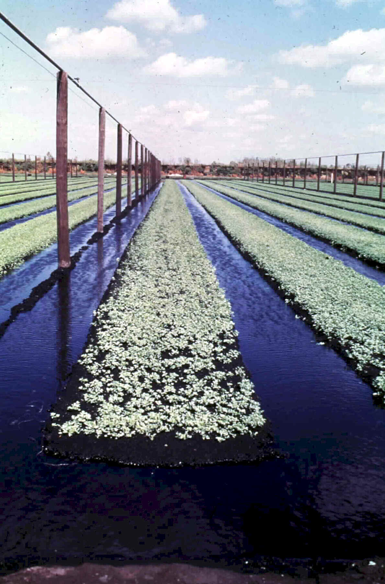
Cultural
Management
Flooding
-anaerobic conditions

Slide 16
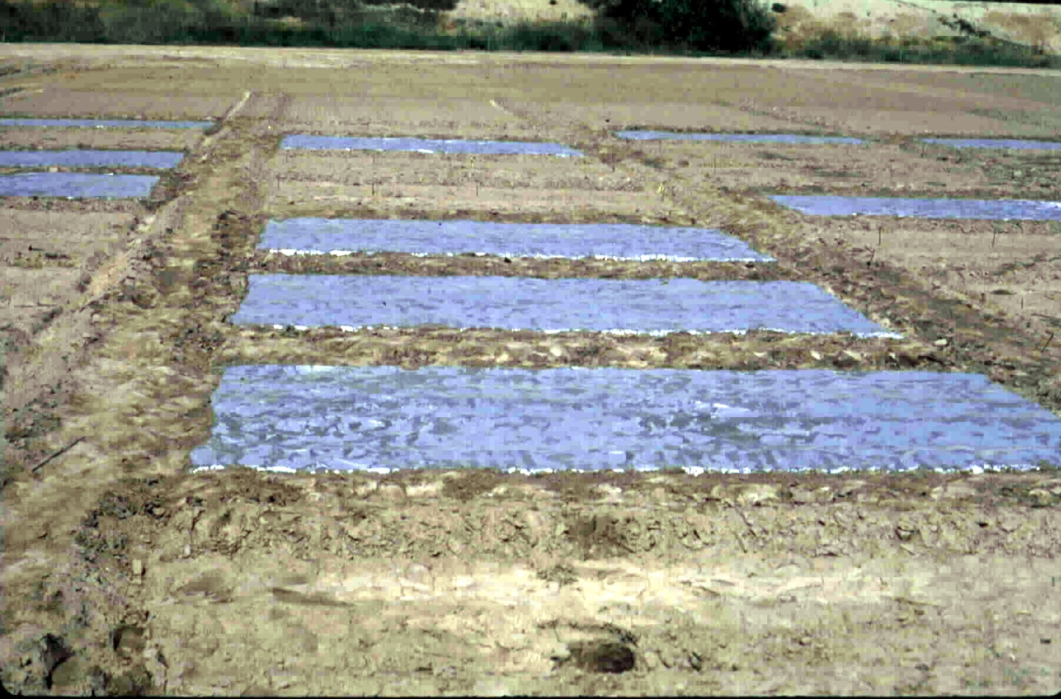
Physical Management
Solarization (and biofumigation)

Slide 17
Host Plant Resistance
Rootstocks
Dagger Nematode

Slide 18
Sources of Resistance to Nematodes
Snyder (1930s), Lider (1950s), Weinberger (1960s), Olmo (1980s), Walker (1990s+)

Slide 19
New Rootstock Characteristics
UCDGRN-1 | nematode resistance from Vitis rupestris and Muscadinia rotundifolia. 80% rooting and grafting success from dormant cuttings.
UCDGRN-2 | nematode resistance from V. rufotomentosa and V. champini (cv Dog Ridge). roots and grafts easily.
UCDGRN-3 | nematode resistance from V. rufotomentosa, V. champinii (cvs Dog Ridge and c9038). good rooting and grafting abilities.
UCDGRN-4 | nematode resistance from V. rufotomentosa, V. champinii (cvs Dog Ridge and c9038). good rooting and grafting abilities.
UCDGRN-5 | nematode resistance from V. champinii (cvs Ramsey and c9021). good rooting and grafting abilities.

Slide 20
New Nematode-Resistant Grape Rootstocks for California Vineyards
Rootstock | Meloidogyne | Meloidogyne | Meloidogyne | Meloidogyne | Meloidogyne
 | incognita | arenaria | incognita | javanica | chitwoodi
 |  | HarmC | HarmA
RS-3 | R | R | R | R | MR
RS-9 | R | R | R | R
UCDGRN-1 | R | R | R
UCDGRN-2 | R | R | R
UCDGRN-3 | R | R | R
UCDGRN-4 | R | R | R
UCDGRN-5 | R | R | R
USDA 10-17A | MR |  |  | R | MR
USDA 10-23B | R |  |  | R | R
USDA 6-19B | R |  |  | R | MR

Slide 21
New Nematode-Resistant Grape Rootstocks for California Vineyards
Rootstock | Criconemoides | Pratylenchus | Tylenchulus | Xiphinema | Xiphinema
 | xenoplax | vulnus | semipenetrans | index | americanum
RS-3 | MR | R | MR | S
RS-9 | MR | R | MR | S
UCDGRN1 | R | R | R | R
UCDGRN2 | MR | MR | MS | R
UCDGRN3 | MS | MR | MS | R
UCDGRN4 | MR | MR | MR | R
UCDGRN5 | MS | MS | R | R
USDA 10-17A | MS | R | R | R
USDA 10-23B | MR | R | R | R
USDA 6-19B | MR | R | R | MR | R

Slide 22
A tool for selecting:
Cover crops
Rotation crops
Rootstocks
Nemabase 2012 – 45,000 entries
Nemabase Search Engine for the Host Status of Plants to Nematodes
Xiphinema index Enter Nematode Genus and species
Vitis Enter Plant Genus and species
Return to Nemabase Search Menu
Return to Nematode Management Menu
Process the Query
http://plpnemweb.ucdavis.edu/nemaplex

Slide 23
Host Status of Plants to Nematodes
Do Another Search
Change Type of Search
Return to Nematode Management Menu
Click on a column head to sort the data
If the form is blank, Nemabase was unable to find data that meet the specified criteria
Susceptibility Glossary (Susc Column)
S = Susceptible | - nematode reproduces well
MS = Moderately Susceptible | - nematode reproduction somewhat reduced
MR = Moderately Resistant | - nematode reproduction considerably reduced
R = Resistant | - nematode reproduction severely supressed
I = Immune | - no evidence of nematode feeding or reproduction
NgenusNspec | Ncommon | PgenusPspec | Pcult | Pcommon | Pfamily | Pusage | Hstat | Susc | Tol
Xiphinema index | Dagger | Vitis sp. L. |  | Grape | Vitaceae | Fruit | H | U | U
Xiphinema index | Dagger | Vitis rufotomentosa x V. champinii x V. riparia | UCD-GRN2 | Grape rootstock | Vitaceae | Rootstock | H | R | T
Xiphinema index | Dagger | Vitis rufotomentosa x V. champinii (Dog Ridge) x V. champinii (c9038) x V. riparia | UCD-GRN4 | Grape rootstock | Vitaceae | Rootstock | H | R | T
Xiphinema index | Dagger | Vitis champinii (Ramsay) x V. champinii (c9021) x V. riparia | UCD-GRN5 | Grape rootstock | Vitaceae | Rootstock | H | R | T
Xiphinema index | Dagger | Vitis rufotomentosa x V. champinii (Dog Ridge) x V. champinii (c9038) x V. riparia | UCD-GRN3 | Grape rootstock | Vitaceae | Rootstock | H | R | T
Xiphinema index | Dagger | Vitis rupestris x Muscadinia rotundifolia | UCD-GRN1 | Grape rootstock | Vitaceae | Rootstock | H | R | T
Xiphinema index | Dagger | Vitis riparia | Schwarzmann;ex West. Aust | River Bank Grape | Vitaceae | Rootstock | H | R | U
Xiphinema index | Dagger | Vitis riparia X V. candicans | 91-39 | Grape | Vitaceae | Rootstock | H | R | U
Xiphinema index | Dagger | Vitis riparia X V. rupestris | 101-14 | Grape | Vitaceae | Rootstock | H | MS | U
Xiphinema index | Dagger | Vitis vinifera L. | French Colombard | Grape | Vitaceae | Edible Fruit | H | S | U
Xiphinema index | Dagger | Vitis sp. L. |  | Grape | Vitaceae | Fruit | H | S | U
Xiphinema index | Dagger | Vitis sp. L. |  | Grape | Vitaceae

Slide 24
Postplant Nematode Management
Nematicides:
Nemacur (fenamiphos) (not available in US)
applied via drip two times during spring root flush at
1/3 gallon each; treat again in fall; max. 2 gal/year.
[ectoparasites +++, endoparasites +]
Enzone (CS₂ liberator) applied in irrigation water - drip or furrow.
[ectoparasites +++, endoparasites ?]
DiTera (antibiotic) applied in irrigation water - drip or furrow
20 lb per acre three times per year.
[ectoparasites ++, endoparasites ?]
Movento (spirotetramat) a lipid biosynthesis inhibitor with systemic activity – applied by foliar spray.
Consider nematicide rotation to delay loss of efficacy

Slide 25
Postplant Vineyard Management
Cultural:
avoid introducing nematodes on equipment, people, water
water and fertility management to compensate for compromised root system
pruning to reduce crop load in nematode-stressed conditions
increase organic matter for soil structure, water-holding capacity, nutrient value and to build soil food web
winter cover crops for soil building and nematicidal effects
Note that chemical nematicides may disrupt food web effects

Slide 26
Commercial Soil Amendments
Farewell Microlife
Microplex F-68 Soil Conditioner
Clandosan 618 Superbac
Agrosyn Guano Plus
Quinoa Sesame
Humic acid Compost
Agri-50 Pent-a-vate
Arise Fertilaid
Zap Ammonium sulfate
Ozone …….and more

Slide 27
Soil Amendments: Potential Modes of Action
Contain beneficial microbes
Stimulate or provide resources for antagonists
Compete for root surface
Reduce plant stress (improved soil structure, moisture
retention, plant nutrition)
Nematicidal breakdown products
…..and sometimes……no effect
B. A. JAFFEE

Slide 28
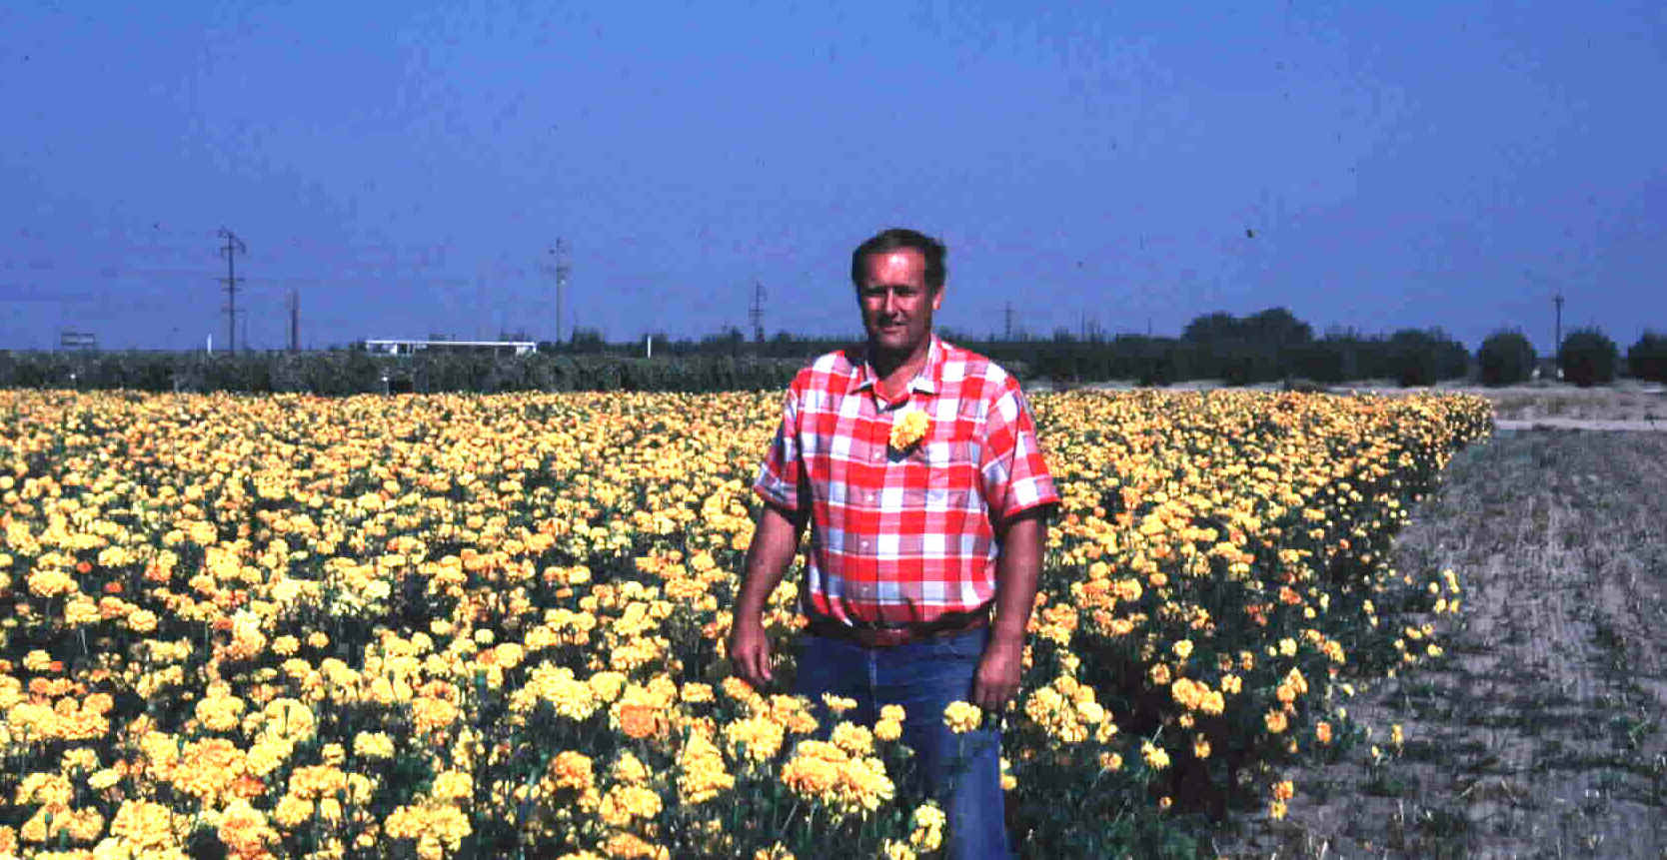
Natural Products
Example: marigolds and α-terthienyl

Slide 29
Selection of Non-host Cover Crops or
Rotation Crops

Slide 30
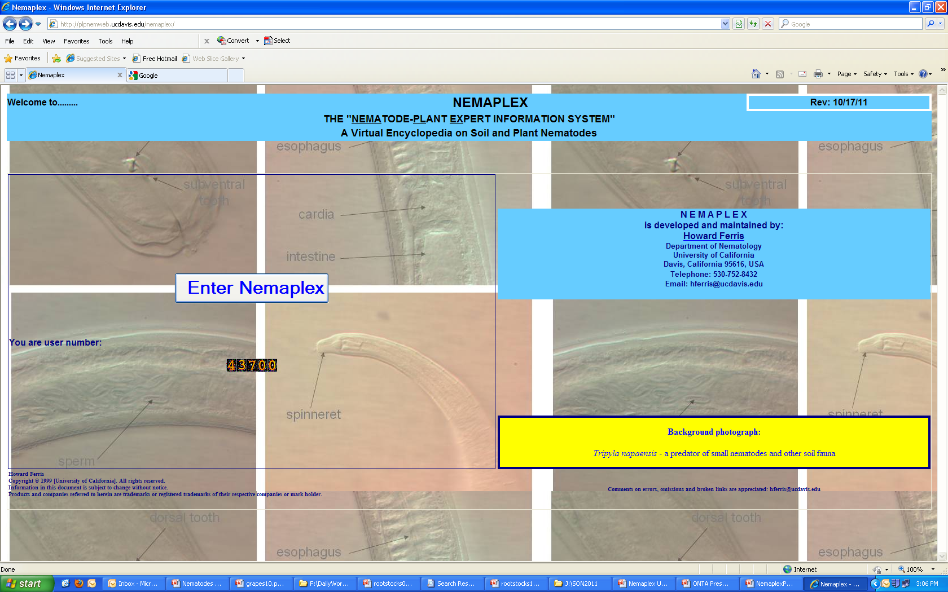
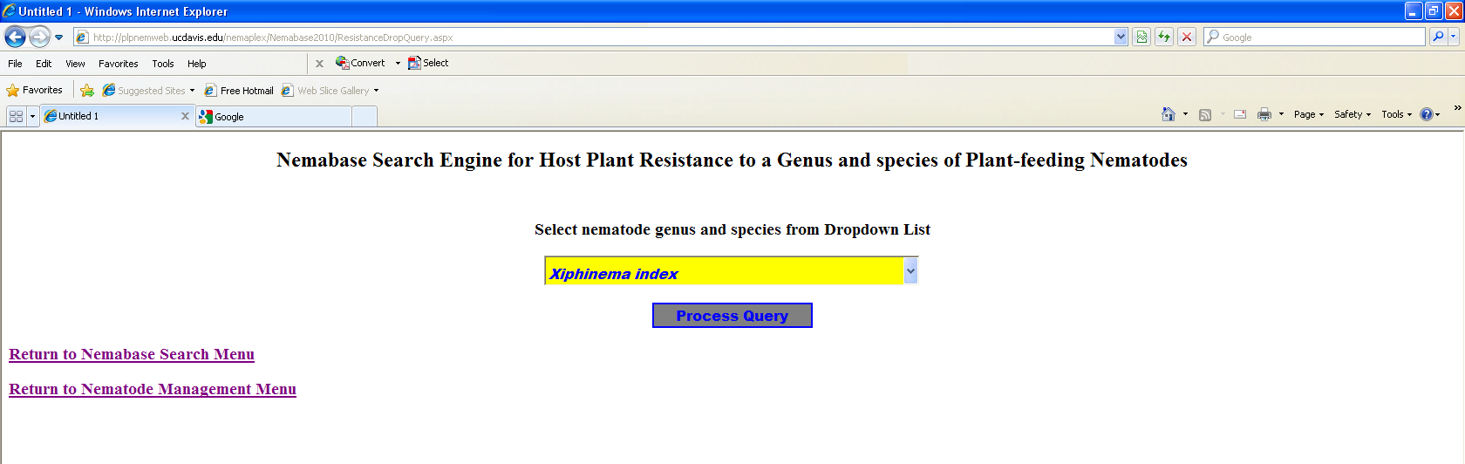
Nemaplex – http://plpnemweb.ucdavis.edu/nemaplex

Slide 31
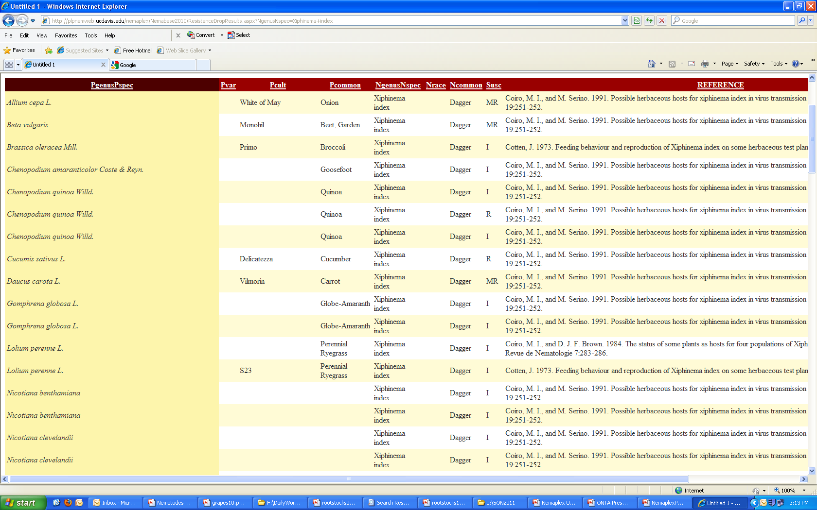
Some potential cover crops resistant or immune to Xiphinema index…..

Slide 32
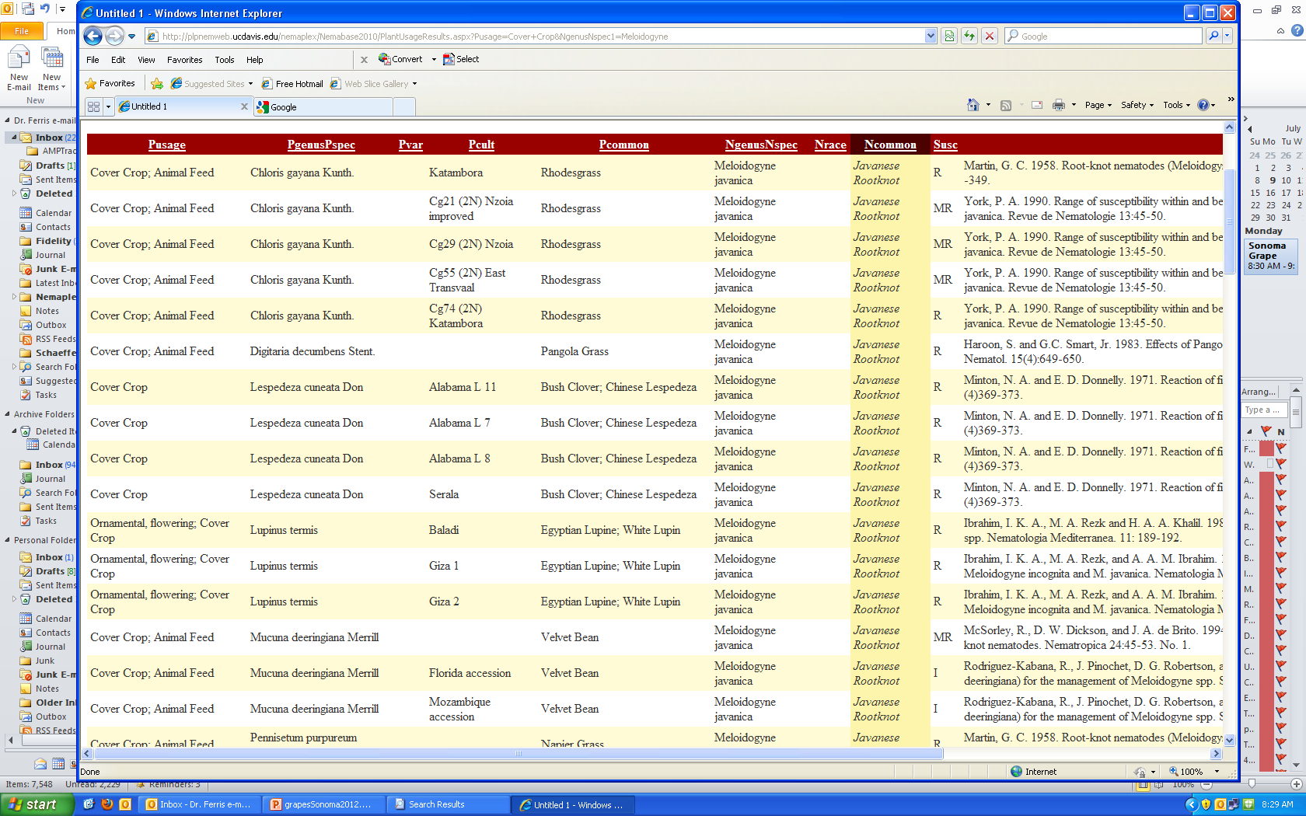
Some potential cover crops with resistance to root-knot nematodes

Slide 33
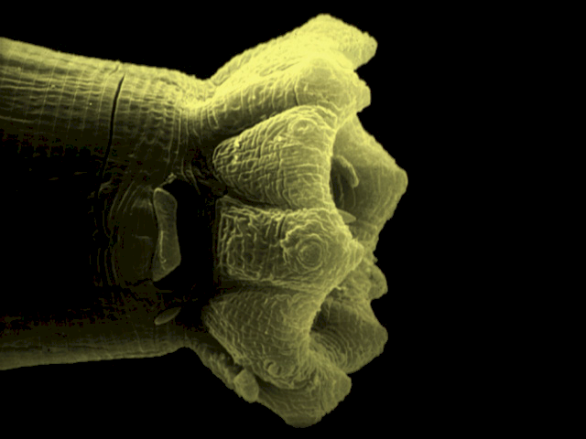

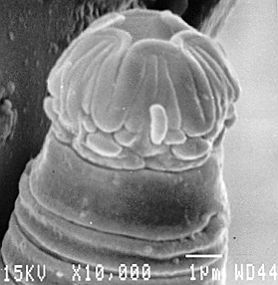

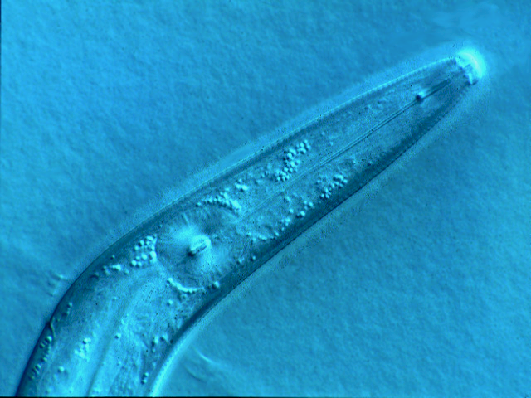
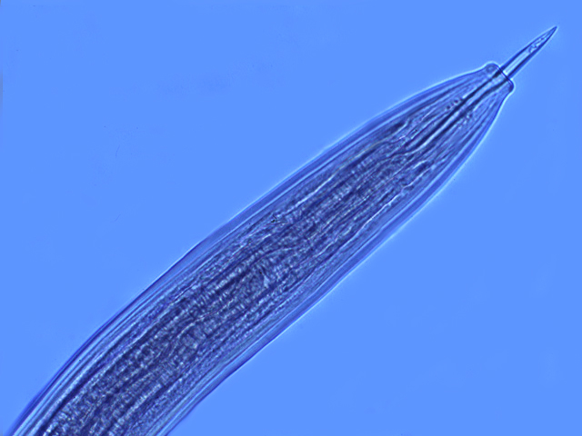
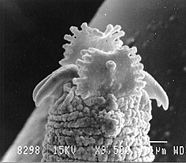
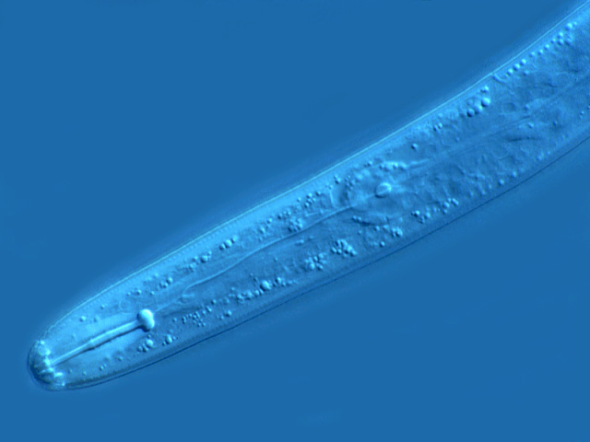
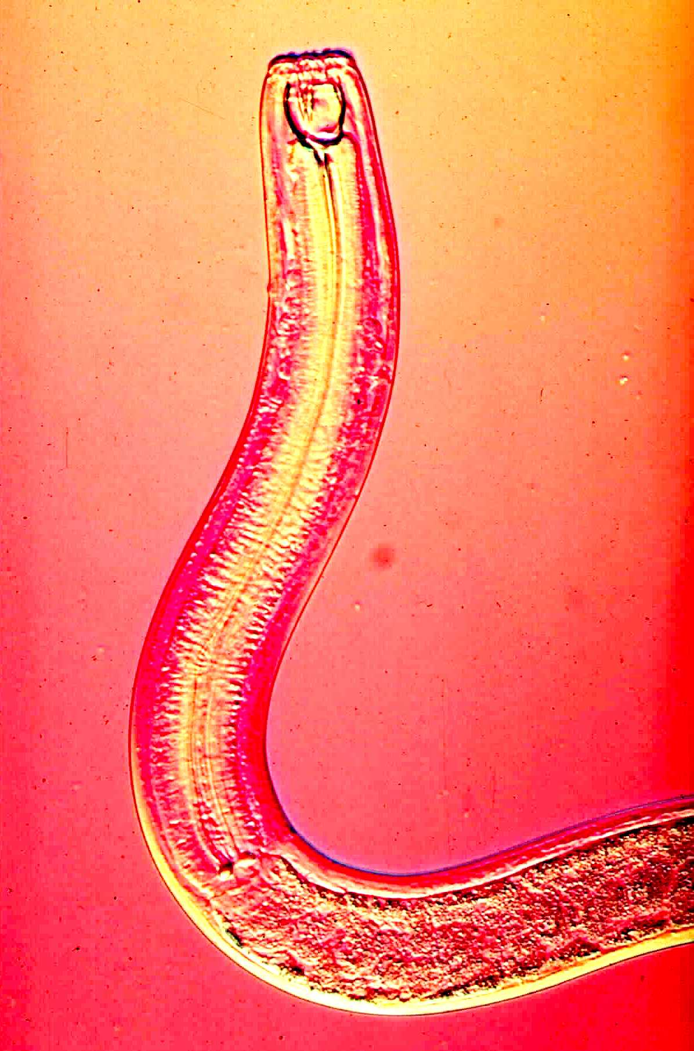




The soil ecosystem……….
Functional Diversity of Nematodes

Slide 34



















Soil Bacteria
Protozoa
Soil Microarthropods
Soil Nematodes

Slide 35


Enrichment and Mineralization

Slide 36



Organic
Reduced
tillage
Standard
tillage
Nem Bacterivores
Nem Predators
Mite Predators
Nem Fungiv
Nem Herbiv
Mite Algiv
Nem Omniv
Mite Omniv
Mite Saprob
Conventional
Standard
tillage
Sánchez-Moreno et al., 2009

Slide 37


Biological antagonists

Slide 38


Regulation of Opportunistic Species
Pristionchus pacificus

Slide 39


An Ecosystem Service: Regulation of Opportunistic Species
Density-dependent predation
Predator: Prey Ratio
Sánchez-Moreno and Ferris, 2007
Notes:
39
We expected to have greater suppressiveness in samples with higher abundances of P and O. But predation depended not on the abundance of the high trophic levels but on the ratio of predator/prey, following a density-dependent function. Suppressiveness is optimized when predator/prey ratio is high; so few preys are available for each predator. When the biomass of prey is very high, suppressiveness in reduced. In agricultural fields, where fertilizers and organic matter are incorporated to the soil, the consequent increase of microbial populations are used by microbial-feeders to increase their population size, and this relationship is altered. When many other prey are available, the predation pressure on the target nematode reduces.

Slide 40




Predators and prey – the Apparent Competition Hypothesis
Generalist and
Specialist Predators
Amplifiable Prey
Target Prey
Fungal-, bacterial-feeding
Nematodes
Plant-feeding Nematodes

Slide 41



Food Web Complexity and the
Regulation Function
Management practices in industrialized agriculture result in:
Soil food web simplification
Reduction in higher trophic levels
We tested nematode predator:prey hypotheses with data from banana plantations in four Central American countries……….
Costa Rica, 2008

Slide 42

Banana Plantations - Panama
Subtle Apparent Competition
Ferris et al., 2012

Slide 43
Trophic cascades: amplifiable and target prey
Trophic cascades: amplifiable and target prey – the expanded model
A=favorable conditions for predators
Functional complementarity
B=co-location of predators and prey
+
Other Prey
E4
A
Predator Nematodes
+
Other Predators
-
+
+
B
B
-
A
E1
Amplifiable Prey
+
Target Prey
+
+
-
+
B
Protozoa
+
B
-
E2
Microbial Biomass
Root Associate
Nematodes
-
E5
E6
Nematophagous Fungi
+
+
Rhizosphere Bacteria
+
+
Organic Matter
+
+
+
+
E3
+
Plant Roots
Litter
+
External Sources
Notes:
43
43

Slide 44







Target Prey:
the ring nematode
Shared Predator:
Hirsutella rhossiliensis
Connectance: the proportion of the potential links in a food web
that are (or can be) realized
Amplifiable Prey:
bacterial- and
fungal-feeding
nematodes
Enhancing Amplifiable Prey
Jaffee et al., 1994

Slide 45











Patch Heterogeneity and Food Web Structure/Functions
Resource distribution
Organism motility
Omnivory
Strong and weak links
Microsite asynchrony

Slide 46



Are the patches interconnected?
Are all the links possible?
So, connectance among soil patches
may be difficult to measure.
Can it be engineered?

Slide 47


Emergent Technologies
Barcoding
DNA fingerprinting
Functional Genomics
Helicotylenchus multicinctus
Pratylenchus penetrans

Slide 48


Economies of Ecosystems: Carbon and Energy are the Currencies
CO₂
CO₂
CO₂
CO₂
Stewardship
bacteria
protozoa
nematodes
carbohydrates
and
proteins
carbohydrates
and
amino acids
nematodes
arthropods
fungi
C
N
nematodes
other
organisms
fungi
arthropods
nematodes
NO₃
Carbon and energy transfer
Carbon is respired by all organisms in the food web
The amounts of Carbon and Energy available limit the size and activity of the web
NH₃
NH₃
NH₃

Slide 49









Fueling the Soil Food Web
external sources
rhizodeposition
old root death
C
herbivory
external sources
rhizodeposition
old root death
C
herbivory

Slide 50


Soil Food Web Stewardship
Winter cover crop – bell beans
California, 2006
Soil fertility
Organic matter
Food web activity
Soil structure
Fossil fuel reduction
Habitat conservation
Food web activity
Soil structure
No-till soybeans, Brazil, 2006

Slide 51

Organic banana
production system
Costa Rica
Functional Connectance
Co-location of Amplifiable and Target Prey
Engineering functional connectance….
Consider effects of drip irrigation, mulching
and reduced tillage in perennial systems

Slide 52





Slide 53

Colonizer-persister Series
Calibration of ecosystem condition:
Maturity Index =
opportunism
structure
enrichment
stability
1
2
3
4
5
Bongers, T. 1990 The maturity index: an ecological measure
of environmental disturbance based on nematode species
composition. Oecologia 83: 14-19.
Bongers

Slide 54





1
2
3
4
5
opportunism
structure
enrichment
stability
Colonizer-persister Series
Structure Indicators
Basal Fauna
Enrichment Indicators
Life course duration
Growth rates
Response to resources
Sensitivity to disturbance
Bongers

Slide 55


Testable Hypotheses of Food Web Structure and Function
Disturbed
N-enriched
Low C:N
Bacterial
Conducive
Enriched
Maturing
N-enriched
Low C:N
Bacterial
Regulated
Ba₁
Enrichment index
Structured
Fu₂
Degraded
Depleted
High C:N
Fungal
Conducive
Matured
Fertile
Mod. C:N
Bact./Fungal
Suppressive
Fu₂
Basal
Ba₂
Om₄
Om₅
Basal
condition
Ca₃
Ca₄
Ca₅
Fu₃
Fu₄
Fu₅
Ba₃
Ba₄
Ba₅
Structure index
Ferris et al., 2001

Slide 56


Trajectory Analysis of Some California Soil Systems
100
Tomato
Systems
Yolo Co.
Prune
Orchards
Yuba Co.
Enrichment Index
50
Redwood
Forest and
Grass
Mendocino Co.
Mojave
Desert
0
0
50
100
Structure Index

Slide 57
Management strategies - Summary
Preplant management
  Planting site selection, non-host rotation
  Preplant soil disinfestation, nematicides
  Clean equipment, water
  Certified planting stock
  Rootstock selection
  Biological antagonists and soil food web health
Postplant management
  Amendments
  Nematicides
  Cover crops, mulching, reduced tillage
  Biological antagonists and soil food web health

Slide 58

Thank you!
http://plpnemweb.ucdavis.edu/nemaplex

Slide 59
Postplant nematode management – organic amendments
onion
garlic
pumpkin
rapeseed
other brassicas
Chinese herbal remedies
cover crops and green manures

Slide 60
In high value crops…Biocides..from CS₂……….
Chemical Methods of
Preplant Nematode Management
Garreau (1854) recognizing the insecticidal value of CS₂.
Thenard (1869) suggested its use in French vineyards for grape phylloxera. Applied by injection into holes 50 cm apart.
  Discontinued with the introduction of phylloxera-resistant rootstocks.
  But it established the idea that soil pests could be controlled by injection of volatile chemicals.

Slide 61

Organic Vegetable Production System
Salinas, California
Connectance in the Soil Food Web
But, this is a very disturbed system, consider:
Disturbance frequency
Differences in population dynamics
Population lags
Ferris et al., in press

Slide 62


Connectance: an emergent theme in sampling for nematodes
Consider the patchiness of nematode populations
Separate
metacommunities?
How often do predators and
prey occur in the same patch?
What are the consequences?

Slide 63




g
m
g
Nematode
assemblages
a=1,2,3,4
b=1,3,4
c=3
d=1,4
e=2
f=1,4
g=5,6,7,8
h=8
i=5
j=5,6
k=7,8
l=5,6,7
m=5,8
h
h
m
k
k
k
h
i
j
(1)
(2)
(1)
(2)
(0)
(1)
(0)
(1)
(0)
(1)
(1)
(0)
(1)
j
lk
i
j
i
e
d
d
a
a
a
a
d
c
c
d
a
a
b
b
c
f
c
f
Taxa detected:
1,2,3,4,5,6,7,8
The issues of co-location
and connectance

Slide 64
Monitoring: Management efficacy
Criconemoides xenoplax L⁻¹ soil
Nematode Dosage Thresholds
Criconemoides xenoplax L⁻¹ soil

Slide 65


Stewardship - My Conclusion:
Keep roots in the soil, avoid resource punctuation and ecosystem disruption
Land-use change in Kansas:
Effects on Nematode Faunal
Structure
Resource Inputs:
Bottom up effects on Soil Food
Web Structure and Function
Consistent N-yield over 75 years without input
N-yield similar to that of high input wheat
Resources to support:
Biomass
Higher trophic levels
Diversity
Complementarity
Continuity
Structure Index
Basal Index
From Glover et al., 2010

Slide 66



Before
After
Vineyard Management

